Slide 1
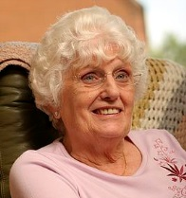
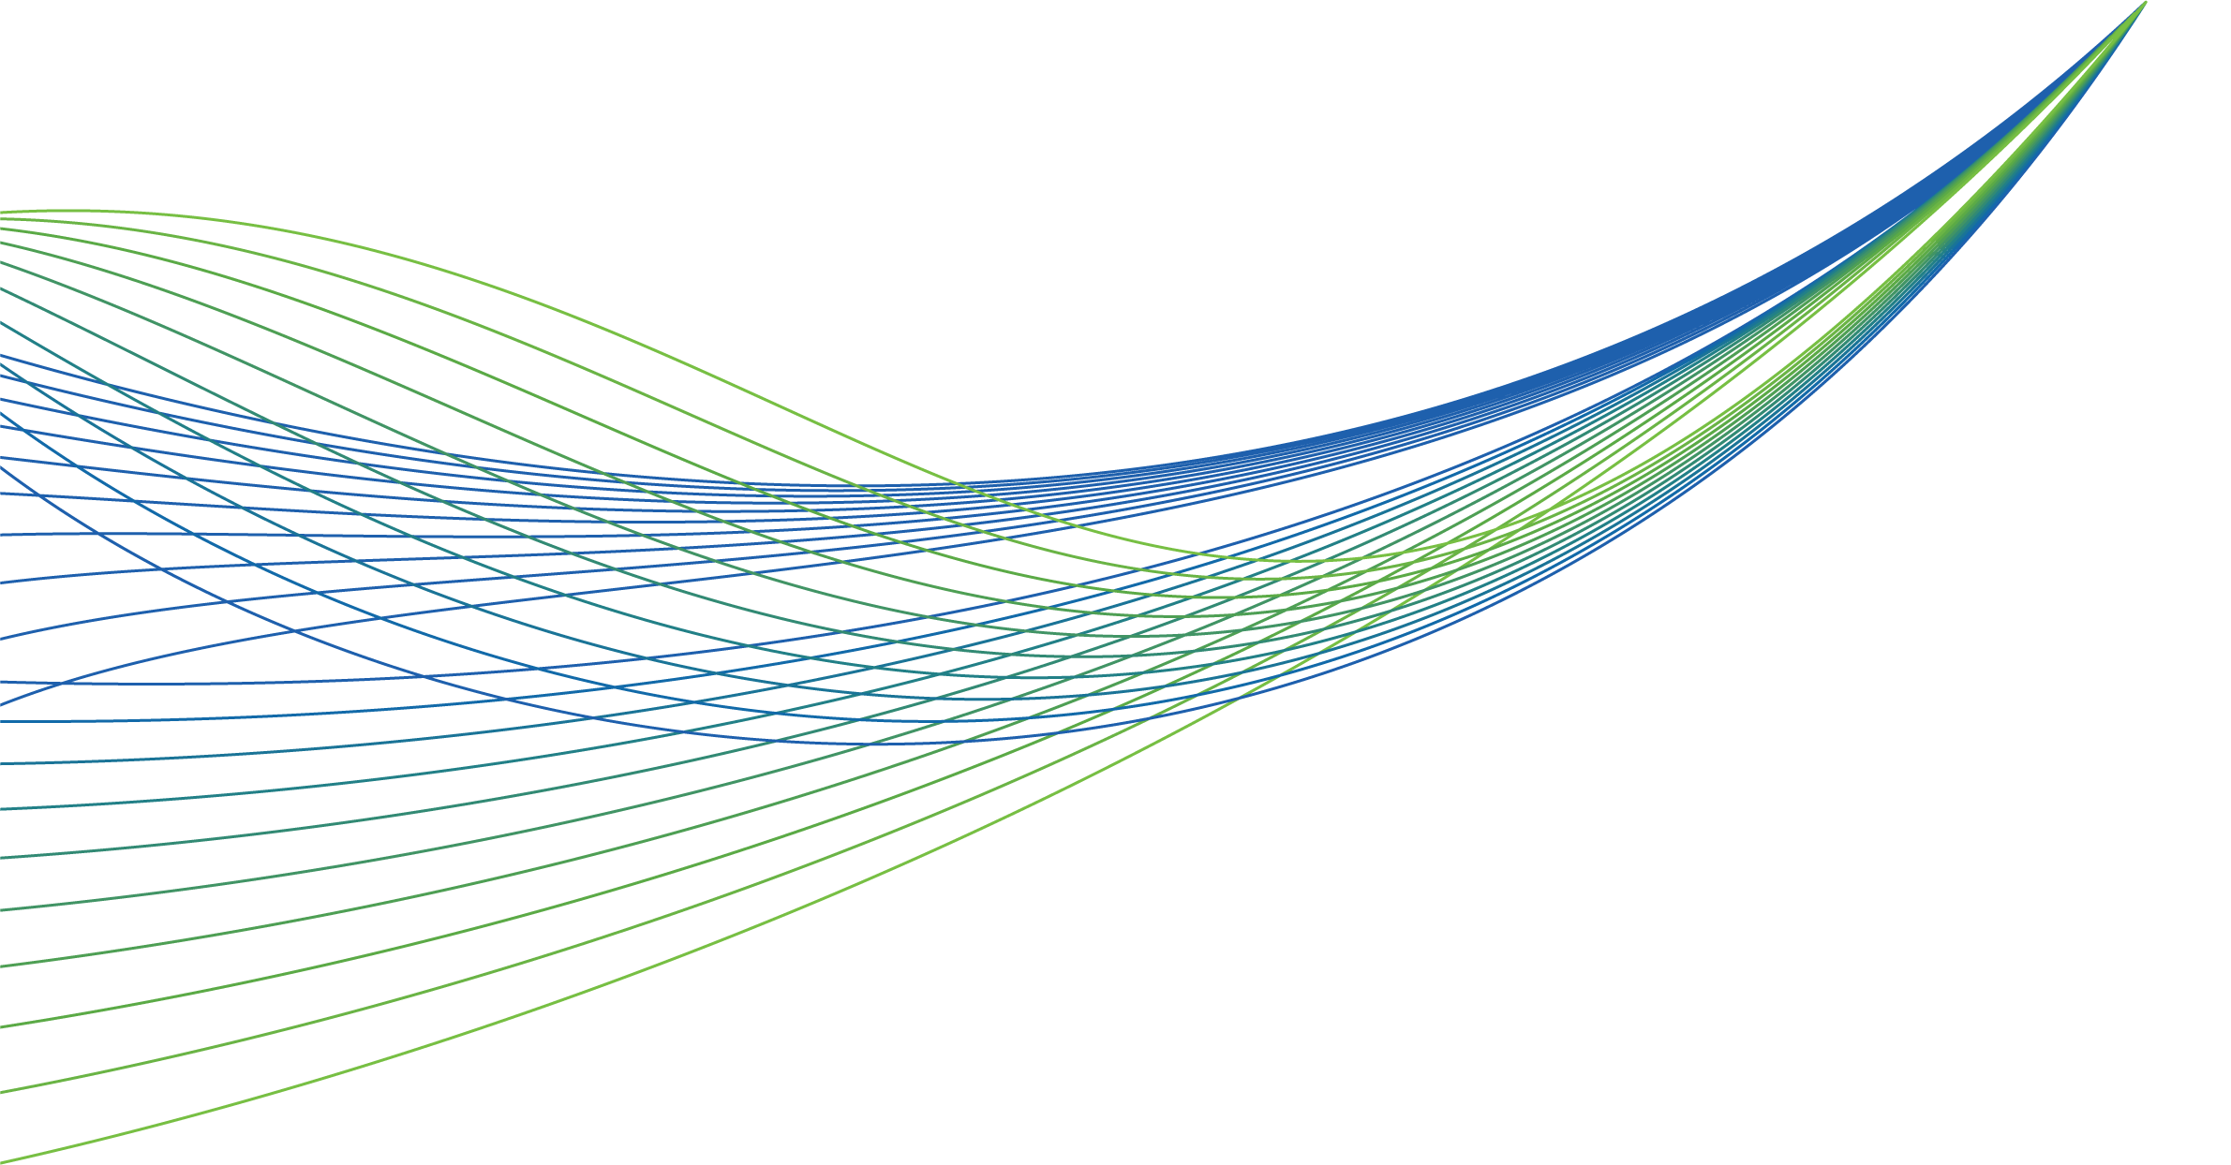
NHS RightCare scenario: The variation between standard and optimal pathways
January 2017
Betty’s story: Wound care
Appendix 2: Short summary slide pack
January 2017

Slide 2
Betty and the sub-optimal pathway
Betty is 70 - a retired shop assistant and has a good social network in the village
She has a health check aged 70. Her BMI is 30 and she is invited to see the Health Care Assistant (HCA) for lifestyle advice (the advice was not ideal)
At 74 she grazes her ankle on a walk and after five weeks of self management she visits her GP who issues antibiotics and after two more weeks refers Betty to the General Practice Nurse (GPN)
She is switched to antimicrobial dressing, has a second course of antibiotics and weekly appointments for six weeks (the dressings put a stop to Aquafit classes)
The wound is now very distressing and is having a significant impact on Betty’s life. The health professionals are unaware
Then another change of dressing (to be changed two to three times per week)
Three months on and still no improvement but the GPN is not confident with compression bandaging - better with the status quo than to make a risky mistake with the bandages!
Another month and then a referral to the dermatology dept. (an eight week wait) where the venous leg ulcer is confirmed, but not communicated effectively
It is several months before a doppler scan is undertaken - for a full assessment
A catalogue of incidents occur & Betty’s situation deteriorates further with many extended weeks of pain, discomfort and distress culminating in a five day hospital stay for cellulitis
It takes two years to heal Betty’s ulcer in the end with a reduced compression system that she could tolerate
Betty’s case is not unique

Slide 3
Would you want to avoid this?

Slide 4
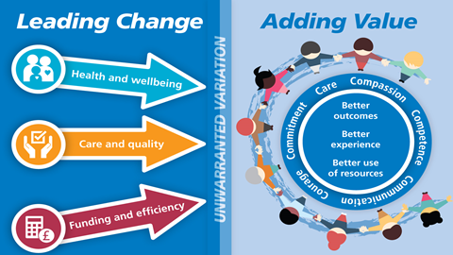
Betty and the optimal pathway
This time (aged 70) Betty’s Health Check is very informative with lots of proactive advice with a personalised care & support plan including an exercise on prescription programme
The GPN review (due to high risk factors) results in a recommendation for compression hosiery and regular reviews
At 74 Betty grazes her ankle whilst rambling and self manages for a few days until consulting the local pharmacist who refers to the lower leg wound pathway (developed by the CCG)
The GPN and the district nursing teams work closely together and so after only four days Betty is referred to the leg ulcer pathway for a full holistic and leg ulcer assessment.
Betty is reassured that pain relief has been carefully planned and she will not become dependent upon the medication
The Doppler assessment confirms a venous leg ulcer requiring high compression treatment
The faster the compression treatment starts, the faster healing takes place and that is Betty’s priority
Painkillers, bandages and education to Betty are well managed so that Betty keeps the bandages on and everyone can see the improvement; Betty is motivated to stick to the regime
Within eight weeks (start to finish) Betty’s leg is completely healed
Betty then continues to wear compression stockings as a preventative measure
Betty is able to have her knee replacement without any delays due to wound complications
Leading Change, Adding Value is a framework for all nursing, midwifery and care staff to use to reduce unwarranted variation

Slide 5
Financial information
Analysis by provider | Sub-optimal | Optimal
Acute | £1,703 | £0
Ambulance service | £466 | £0
Community teams | £2,167 | £12
Primary care | £1,334 | £346
Pharmacist | £3 | £3
Leg ulcer pathway | £0 | £144
Grand total | £5,673 | £505
In the suboptimal scenario:
- Dressings represent £1,353 (24%) of the total costs versus £88 in the optimal pathway.
- Clinical time represents £2,139 (38%) of the total costs versus £195 in the optimal pathway.

Slide 6
Financial information
Analysis by cost category | Sub-optimal | Optimal
Primary care management | £1,337 | £349
Community care | £2,167 | £156
Non-elective admissions | £2,169 | £0
Grand total | £5,673 | £505
 | Sub Optimal Clinical Time | Optimal Clinical Time | Sub Optimal Prevention | Optimal Prevention | Sub Optimal Dressings | Optimal Dressings | Sub Optimal Other
Primary care | £935 | £93 | £11 | £222 | £390 | £34 | £0
Community care | £1,204 | £102 | £0 | £0 | £964 | £54 | £0
Non-elective admissions | £0 | £0 | £0 | £0 | £0 | £0 | £2.169
Total | £2,139 | £195 | £11 | £222 | £1,354 | £88 | £2,169
Note: The sub-analysis table splits have been estimated by NHSE Community Nurse Lead
Not only is Betty’s health and quality of life much better in the optimal scenario, but the costs to the health economy are reduced 10 fold.

Slide 7
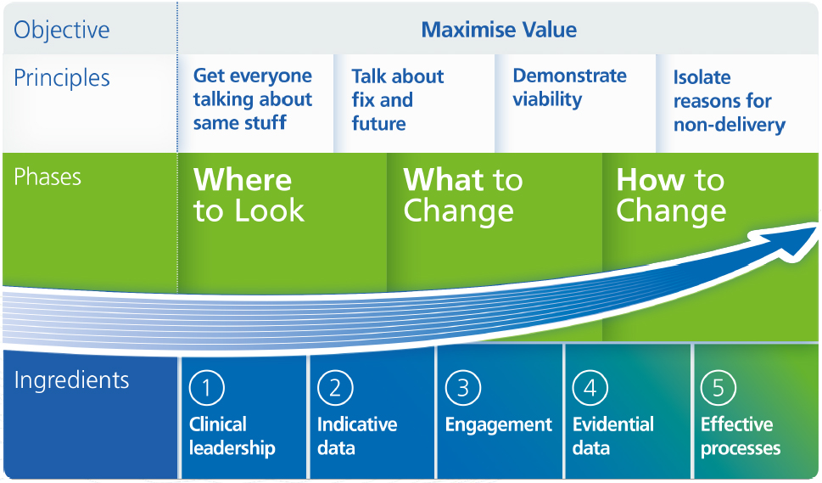
The NHS RightCare approach

Slide 8
Further information
For more information about Betty’s journey, NHS RightCare or long term conditions you can:
Email
rightcare@nhs.net
england.longtermconditions@nhs.net
Visit
https://www.england.nhs.uk/rightcare/
Tweet
@NHSRightCare

