Slide 1
NHS RightCare scenario: The variation between standard and optimal pathways
Paul’s story: Diabetes
Appendix: Summary slide pack
August 2014

Slide 2
Paul and the sub-optimal pathway
Paul is 45, a bricklayer with a local employer. He is married to Wendy who is 42 and a barmaid. They have a 16 year old son called David
Paul supports his local football club but doesn’t do too much exercise. He smokes 10 cigarettes a day and drinks around four pints of beer a day. He is overweight
The family lives in a village where the only shop has limited food options
Paul and Wendy’s GP works in a small practice, 17 miles away from the nearest district general hospital
Paul’s journey starts when, prompted by Wendy, he sees his GP:
Two years of increased urinary frequency and loss of energy
GP performs tests and confirms diabetes
Initial management with diet, exercise, pills
Six visits per year to practice nurse
Six lab tests per year

Slide 3
Five years later…
Paul is now 50. He has given up smoking but is still drinking and has not lost weight.
His recreation is still watching football and going to the pub
He has been on insulin for a year
His left leg hurts (vascular problem)
Paul is not walking far, not driving, and missing work
He has been referred to the hospital diabetes service and vascular surgeon – outpatients department at hospital
Wendy has to drive him there
David is at university

Slide 4
Two years later…
Paul is now 52. His leg suddenly goes white and painful and is amputated below the knee
He has significant heart and renal complications
His vision is deteriorating
Paul loses his job, with little chance of retraining
Applies for more suitable housing
Wendy gives up her job
David takes a year off university
This version of Paul’s journey costs £49k at 2014/15 prices

Slide 5
Paul’s story: What the CCG has done
The local CCG has looked at the variation data in its NHS RightCare Commissioning for Value pack and identified diabetes as a key improvement priority
They have engaged the right people, designed an optimal pathway, identified what needed to change, built the case, taken the decisions and implemented the changes
What does Paul’s journey look like now?

Slide 6
Paul and the optimal pathway
Paul is 45, a bricklayer with a local employer. He is married to Wendy who is 42 and a barmaid. They have a 16 year old son called David
Paul supports his local football club but doesn’t do too much exercise. He smokes 10 cigarettes a day and drinks around four pints of beer a day. He is overweight
An NHS Health Check identifies Paul’s condition at the end of year one. Case management begins
Use of specialist clinics for advice on diet and exercise (at a greater expense) and this is repeated every two years
Paul’s Care Plan / Medication / Retinopathy Screening is brought forward 18 months compared to Journey One
Self Management – through the Desmond Programme
Paul attends a Diabetes Patient Support Group, set up locally
Journey one cost £49k and managed Paul’s deterioration
Journey two costs £9k and keeps Paul well

Slide 7
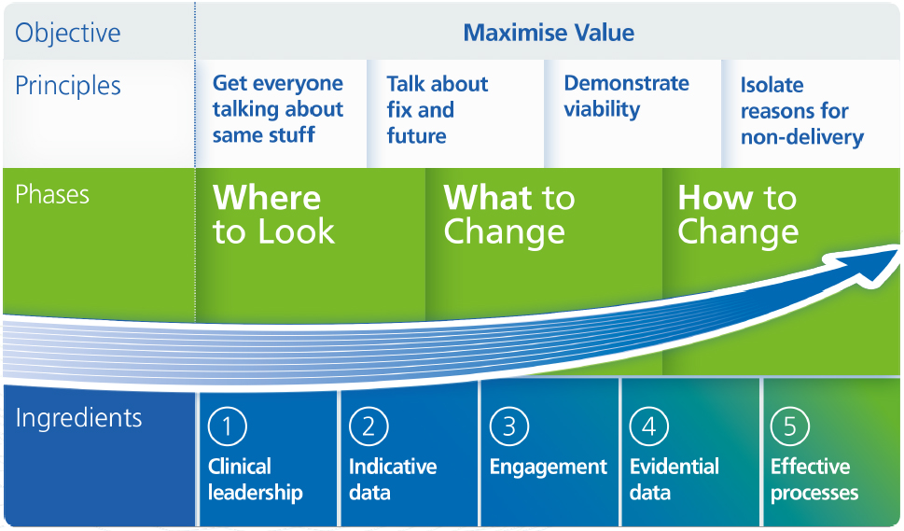
The NHS RightCare approach

Slide 8
Further information
For more information about Paul’s journey, NHS RightCare or long term conditions you can:
Read the full scenario
https://www.england.nhs.uk/rightcare/wp-content/uploads/sites/40/2016/09/Casebook_Paul-Adams-Scenario_Diabetes.pdf
Email
rightcare@nhs.net
england.longtermconditions@nhs.net
Visit
https://www.england.nhs.uk/rightcare/
Tweet
@NHSRightCare

