Slide 1
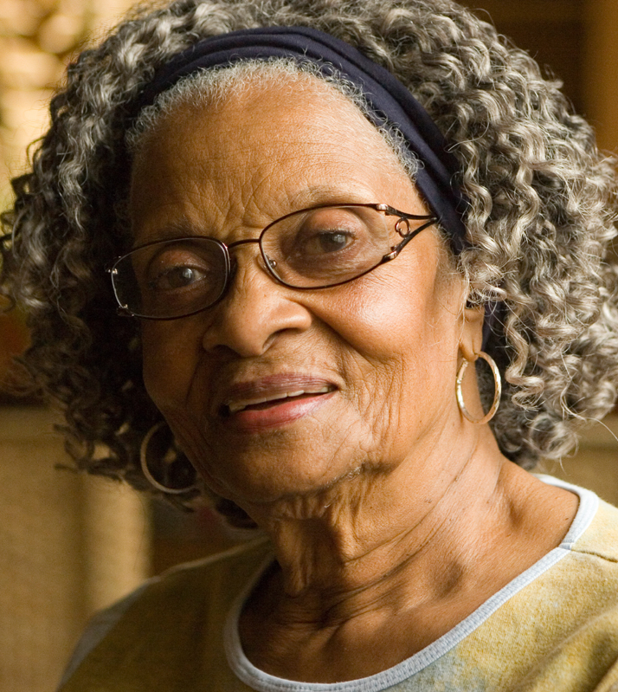
NHS RightCare scenario: The variation between standard and optimal pathways
Clara’s story: Multimorbidity
Appendix 1: Summary slide pack
January 2018

Slide 2
Clara’s story
This is the story of Clara’s experience of a multimorbidity care pathway, and how it could be so much better.
At each stage we have modelled the costs of care, both financial to the commissioner, and also the impact on the person and their family’s outcomes and experience.
In this scenario we examine a multimorbidity care pathway, comparing a sub-optimal but not atypical scenario against an ideal pathway.
1
2
4
3
It shows how the NHS RightCare methodology can help clinicians and commissioners improve the value and outcomes of the care pathway.
This document is intended to help commissioners and providers to understand the implications, both in terms of quality of life and costs, of shifting the care pathway.

Slide 3
Clara and the sub-optimal pathway
Clara, born in Jamaica, is 78 years old; she is widowed and has no relatives within a hundred mile radius - but her dog Bella is a great companion. She tries to attend church and enjoys going to pensioners’ clubs, although a struggle due to her worsening health
Clara has multiple long term conditions, including ischaemic heart disease, type 2 diabetes, osteoarthritis, hypertension and depression. She also has obesity and feels lonely and isolated. She is living with increasing frailty
She is prescribed around 10 medications and has to take around 20 tablets a day. However, her memory is getting worse and she sometimes forgets some of them. She also has to attend around 30 medical appointments a year, if she is able
Clara’s journey started aged 75 when she started experiencing chest pain. The pain quickly became severe and she was taken to A&E by ambulance. The diagnosis was angina (due to ischaemic heart disease) – her medication increased
The following night, she felt light-headed (blood pressure drop). She collapsed, banging her head on the wall; another ambulance & CT scan & overnight stay in hospital. Following this, Clara was more reluctant to get out and about
Bella died the following January and this was a significant event for Clara. Her GP prescribed anti-depressants

Slide 4
Clara and the sub-optimal pathway
Over a few months, Clara lost a lot of weight, going from 83kg to 62kg, due to her low mood, advancing frailty and a lack of appetite caused by all of the medication she was taking. This weight loss led to diabetes medication problems
In June 2015, aged 76, Clara had another fall at home, hurting her hip, and was taken to A&E by ambulance and given less than ideal painkiller prescriptions and advice
She then had a further fall and was taken to A&E and was found to have a fractured wrist. Over the three weeks she was in hospital, Clara’s mental state deteriorated and she was noted as having ongoing cognitive impairment
Clara then required 24 hour care to meet the needs associated with her frailty and cognitive impairment. Although she found the carers very helpful, she still felt very lonely
In August 2016, Clara deteriorated quickly with an acute chest infection and associated acute kidney failure, and was admitted to hospital. She remained there for the next 10 days, declining and sadly passing away on the ward

Slide 5
Clara and the sub-optimal pathway
No prevention
Too long in acute care
Not enough support
Reactive
No education
No proactive third sector
Traditional treatment
Meds not well managed
Too much time
in bed
Personal distress
Too much reliance on acute care
No risk profiling and identification
Insufficient home care support
Inappropriate acute care

Slide 6
Questions for GPs and commissioners
In the local population, who has overall responsibility for:
1
Identifying individuals and their carers living with multimorbidity?
2
Systematically identifying individuals living with multimorbidity?
3
Planning care models to address multimorbidity, which focus on a multi-morbidity approach rather than on specific single conditions?
4
Coordinating and delivering care to specifically address multimorbidity for individuals?
5
Has any engagement activity taken place with patients with regards to multimorbidity care?
6
Do you already have valuable local data around patient experience and outcomes for multimorbidity care in your area?
7
How could this local data be used to identify and drive improvements?

Slide 7
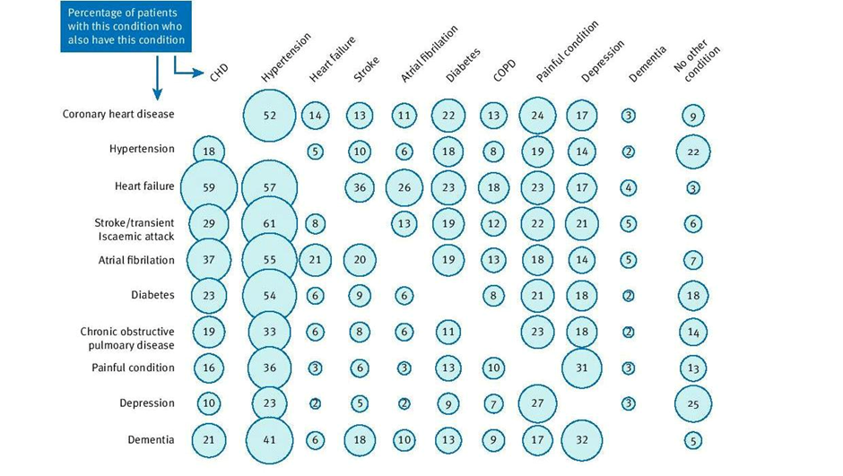
Source: BMJ 2016;354:i4843
People living with multimorbidity
Notes:
(rate of falls & 10 days)

Slide 8
Clara and the optimal pathway
The story of Clara’s optimal pathway starts two years earlier when her GP surgery identified moderate frailty using the electronic Frailty Index (eFI) and multimorbidity. She was identified as needing the tailored approach. (NICE guidance NG56 refers to multimorbidity: clinical assessment and management)
Clara’s practice allocated her a dedicated care co-ordinator, Sarah. Clara felt at ease with her and Sarah understood that Clara had a number of different problems and arranged for regular check-ups
Sarah also offered support such as signposting to financial entitlements, advice on arranging Lasting Powers of Attorney and for personal welfare, even talking through the care Clara would like if she developed a serious illness
Re concerns over Bella, the practice referred her to a local charity, which gave support including organising a local voluntary organisation to take Bella out for walks most days
Clara explained to Sarah that she was struggling with her medication; Sarah arranged for an automatic pill dispenser and she was also set up with a telehealth system
Her GP referred her to a memory clinic for an assessment which showed only mild cognitive impairment. This presented a valuable opportunity to alert Clara and her family to the higher risk of delirium in acute illness and to plan for this eventuality

Slide 9
Clara and the optimal pathway
Clara was also referred to a falls risk assessment. As a result, the council put in place a movement sensor and a care call. She was also referred to a strength and balance class
During Clara’s chest pain and angina episode the A&E team had access to Clara’s electronic shared record, which showed which medicines were issued when and that she was living with frailty, and so initiated a comprehensive geriatric assessment
Clara was kept in hospital overnight and given a medication review
When Bella died her GP referred her for psychological support through the local ‘Talking Mental Health’ service
Clara began to lose weight quickly due to her increasing frailty. She was given a further holistic review, referred for assessment and was given a care package that included twice-daily support at home to carry out basic tasks
Clara fell and hurt her hip at church. She was taken to A&E and the x-ray showed nothing serious. Her up-to-date shared record showed that she was already on analgesics for her osteoarthritis, so she was referred her to an intermediate care team to support her at home after discharge; she returned home the next day
As Clara’s health declined, her GP made sure they understood her end of life wishes and her care package was increased. Rather than being rushed to hospital she was kept at home in line with her wishes, where she died peacefully surrounded by her family

Slide 10
Clara and the optimal pathway
Prevention Focus
Right first time focus
Fast
Appropriate
Diagnosis
Appropriate medication
Greater understanding of need
Minimal time in acute
Support mechanisms in place
Trusted system
Happier and healthier experience
Proactive
Education
Third sector inclusion
Great acute care / knowledgeable
GP awareness and identification
Great home care support

Slide 11
Financial information
Analysis by provider | Sub-optimal | Optimal | Optimal %
Third sector | £0 | £510 | N/A
Acute | £14,570 | £1,028 | 7%
Ambulance service | £932 | £466 | 50%
Community teams | £75 | £1,717 | 2276%
Mental health provider | £0 | £1,655 | N/A
Primary care | £657 | £1,140 | 174%
Social services | £10,227 | £9,024 | 88%
Dentist / Optician | £0 | £40 | N/A
Grand total | £26,462 | £15,581 | 58.9%
As can be seen from the table, secondary care expenditure in the two scenarios is radically different. Acute costs in the optimal case represent only 7% of the original sub-optimal case (94% reduction in bed days from 35 days in the suboptimal case to two days in the optimal case) equating to a reduction of £13.2k.

Slide 12
Financial information
Analysis by cost category | Sub-optimal | Optimal | Optimal %
Primary care management | £627 | £1,090 | 174%
Urgent and emergency care | £1,160 | £694 | 60%
Secondary care management | £14,342 | £2,455 | 17%
Prevention and public health | £30 | £885 | 2,941%
Community care | £75 | £8,740 | 11,584%
Nursing home care | £10,277 | £0 | 0%
Intermediate care | £0 | £1,717 | N/A
Grand total | £26,462 | £15,581 | 58.9%
In the sub-optimal pathway Clara’s care was over-reliant on secondary care and was not sufficiently managed in primary care or at home. Improved management had a dramatic impact on her and her family. Such costs are difficult to quantify, but are very real. The secondary point is that a saving of 41% is material to any health economy.

Slide 13
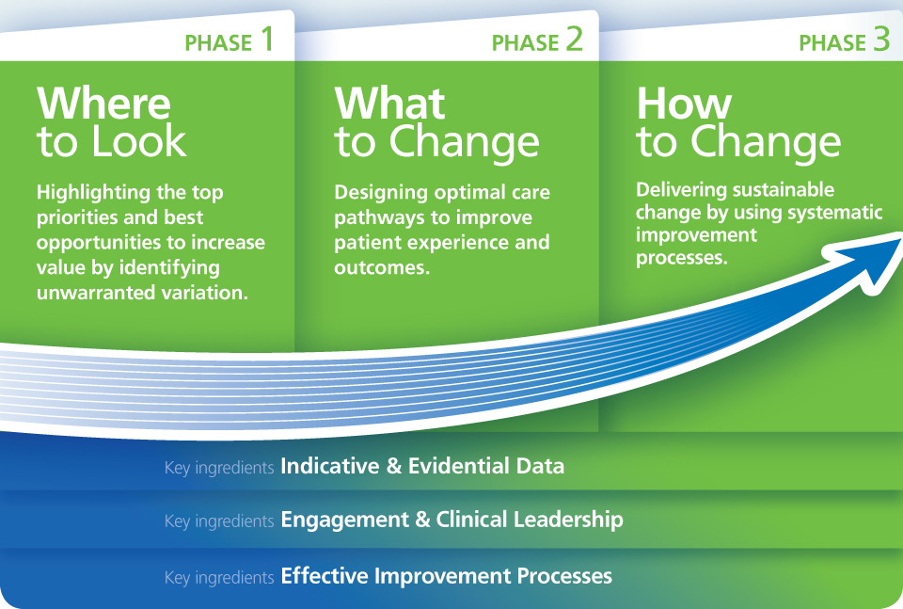
NHS RightCare Approach

Slide 14
Further information
For more information about Clara’s journey, NHS RightCare or long term conditions you can:
Email
rightcare@nhs.net
england.longtermconditions@nhs.net
Visit
www.england.nhs.uk/rightcare
Tweet
@NHSRightCare

