Slide 1
NHS RightCare scenario: The variation between standard and optimal pathways
Katie’s story: Advanced colorectal cancer
Appendix 1: Summary slide pack
January 2018

Slide 2
Katie’s story
This is the story of Katie’s experience of an advanced colorectal cancer care pathway, and how it could be so much better
In this scenario we examine a colorectal cancer care pathway, comparing a sub-optimal but not atypical scenario against an ideal pathway.
At each stage we have modelled the costs of care, both financial to the commissioner, and also the impact on the person and their family’s outcomes and experience.
1
2
4
3
It shows how the NHS RightCare methodology can help clinicians and commissioners improve the value and outcomes of the care pathway.
This document is intended to help commissioners and providers to understand the implications – both in terms of quality of life and costs – of shifting the care pathway

Slide 3
Katie and the sub-optimal pathway (1)
Katie is a 46-year-old retail worker. She lives with her husband, Isa and two young children
Katie had surgery and adjuvant chemotherapy for colorectal cancer when she was 45. Scans clear at one year and the family moved county for husband’s job
Katie developed right upper quadrant pain – persisted and became more severe over a month
Waited two weeks for GP appointment – saw GP twice and out of hours GP once over next two weeks
Pain intensified – ambulance took her to A&E where enlarged liver noted
Admitted to surgical ward – inpatient for three weeks. CT scan showed metastatic disease and she had liver biopsy. Katie was told the news on the ward whilst she was on her own, and had to break the news to Isa herself
During this time, Isa took over childcare and was struggling, eventually getting sacked from his job
Katie was referred to oncologist as outpatient: Palliative chemotherapy planned

Slide 4
Katie and the sub-optimal pathway (2)
After first cycle of chemotherapy, struggled with pain and constipation: Visits to A&E and out of hours GP
After further chemotherapy and inpatient acute care, follow up CT scan showed no response to chemotherapy and her liver function deteriorating: Chemotherapy discontinued
The district nurse put in an application for the care package through continuing healthcare (CHC) but Katie’s clinical condition deteriorated prior to this care being put in place
Further admission to acute setting with bowel obstruction: Isa was told by the nurses that as Katie was ‘terminally ill… nothing can be done.’ Isa was told he should ‘take her home to die.’
Katie said she did not want to die at home. Her preference was for a hospice if a side room was available. She did not want to discuss Advance Care Plans or decisions about Cardiopulmonary Resuscitation, or see the community palliative care team – still struggling with situation
Katie died at home in the end and the family situation was stressful and distressing in the extreme

Slide 5
Katie and the sub-optimal pathway
Slow diagnosis
Care integration
Too late
Healthcare communication & patient education could be improved
Traditional treatment
Pathway flow not optimised
Lack of patient choice
Too much reliance on acute care
Devastating consequences
Reactive rather than proactive
Insufficient community care support
Inappropriate care

Slide 6
Questions for GPs and commissioners
In the local population, who has overall responsibility for:
1
Leading the Ambitions Framework and realising the DH Choice Commitment for the local system?
2
Ensuring the identification and registration of people with life-limiting illness on a locality register and multi-disciplinary meetings to optimise holistic care?
3
Ensuring discussion, shared decision making & documentation of care plans?
4
Implementing digital solutions including electronic palliative care coordination systems?
5
Ensuring that care is personalised for the individual, including the offer of personal health budgets for people who might benefit from one?
6
Ensuring commissioners utilise the suite of contemporary tools and guidance available aimed at reducing unwarranted variation and improving experience
7
Involving patients in planning improvements in the care provided for people with advanced colorectal cancer and palliative care needs?

Slide 7
Katie and the optimal pathway (1)
Katie and her family moved to their new home in January, having finished her chemotherapy for colorectal cancer a year earlier
When registered, her new GP promptly referred her to a local nurse-led colorectal cancer follow-up clinic and forwarded her notes and images
When she developed persistent abdominal pain a year later, Katie rang the colorectal nurse specialist directly – this triggered the locally agreed pathway and a CT scan and bloods were organised
MDT discussion took place following results of CT scan and then of liver biopsy.
On each occasion, Katie was offered appointment at results clinic and opportunity to bring somebody with her
Katie was given a double appointment in her GP surgery to allow time for questions and discussion. A personalised care and support plan was documented using the enhanced section of summary care records

Slide 8
Katie and the optimal pathway (2)
Katie was seen by the enhanced supportive care service in hospital and palliative nature of the treatment plan and symptom management discussed. Community palliative care team and local hospice family support team supported Katie and her family at home
Katie’s pain settled so she was able to return to work part-time, undergoing two cycles of chemotherapy
Follow up CT scan results showed that her cancer was not responding - Katie decided to stop chemotherapy
Katie was introduced to the concept of a personal health budget and later used it to pay her neighbour to help with her care
Towards the end (two months later than the suboptimal scenario), although Katie’s care was not perfect (as a hospice side room was not available when she needed it), she and her family were well prepared and well supported
Katie was able to die peacefully in hospital (importantly not at home) and the whole process was well managed, including the provision of family bereavement support

Slide 9
Katie and the optimal pathway
Prevention Focus
Right first time focus
Efficient processes
Appropriate
Strong co-ordination between primary and secondary care
MDT working
Patient choice
Shared decision making
Support mechanisms in place
Trusted system
Happier and healthier experience
Proactive education and communication
Third sector engagement
Proactive and great communication
Great community care
Great holistic care

Slide 10
Caregiver support
The quality of life of a person with colorectal cancer and their family is deeply affected by the diagnosis, as a result of both the physical and psychological impact it has.
Caregivers often provide uncompensated care, which is physically, emotionally, socially and financially demanding and results in the neglect of their own needs.
It has been demonstrated that the psychological health of caregivers is often negatively affected, with reports of increased prevalence of both anxiety and depression.
Recognising the needs of carers is extremely important, both for them and the person for whom they care, and has been shown to have positive effects on quality of life and quality of care.
Information available for carers:
www.carersuk.org
www.macmillan.org.uk/information-and-support/audience/looking-after-someone-with-cancer.html

Slide 11
Financial information
Analysis by provider | Sub-optimal | Optimal | Optimal %
Third sector | £0 | £1,379 | n/a
Acute | £18,467 | £4,978 | 27%
Ambulance service | £536 | £0 | n/a
Carer | £0 | £1,152 | n/a
Community teams | £321 | £3,732 | 1164%
Patient | £0 | £10 | n/a
Primary care | £302 | £459 | 152%
Grand total | £19,626 | £11,726 | 59.7%
Secondary care expenditure in the two scenarios is radically different. Acute costs in the optimal case represent only 27% of the original sub-optimal case (90% reduction in bed days) – equating to a reduction of £13.5k.
Community teams offer a great deal more support and a personal carer is also necessarily higher in the optimal scenario as the optimal case needs to invests in these areas to ensure Katie’s care and support is as good as possible given this very difficult case. NB This also raises the importance of improved strategic budgeting across the wider health economy.

Slide 12
Financial information
Analysis by cost category | Sub-optimal | Optimal | Optimal %
Community care | £125 | £2,907 | 2333%
Elective admissions | £0 | £1,000 | n/a
Palliative and End of Life | £156 | £4,002 | 2558.1%
Prescribing and Meds Optimisation | £88 | £491 | 559.5%
Primary care management | £117 | £384 | 329.4%
Secondary care management | £17,719 | £2,902 | 16.4%
Self care | £0 | £20 | n/a
Urgent and emergency care | £1,421 | £20 | 1.4%
Grand total | £19,626 | £11,726 | 59.7%
Not only is Katie’s quality of care so much better in the optimal scenario, but the cost savings are also significant at £7.9k (40%). NB the financial costs are calculated on a cost per patient basis and local decisions would need to take a population view of costs and improvement. Plus chemotherapy costs (including drug costs) are the same in both scenarios. This is not a distinguishing variable in this study.

Slide 13
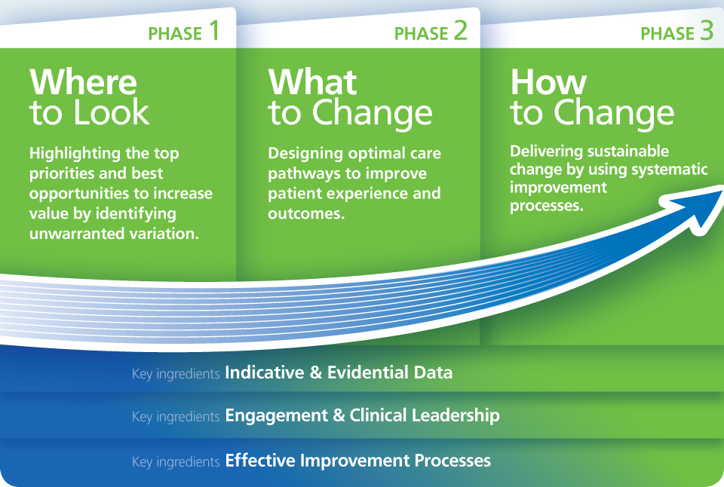
Financial information

Slide 14
Further information
For more information about Katie’s journey, NHS RightCare or long term conditions you can:
Email
rightcare@nhs.net
england.longtermconditions@nhs.net
Visit
www.england.nhs.uk/rightcare
Tweet
@NHSRightCare

