Slide 1
NHS RightCare scenario: The variation between standard and optimal pathways
Sarah’s story: Parkinson’s
Appendix 1: Summary slide pack
January 2018

Slide 2
Sarah’s story
This is the story of Sarah’s experience of a Parkinson's care pathway, and how it could be so much better.
At each stage we have modelled the costs of care, both financial to the commissioner, and also the impact on the person and their family’s outcomes and experience.
In this scenario we examine a Parkinson's care pathway, comparing a sub-optimal but not atypical scenario against an ideal pathway.
1
2
4
3
It shows how the NHS RightCare methodology can help clinicians and commissioners improve the value and outcomes of the care pathway.
This document is intended to help commissioners and providers to understand the implications, both in terms of quality of life and costs, of shifting the care pathway.

Slide 3
Sarah and the sub-optimal pathway
Sarah, a 70-year-old retired librarian, lives with her husband Ian. She is an active volunteer in the community
Sarah first visited her GP in March of year one – she had noticed ‘slowing down’. At the third visit in July, her GP started to suspect Parkinson’s and organised investigations and treatment
The diagnosis of Parkinson’s was confirmed by the neurologist almost a year later and her medication changed
Sarah and Ian tried to come to terms with her diagnosis but her social life was diminished because of symptoms causing her embarrassment
In year six, Sarah was admitted for surgery on her troublesome bunion. The Parkinson’s medication was omitted pre-op and not reinstated quickly enough post-op, causing significant physical regression and led to prolonged hospital stay
In year seven, the caring situation at home was reaching crisis point and Sarah was admitted to a Community Intermediate Care bed for respite – where she started on an antidepressant
There was a catalogue of primary and secondary care events which were distressing for both Sarah and Ian and affected quality of life for both of them
By May of year nine, Sarah’s condition was deteriorating relentlessly. Her care package was increased but they still struggled to cope
When she deteriorated acutely, she was transferred to the acute medical unit but died there 18 hours later; staff hadn’t had time to get to know or support her or Ian
Ian was very distressed and became depressed and mentally unwell for over a year after Sarah’s death

Slide 4
Sarah and the sub-optimal pathway
No prevention
Too long in acute care
Not enough support
Reactive
No education
No proactive third sector
Traditional treatment
Meds not well managed
Too much time
in bed
Personal distress
Too much reliance on acute care
No risk profiling and identification
Insufficient home care support
Inappropriate acute care

Slide 5
Questions for GPs and commissioners
In the local population, who has overall responsibility for:
1
Identifying individuals and their carers living with Parkinson’s?
2
Planning care models to address key stages of diagnosis, maintenance, complex and palliative care?
3
Identifying and reporting on measurable positive and negative associated outcomes?
4
Quality assurance and value for money of Parkinson’s care?
5
Has any engagement activity taken place with patients with regards to Parkinson's care?
6
Do you already have local data around patient experience and outcomes for Parkinson's care in your area?
7
How could this valuable local data be used to identify and drive improvements?

Slide 6
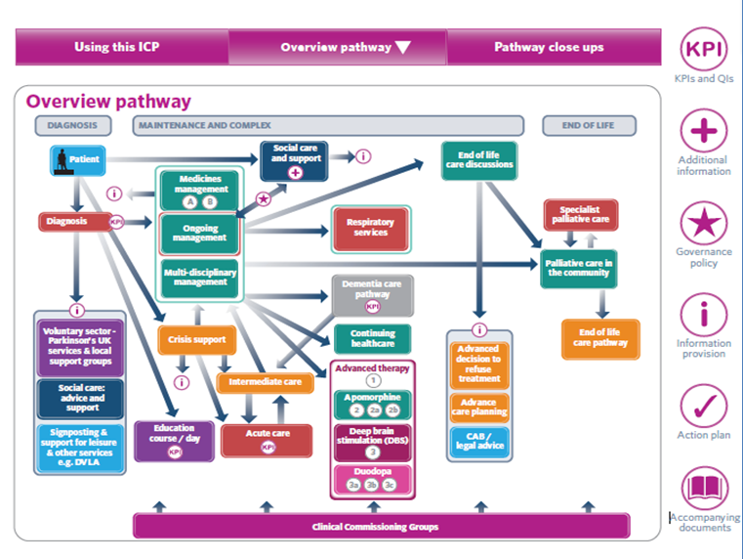
An integrated Parkinson’s pathway. Care needs can be made explicit and coordinated between team members
Source: Peel et al (2013) BJNN, 9(6): 292-300
Notes:
(rate of falls & 10 days)

Slide 7
Sarah and the optimal pathway
In April, Sarah saw her GP who suspected Parkinson's and immediately referred her, untreated, to the local neurology clinic. Treatment was initiated quickly using shared decision making
The Parkinson’s nurse specialist provided excellent support around medication, links to therapists, signposting to the Parkinson’s UK website and introduced the idea of advance care planning
Sarah had structured reviews with her practice nurse and GP in between annual reviews at the neurology clinic, with the Parkinson’s nurse specialist available directly by phone at any time
Sarah undertook exercise classes in the community and Ian joined a carer support group run by the local Parkinson’s UK branch for social activities and mutual support, attending regularly over that year. This support was very valuable and continued for four years
Sarah’s hospital stay for her bunion surgery was minimal (four days) and uneventful because her medication regime was tightly managed
There were a series of primary and secondary care interventions to support both Sarah and Ian as her condition began to deteriorate. The specialist palliative care team, primary care team and other specialists worked together to support her and Ian
Sarah was regularly discussed at MDT meetings, her records updated on the Electronic Palliative Care Coordinating System and her care package increased to meet her needs
In year 10 Sarah died peacefully at home with Ian at her side
Three months after Sarah’s death the Parkinson’s nurse specialist visited Ian, who expressed his gratitude for all the care they both received

Slide 8
Sarah and the optimal pathway
Right first time focus
Fast
Appropriate
Diagnosis
Appropriate medication
Greater understanding of need
Minimal time in acute
Support mechanisms in place
Trusted system
Personalised care planning
Happier and healthier experience
Proactive
Choice
Education
Shared decision making
Third sector
Great acute care / knowledgeable
GP awareness and identification
Great home care support

Slide 9
Financial information
Analysis by provider | Sub-optimal | Optimal | Optimal %
Third sector | £2,880 | £1,219 | 42%
Acute | £50,757 | £3,542 | 7%
Ambulance service | £2,330 | £0 | 0%
Community hospital | £3,843 | £2,404 | 63%
Community teams | £3,025 | £7,351 | 243%
Primary care | £702 | £1,552 | 221%
Social services | £4,466 | £8,214 | 184%
Grand total | £68,004 | £24,282 | 36%
Secondary care expenditure in the scenarios is radically different. The optimal case represents only 7% of the original sub-optimal case – a reduction of £47k.
Primary care and social care expenditure are necessarily higher in the optimal scenario as the optimal case invests in early intervention, community teams, practice-level support and social services (which raises the importance of improved strategic budgeting across the wider health economy). This is more than offset by the secondary care savings. However, please note the financial costs are calculated on a cost per patient basis and local decisions would need to take a population view of costs and improvement.

Slide 10
Financial information
Analysis by cost category | Sub-optimal | Optimal | Optimal %
Community care | £8,732 | £10,718 | 123%
Elective admissions | £800 | £1,600 | 200%
Intermediate care | £3,607 | £2,404 | 67%
Non-elective admissions | £13,600 | £0 | 0%
Palliative and end of life care | £480 | £2,958 | 617%
Prescribing and meds optimisation | £313 | £2,015 | 644%
Prevention and public health | £0 | £457 | n/a
Primary care management | £360 | £879 | 245%
Rehabilitation | £5,768 | £1,362 | 24%
Secondary care management | £32,692 | £1,609 | 5%
Self care | £0 | £155 | n/a
Urgent and emergency care | £1,654 | £125 | 8%
Grand total | £68,004 | £24,282 | 36%
This is a scenario that clearly highlights that proactive planning and correct signposting to well trained (and equipped) teams is important - there is a significant impact on patient outcomes, quality and finance. Care can be improved by investigating the root cause of sub-optimal care and working with clinicians to design an improved evidence-based pathway.
Not only is Sarah’s health and quality of life much better in the optimal scenario, the cost savings are significant.

Slide 11
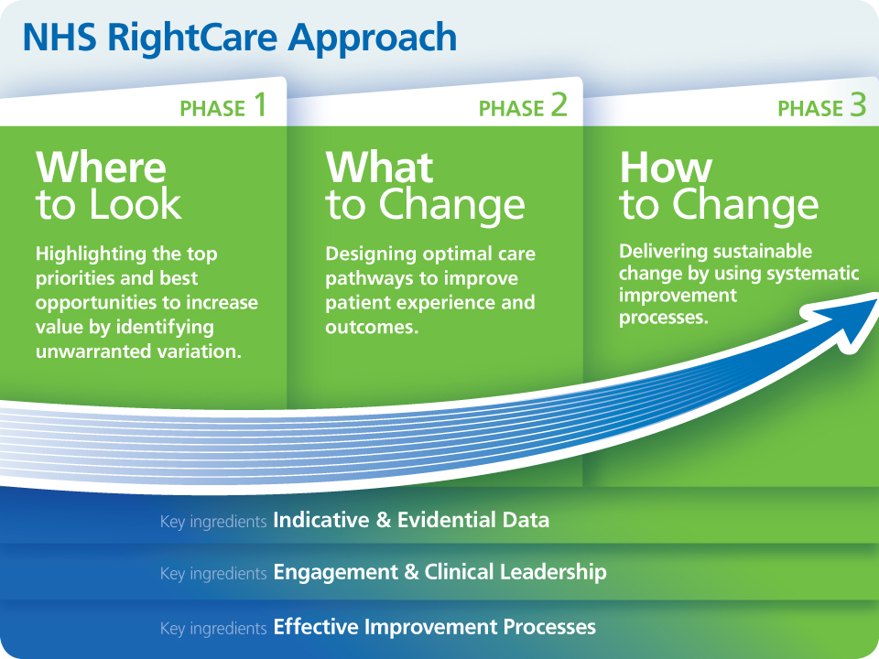
NHS RightCare Approach

Slide 12
Further information
For more information about Sarah’s journey, NHS RightCare or long term conditions you can:
Email
rightcare@nhs.net
england.longtermconditions@nhs.net
Visit
www.england.nhs.uk/rightcare
Tweet
@NHSRightCare
You can watch the supporting video on the NHS RightCare YouTube page

