Slide 1
NHS RightCare scenario: The variation between sub-optimal and optimal pathways
Rob’s story: Sepsis
Summary slide pack
June 2018
Gateway reference 07876

Slide 2
Rob’s story
This is the story of Rob’s experience of a sepsis care pathway, and how it could be so much better
At each stage we have modelled the costs of care, financially to the commissioner, and also the impact on the person and their family’s outcomes and experience.
In this scenario we examine a sepsis care pathway, comparing a sub-optimal but typical scenario against an ideal pathway.
1
2
4
3
It shows how the NHS RightCare methodology can help clinicians and commissioners improve the value and outcomes of the care pathway.
This document is intended to help commissioners and providers to understand the implications – both in terms of quality of life and costs – of shifting the care pathway

Slide 3
Rob and the sub-optimal pathway
Day 9 - Post operation - cough Dry cough, mild fever, no real concerns with family as there is a “bug going around”.
Day 14 – Cough persisting Family now concerned as Rob has not been eating and feels “fluey”. GP contacted.
Day 14 – GP tel. consultation GP suspects viral bronchitis - should resolve itself. Call back if no better or if it gets worse.
Day 16 – Concern and GP appt Family are now very concerned as Rob is breathless and vomiting. GP surgery arrange for an afternoon appt. GP is shocked by Rob’s condition and calls for an ambulance. After three hours waiting GP calls 999 for a blue light response.
Day 16 – Ambulance Double technician ambulance crew arrive and take Rob to the surgical assessment unit where he is “a bit slow to respond”.
Day 16 – Ward admission Not “handed over” to staff and the GP observations are missing.
Day 16 - Observations Baseline observations done by HCA. NEWS score calculated and oxygen given. Junior doctor alerted but the registrar is busy. Later the junior doctor administers stat bolus 500ml of glucose 5% over five minutes but the cause is still unclear.
Day 16 – Serious deterioration Mental state is deteriorating and the registrar suspects pneumonia. Rob is now breathless, shocked and close to collapse. ICU ventilate, give antibiotics, fluid resuscitation and inotropes over a five day period.
Day 27 – Discharged home After a further stay in the General Medical Ward Rob is discharged home.
Day 29 – GP follow-up Rob is struggling to walk and needs a stick. His memory is poor and he still has a persistent cough and is still breathless.
Day 90 – Limited recovery Rob can now undertake small amounts of activity but needs frequent rest. His sleep is disturbed and his moods are low with disturbing flashbacks on a regular basis. His family are seriously concerned about Rob’s mental health; the whole family are feeling the strain.
Day 100 – Legal action The family write a formal letter of complaint to the GP threatening legal action.

Slide 4
Rob and the sub-optimal pathway
Insufficient education
Poor communication
Long term consequences
Operation discharge
Patient awareness
GP reception
Observations not tracked
Poor handovers
Deterioration not tracked
Serious implications
Family distress
Legal challenge
A lack of understanding and urgency
Lack of common language
Costly in terms of outcomes and £s

Slide 5
Questions for GPs and commissioners
In the local population, who has overall responsibility for:
1
Promoting the use of NEWS2 across the whole care pathway including within the community as well as all hospitals in your areas?
2
Promoting sepsis as a condition for which targeted interventions must be planned and delivered?
3
Ensuring timely referral, communication and action throughout the pathway?
4
Identifying and reporting on measurable positive and negative sepsis associated outcomes?
5
Planning care models to address key stages of sepsis diagnosis and intervention escalation?
6
Evaluating any existing engagement activity that has already taken place with patients with regards to sepsis?
7
Understanding how this local data could be used to identify and drive improvements?

Slide 6
The levels of NEWS2 scores and associated risk
Date | Time |  | Clinical concern | NEWS
14 days pre admission |  | Post op discharge | Low | Unknown
2 days pre admission |  | GP call | Low | Unknown
Admission day 1 | 1545 | GP appointment | High | Unknown
 | 2015 | Ambulance | High | Unknown
 | 2048 | SAU arrival | High | Unknown
 | 2200 | Surgical review | High | Unknown
 | 2300 | Medical review | High | Unknown
 | 2330 | ICU | High | Unknown
Admission day 12 |  | Discharge | Low | Unknown
Sub-optimal case
Date | Time |  | Clinical concern | NEWS2
14 days pre admission |  | Post op discharge | Low | 0
2 days pre admission |  | First GP appointment | Medium | Not calculated
Admission day 1 | 0900 | Second GP appointment | High | 10
 | 0930 | Ambulance | Very High | 13
 | 1000 | ED Resus | Extreme | 14
 | 1100 | ED Resus | Extreme | 12
 | 1200 | ED Resus | Extreme | 15
Admission Day 2 |  | HDU | High | 10
Admission Day 3 |  | Ward | Medium | 3
Optimal case

Slide 7
Rob and the optimal pathway
Day 9 – Post operation-cough Dry cough, mild fever, no real concerns with family as there is a “bug going around”.
Day 14 – Cough persisting Family now concerned as Rob has not been eating and feels “fluey”. GP contacted as aware of Thromboembolism and sepsis from the hospital discharge information post surgery.
Day 14 – GP tel. consultation Receptionist notes ‘sepsis’ language from the family and arranges emergency GP appt. GP records vital stats and provides leaflet – doesn’t justify antibiotics at this stage.
Day 16 – Concern and GP appt. Family are now very concerned as Rob is breathless and vomiting. Surgery advises to come in immediately. GP is concerned by Rob’s condition and calls the medical admissions team and ambulance with a NEWS score of 10 and “sepsis suspected”, plus prepares a detailed letter with deterioration information for the ambulance crew.
Day 16 – Ambulance and A&E Ambulance crew with paramedic arrive and take Rob to the Emergency Unit . He then receives the sepsis six and has a chest X-ray, plus contact with the ITU outreach team who agree HDU admission is required – antibiotics administered.
Day 17 – Ward admission Moved to General Medical Ward after one day in HDU.
Day 18 - Observations Rob is now looking well enough for discharge – antibiotics reviewed and changed.
Day 19 – Discharge Discharged home with discharge summary (sepsis and pneumonia) and anticipated recovery path.
Day 20 – GP follow-up GP explains what recovery will be like and arranges vaccination in the near future – the family are very grateful for the GP’s prompt action.
Day 90 – Recovery Pneumonia has completely resolved and Rob has just returned from a family wedding and a three week holiday in Trinidad.
Day 100 – GP practice The practice undertakes an SEA review of the case and recognises the value of a sepsis reflection aware practice and the use of physiology and communication to improve patient outcomes.

Slide 8
Rob and the optimal pathway
Planned education
Thoughtful communication
Positive outcome
Patient at discharge
GP reception
All clinicians in pathway
Observations logging
Quality handovers
Proactive communication
Back on feet very quickly
Family are thankful
Maintains a normal life
Deterioration focus and urgency
NEWS2 common language
Significant savings - distress and £s

Slide 9
Financial information
Analysis by Cost Category | Sub-optimal | Optimal | Optimal %
Primary care management | £238 | £451 | 190%
Urgent and Emergency care | £247 | £247 | 100%
Secondary care management | £7,518 | £2,318 | 31%
Grand total | £8,003 | £3,016 | 38%
The key improvement is due to prompt diagnosis and good communication between healthcare professionals which results in prompt administration of antibiotics. This significantly reduces the volume and type of bed days in hospital from 11 days, including five in ICU, in the suboptimal case down to four days, with one in ICU, in the optimal case.
Primary care then invests much more significantly in post sepsis aftercare with practice visits every two weeks for the first three months after hospital discharge. Close monitoring post-sepsis is very important.
This shift in focus represents improved value for money, better use of healthcare resources and most importantly a significant improvement in Rob’s clinical outcome and quality of life.
NB: Please refer to the detailed scenario for data and financial analysis details and caveats.

Slide 10
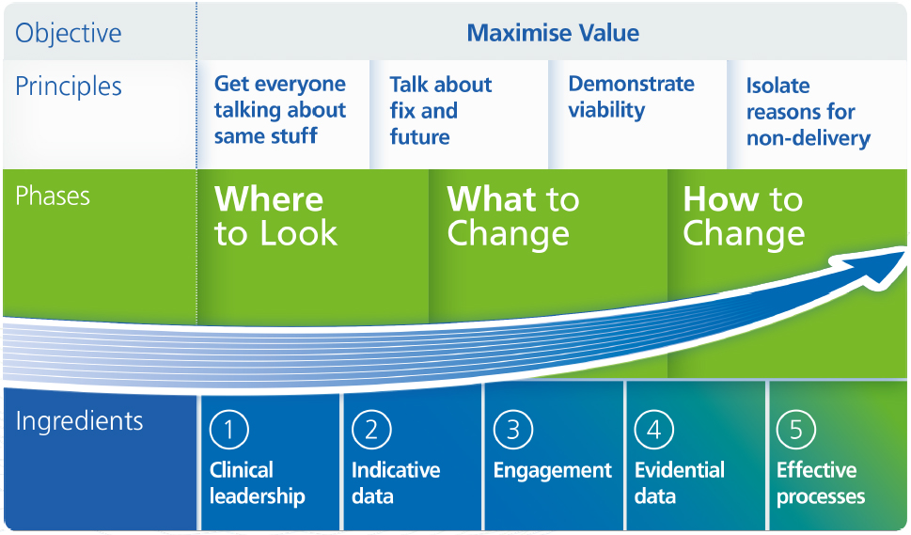
The NHS RightCare approach

Slide 11
Further information
For more information about Rob’s journey, NHS RightCare or the sepsis programme you can:
Email:
rightcare@nhs.net
england.clinicalpolicy@nhs.net
Visit:
www.england.nhs.uk/rightcare
www.england.nhs.uk/?s=sepsis
Tweet:
@NHSRightCare
Please note: Appendices to support the main scenario document and the PowerPoint summaries can be found at https://www.england.nhs.uk/rightcare/products/ltc/sepsis-scenario/

