Slide 1
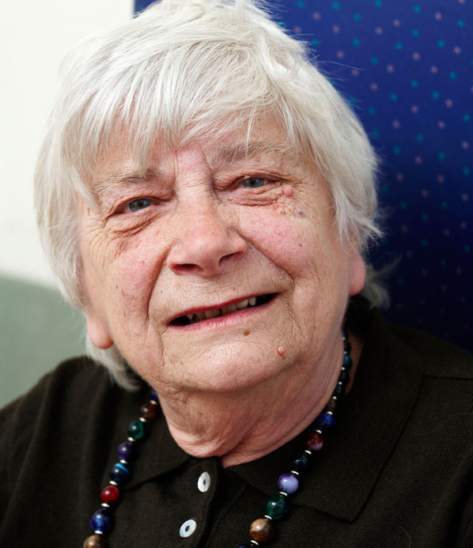
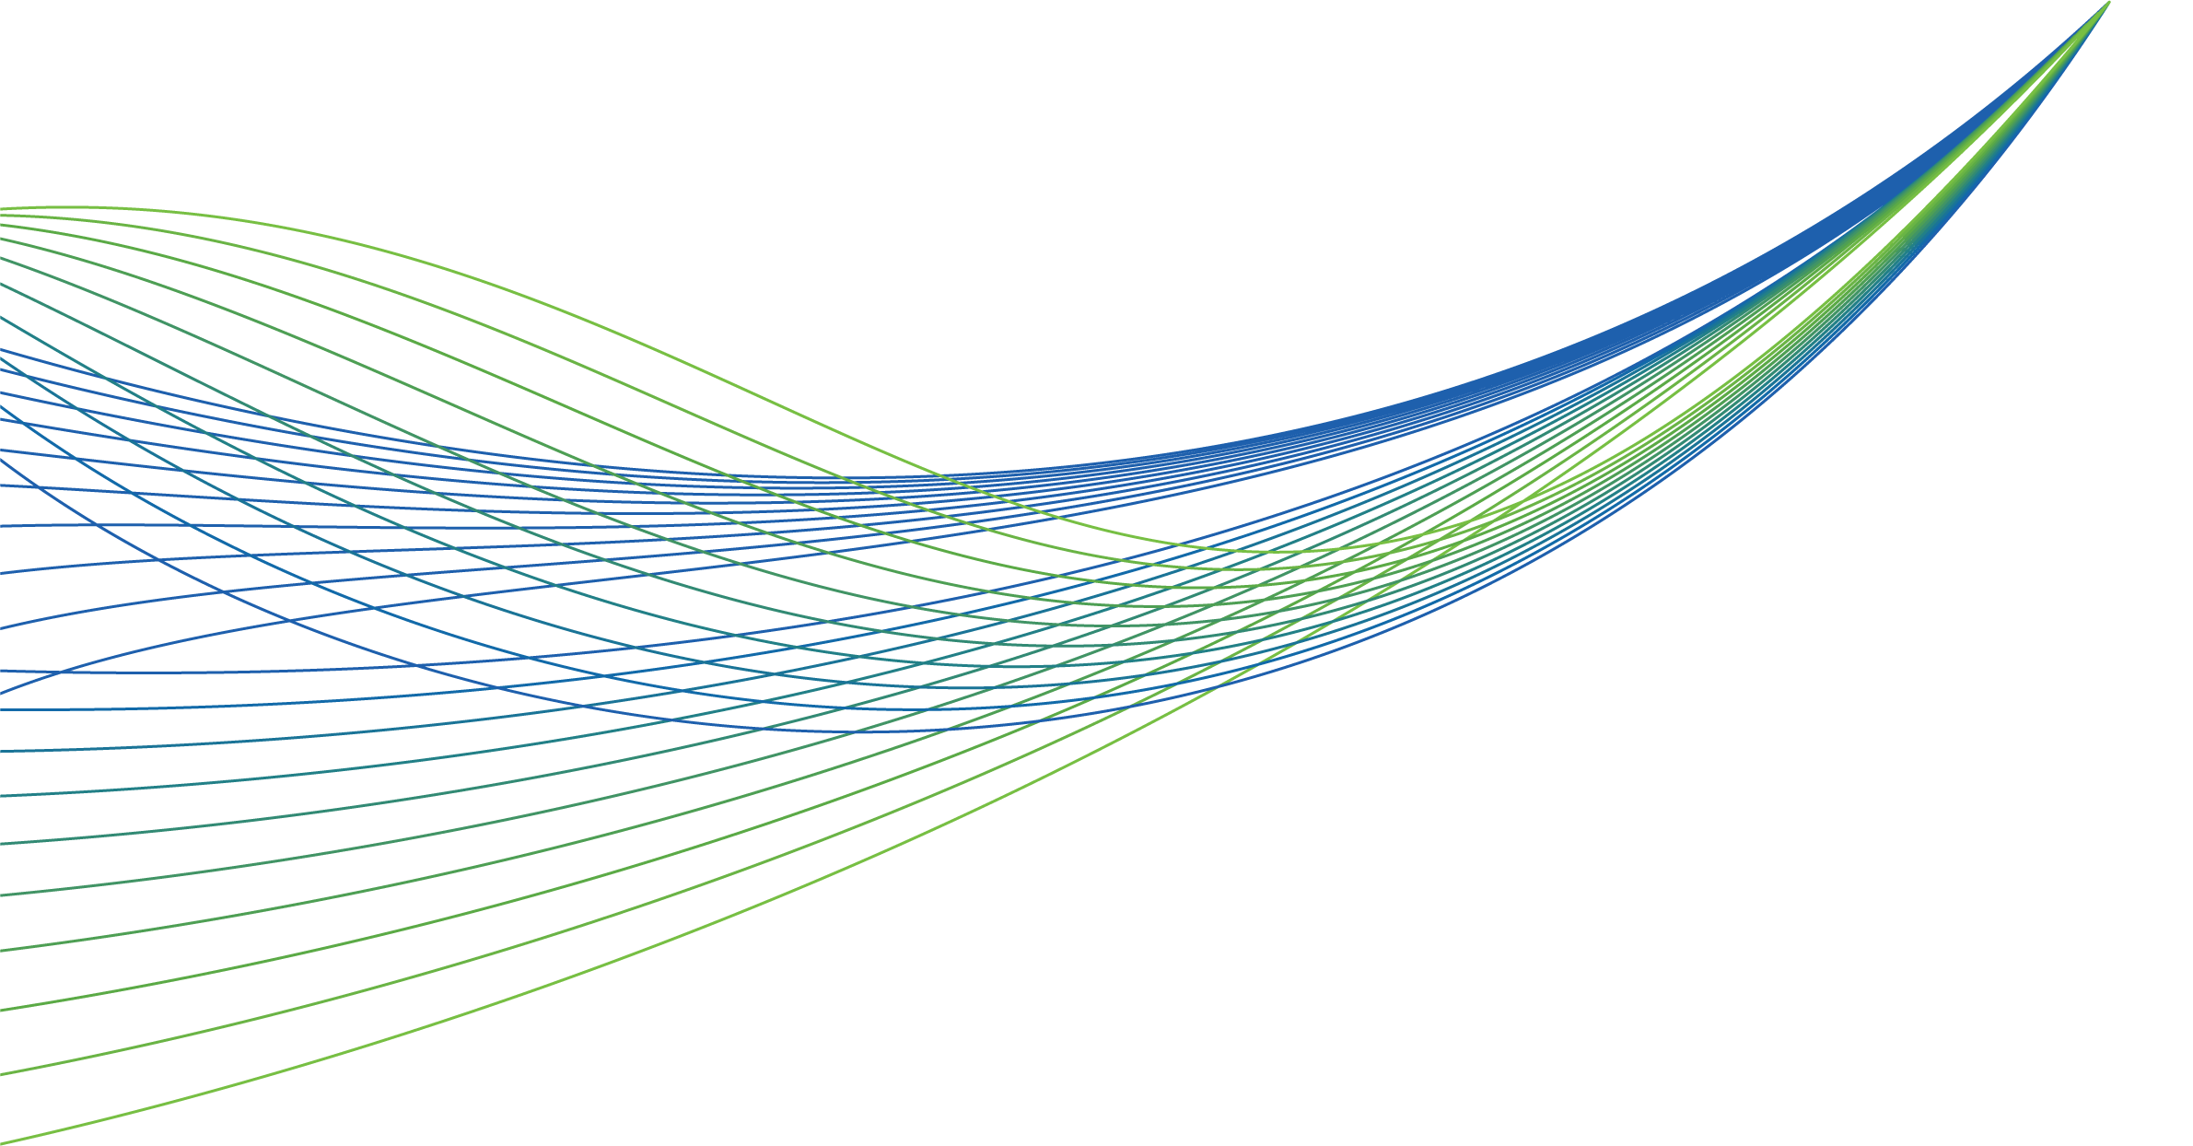
RightCare scenario: The variation between suboptimal and optimal pathways
Janet’s story: Frailty
Appendix 1: Summary slide pack
Published August 2016
Updated June 2019

Slide 2
Janet’s story
This is the story of Janet’s experience of a frailty care pathway, and how it could be so much better.
At each stage we have modelled the costs of care, both financial to the commissioner, and also the impact on the person and their family’s outcomes and experience.
In this scenario we examine a frailty care pathway, comparing a sub-optimal but typical scenario against an ideal pathway.
1
2
4
3
It shows how NHS RightCare can support health systems improve the value and outcomes of the care pathway.
This document is intended to help systems to understand the implications – both in terms of quality of life and costs – of shifting the care pathway.

Slide 3
Janet and the suboptimal pathway
Janet is 84, a retired teacher living with her 85 year-old husband Arthur.
On a Friday evening, Janet falls. Arthur calls 999 and Janet is taken to A&E.
Janet is given a hip x-ray. There is no fracture, but blood and urine tests show a urinary tract infection and dehydration, so she is admitted to an acute medical ward.
The next day (Saturday) she is moved to a general medical ward.
After the weekend, Janet is assessed as having postural hypotension.
Due to a lack of available beds in the community, Janet is moved to a winter escalation ward in the hospital. She falls again in the ward. As a result she is no longer fit for rehabilitation and requires a care package.
This is put in place almost three weeks after admittance and she is finally discharged.
Three weeks later, Janet falls again and, after discharge from hospital, goes into a care home. After rapid deterioration and another fall, she returns to acute care and after 10 days on the intensive care ward, she passes away aged 84.

Slide 4
Janet and the suboptimal pathway
No prevention
Pillar to post
Too late
Reactive
No education
No third sector
Traditional treatment
Many wards
Too much time
in bed
Damage done
Too much reliance on acute care
No risk profiling and identification
Insufficient home care support
Inappropriate acute care

Slide 5
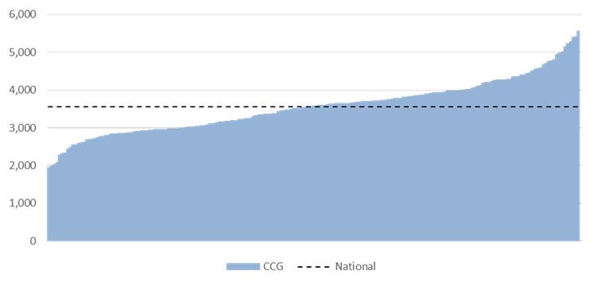
The scale of the issue
We know that there is a strong correlation between frailty, impaired mobility and falls. Therefore, to understand the potential scale of frailty issues across England a good measure is the ‘Injuries due to falls – Emergency admissions for people aged 75+ per 100,000 age-sex weighted population (2017/18)’.
In England the rate of emergency admissions for people aged 75 or older due to injuries from falls was 3,550 per 100,000 population in 2017/18. Across all 195 CCGs this equates to more than 163,000 serious falls for this age group, and these are just the ones that we know about – this scale is significant.

Slide 6
Areas for systems to consider
The role of local systems is to understand the reasons why people become frail and to use that knowledge to commission care and offer support differently in the future. Areas to consider:
1
Promoting frailty as a condition which must be systematically identified, in order for proactive, timely and targeted interventions to be planned and delivered.
2
Taking a system-wide approach to population segmentation and risk stratification for older people living with frailty.
3
Planning care models to support people living with mild and moderate frailty to age well.
4
Planning care models to support people living with moderate and severe frailty to live in their communities.
5
Identifying and reporting on measurable positive and negative frailty-associated outcomes.
6
Ensuring communication about frailty and cognitive status occurs across health and social care sectors, and between primary, secondary and community care.
7
System wide training and competence according to the Frailty Core Capabilities Framework to support people living with frailty.

Slide 7
Janet and the optimal pathway
Janet’s journey begins four years earlier when, aged 80, she and Arthur are visited by the Fire Service as part of their ‘Safe and Well’ visits. They carry out a gait speed test on Janet and Arthur which shows Janet has early signs of frailty. They provide practical guides and information and put Janet in contact with a local charity that runs exercise classes for the over 80s.
Five years on, Janet’s exercise group leader notices a deterioration in how much Janet can do and recommends she visit her GP who diagnoses her as living with moderate frailty.
The GP informs Janet of the enhanced Summary Care Record and asks for her consent for this to be used. They then refer her to the local Ageing Well multi-disciplinary team (MDT) for further assessment and intervention.
The MDT carries out a falls risk assessment and fully involves Janet and Arthur in all discussions. They undertake a medication review with the local pharmacist and refer Janet to her local memory service which culminates in a jointly agreed personalised care plan.
12 months later, aged 86, Janet falls. Arthur contacts NHS 111 for advice. A community paramedic assesses Janet but she has no serious injuries and does not need to be admitted. Community support is arranged for the next few days and the MDT refers Janet for a comprehensive geriatric assessment that confirms she had postural hypotension – further support steps are taken to minimise her risk of falling.
Two years later, Janet falls again and this time does have a short hospital stay and returns home with a support package. Aged 89, Janet passes away at home surrounded by her family, in accordance with her personalised care plan.

Slide 8
Janet and the optimal pathway
Prevention focus
Fast
Appropriate
Bespoke treatment
Little time in bed
Greater understanding of need
Support mechanisms in place
Trusted system
Happier and healthier experience
Proactive
Education
Third sector
Risk profiling and identification
Great acute care
Great home care support

Slide 9
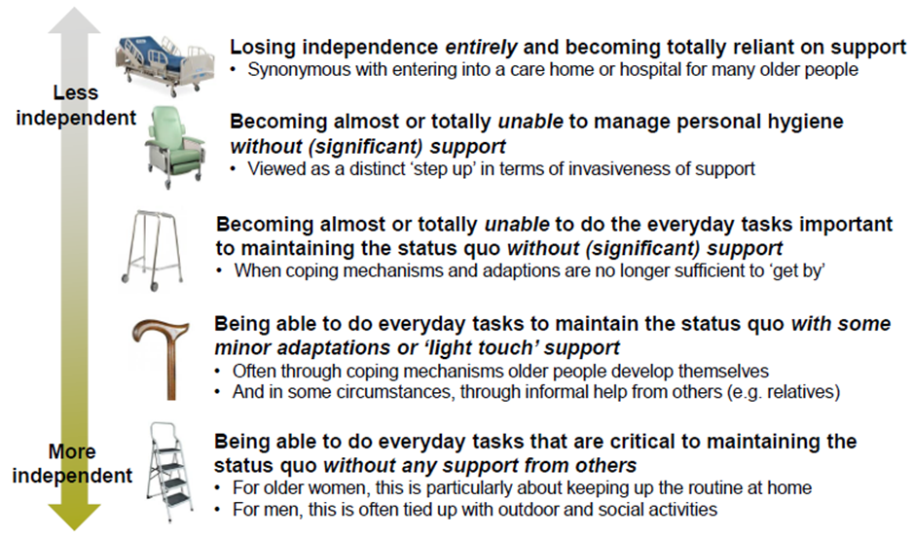
Patient spectrum
Older people tend to conceive their ability to live independently as a ‘spectrum’.
Notes:
Amended

Slide 10
Financial information
Analysis by cost category | Suboptimal £ | Optimal £
Community care | 1,470 | 13,809
Immediate care | 3,321 | 0
Prevention and public health | 0 | 1,425
Primary care management | 0 | 4,885
Urgent and emergency care | 1,497 | 831
Non-elective admissions | 24,075 | 1,460
Total | 30,363 | 22,410
Costs shown above should be treated as indicative costs to the healthcare economy. Where available, reference costs have been used, particularly to estimate the cost of emergency care and non-elective admissions.

Slide 11
Financial information
Analysis by provider | Suboptimal £ | Optimal £
Acute trust | 24,816 | 1,460
Urgent treatment centre | 0 | 74
Ambulance service | 756 | 757
Primary / community care | 1,470 | 18,694
Care home | 3,321 | 0
Third sector and other | 0 | 1,425
Total | 30,363 | 22,410
Costs shown above should be treated as indicative costs to the healthcare economy. Where available, reference costs have been used, particularly to estimate the cost of emergency care and non-elective admissions.

Slide 12
NHS RightCare
For more information about Janet’s journey, NHS RightCare or long term conditions you can:
Email:
rightcare@nhs.net
england.longtermconditions@nhs.net
Visit:
https://www.england.nhs.uk/rightcare/
Tweet:
@NHSRightCare

