Slide 1
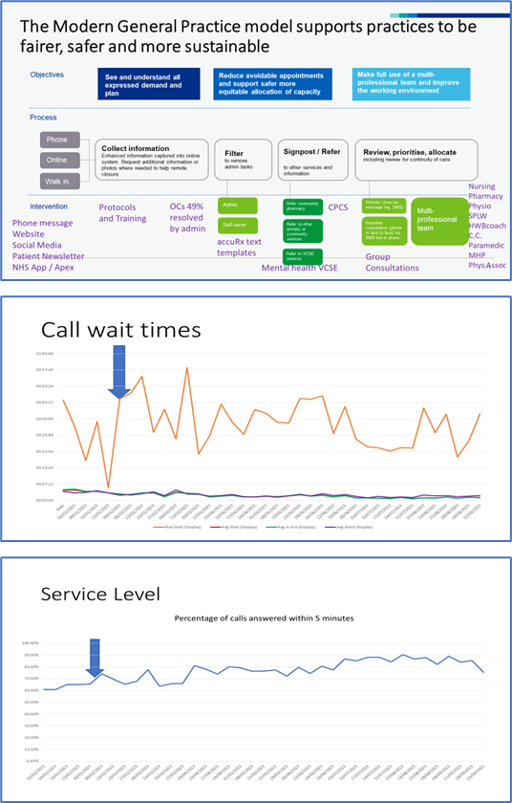
Modern General Practice - Same Day Access Model - Acute Care Team Woodley Centre Surgery, Berkshire West
As of 2023, Woodley Centre Surgery has an existing list size of 13,508 predominantly covering the Reading area and have experienced a huge increase in calls coming into the surgery from previous years with currently taking over 130,000 calls. The practice current model was not fit for purpose with the increase and move to the General Practice Model to:
See and understand all expressed demand and plan
Reduce avoidable appointments and support safer more equitable allocation of capacity
Make full use of a multi-professional team and improve the working environment
This led to the practice implementing and designing several tools to enable reception/admin team to filter the calls received that include:
Process Map – this flow chart helps the reception/admin staff to work through the request and to ensure that the patient receives the right care as soon as appropriate.
GP Appointment Protocol – this details which appointments would be considered same day (urgent) or routine.
Nursing Matrix detailing which nurses can be booked for specific appointments (flu vax, COPD, blood pressure checks etc.)
Safety Netting AccuRx detailing advice to give over the phone for minor ailments (earache, cough, fever etc.)
As well as the above, the practice offers four specialist group clinics that patients can book into for menopause, blood pressure, mindfulness and postnatal, with a potential to include a fifth group for Diabetes. The charity Mind are also onsite offering support to those patients with low grade stress and anxiety.
The practice has several routes that they use to communicate with patients including messages on the telephone system, practice website, social media and patient newsletter. They are currently working towards making more use of the NHS App.
The impact in utilising these tools both over the phone and via online consultations, has enabled the admin team to filter 49% of contacts made with the practice, away from the appointment books and offered patients a reduction in call waiting times and increase in service level provided ensuring that they are seen by the right professional at the time needed.
Lessons learnt
Implement Protocols and Training
Ensure to deliver comms to patients- Phone message- takes time to prepare and patient leaflet
Develop a skills matrix
Offer group clinics on rotas, book straight in
No matter how patients approach the surgery, need to give the same message
CPCS confidence, send at 10am when phones quieter
Ensure patients are involved
Staff sickness levels- employ more cover
Proactive care planning and LTC reviews will help to reduce on the day demand
Patients would like more f2f slots

