Slide 1
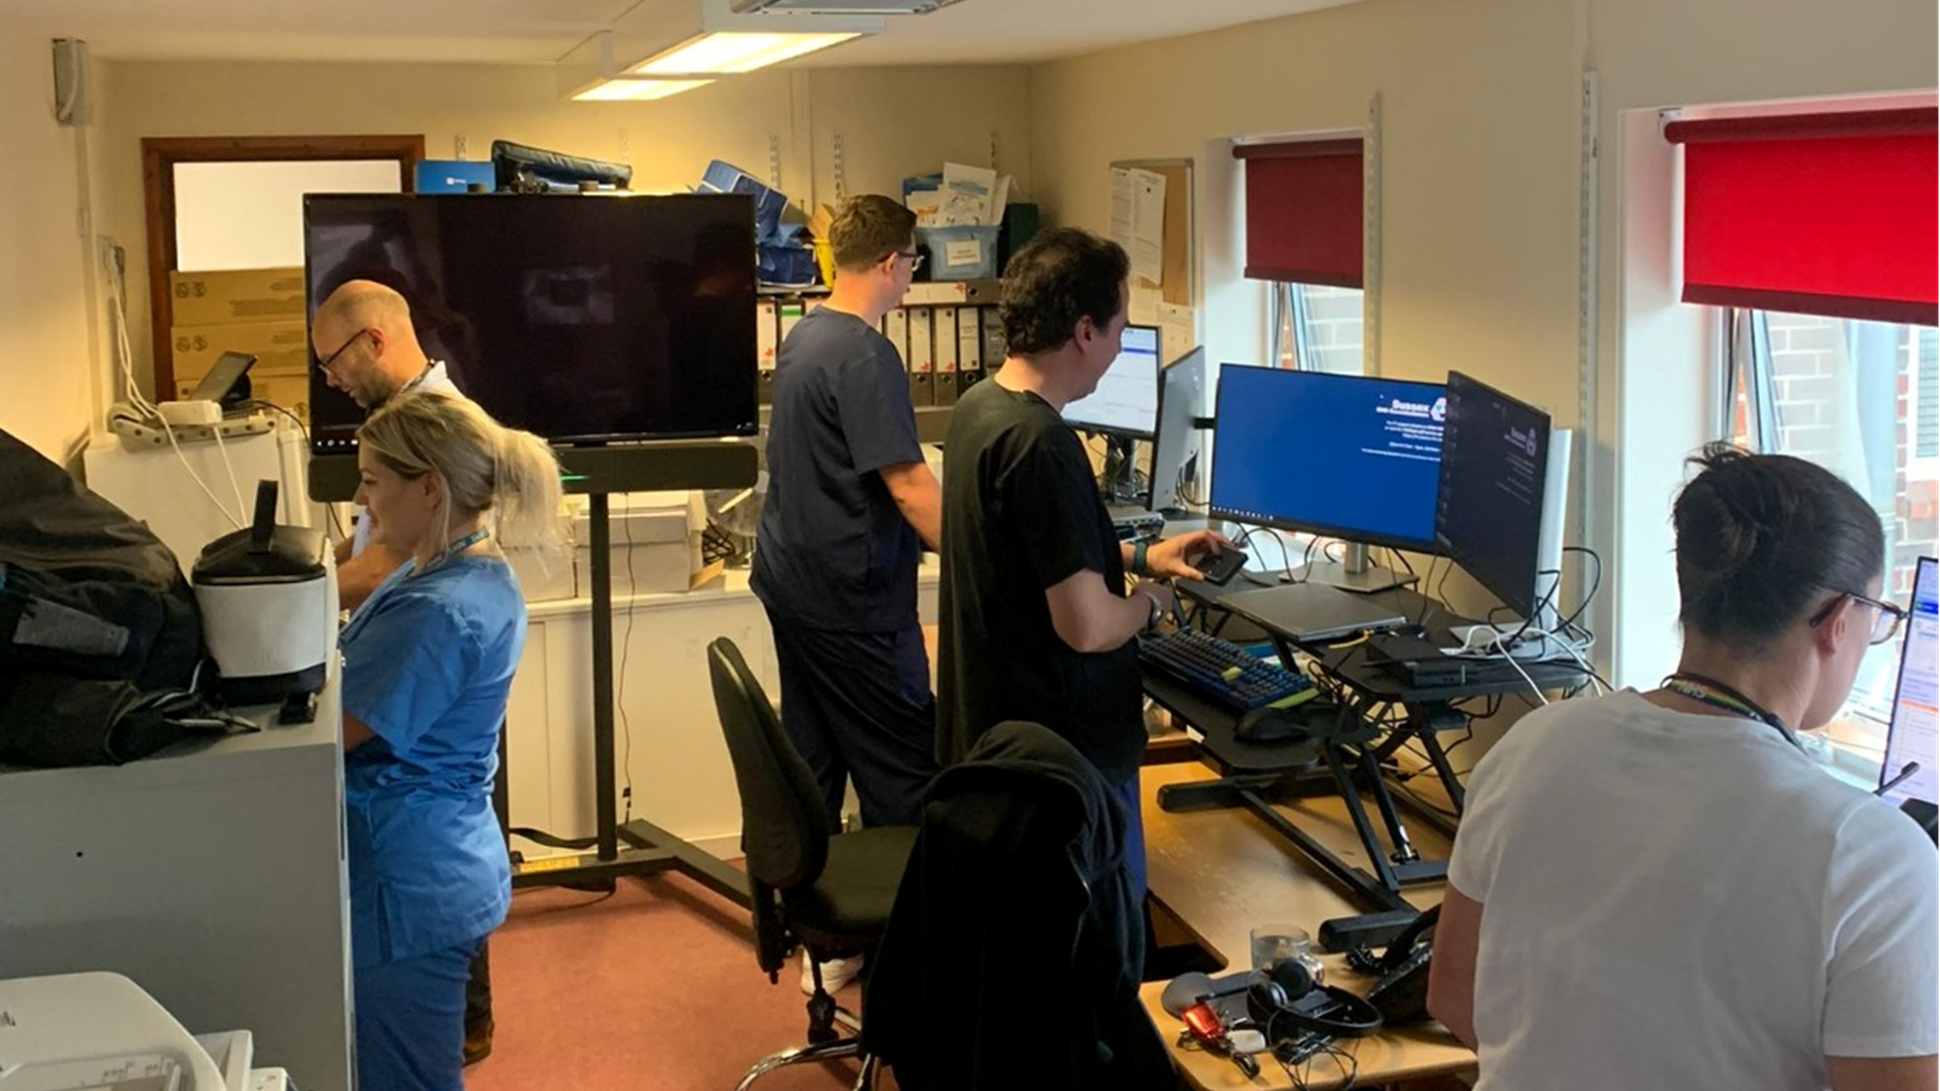
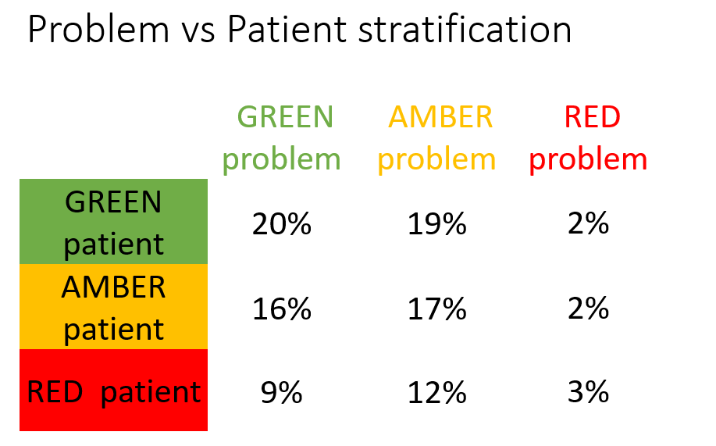
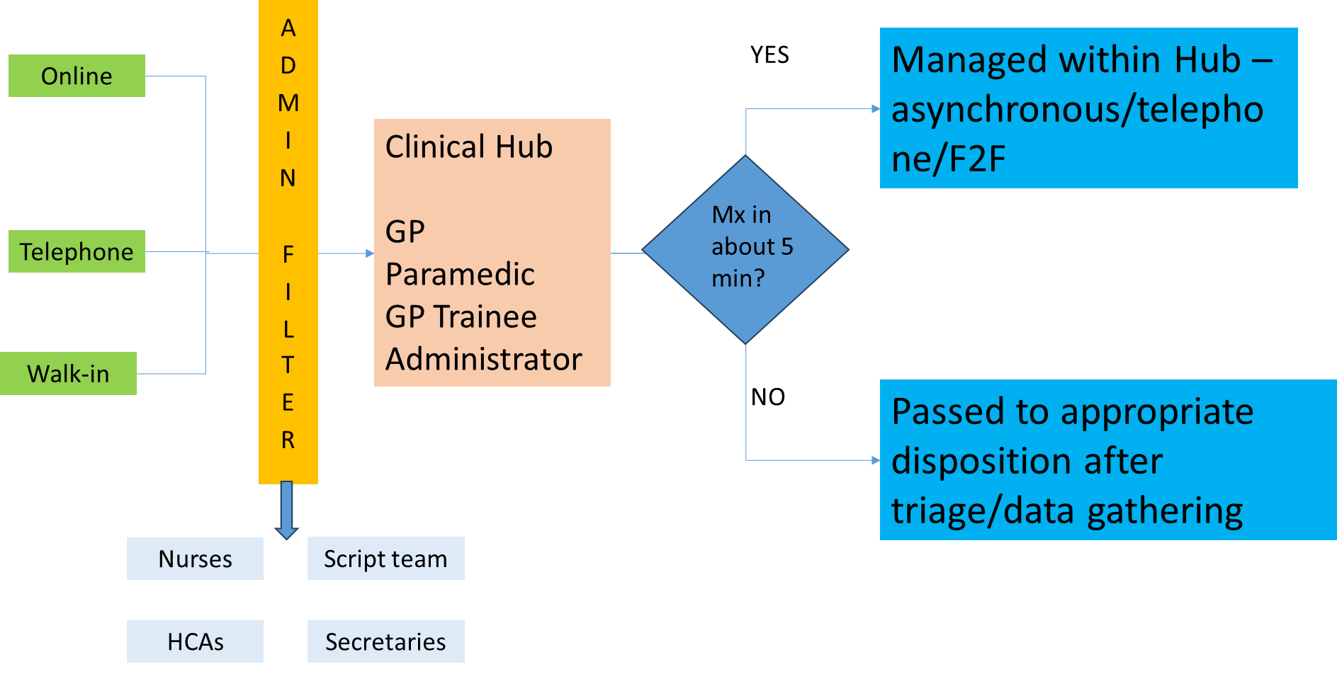
Modern General Practice working - Clinical Hub
Sussex – Light House surgery
Lighthouse Medical Practice supports around 17000 patients in Eastbourne, East Sussex. Modern General Practice is one of the key components of the Primary Care Access Recovery Plan (PCARP) delivery plan. Like most practices, Lighthouse has been managing greater demand in recent years and has been looking to move away from traditional methods of meeting demand. Taking a phased approach to ensure patient safety and build the confidence of staff in the new model, they have established a clinical hub. The clinicians in the hub can reach out to people asking for medical help, mainly through asynchronous methods like SMS, and ask questions to determine the best way to address the patients’ needs. They then decide whether it should be managed in the hub or passed to other internal or external clinicians. A standard audit template is completed which records the different problem types encountered - RED (will be >15 mins to manage/continuity crucial), AMBER (c.10 mins to manage, continuity preferable) or GREEN (c.5 mins to manage, continuity not important). This helps to inform staffing and skill mix. Regardless of how people contact the practice, they are all managed through the same process, reducing the risk of driving inequalities due to disparities in digital access or ability to get to the surgery.
Traditional care navigation is done by admin teams who in doing so take on clinical risk, and the potential frustration of patients who see them as a barrier. This model transfers all clinical risk to clinicians who can add value through managing problems rather than simply triaging, and by arranging appropriate tests before appointments. All patients get input from a doctor, and so when care navigation to another service is suggested, it is an easier conversation.
As well as facilitating more efficient patient flow, there are implications for the use of clinical space and for workforce satisfaction. The 4 clinicians and 1 administrator in the hub would normally have a room each. Now they are in the same room. This was real implications for the practice’s estates model. In addition, clinical staff have more time to share good practice between themselves, develop a standard approach, and provide close supervision of other clinical staff such as paramedics and GP trainees.
Early indications
Better management and understanding of flow, demand and disposition, segmented by patient complexity
A potential downward trend of people reattending with the introduction of the hub – suggesting they are more likely to receive the treatment and care they need first time
62% of patients surveyed (albeit a small sample) found the process better or much better than before
Less pressure on reception, which can be run remotely, due to faster disposition of calls

