Slide 1
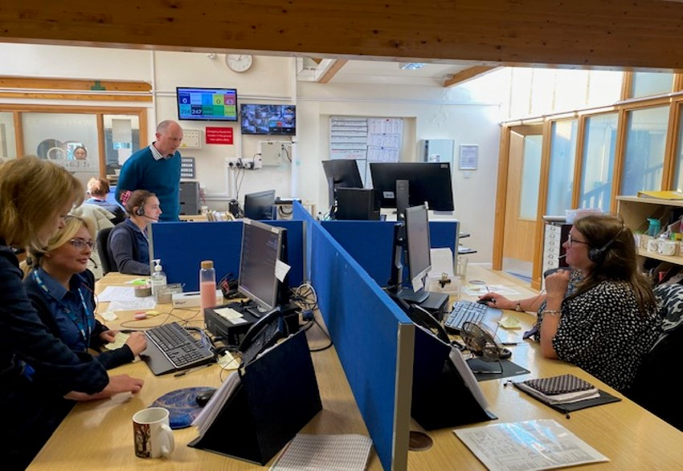
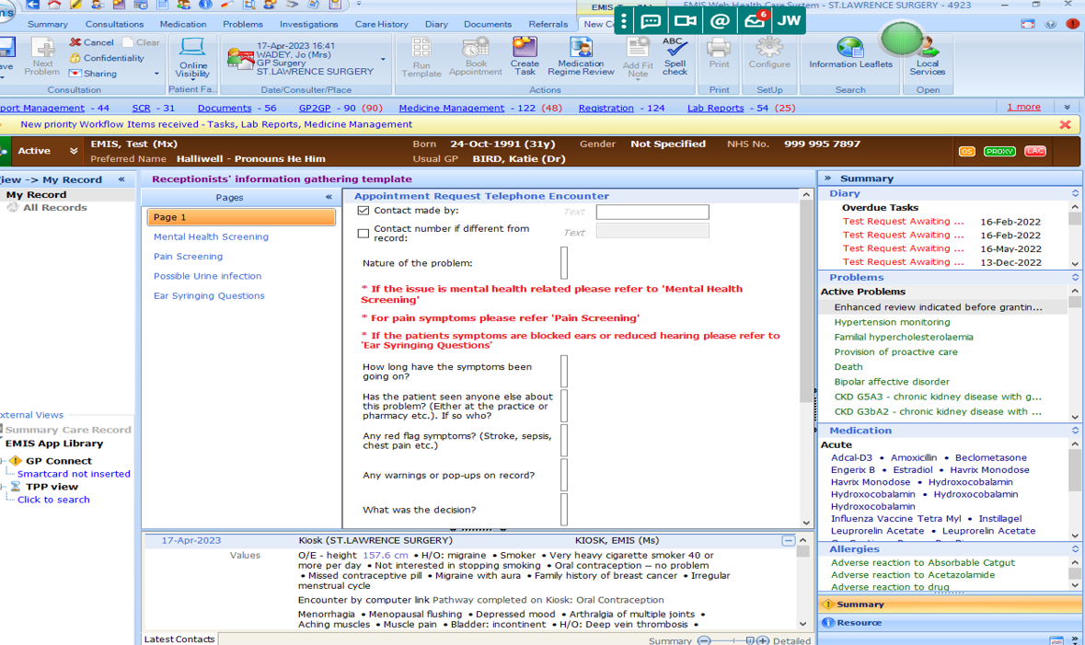
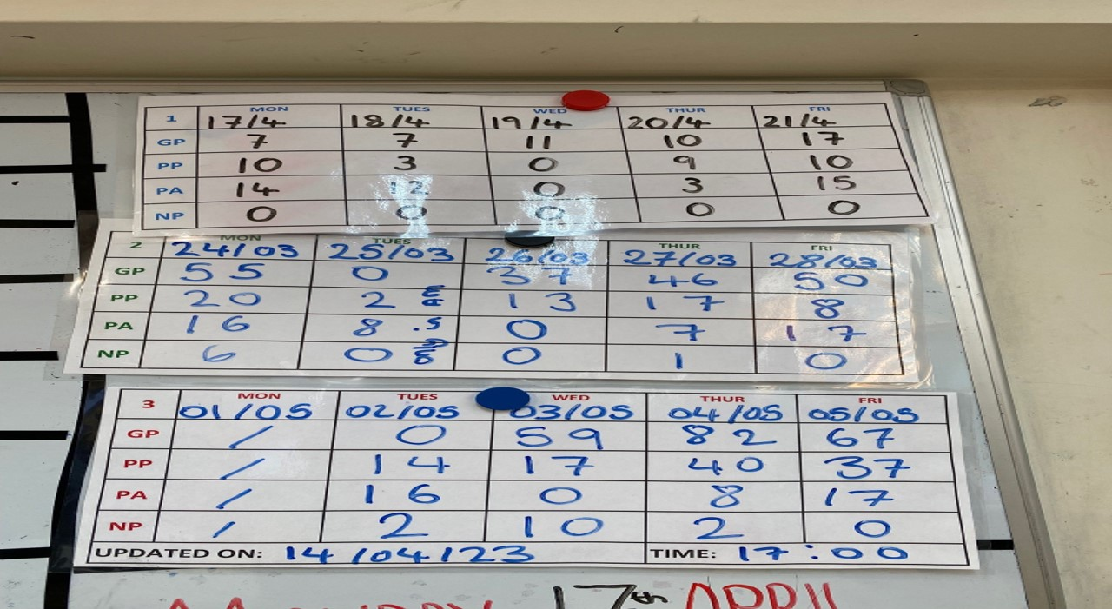
Modern General Practice working - Clinical Signposting
St Lawrence Surgery, Sussex
St Lawrence Surgery is based in Worthing, West Sussex, and represents 16,161 registered patients. It is part of Sussex ICB. Like most practices, Lighthouse has been managing greater demand in recent years and has been looking to move away from traditional methods of meeting demand. Modern General Practice is one of the key components of the Primary Care Access Recovery Plan (PCARP) delivery plan.
The Practice used Clinical Signposting as an effective means of moving towards the Modern General Practice Model, by implementing a GP in the main office with the patient services advisor team, to assist with clinical signposting, helping patients get to the right service at the right time. They also implemented a new telephone system that allowed them to better interrogate their call data. The Practice began a process of running their telephone and appointment data and mapping it against their workforce. They began a large-scale change management program and ultimately implemented a GP in the main office with patient services advisors in December 2019. Using this system, and the forms they have set out for patient services advisors to complete during calls, a patient services advisor can take details of the patient and the nature of their call, plus any relevant details, history, etc. and then raise a hand for the GP to assist, look at the information and make a clinical decision. Patients are signposted to the correct member of the clinical workforce as necessary, and appointments can now be booked up to three weeks’ ahead.
This new way of working required some considerations, including guidance/pathways for the patient services advisor team via the patient forms they complete (i.e., for pain, UTI’s, mental health, etc.). Due to the full-on role for the GP in the main office, shift changes with other GPs are required at regular intervals.
Their data has evidenced that, apart from post-weekend, the 8am call volumes have decreased, meaning more patients are able to get through to a patient services advisor more quickly, facilitating more efficient patient flow. The patient services team are also much happier, and patients are very satisfied with the service provided. National Patient Survey results showed improved patient access to the surgery and improved patient experience. It has also been noted that clinicians are being utilised more effectively and not treating minor illness or other pathways that can be delivered by other members of the clinical workforce. GP activity proportionally dropped by 1% through assignment/sign-posting to other clinicians; and this re-assigned work increased Paramedic activity by almost 1,600 interactions.
Early indications
The number of patients being seen by the surgery increased by 10%;
There has been a 24% reduction in GP triage time;
An 8% increase in pre booked GP telephone calls;
The number of times patients were seen multiple times reduced; their problem was delt with more efficiently on the first visit;
Reduced pressure on reception in the morning as patients could still get an appointment later in the day;
An almost perfect match between the ideal destination for the patient and actual destination for the patient (for example a patient ideally being seen by a GP and that patient was able to access the care they needed).

