Slide 1
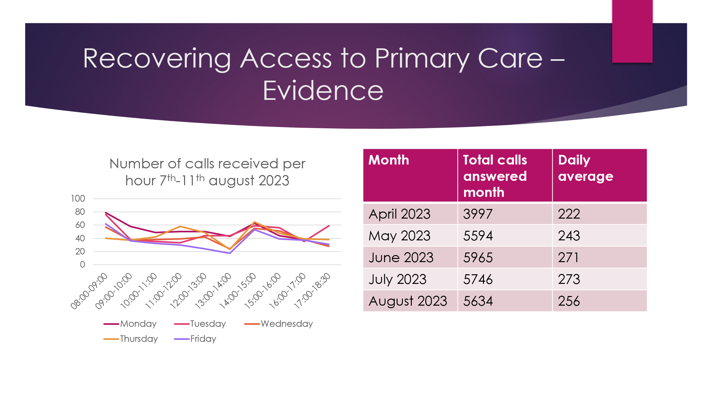
Modern General Practice working – GP Signposting
Fitzalan Medical Group, Littlehampton
Fitzalan Medical Group supports around 16,000 patients in Littlehampton, West Sussex, of whom 11,000 classify as IMD score 1. Like most practices, Fitzalan has been managing greater demand in recent years and has been looking to establish new methods of meeting demand. Modern General Practice is one of the key components of the Primary Care Access Recovery Plan (PCARP) delivery plan.
The challenges that led to the practice taking on this improvement work included some national level challenges such as appointments almost always beign fully booked by 8:30am; but also some challenges specific to the practice such as the closure of another nearby practice which saw Fitzalan Group take on an increased registered patient list, the retirements of senior 5 GP partners and GP recruitment challenges following this. These challenges combined created resource pressure, with GPs exhausted and excessive pressure on reception staff creating a poor patient experience which led to a negative CQC rating.
The practice decided to implement a GP signposting model, whereby a GP directly oversees and influences the care navigation team at the time that patients’ make initial contact with the surgery, to improve efficiency of access to correct care pathways first time, and create resilience by allowing for flexibility of the system as needed on a day-by-day basis. With the assistance of on overseeing GP, the care navigation team are able to effectively signpost patients to the right community or secondary care resource if appropriate, to a nurse practitioner for tests before seeing a GP, or to a GP either via telephone or face to face appointment as needed. They can also make direct administrative referrals for letters, etc., reducing the need for a patient to make an appointment to do so. The team are also trained to advise patients of alternative resources for making requests such as their website or the NHS App.
To deliver this successfully, the practice’s existing safety processes continued as usual, but were supplemented with the additional safety procedures:
Enhanced safety processes for clinical governance for the varied skill-mix of professions
Enhanced training for involved clinicians
GP designed protocols
Immediate and long-term audit and oversight by clinical governance team
Audits specifically review the accuracy of the clinical result to ensure correct clinical signposting decisions
The practice has also developed strategies and policies to support this model, considering effective community integration, addressing health inequalities, use of digital and effective training and team building for the workforce.
Early indications
A 49% increase in calls answered in June 2023 compared to April 2023.
Around 1,000 more online contacts in January 2023 compared to January 2022
Friends and family ‘satisfied’ patient percentage rose to highest levels ever in 2023 (91% year total)
GPAD data from 11th Nov 2023 showed percentage of appointments within 2 weeks of contacting GP as 79%

