Slide 1
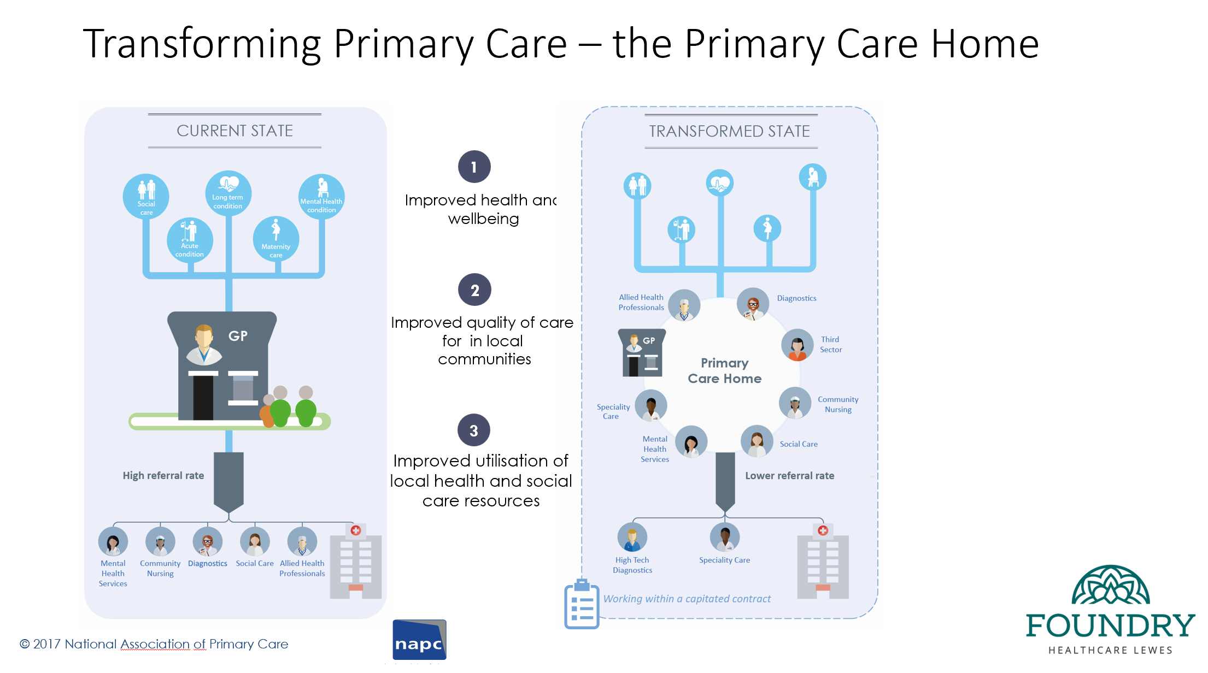
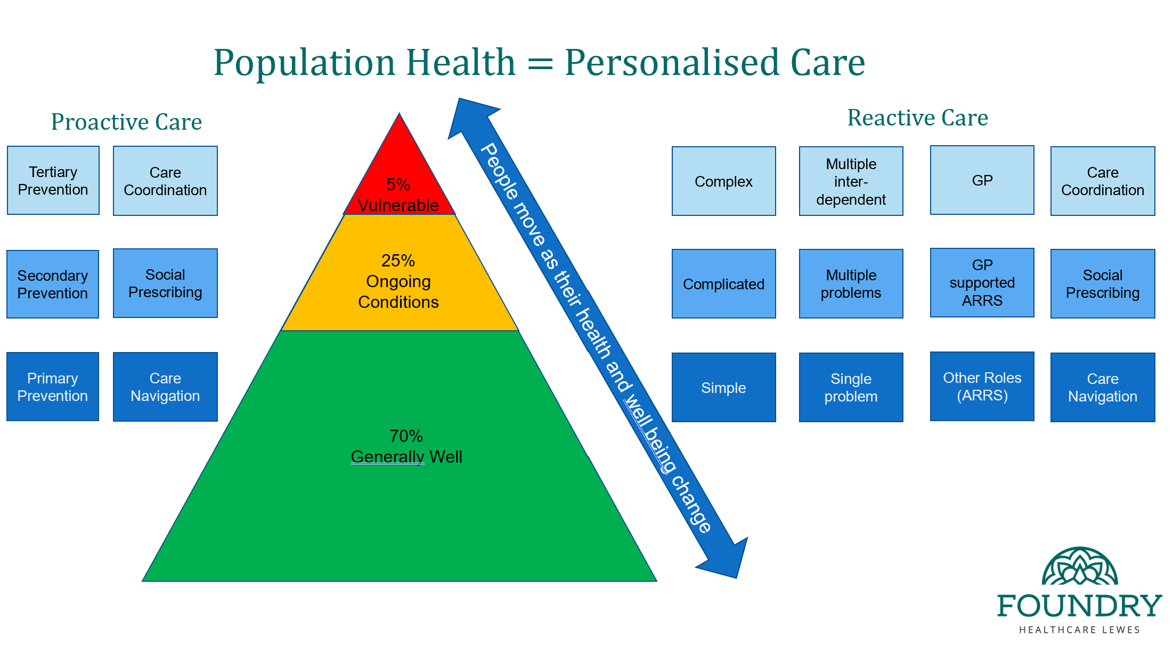
Modern General Practice working – A population health approach
Foundry PCN, Lewes - Sussex
Foundry Healthcare Lewes are an NHS Primary Care Network made up of 4 Lewes surgeries who have come together to improve GP and other healthcare services in Lewes and surrounding areas. Like most Practices and PCNs, Foundry has been managing greater demand in recent years and has been looking to establish new methods of meeting demand. Modern General Practice working is one of the key components of the Primary Care Access Recovery Plan (PCARP).
Taking a phased approach to ensure patient safety and build the confidence of staff in the new model, they have established an acute primary care hub that includes Allied Health Professionals, Diagnostics, Mental Health services, Community Nurses, Third Sector organisations, Social Care and Speciality Care – ensuring that patients see the right clinician at the right time. They have done this by making one of the four practices in their PCN a multi-disciplinary hub, housing all of the above. This helps reduce unnecessary time wasted for GPs (for example seeing a patient before any diagnostics have been carried out) and also helps reduce the high referral rate into diagnostics, mental health services, social care and community nursing, as these services are available and can be contacted in-house. The PCN has been able to do this efficiently, by using data from its e-rostering system to evidence change and inform workforce and rota planning as required.
This model adds value by giving Allied Health Professionals an opportunity to see the patient first - managing problems rather than simply triaging, with the ability to conduct appropriate tests before GP appointments. Continuity of care was considered for patients with long-term conditions, complex needs and/or serious comorbidity or frailty. Those patients were grouped into red and amber groups which signalled a higher requirement for continuity of care.
As well as facilitating more efficient patient flow, there are implications for the workforce also. Clinical staff have more time to share good practice between themselves, develop a standard approach, and provide close supervision of other clinical staff such as paramedics and GP trainees.
Early indications
Reduced the number of avoidable appointments to 6.5% compared to an average of 27%.
Top 5% of frequent attenders only use 30% of GP Consultations compared with 40% elsewhere
FFT results over previous 3 months - 76% ‘Excellent’ + 12% ‘Good’ experience;
Access Improvement Programme (outreaching to Patients in order to communicate Foundry model + regularly surveying patients around their experience);
Improved staff retention – 4% turnover;
Create a sustainable financial model;
Created an organisational culture of continual improvement.

