Slide 1
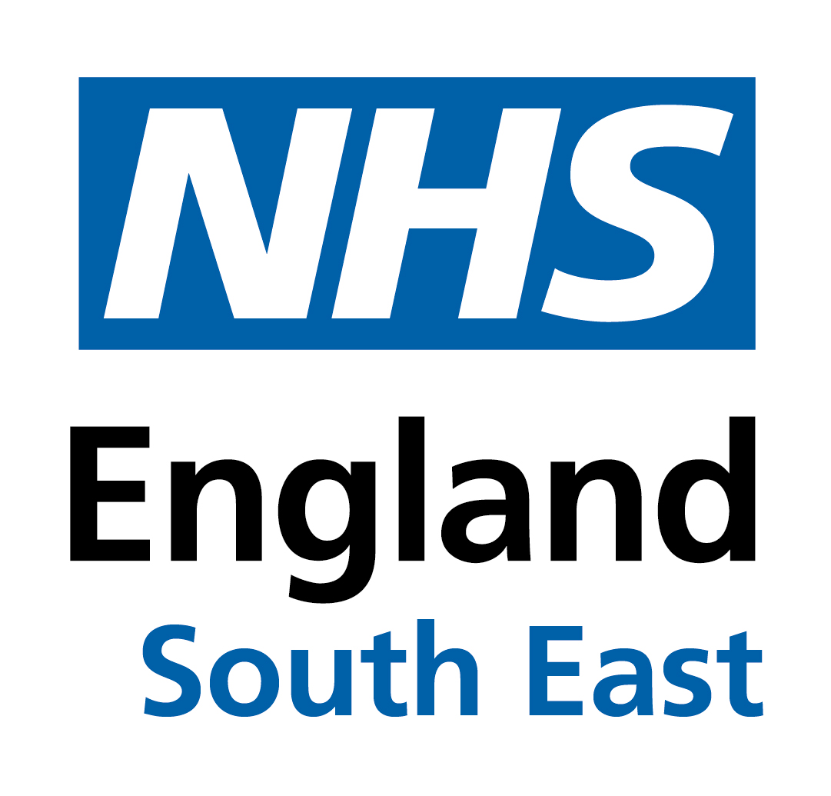
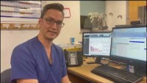
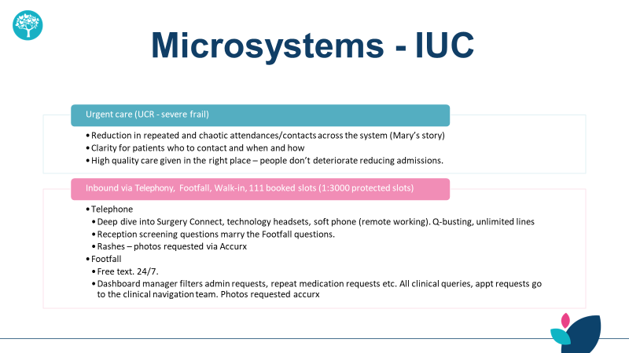
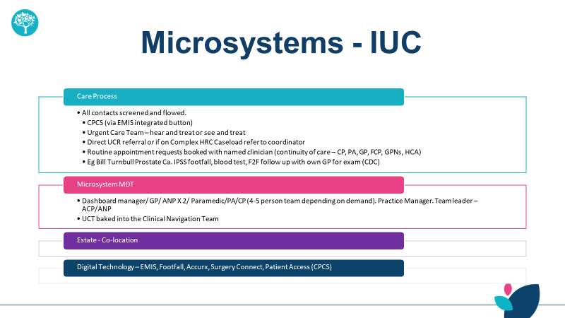
Surrey Heartlands- Greystone House surgery
Integrated primary care Model - Surrey Heartlands Health and Care Partnership
Aligned with the Fuller Report and ensuring actioned to the national Primary Care Access Recovery Plan and Modern General Practice, the ambition and vision for the Surrey Heartlands Health and Care Partnership is:
Developing effective integrated and coordinated pathways starting from the patient’s home and the high street, ensuring demand is appropriate across care channels
Promote the neighbourhood partnership model of working, ensuring different disciplines learn to work together seamlessly
Streamlining access to care and advice by reviewing current access channels and associated challenges and utilising various mechanisms to best streamline patients / citizens
Delivery of Place Partnership plans within desired delivery timescales
Ensuring all services have access to the same channels, enabling seamless transfer between services for patients
Greystone House Surgery offers services to over fifteen and a half thousand patients and is situated across Redhill, Riegate and Merstham in East Surrey, which is an economically and socially diverse group of patients. Merstham is one of the more deprived areas in Surrey. Like every general practice, there is struggle dealing with on the day demand and how the practice deals with that as efficiently as possible to ensure the patients get the level of care that they require but also that the practice delivers a sustainable service to doctors, nurse practitioners and team.
Greystone House Surgery implemented a model which separated out routine care and urgent care by creating a dedicated team which includes:
Care navigation in place ensuring the patient is offered the right care when needed
Capability to access data and assess performance
Resilient team determining immediate attention, more acute, same day service and which are more routine and complex matters best served by the GP team or dealt within the anticipatory care hub
Administrative online platform that allows for single access to move required work to the clinical work list
Pharmacy offer in place for patient ensuring process is safe and validated allowing patients to be seen on the same day booking patients into pharmacy at time of choosing
Offer a patient platform allowing patients to access practice at any given time seven days a week
Easier access for patients on Mondays when there is a back log of patients offering patients easier access
Ability to gather data to access performance via online portal platform that is available 24 hours a day
Complicated and frail patients are dealt with by care coordinators and the anticipatory care hub for continuity of care for the more complex patients
Introductory video
The benefits of this new way of working has been the offer of a more holistic multi-disciplinary approach for the patients as they are now able to receive care from different specialties via different inputs with advanced nurse practitioners playing a key role, clinical pharmacist with their medicine knowledge and GP oversight teams working together in one space that helps the team deliver clear cohesive face-to-face human contact about certain scenarios saving tie for practice and patients offering a more efficient patient access pathway to the surgery.

