Slide 1
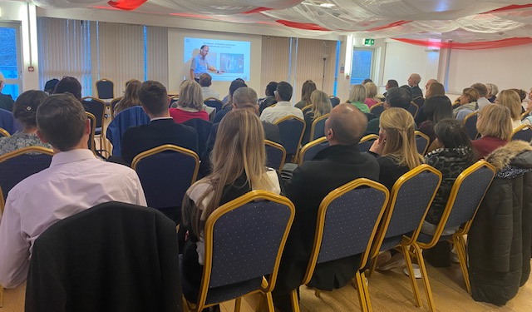
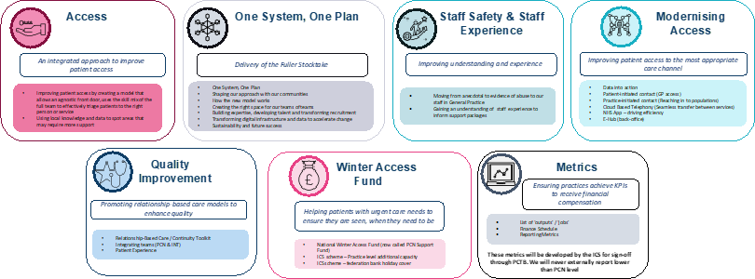
Surrey Heartlands- Modern General Practice - General Practice Development Toolkit
The challenges faced by the health and care sector are greater today than they have ever been, with a gap between the demand for health and care, and what is currently able to be delivered. In line with the Fuller Stocktake, there is a need to radically modernise the design and delivery of health and care now and in the future. Building upon previous work undertaken across Surrey Heartlands, there is now a need to focus heavily on two key areas that matter most to local communities; making it easier to access care patients need, when they need it and creating the space and time for clinicians to provide the continuity of care that is so important to patients.
The Surrey Heartlands General Practice Development Toolkit is a local programme that has been developed to encourage GPs to proactively deliver efficiencies within their practices. It is a package of support including three face to face workshops followed by dedicated practice level support and review by a local team to implementing the learnings from each workshop.
Key areas of focus within the Toolkit include the modernisation of general practice (e.g implementation of online triage and remote consulting), optimisation of digital solutions (e.g. cloud-based telephony), exploring “at scale” Primary Care with a view to enhancing the experience of staff and patients alike. Each cohort of practices running through the Toolkit programme have dedicated leads from the ICB Primary Care Team as well as a Teams Channel specific to their cohort with information, notes and opportunities to network. In addition, speakers at the workshop sessions are led by local practices who have undertaken changes or in the midst of a change. This ensures that the challenges and successes of implementing new models are undertaken with a dedicated group of peers to help support along the journey.
This programme has been spearheaded from within Surrey Heartlands and is the culmination of years of discussion with local practice teams to understand what is really needed to support change. Although subsequent national offers to practices as part of the Primary Care Recovery Plan (General Practice Improvement Programme) are now available, the Toolkit is being held as the Surrey Heartlands response to supporting recovery and innovation within general practice locally. It provides an opportunity to both deliver against the Fuller Stocktake, with consistent ICB guidance, whilst allowing for autonomy of delivery by each local practice.
The programme workshops sessions are delivered in three waves and below you will find video content to each session.
Programme Update
98 of 101 practices have participated and are actively engaged
21 face to face workshops delivered to practice ‘waves’ (Aug 2023 – Feb 2024) across the initial phase of the programme
The second phase of the programme (Dec 2023 onwards) will have visits from the ICB team take place to follow up 'action-plans’ focusing on future transformation taken from the conversation.
Programme Resources
Modernisation of General Practice Resources is a platform that has been developed to provide the tools, resources, and information to support with transformation within General Practice following the workshops.
More information on the ICBs delivery of the development toolkit sessions can be here.
Workshop 1 - Patient initiated contact
Switching to total clinical triage at The Grove
How clinical triage works
Digital consulting vs triage
Feedback from local practices
“We look after very elderly population, there was always been the impression that our patients wouldn't use digital. But you know, we've been proven wrong. Our elderly are actually very keen on using digital means to get in touch with us and for the first time in I've been here now 13 years, we actually have appointments to give out in the afternoon, which we've never had before.”
“I've actually managed to spend a bit of time doing a bit of a deeper dive into our particular cohort [of persistent attenders] at my practice. It's really fascinating that a relatively small proportion of your list could be using about 1/4 of your appointments and that's pretty standard across the practices.”
Workshop 2 – At scale access and persistent attenders
Persistent Attender
“The main thing about the programme is really just appreciating each practice culture is different, but there are some really common things and solutions that we can share, but certainly, the total triage and the opportunity [it] offers for continuity of care has been the biggest thing for us”
Workshop 3 – Practice initiated contact
Proactive care
Long Term Conditions

