Slide 1
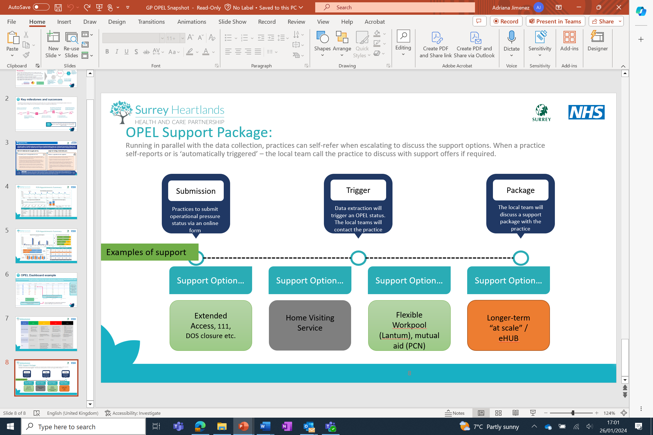
Surrey Heartlands Health and Care Partnership General Practice Opel Reporting
The challenges faced by the health and care sector are greater today than they have ever been, with a gap between the demand for health and care, and what is currently able to be delivered. In line with the Fuller Stocktake, there is a need to radically modernise the design and delivery of health and care now and in the future. Building upon previous work undertaken across Surrey Heartlands, there is now a need to focus heavily on two key areas that matter most to local communities; making it easier to access care patients need, when they need it and creating the space and time for clinicians to provide the continuity of care that is so important to patients.
Building an Operational Pressures Escalation Level (OPEL) dashboard for Primary Care has helped to identify rising pressures and to direct resource to where it is most needed. This framework has now been adopted across the South East region.
The problem is that there is lack of accurate and timely data to give a ‘true picture’ of demand and capacity across Surrey Heartlands ICS. As a result, resource allocation and planning was challenging, and ineffective and patient experience was negatively impacted
Surrey Heartlands developed a solution to introduce OPEL reporting into Primary Care to enable system-wide visibility of pressures from Primary Care across Secondary Care with the aim to connect these data sets in the future. The development of the OPEL framework was introduced to manage surges and peaks in demand and the risks associated. Across Primary Care escalation thresholds and plans were introduced to proactively manage surges in demand and to clarify roles and responsibilities and communication flows.
Practice support package
This initiative has been moving at pace with a focus on continuous improvement and increasing the number of data sets to support the aim of having a true and accurate picture of demand and capacity across Primary Care. Key milestones and successes include:
ICS/Place level dashboard and PCN dashboard built
Data uploaded daily into Foundry
Data from dashboard feeding into key meetings, such as SOC
Workforce and Practice Submission forms created
New datasets onboarded into Foundry including age bands and additional appointments data
111 data/LIVI/IA data is onboarded into the tool
Continued development
Of OPEL dashboards and web tool for practices
New data sets will continue to be added and there is ongoing work to support practices with comms and to provide local support for OPEL.
Opel Dashboard Example
Identifying trends and understanding local population demographics and behaviours
Better collaboration across PCN’s and ability to control known capacity and demand factors (annual, sickness and maternity leave, winter pressures etc)
Benefits
Improved patient journey through improved scheduling and booking, reduced backlog of patients
Pro-active planning to effectively managing demand and capacity
This model enables the future vision of primary care to be able to access timely and accurate demand data, allowing for effective resource planning and the safe operational management of any escalating pressures resulting from either a surge in demand or depleted capacity. At a regional level, NHSE/I will be able to clearly quantify the demand on our primary care systems, highlighting where systems may be under-resourced and supporting the delivery of effective demand and capacity planning to ensure a safe, sustainable and high-quality primary care service.

