Slide 1

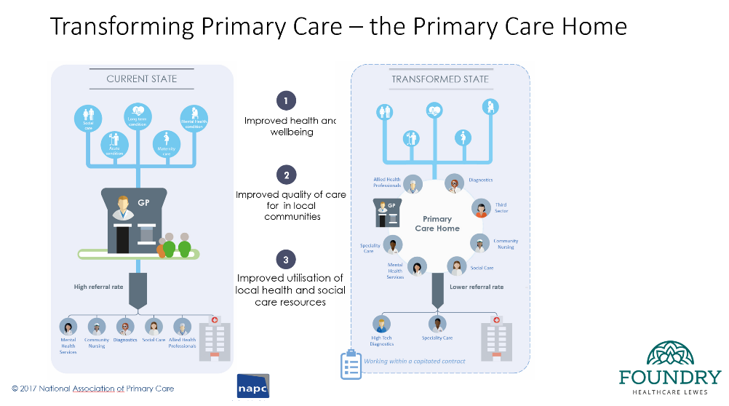
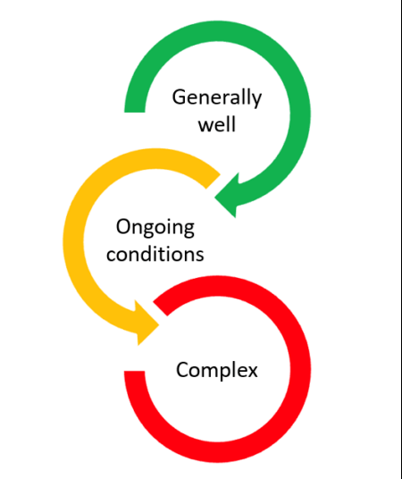
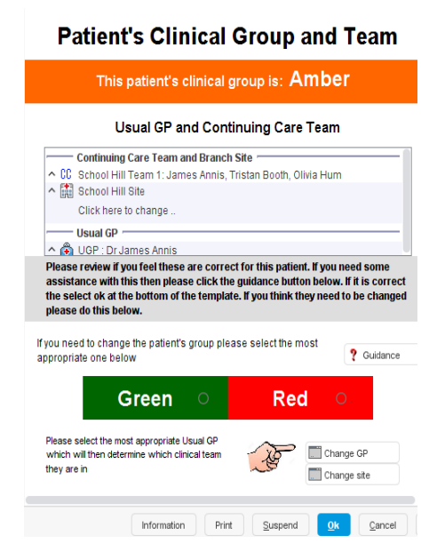
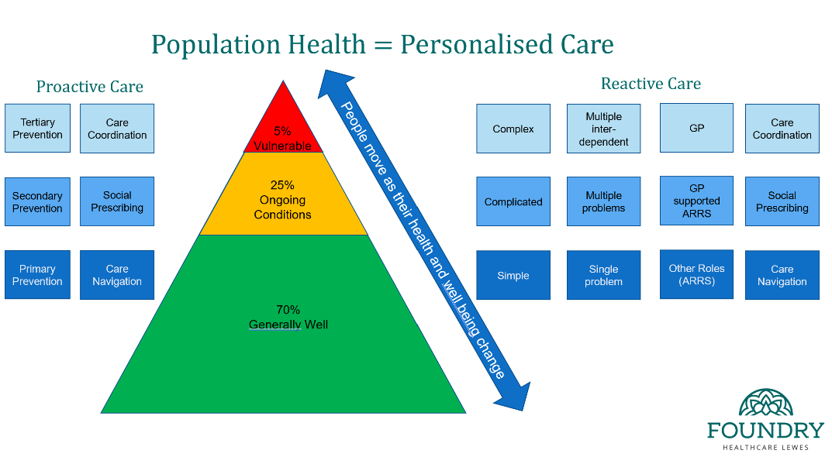
Modern General Practice working – A population health approach
Foundry PCN, Lewes - Sussex
Foundry Healthcare Lewes is a single Practice Primary Care Network made up of 4 surgeries in the Lewes and Ringmer area of East Sussex. The Practices initially came together through their involvement in NAPC’s Primary Care Home programme and their collective vision to create a more preventative, proactive and integrated approach to managing their 28,500 patients.
Foundry introduced a methodology for segmenting patients according to their clinical need/social complexity and prioritising continuity for those patients who need it most. They found traditional search-based approaches time consuming and retrospective and therefore developed their own tool, creating a real-time, clinician-led system where patients are dynamically categorised as Red, Amber, or Green at the end of each consultation. This simple yet powerful model (can be integrated with Systmone and EMISS) allows practices to proactively manage continuity of care, engage the whole team in decision-making, and improve outcomes for both patients and clinicians.
Foundry operates a centralised clinical hub for triaging patients and meeting urgent on the day pulling in a range of multi-disciplinary professionals embedded within the team. This includes in-house paramedics, physiotherapists, mental health workers, clinical pharmacists, social prescribers and they also work in an integrated way with acute physicians, third sector organisations, community health and mental health providers. They are about to launch a pilot project integrating the Ambulance service with their extended frailty team. Red/Amber patients and those Green patients requiring episodic continuity, rather than being dealt with in the hub, are seen at their registered site with their named GP or another member of their site based team familiar with their background.
Foundry has since introduced Modern General Practice Model in its entirety including full (6.30am-6.30pm) on-line consultation since April 2024. This comprehensive understanding of demand now enables a far more intelligence driven, needs based and strategic approach to meeting need and planning/optimising practice capacity. To this end, Foundry has created a data insights dashboard which pulls together information across the range of operations including website traffic, phone lines, on-line consultations, clinical appointments requested and given, continuity and access metrics.
Foundry has also introduced a culture of continuous improvement, GPs and other clinicians are allocated weekly management time to lead on a range of clinical quality improvement programmes based on annually agreed priority areas such as frailty, diabetes, CHD etc. Training including in QI methodology, project management and change management qualifications are offered across the whole Foundry team.
Early indications
Reduced the number of avoidable appointments to 6.5% compared to an average of 27%.
Top 5% of frequent attenders only use 30% of GP Consultations compared with 40% elsewhere
FFT results over previous 3 months - 76% ‘Excellent’ + 12% ‘Good’ experience;
Access Improvement Programme (outreaching to Patients in order to communicate Foundry model + regularly surveying patients around their experience);
Improved staff retention – 4% turnover;
Create a sustainable financial model – driving up Partner profit.

