Slide 1

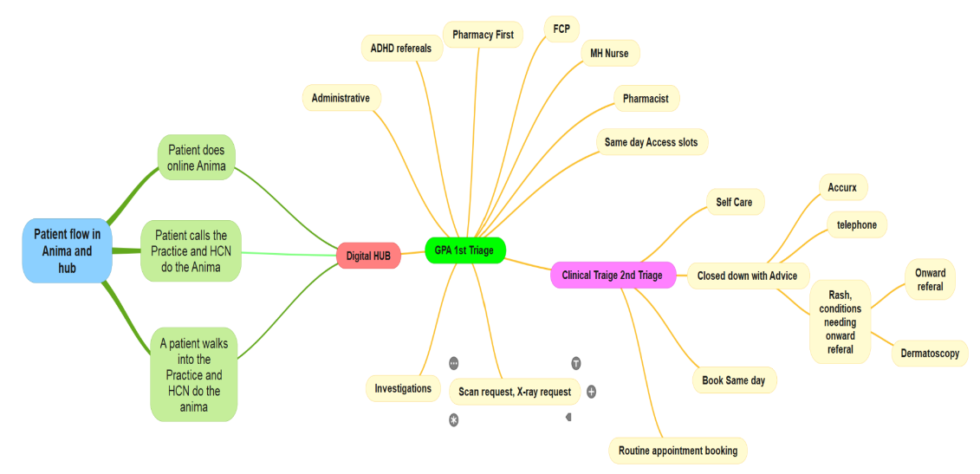
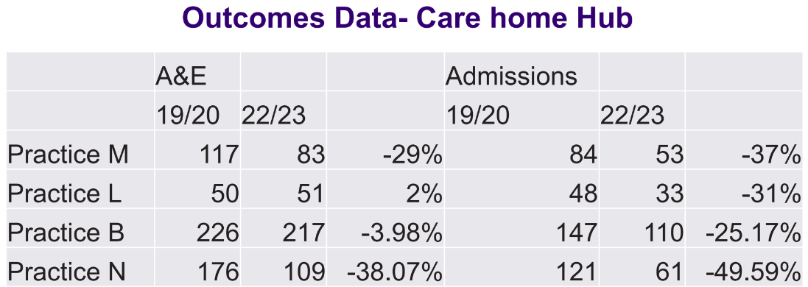
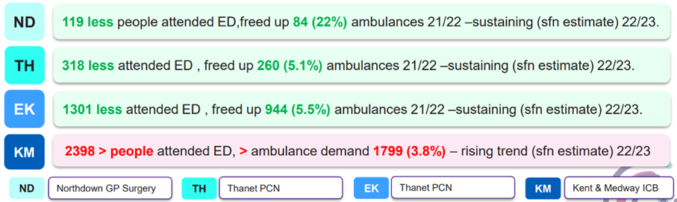
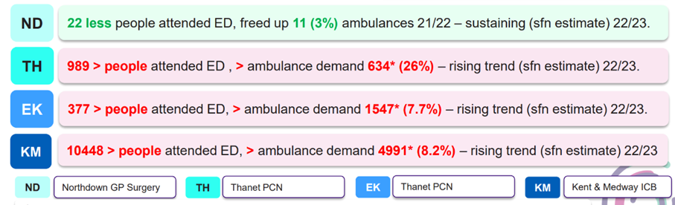
Northdown Surgery – Transforming Access & Care Models
Context & Drivers to support delivery of Modern General Practice
Ground Reality and Aim: Northdown was approximately a 10,000-size practice in Margate, and it is in the most deprived area of the Kent and Medway ICB, there were 2 GPs (one leaving), unsustainable model, merger failure, risk of contract hand-back. The aim was to align capacity with need, improve patient experience, and create a sustainable, modern general practice model.
Practice-Led Initiative: Inspired by the National MGP, refined locally with support from PAM Tim Chan (peer ambassador). Whole practice team engaged: GP assistants, Partners, Practice Manager, Operational Lead. PPG involvement secured through early engagement. Patient outreach via drop-in sessions at local church to explain and promote the changes.
Key Interventions:
Digital Front Door: Online consultation (OC) as the “front door” for the entire population; all first contact routed through this hub.
Care Home Hub: Dedicated team now covering 670+ patients across 27 homes (aim: 1,400 patients/69 homes). 94% of patients have TEP/Respect forms completed.
Workforce Expansion: From 2 GPs → 19 GPs; 2 partners → 6; 3 - GP trainees, diversified with ANPs, pharmacists and paramedics.
Roundhouse Model: “We see and sort it” approach, GP consultant on shop floor, trust-building open-door policy.
Impact
From closure to beacon: Once facing closure, the practice is now seen as a beacon of innovation and stability, leading on new models of care.
Sustainability (Feb 2024): Launch of the Digital Hub marked a turning point, showing the model could scale and sustain improvement.
87.6% reduction in GP workload from care home patients.
30% of online consults resolved at the hub, reducing pressure on clinicians.
Patient satisfaction at Northdown improved from 45% → 76% (2023–24).
Further Patient satisfaction: Friends & Family results improved from 90% positive (Feb 2024) to 94% positive (Aug 2025), with negative feedback more than halved from 7% to 2% in the same timeframe.
Significant reduction in ED attendances and admissions across older age groups.
Growth from 10,000 patients → 24,800 across two sites.
Digital Front Door - Workflow
80 Plus population
70-79 population
Learning & Enablers
Strong local leadership and peer support (PAM).
Whole-team engagement critical to culture shift.
Community buy-in via PPG and church sessions.
Scaling potential across wider Thanet neighbourhood.
Contact for more information: ashwani.peshen@nhs.net

