Slide 1


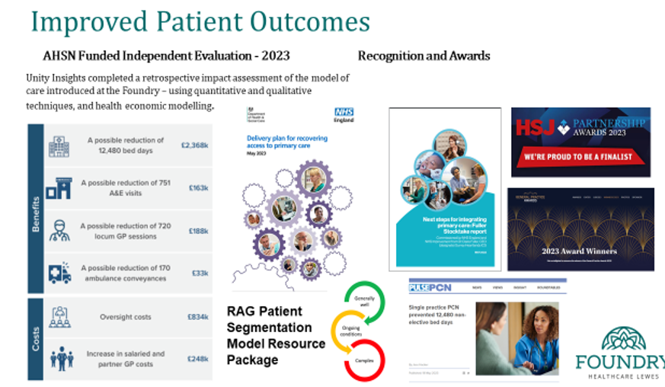
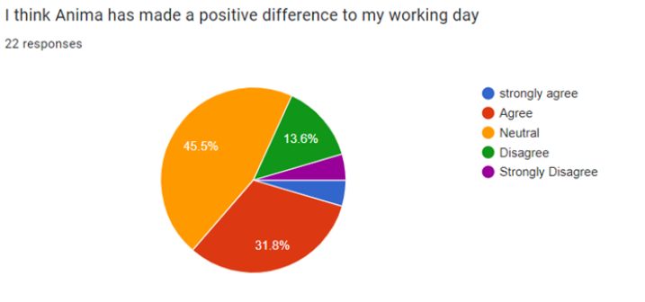
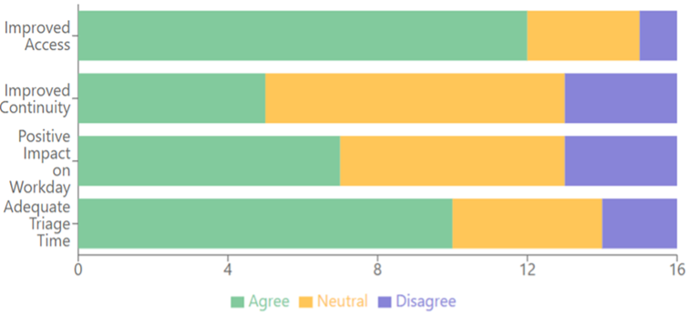
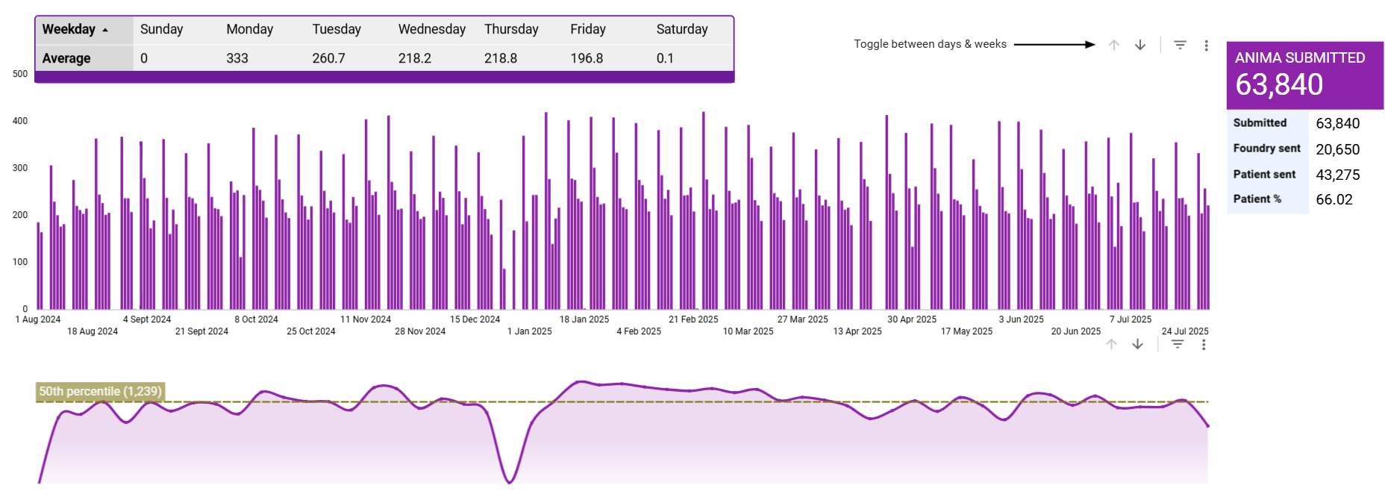
Intelligence Driven General Practice – Online Consultations Foundry Healthcare, Lewes (South East Region)
Foundry Healthcare is a single practice PCN serving 28,500 patients across Lewes and Ringmer. The population is older, with higher prevalence of long-term conditions, and relatively affluent with some pockets of deprivation. Formed through the merger of three practices, Foundry employs over 125 staff across four sites and is nationally recognised for its segmented, proactive model of care.
Feedback from patients made it clear that limited daily online consultation slots were frustrating, with availability often closing early in the day. At the same time, dissatisfaction with the first-come-first-served phone system placed strain on both patients and clinicians, with GPs often seeing patients who could have been managed more efficiently. Clinicians were also concerned that opening up online access might overwhelm the practice with unlimited demand.
In April 2024, Foundry introduced a full online consultation model to capture 100% of patient requests and provide a clearer picture of demand. The system runs from 6.00am–6.30pm, Monday to Friday, with Care Navigators redirecting patients to appropriate services such as Pharmacy First, administrative support, or long-term condition reviews. All requests are triaged by a GP, with urgent cases prioritised for same-day care and routine needs directed to the right professional within appropriate timeframes. GP rotas were remodelled to include protected triage sessions while reducing fatigue by limiting each GP to one triage clinic per day.
Alongside these operational changes, Foundry ran an extensive patient engagement programme with information on the website, in-surgery communications, newsletters, outreach events, and digital support sessions for those less confident with technology. Importantly, alternative phone and walk-in routes were maintained, reassuring patients that online consultations were an option, not a requirement. Foundry also implemented a demand and capacity tool (Tempo -currently operating in several practices across the country), enabling the practice to analyse total incoming demand, design rotas accordingly, and plan its workforce and skill mix more strategically.
Some of the clinical benefits included increased opportunities for appropriate redirection, which led to a significant increase in Pharmacy First referrals accepted, equivalent to 26 GP appointments a week. There were also more opportunities to complete required investigations beforehand, meaning that only one GP appointment was needed. This new way of working also optimised access and appointments making it more equitable and appropriately managed. There was no longer a first come, first served basis, access was improved for the most vulnerable patients, or those without online access, by reducing traffic to the telephone just to name a few.
Lessons learnt
25% of requests resolved at triage without a GP appointment
≈26 GP appts/week saved through Pharmacy First referrals
50% of urgent demand managed by paramedics, remainder by GPs
Continuity for high-need patients ↑10%
GP Survey 2025: 80% overall good (vs 75% national); 74% appointment good (vs 70%); 61% website easy (vs 51%)
Clinician survey: 36% reported OCs improved their working day; 75% said access improved
Demand remained stable — variation in capacity was the main driver of stress; minimum staffing levels and leave rules eased pressure
Maintaining phone and walk-in routes reassured patients and built confidence in the new model
For additional information, please contact Dr Hannah Burrage h.burrage@nhs.net

