Slide 1


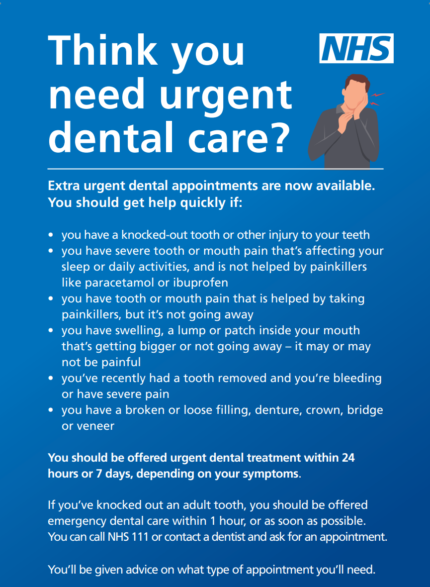


South East URGENT NHS Dental Care Communications Awareness Week
Why this matters
Government commitment: 700k additional urgent NHS dental appointments per year
South East allocation: 105k appointments annually
ICBs commissioning since April 2025 – performance improving but target not yet met
Key challenge: low public awareness of availability and eligibility
Aim
Increase public awareness and uptake of urgent NHS dental care appointments across the South East to support delivery against the regional target.
What we’re doing
Coordinated regional awareness week
Week commencing: 26 January
All ICBs communicating at the same time
Consistent messaging using shared regional assets as well as local assets
Campaign assets
Short & long-form video clips featuring Regional Dental Lead (practising dentist, Kent)
HIOW ICB dentist clips (urgent conditions)
Social media graphics & copy
Web and newsletter content
Campaign toolkit & suggested posting schedule
📅 Assets ready by: 21 January
Use in conjunction with national assets/toolkit
Key messages
Urgent NHS dental care is available locally
You don’t need to be registered with a dentist
Urgent care includes Severe dental pain; Facial swelling; Dental trauma/injury and Uncontrolled bleeding
Roles
Regional comms: assets, coordination, messaging, evaluation
ICB comms: local deployment, tailoring, partner amplification, recording activity
Success measures
Engagement with campaign content
Increased traffic to urgent dental care pages
Improved utilisation of commissioned urgent appointments
Channels
ICB social media & websites
Local authority & VCS partners
Local stakeholder amplification
Local and regional media
Week Of Action
Monday 26 January 2026 – 1 February 2026

