Slide 1

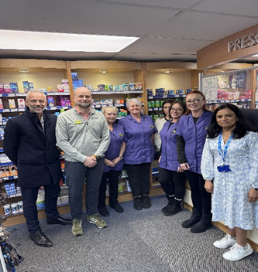
Copnor Pharmacy: Copnor Pharmacy Leads the Way integrating Primary Care Pharmacy
Copnor Pharmacy in Portsmouth is demonstrating how Community Pharmacy can play a central role in modern primary care. Located in an area with significantly higher levels of health and disability deprivation than the national average, the pharmacy has become a trusted frontline NHS access point, delivering high-volume vaccination programmes and consistently engaging early with new NHS services to improve access for residents.
What changed
Strong collaboration with Derby Road Group Practice, serving around 17,000 patients, has helped position Copnor Pharmacy as a key partner in delivering clinically led care in the community. Between February 2024 and November 2025, the pharmacy completed 1,429 Pharmacy First consultations, including 840 clinical pathway consultations and 589 minor illness referrals. Despite the transition from CPCS to Pharmacy First, referrals from general practice have remained strong, reflecting a high level of trust between clinicians across the local primary care system.
How services are being delivered
Rather than increasing headcount, the pharmacy has focused on upskilling its existing workforce. Technicians and pharmacy staff now support services such as blood pressure checks, contraception advice and Pharmacy First consultations, allowing Pharmacists to concentrate on clinical assessment. The addition of a second consultation room enables multiple services to run simultaneously, creating a mini multidisciplinary team environment within the pharmacy and improving patient flow.
Impact
This approach has strengthened the relationship between community pharmacy and general practice, improving patient access to care while helping reduce pressure on GP services. High uptake of services such as contraception and Pharmacy First consultations demonstrates the value of strong system communication and collaboration between the pharmacy, local practices and the Integrated Care Board.
Looking ahead
With strong partnerships already in place, Copnor Pharmacy is well positioned to play a greater role within Integrated Neighbourhood Teams. Future opportunities include expanding referrals for blood pressure monitoring and supporting local diagnostic services, helping to position Community Pharmacy as an accessible hub for preventative care, monitoring and early intervention within neighbourhood health systems.
Final Reflection: What Makes Copnor Pharmacy stand out from the rest:
Copnor Pharmacy stands out for its commitment to continually improving patient care and strengthening partnerships across Primary Care. By embracing change, building trust with local partners and embedding itself within the wider health system, the team demonstrates what modern, patient-centred Community Pharmacy can look like.
Owner Nicholas Felstead Owner/Pharmacist said: “Nicholas Felstead, Owner and Pharmacist said: "Up until now, it always felt like things were very GP‑focused. Today, it feels like community pharmacy is finally being seen.“
James Hempsted-Kingham, Regional Transition Director & Director of Primary Care & Public Health Commissioning, South East Region said: “Copnor Pharmacy has shown what true partnership in primary care looks like… they are setting a strong example for Community Pharmacy across the region.”
Hinal Patel, ICB Community Pharmacy Clinical Lead, said: “Integrating community pharmacy within primary care is essential to a sustainable health system, ensuring patients receive the right care, in the right place, at the right time.”

