Slide 1

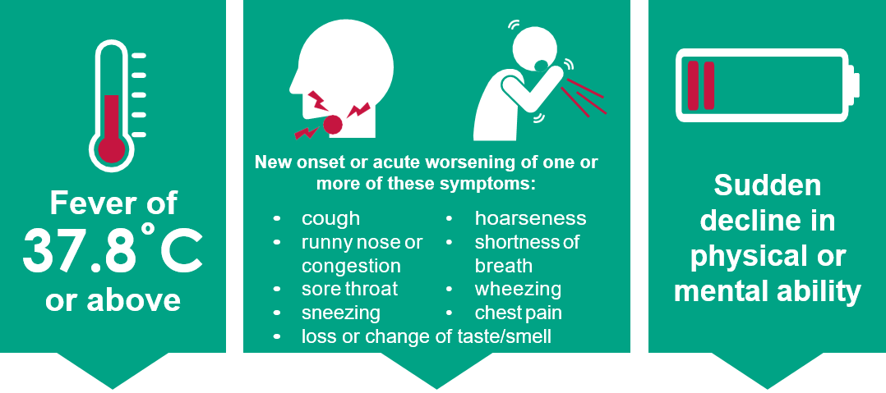

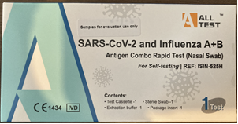
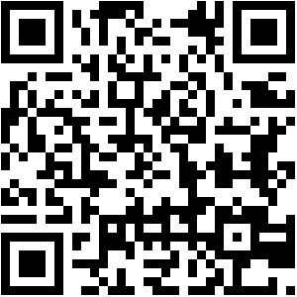

Flu and COVID-19 outbreaks
South East England adult social care residential settings
Do 2 or more service users have the following symptoms within 5 days of each other?
If yes, you might have an outbreak of COVID-19, flu, or other acute respiratory infection (ARI).
Support residents with symptoms to stay away from others; send staff with symptoms home
Test symptomatic service users with UKHSA supplied Combination Flu and COVID-19 LFDs. Residents eligible for COVID-19 treatments should be tested with a COVID-19 LFD available for free on the NHS from participating pharmacies.
Fill in the Report an outbreak tool
to obtain advice.
Our CQC Location ID:….....................
Combination LFD tests kept in: …………………………........................
Report your ARI outbreak:
Complete the web-based Report an Outbreak Tool via https://forms.ukhsa.gov.uk/ReportAnOutbreak
OR use the QR CODE
The UKHSA South East health protection team will review the information you submit and provide advice via email or a phone call to help manage the outbreak. Antivirals for confirmed or suspected flu outbreaks are most effective when started early.

