Slide 1
The how, why and what of telemedicine in care homes
– learning from a Care Homes Vanguard
Rachel Binks
Nurse Consultant – Digital & Acute Care
Airedale NHS Foundation Trust

Slide 2


Digital Health
Telecare
Telecoaching
Telemonitoring
Teleconsultation

Slide 3
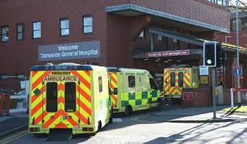

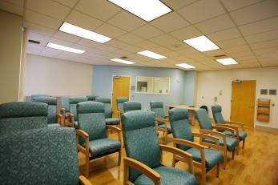
A system designed by default
Some people seem to do quite well without waiting for healthcare support…

Slide 4
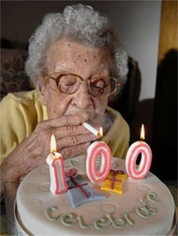

Slide 5

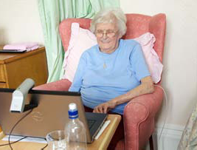
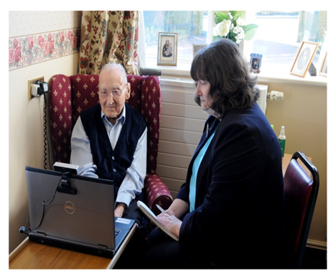

right care today
Teleconsultation
Prison health care
Care at home
Nursing & residential care
Supporting end of life patients
24/7 clinical hub
improving patient experience
changing patient flow
reducing costs
Electronic shared record
  connecting primary & secondary care now
  connecting whole health & social care economy tomorrow

Slide 6
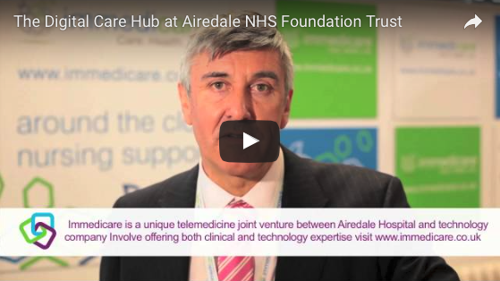
Video insight into our Telemedicine Service
http://www.airedale-trust.nhs.uk/services/telemedicine/

Slide 7

right time – care anywhere

Slide 8
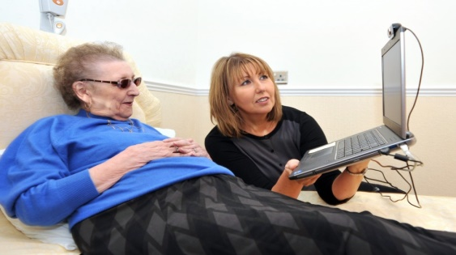
right place - replicable model
475 Nursing/Residential Care Homes + 50 in implementation
Supporting > 18,000 residents

Slide 9

Aims of the service
Provide, safe, effective high standards of care
To support residents to stay at home
Support residents/nurses/
carers in the planning
and delivery of care
Escalate to community
teams out of hours

Slide 10
Other services delivered from the digital care hub
Shared record
Registered practitioners
Visual contact
Gold Line
GP Triage
Intermediate Care Hub
Acute Care Team
Single Point of Access
Complex Care Team

Slide 11

Video insight into our
Gold Line Service
http://www.health.org.uk/gold-line

Slide 12
Data from End of Life Care Profiles PHE and district wide reporting (CSU)
 | National data England 2013 | AWC 2013 | Bradford District 2013 | Bradford City 2013 | GSF/Gold Line Year 2013/14
All deaths in hospital | 48.3 | 36.0 | 45.9 | 50.4 | 14%
All deaths at home | 22.4 | 20.1 | 24.5 | 23.1 | 41%
All deaths in care homes | 21.6 | 33.2 | 19.0 | 19.7 | 22%
All deaths in hospice | 5.5% | 8.8 | 8.3 | 4.6 | 23%

Slide 13
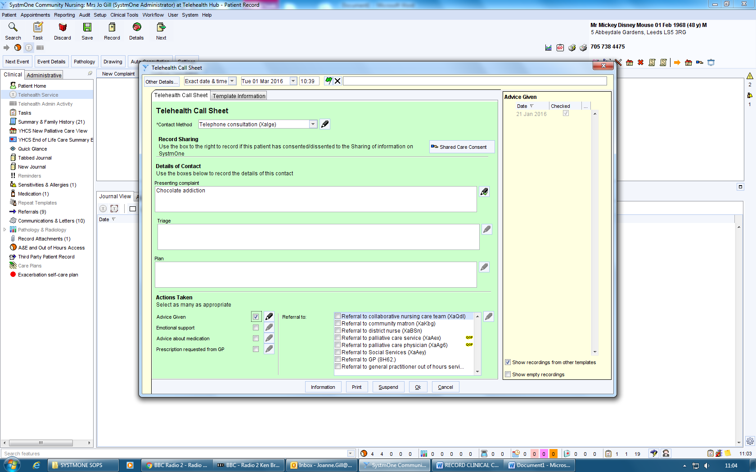
Call sheet

Slide 14
Reporting
Nursing Homes |  |  |  |  | Residential Homes
Day | Current Month | Last Month | % Variance | YTD | Day | Current Month | Last Month | % Variance | YTD
Monday | 128 | 85 | 51% ↑ | 213 | Monday | 194 | 153 | 27% ↑ | 347
Tuesday | 117 | 74 | 58% ↑ | 191 | Tuesday | 174 | 121 | 44% ↑ | 295
Wednesday | 83 | 83 | 0 ↔ | 166 | Wednesday | 152 | 121 | 26% ↑ | 273
Thursday | 76 | 79 | 4% ↓ | 155 | Thursday | 128 | 104 | 23% ↑ | 232
Friday | 88 | 108 | 19% ↓ | 196 | Friday | 145 | 160 | 9% ↓ | 305
Saturday | 106 | 107 | 1% ↓ | 213 | Saturday | 153 | 174 | 12% ↓ | 327
Sunday | 110 | 76 | 45% ↑ | 186 | Sunday | 197 | 108 | 82% ↑ | 305
Time | Current Month | Last Month | % Variance | YTD | Time | Current Month | Last Month | % Variance | YTD
Morning | 295 | 255 | 16% ↑ | 550 | Morning | 456 | 379 | 20% ↑ | 835
Afternoon | 413 | 357 | 16% ↑ | 770 | Afternoon | 687 | 562 | 22% ↑ | 1,249
Hours | Current Month | Last Month | % Variance | YTD | Hours | Current Month | Last Month | % Variance | YTD
In Hours | 344 | 329 | 5% ↑ | 673 | In Hours | 466 | 419 | 11% ↑ | 885
Out Of Hours | 364 | 283 | 29% ↑ | 647 | Out Of Hours | 677 | 522 | 30% ↑ | 1,199
Total | 708 | 612 |  |  |  | 1143 | 941

Slide 15
Reason for call
Nursing Homes |  |  |  |  | Residential Home
Purpose | Current | Last | % Variance | YTD | Current | Last | % Variance | YTD
Advance Plan/DNAR | 0 | 0 | 0 ↔ | 0 | 0 | 0 | 0 ↔ | 0
Agitation/Confusion | 0 | 0 | 0 ↔ | 0 | 0 | 0 | 0 ↔ | 0
Anxiety | 1 | 4 | 75% ↓ | 5 | 8 | 11 | 27% ↓ | 19
Bowel concerns | 0 | 0 | 0 ↔ | 0 | 1 | 0 | 100% ↑ | 1
Breathing difficulties | 18 | 14 | 29% ↑ | 32 | 31 | 17 | 82% ↑ | 48
Catheter concern | 12 | 10 | 20% ↑ | 22 | 26 | 22 | 18% ↑ | 48
Cerebral event | 1 | 0 | 100% ↑ | 1 | 0 | 0 | 0 ↔ | 0
Chest infection | 75 | 65 | 15% ↑ | 140 | 68 | 46 | 48% ↑ | 114
Chest pain | 2 | 0 | 100% ↑ | 2 | 7 | 9 | 22% ↓ | 16
Death | 0 | 0 | 0 ↔ | 0 | 0 | 0 | 0 ↔ | 0
Dehydration | 12 | 6 | 100% ↑ | 18 | 24 | 7 | 243% ↑ | 31
Emotional distress | 7 | 4 | 75% ↑ | 11 | 6 | 8 | 25% ↓ | 14
EOL Symptoms | 0 | 0 | 0 ↔ | 0 | 0 | 0 | 0 ↔ | 0
Eye Infection (eye) | 8 | 9 | 11% ↓ | 17 | 21 | 7 | 200% ↑ | 28
Falls | 49 | 31 | 58% ↑ | 80 | 119 | 91 | 31% ↑ | 210
General Deterioration | 0 | 0 | 0 ↔ | 0 | 0 | 0 | 0 ↔ | 0
Head Injury | 0 | 0 | 0 ↔ | 0 | 0 | 0 | 0 ↔ | 0
Medication issue | 0 | 0 | 0 ↔ | 0 | 1 | 0 | 100% ↑ | 1
Nausea | 4 | 1 | 300% ↑ | 5 | 6 | 5 | 20% ↑ | 11
Other | 239 | 197 | 21% ↑ | 436 | 398 | 251 | 59% ↑ | 649
Pain Management | 39 | 24 | 63% ↑ | 63 | 68 | 50 | 36% ↑ | 118
Seizure | 5 | 5 | 0 ↔ | 10 | 10 | 3 | 233% ↑ | 13
Skin complaints | 86 | 25 | 244% ↑ | 111 | 106 | 86 | 23% ↑ | 192
UTI (suspected) | 68 | 41 | 66% ↑ | 109 | 109 | 76 | 43% ↑ | 185
Vomiting | 13 | 10 | 30% ↑ | 23 | 18 | 10 | 80% ↑ | 28
Wound care | 11 | 5 | 120% ↑ | 16 | 17 | 30 | 43% ↓ | 47

Slide 16
Outcome of calls
Nursing Homes |  |  |  |  | Residential Homes
Referral | Current Month | Last Month | % Variance | YTD | Current Month | Last Month | % Variance | YTD
collaborative care team | 0 | 1 | 100% ↓ | 1 | 0 | 3 | 100% ↓ | 3
community matron | 2 | 3 | 33% ↓ | 5 | 4 | 12 | 67% ↓ | 16
district nurse | 12 | 5 | 140% ↑ | 17 | 60 | 72 | 17% ↓ | 132
palliative care service | 0 | 1 | 100% ↓ | 1 | 0 | 0 | 0 ↔ | 0
palliative care physician | 0 | 0 | 0 ↔ | 0 | 0 | 1 | 100% ↓ | 1
Referral to social services | 0 | 1 | 100% ↓ | 1 | 0 | 0 | 0 ↔ | 0
Referral to GP | 224 | 204 | 10% ↑ | 428 | 258 | 223 | 16% ↑ | 481
GP out of hours service | 170 | 115 | 48% ↑ | 285 | 209 | 152 | 38% ↑ | 361
Intention (would have) | Current Month | Last Month | % Variance | YTD | Current Month | Last Month | % Variance | YTD
called their GP | 509 | 342 | 49% ↑ | 851 | 721 | 509 | 42% ↑ | 1,230
attended A&E or called an ambulance | 56 | 38 | 47% ↑ | 94 | 85 | 68 | 25% ↑ | 153
contacted community nursing | 8 | 9 | 11% ↓ | 17 | 69 | 58 | 19% ↑ | 127
Not have contacted an alternative healthcare provider | 20 | 6 | 233% ↑ | 26 | 32 | 18 | 78% ↑ | 50
Not applicable | 57 | 56 | 2% ↑ | 113 | 137 | 76 | 80% ↑ | 213
Outcome | Current Month | Last Month | % Variance | YTD | Current Month | Last Month | % Variance | YTD
Patient remained in place of residence | 618 | 527 | 17% ↑ | 1,145 | 1,018 | 779 | 31% ↑ | 1,797
Ambulance request for patient | 83 | 65 | 28% ↑ | 148 | 123 | 110 | 12% ↑ | 233
Hospital notified of death | 7 | 2 | 250% ↑ | 9 | 9 | 9 | 0 ↔ | 18

Slide 17
What would you have done?

Slide 18
Actual GP referrals

Slide 19
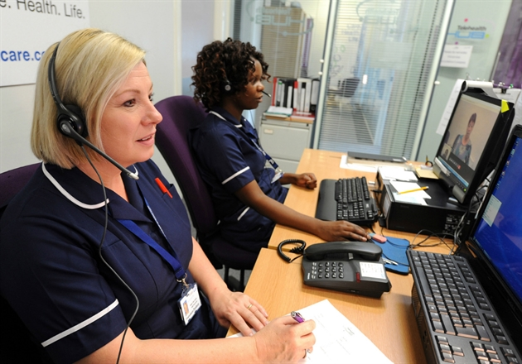
GP triage
Clinical assessment by Hub nurse
Onward refer if required to HCP for home visit
Request prescription
GP surgery informed by NHS secure mail

Slide 20
GP feedback
"Of all the changes in the 15 years I have been working this is the greatest change which has reduced workload I can remember. I don't mind the extra "late" duty doc visit as this is more than made up in the drop in other visits. A big thank you to all involved."

Slide 21
Innovation potential
“The innovation that telemedicine promises is not just doing the same thing remotely that used to be done face to face, but awakening us to the many things that we thought required face to face contact, but actually do not.”
David D Asch MD, MBA,
Perelman School of Medicine, University of Pennsylvania

Slide 22

Building on our innovation
What will the future look like?
New models of care:
“…in some places the future is already emerging, for example in Airedale…”

Slide 23
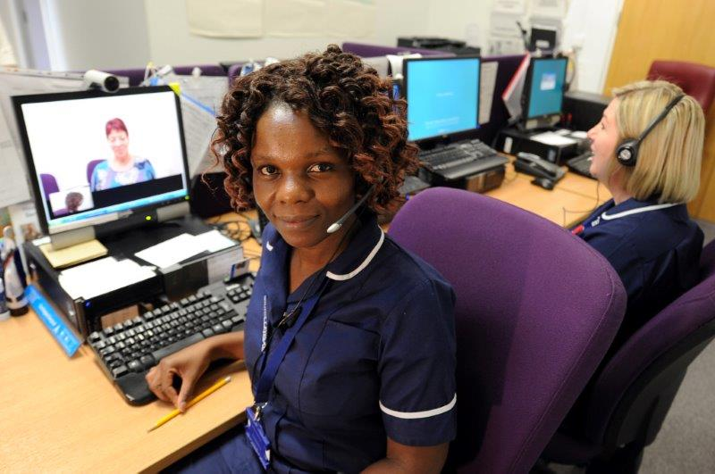
Remote training and clinical support
Support for care home staff using the VTR
Support for DNs and community teams – do they need to attend?
Overview and clinical support of care home staff developing enhanced roles
Remote outpatient clinics

Slide 24
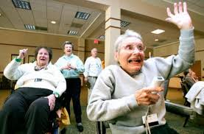
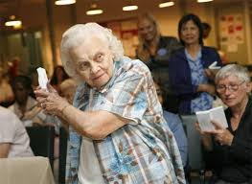
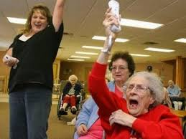
Questions
Technology Enabled Health
– the art of the possible…

