Slide 1
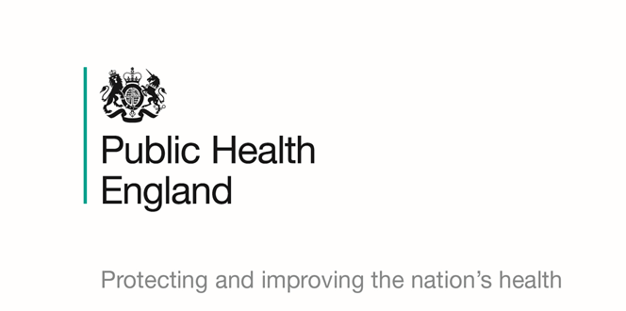
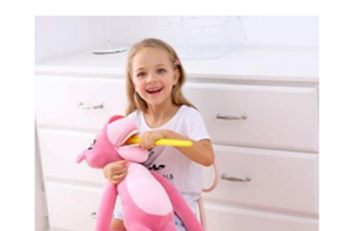

Prevention at scale:
Pharmacy Campaigns South of England Evaluation Report
NHS England & Public Health England pilot to deliver and evaluate the “Children's Oral Health Campaign” which was run in Pharmacies in South of England 2019 from 13th May – 13th June 2019.

Slide 2
Contents
Background
Geography
Aims
The Campaign
The Process
Evaluation
Engagement
Case Studies from Feedback

Slide 3
Background
Annually pharmacies are required to participate in up to six public health campaigns at the request of NHS England as part of the NHS Community Pharmacy Contractual Framework. NHS England is the accountable body for coordinating the Public Health Campaigns.
Over the last two years PHE South has been working in partnership with NHSE (South) South West to coordinate public health campaign communications, resource delivery and campaign evaluations.
Pharmacies are often asked to run campaigns by many organisations local and national and in a fast-paced environment Public Health England campaigns can be confused with other organisations.
Therefore rationale for this pilot was that if all community pharmacies are involved in delivering campaigns in a coordinated manner, the campaign messages would have greater exposure to the target groups. This in turn would bring both increased public benefit and administrative efficiencies for NHS England and the local public health system. The standardised process was designed to offer improved clarity to pharmacies on PHE campaigns, and identify opportunities for sharing of training, learning and campaign best practice with and amongst pharmacies.

Slide 4
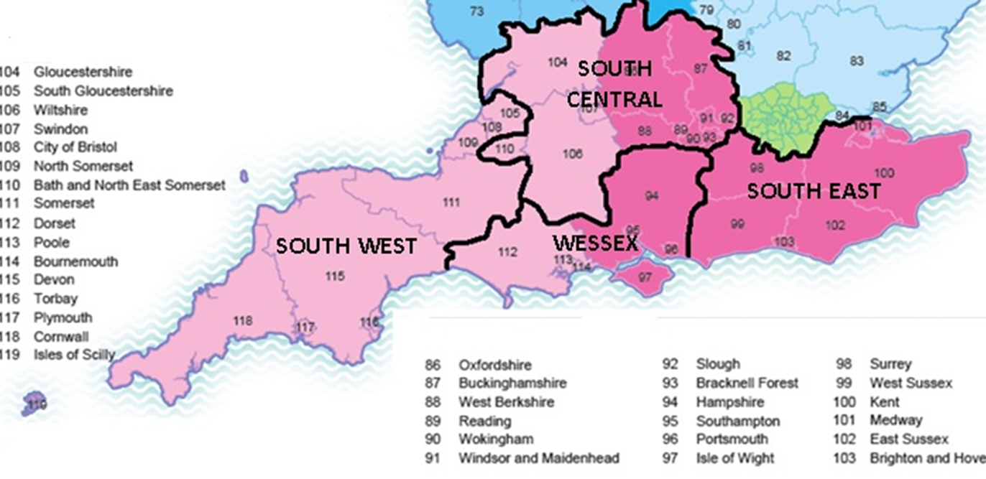
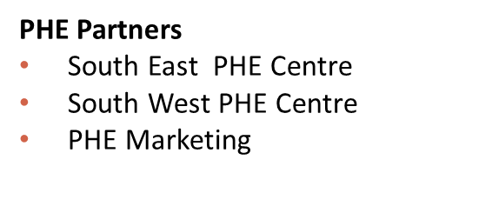
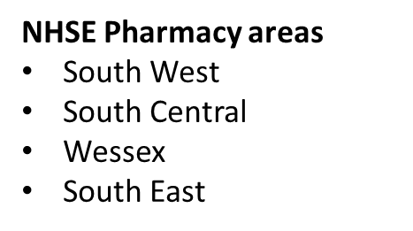
Geography
Old Geography of NHS England – New areas indicated in Pink - South West and South East.

Slide 5
Pilot aims
The rationale for this pilot is that if all community pharmacies are involved in campaigns in a coordinated manner, the campaign messages would have greater exposure to the target groups. This in turn would bring both increased public benefit and administrative efficiencies for NHS England and the local public health system. The standardised process also offers improved clarity to pharmacies on the campaigns, and identifies opportunities for sharing of training, learning and campaign best practice with and amongst pharmacies.
Engage pharmacies across the South, in the campaigns and provide clarity.
Evaluate National Campaigns which have never been done before.
Coordinate and increase administrative efficiencies for NHS teams and local public health system.
Create opportunities for sharing of training, learning and campaign best practice amongst pharmacies.
Deliver greater exposure of campaign messages that improves outcomes for people.
Evaluate National Campaigns in the same way.

Slide 6
The pilot process (per campaign)
Pharmacies briefed on upcoming campaign by NHS South
National Campaign Resources distributed
Campaign takes place
NHS South share data and PHE South analyse for the evaluation report
Pharmacy briefing and evaluation form distributed by NHS South
Pharmacies return evaluation to NHS South
Feedback on campaign success & best practice via evaluation reports to Pharmacies
PHE South & NHS South sign off reports

Slide 7
Children’s Oral Health Campaign
The aim of the campaign was to encourage conversations with parents and carers to improve the awareness of children's oral health across the South of England.
The campaign coincided with National Smile Month. The community pharmacy campaign was targeted at the parents or carers of children under the age of five. The Children’s Oral Health Campaign involved advertising partnerships, PR, and social media (Facebook, Twitter, Instagram).
The Campaign ran from 13th May – 13 June 2019.
Resource packs were distributed to the Pharmacies which were a little late but there were online and delivered packs including interactive materials for children.

Slide 8
Children’s Oral Health Campaign
“The children loved having a chart to take away , the smiles on the children's faces made the campaign worthwhile”.

Slide 9
Evaluation
Campaign Based:
Evaluation was a the core of the campaign and iterative learning was encouraged throughout via the campaign reports. These reports captured the data that pharmacies were asked to report back on including:
Number of conversations with consumers
Number of conversations within medicines reviews
If social media was used or special events took place
Any case studies
Training requirements
Feedback on campaign resources

Slide 10
Engagement overview
*The report captures only those pharmacies that returned the evaluation form, it should be remembered that many pharmacies may have displayed the resources without returning the forms.
**To note Dorset and BGSW now included with SW and Thames Valley included in SE.

Slide 11
Engagement Trends & Analysis
A total of 56% of pharmacies completed the evaluation survey, which is an increase of 17% from the last campaign.
A total of 21,277 Conversations with patients undertaken in the campaign for the South:
10.25% of these occurred through a MUR/NMS
1618 people were advised by pharmacists to seek appropriate medical care .
Events and Online Media:
44 Social Media Campaigns were undertaken
194 Special Pharmacy Events were undertaken for the period, which was an increase from the 79 events undertaken for Help us to Help you Campaign.

Slide 12
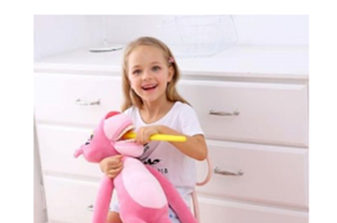
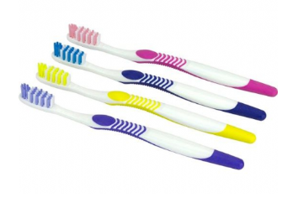
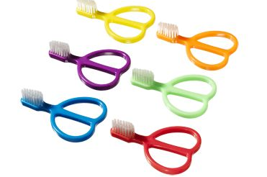
Case study Children’s Oral Health
“Lot of parents got to know the importance of oral care in children from the young age and to limit the sugar intakes for the children. As we mainly have elderly community in our village and less of the parents with children under the age of 5, which limited the number of parents we could approach.”.
“Linking the campaign to the online virtual outcomes training all staff had already completed was a great idea as staff members really felt engaged and knowledgeable about the topic. - in regards to the materials it was a little confusing having them branded this year as previously we have been told as a HLP to not use branded materials for our campaigns.”
“The toothbrushing charts were a real conversation starter. The information on the website was great for training the team on oral health.”.
“It was easy to approach families and tell about the campaign. However, improving children's oral health often involves changes in lifestyle including healthier eating habits that may be difficult to change”.
Bright leaflets and inviting campaign materials worked well as children picked up the leaflets themselves and we could initiate conversations with them and parents. We also created a "healthy mouth" and an "unhealthy mouth" baskets and laminated some pictures of healthy and unhealthy foods for children to put in the healthy or unhealthy mouths. This worked well as while the children were playing we could talk to them about why the food wasn't good for their teeth and how they can make sure they are brushing properly and taking care of their teeth.

Slide 13
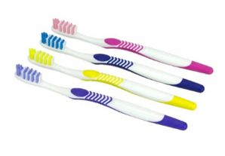
Case Study Evaluation of Campaign Materials
More interactive support materials (like toothbrushing chart)
The materials provided were relevant for the targeted age group . Children were eager to take on the challenge of the tracker to monitor their tooth brushing activity . This was helpful to indicate how easy this is and for parents to motivate the children.
Parents very happy with promotional material as they thought it would help promote their child's oral health care.
The children loved having a chart to take away , the smiles on the children's faces made the campaign worthwhile.
The leaflet was quite educative and the children really loved the toothbrush challenge. More parents still need to be educated on the important of booking appointment with dentist and ensuring children brush twice a day.
We purchased our own "teeth" and got children to clean them
We didn't get the promotional material until a week into a week into the campaign, so did not have the full amount of time to prepare, was all quite rushed. The children loved the activity chart with the teeth cleaning chart on it as well, was bright and caught their attention.The campaign was good but I feel it should stay on a bit longer.
It was not always possible to engage with patients as they were children (target audience) and hence the conversation was held primarily with parents or indeed grandparents.
A lot of Pharmacies mentioned the delay in campaign materials but did not have enough.
Colgate campaign materials were very weak. The "little monster" poster was inappropriate, although we did use the "Protecting your child's smile“
646 Pharmacies suggested Online Training or Webinars would be useful.

Slide 14
The Campaign Feedback
Late Campaign Materials was an overwhelming feedback comment.
Child friendly resources especially the colouring charts were popular.
Pharmacies felt that the link between the CPPE training was really successful.
Overall a successful campaign
Very good Case Studies back which have been reported in next section.

Slide 15
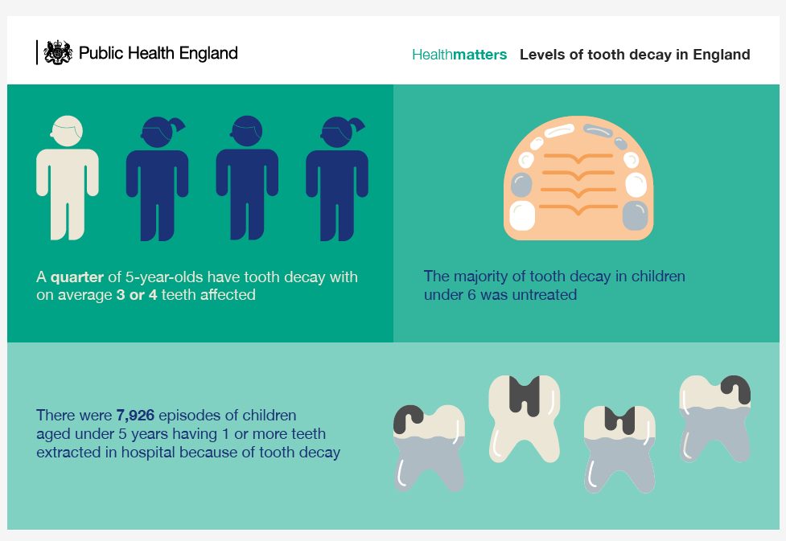

Slide 16
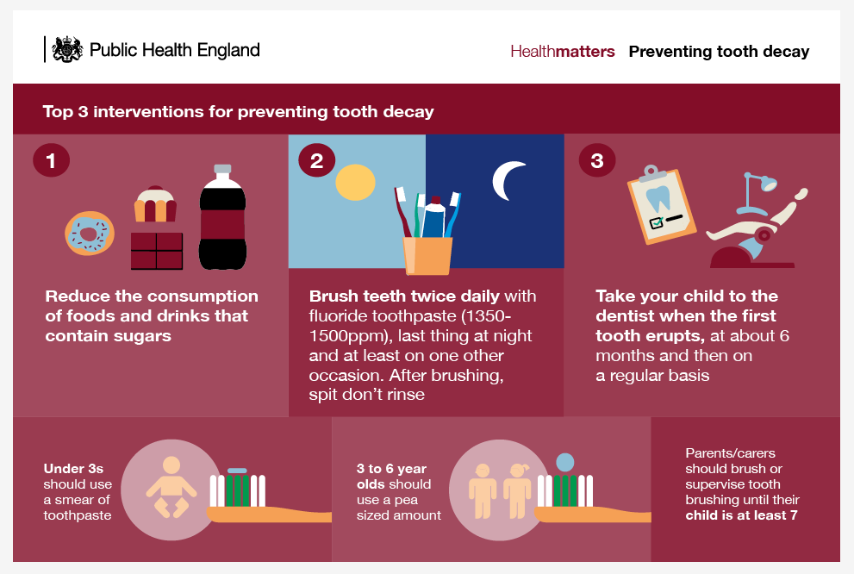

Slide 17


Feedback
A parent with three young children came back to for more charts as it was very useful and the children loved it. They were fighting over the two she had previously taken. She came back for 3 more as her friends also wanted them for their children.
A 10 year old child came in complaining of tooth pain, their mother said that they struggle to clean their teeth thoroughly. We referred to the dentist and they then came back with a prescription for toothpaste and was booked in to see the dentist again in one months time for a check up. When handing out the prescription we gave an activity pack to the child.
A lady from a care group asked for more of the tooth brushing charts to get the kids more involved and was very keen on setting the kids up in life for a good daily routine.
An 8 year old child, who had abscess in her mouth was very scared of getting infections in her mouth and had heard stories of people dying from infections. After discussing some helpful tips about brushing and sugar intake she was referred to see her dentist and got prescribed oral antibiotics. She seemed relieved and promised she would take more care of keeping oral hygiene to prevent any infections in future.

Slide 18


Feedback
I helped a mum chose the correct toothbrush and toothpaste for their child and her and showed the child good brushing techniques. I also told the child she should brush her teeth alongside her favorite song.
I had one referral of a patient to a Dentist for further treatment. The patient returned to thank me for pushing her to make another appointment.
I had one referral of a patient to a Dentist for further treatment. The patient returned to thank me for pushing her to make another appointment.
A mum who returned to get a second chart for her other child and one for her friends child as they wanted to use one themselves. It made brushing teeth fun and frequent for the kids.

