Slide 1
Meet our South West NHS England and NHS Improvement South West Nursing Leadership
Team

Slide 2
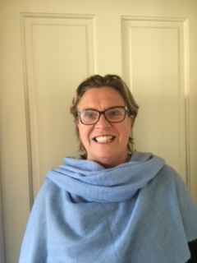
Sue Doheny South West Regional Chief Nurse

Slide 3
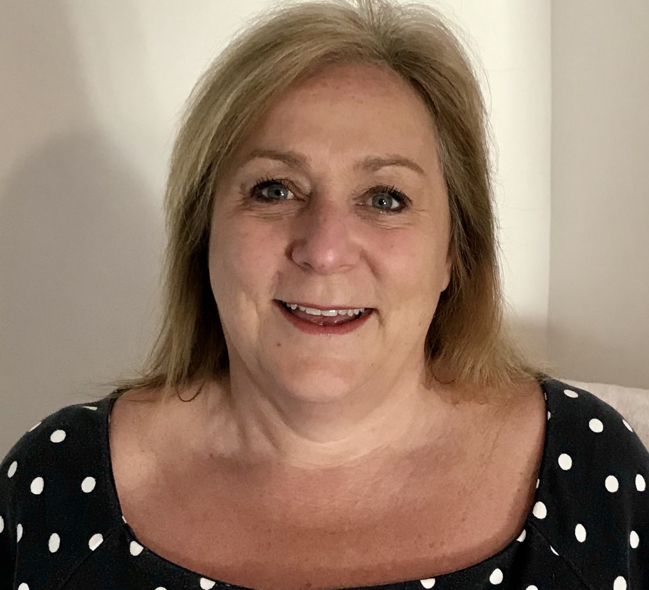
Sally Matravers Assistant Director of Nursing – Infection Prevention and Control

Slide 4
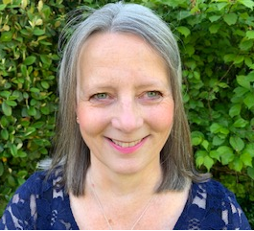
Rosie Luce Assistant Director of Quality and Safeguarding

Slide 5
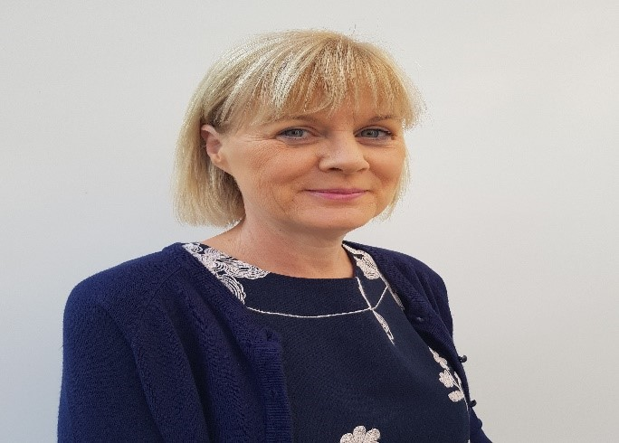
Bernadette Edwards Transformation & Improvement Lead CHC (South)

Slide 6
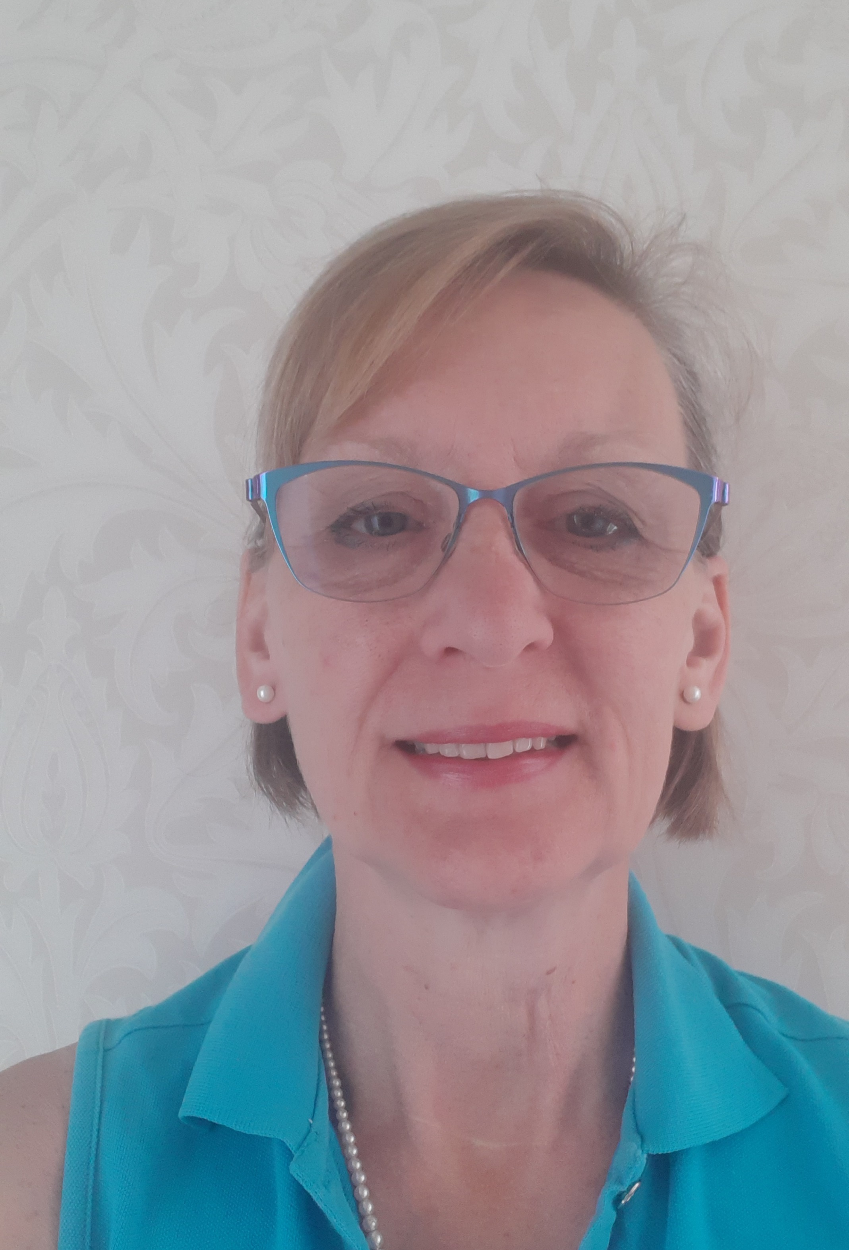
Madelyn Griffiths Senior Quality and Safeguarding Lead- Direct Commissioning

Slide 7
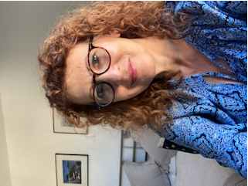
Trudi Pigott Deputy Clinical Quality Director

Slide 8
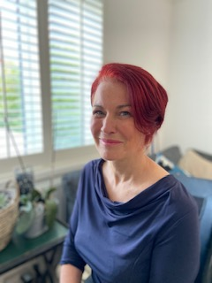
Penny Smith Director of Nursing Leadership & Quality Improvement

Slide 9
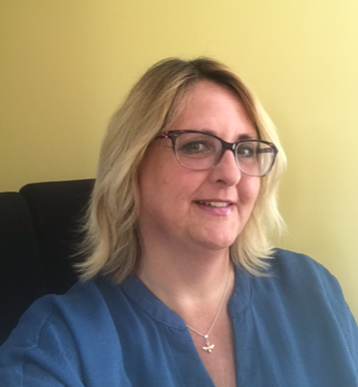
Michelle Hopkins Deputy Clinical Quality Director

Slide 10
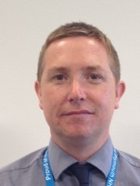
Graham Carr Children and Young People’s & SEND Lead Learning Disability & Autism Programme

Slide 11
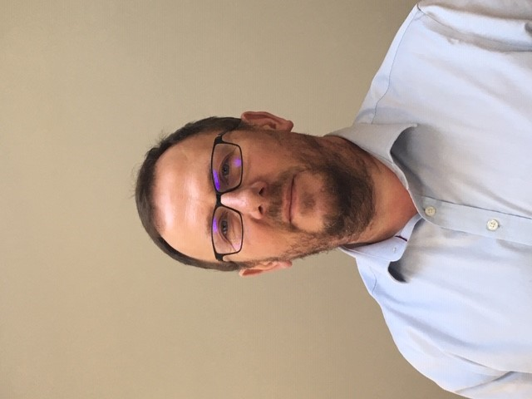
Kevin Elliott Head of Nursing Learning Disability & Autism Programme

Slide 12
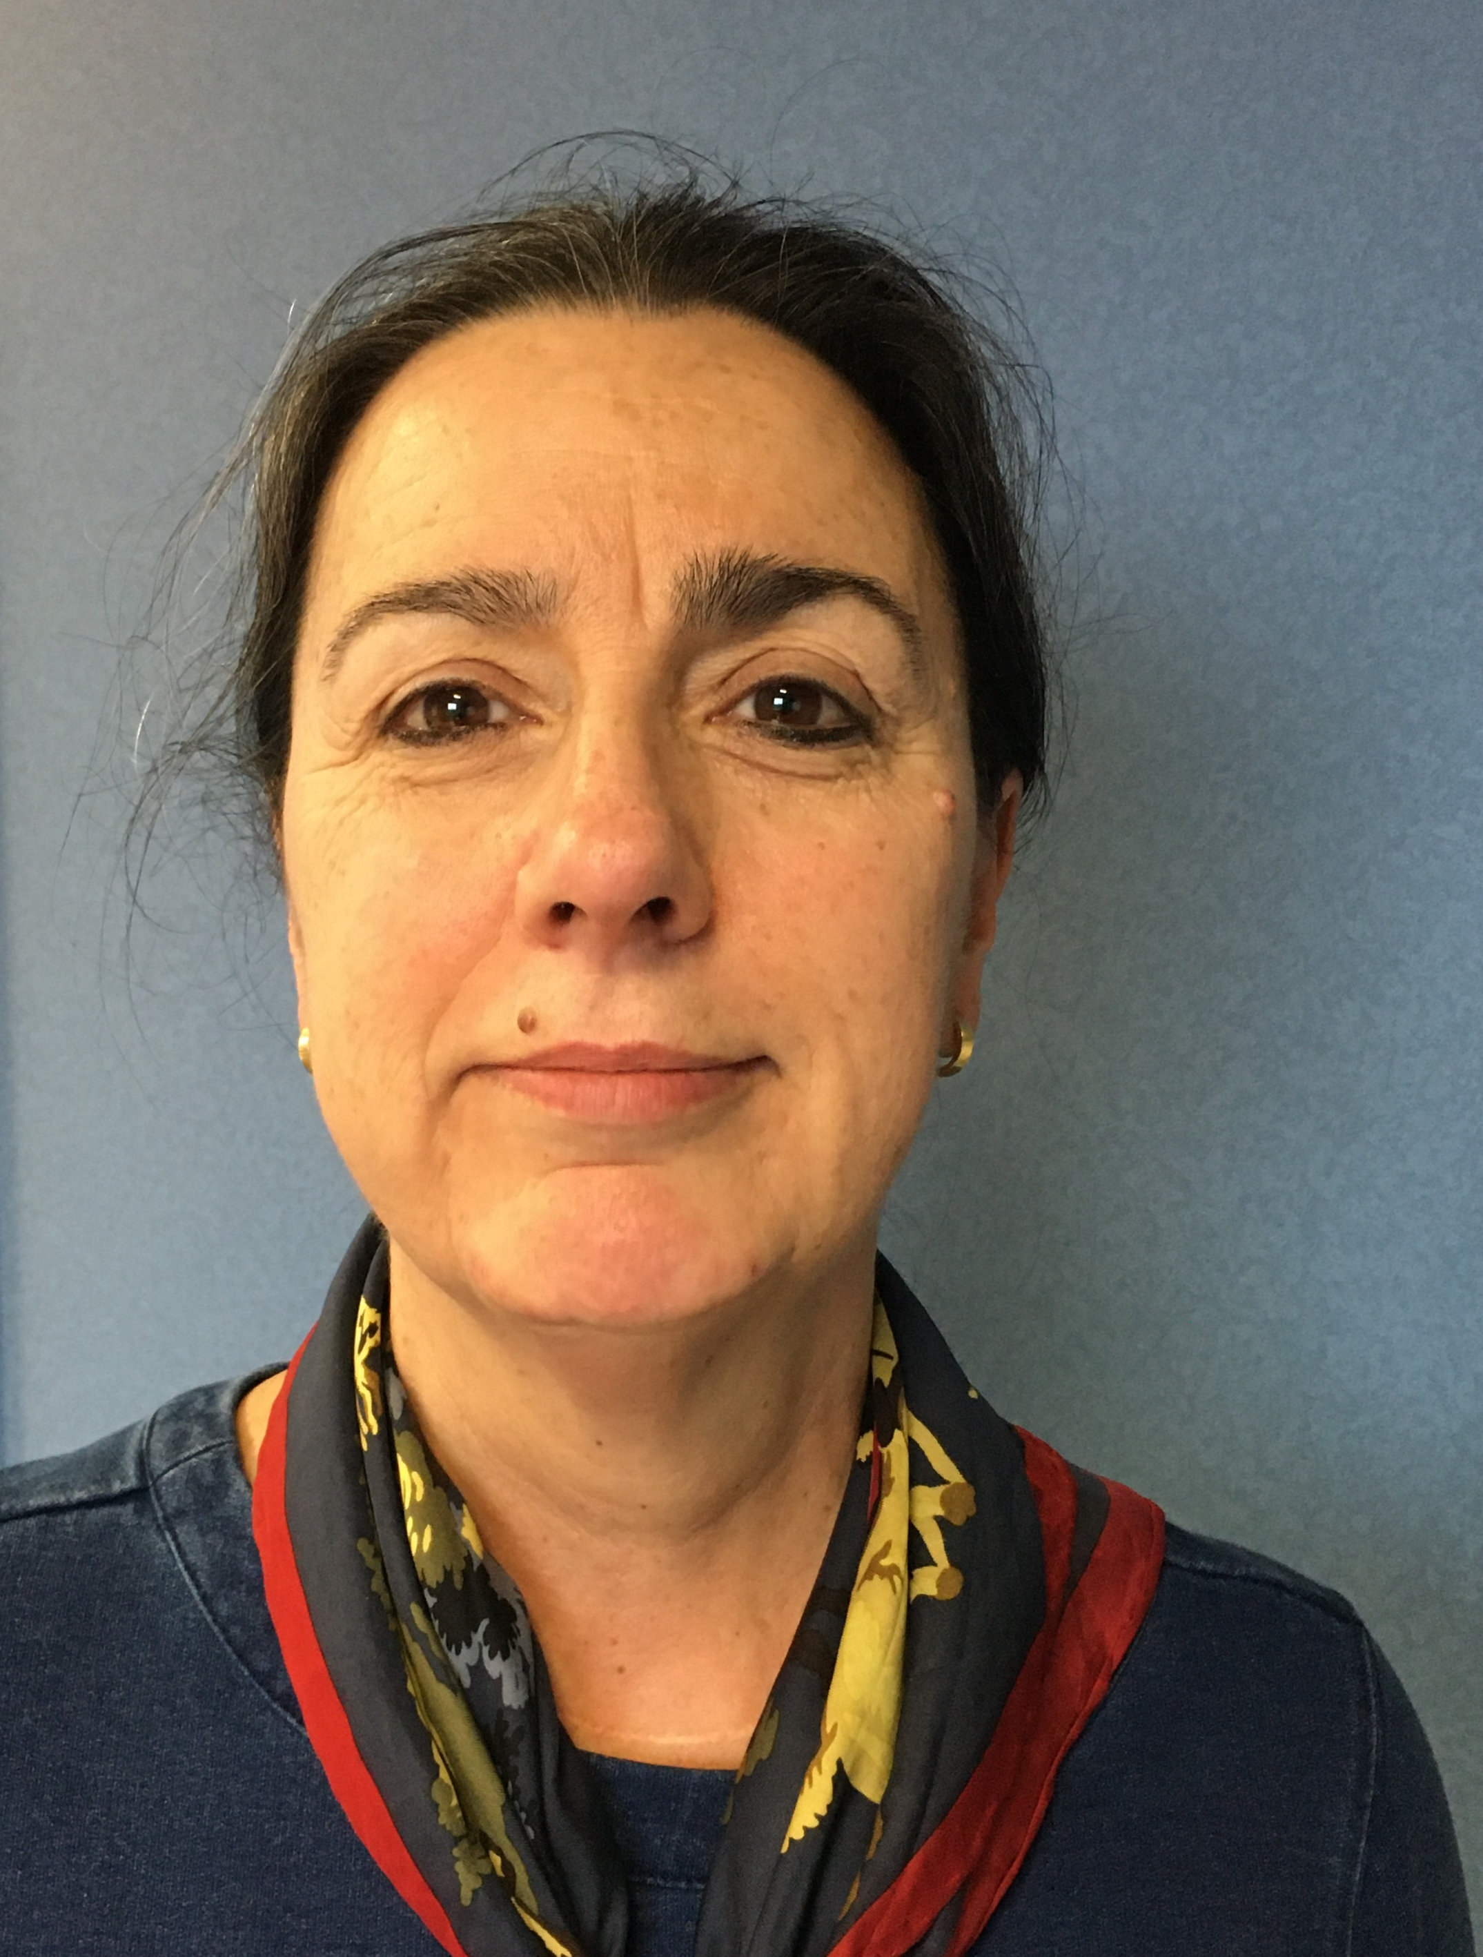
Jill Crook Director of Nursing Professional and System Development

Slide 13
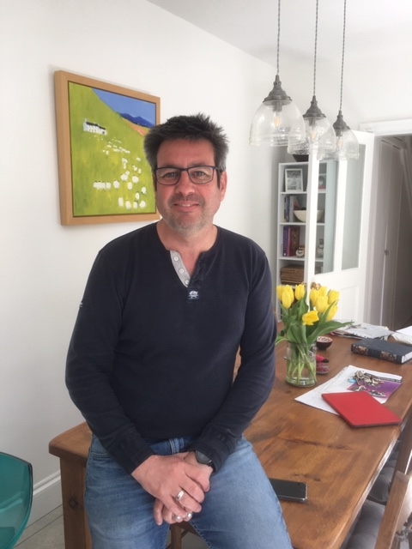
Tariq White Managing Director of SWAG Cancer Alliance

Slide 14
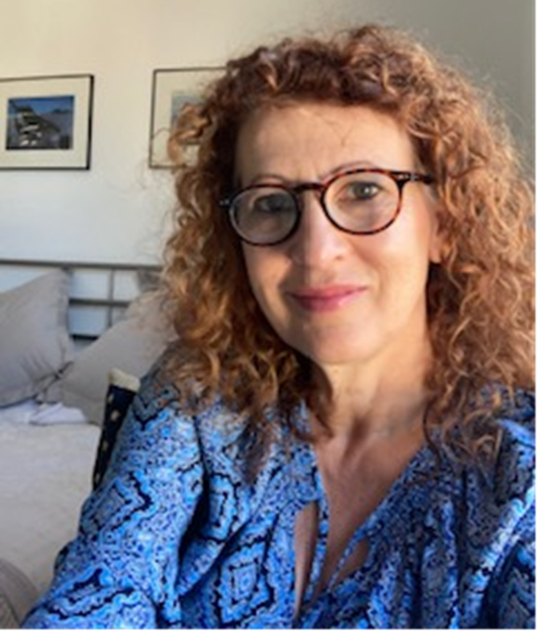
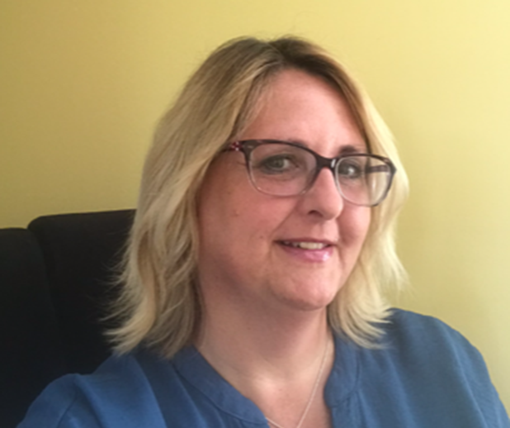
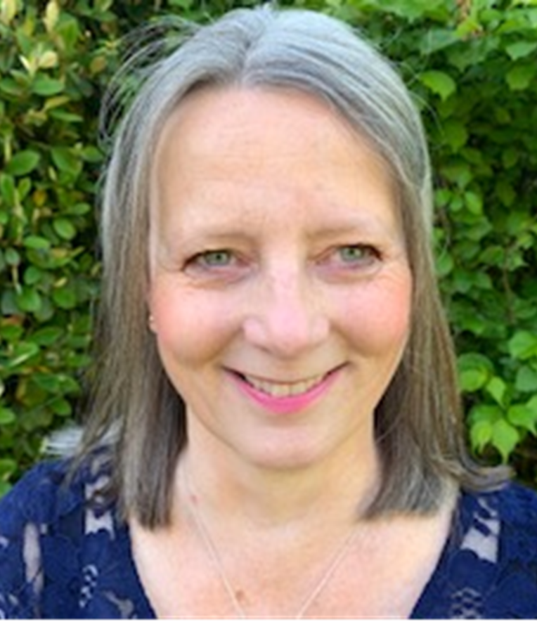
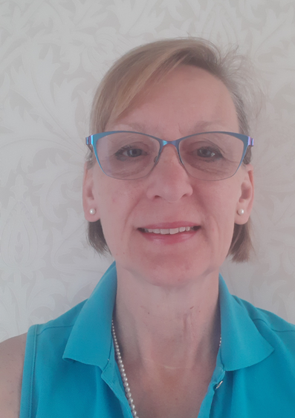
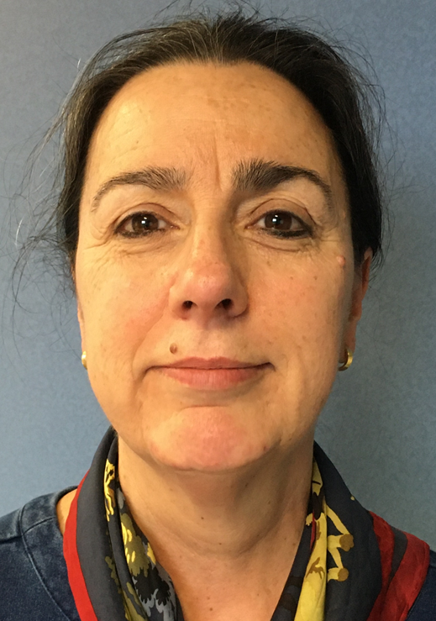
Our South West Nursing leadership Team

