Slide 1
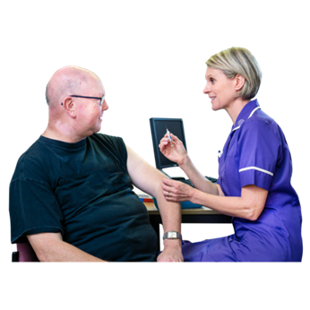
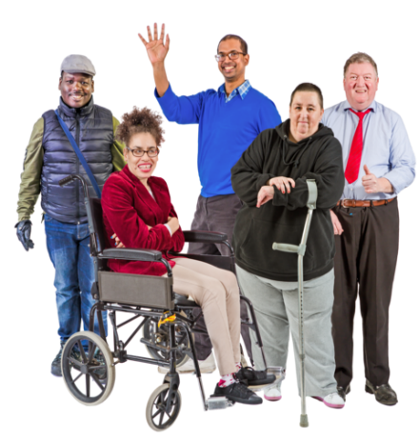
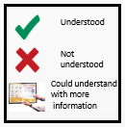
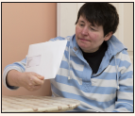
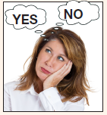
FLU VACCINATION
Easy read Cards
Supporting people with Learning Disabilities to understand and consent to flu vaccination
All people with learning disabilities are invited to have a flu vaccination every year.
This vaccination can help you from getting the flu.
Your GP surgery will invite you in for your flu vaccination. You may get a phone call or a letter.
You need to decide if you want to go for the flu vaccination.
You can ask for help and more information from other people you trust to help you decide.
Developed by Katy Welsh, Jane Belt & Anne Bowdler - September 2020

Slide 2
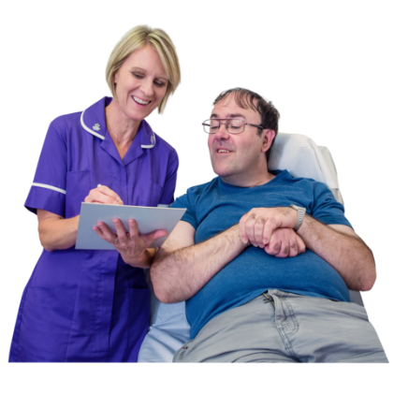
If you decide to go for your appointment you might need to ask them for a longer appointment so you are not rushed.
Most people go to their GP surgery for their flu vaccination.
Some people may also go to their local pharmacy / chemist.
When you arrive for your appointment the nurse will ask you some questions about you and your health.
You can take someone who knows you to help you with this if you need to.
The nurse will ask you to roll up your sleeve and hold your arm down by your side. You will need to keep your arm still.
Developed by Katy Welsh, Jane Belt & Anne Bowdler - September 2020

Slide 3
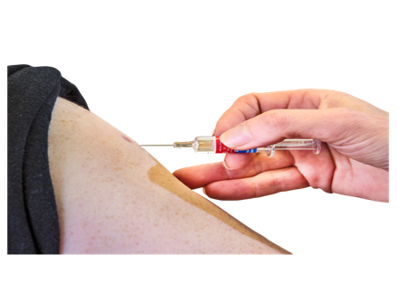
The nurse will give you the flu vaccination in your arm. This is given by using a small needle.
After you have had the flu vaccination, you will be asked to sit and wait in the waiting room for 10 minutes. This is to make sure you feel OK.
After 10 minutes you will be able to leave the GP surgery.
If you do not like needles you may be able to have a nasal spray.
Developed by Katy Welsh, Jane Belt & Anne Bowdler - September 2020

Slide 4
