Slide 1


COVID 19 Booster Uptake: Best Practice
Wednesday 18th January 2023

Slide 2

Homelessness and those Sleeping Rough
18th January 2023
NHS England and NHS Improvement

Slide 3
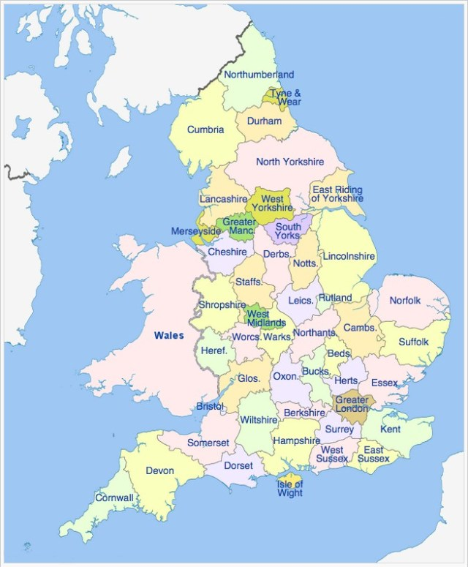
Some Key Initiatives for those experiencing Homelessness and/or Sleeping Rough – December 2022
The map below shows a handful of the initiatives that are taking place over the next couple of week. We plan to assess the impact of these with further detailed data analysis. The following slides provide more initiatives that are happening by Region.
9th, 23rd, 30th Dec - Vaccination sessions at Forward Leeds Drug & Alcohol Service
Visits by roving teams to Shelter hub in Newcastle
Vaccination sessions taking place at homeless accommodation in West and South Yorkshire
Roving team offering vaccinations at hostels and other facilities for vulnerable people – including GPs and homeless specialist nurses
Vulnerable Adults Service – healthcare for individuals who are homeless will run open sessions/walk in clinics during the Christmas period.
Shrewsbury Ark Clinic hosting roving vaccination team to offer COVID vaccination to service users
Outreach and vaccinations administered at: The Bridge Shirley and Solihull United Reformed Church
From 1st Jan 23 - Wellness on Wheels Bus available to visit homeless hostels, VCSE and other groups supporting homeless and rough sleepers
24 – 30th Dec - Caring at Christmas vaccination outreach from Sirona Health in a range of Bristol venues
5 Crisis hotels and 4 Crisis centres open over Christmas 22 and Jan 23, with vaccination offer available over whole festive season.Crisis Volunteer Healthcare, East London FT, Central London Community Healthcare, and Find and Treat.
Health On the Move bus facilitated 5 clinics in Oxford (Turning Point and St Mungo’s), 2 in Bicester (Salvation Army), 1 in Banbury (Turning Point)
‘Boost Your Immunity and Wellbeing Winter Health Event’ NHS Drop-in Clinic MECC offering, incl. flu and Covid, TB screening, acupuncture, and other activities. Hot food and refreshments served.
Health for Homeless – weekly outreach clinics at 3 locations, providing flu and COVID vax
Health and wellness days: The Heaney Hub, RBKC - Hope Gardens, H&F , The Passage Day centre, WCC, Find & Treat events.
Worthing – temporary night shelter opened and working with Health Central Surgery to ensure guests can access vaccinations

Slide 4
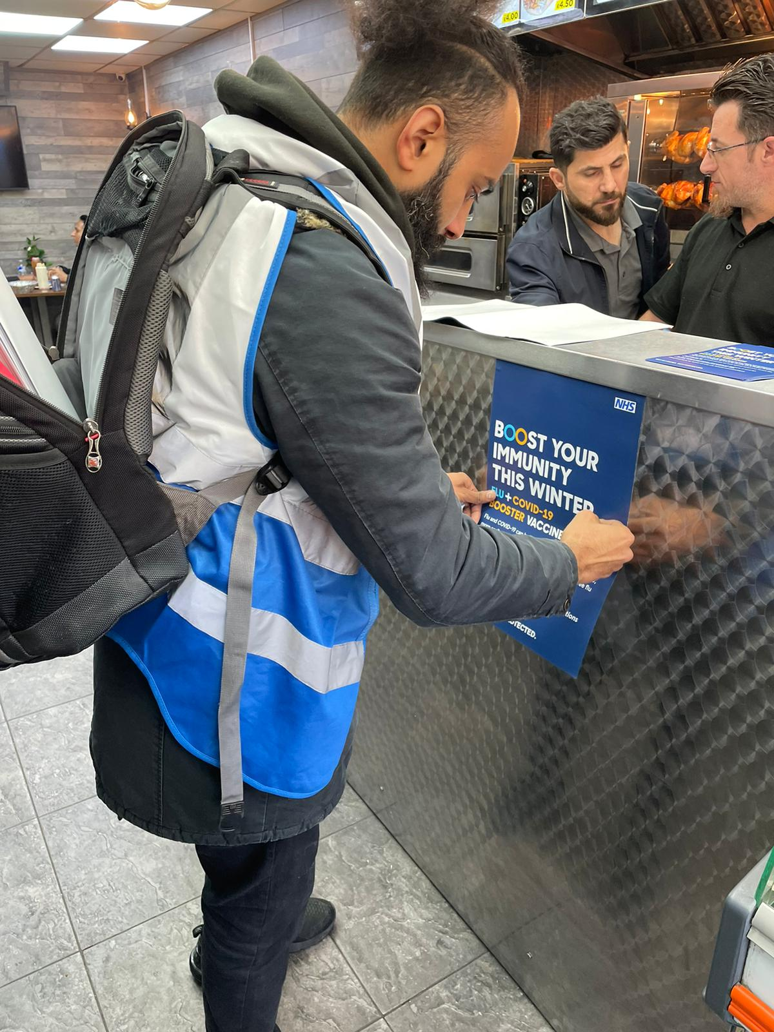
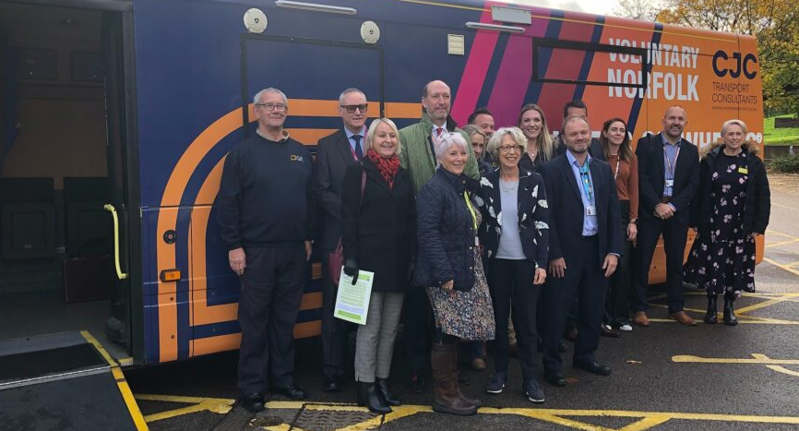
Some Key Initiatives for those experiencing Homelessness and/or Sleeping Rough – January 2023
The map below shows a handful of the initiatives that are taking place over the next couple of week. We plan to assess the impact of these with further detailed data analysis. The following slides provide more initiatives that are happening by Region.
Roving Street Team still working through January to go out and find people
Ongoing work with the dedicated Shelter hubs in the Birmingham area
Mobile units are targeting food banks
Dedicated homeless session planned for January 18th – Living Well Bus still out in the area providing vaccinations
Teams are working with Street Kitchen to reach the cohort
ICB has been invited to be part of a task and finish group to identify how to best support this population
WoW bus programme available from the 1st January targeting hostels, VCSE groups and other organisations which support rough sleepers and those experiencing homelessness.
Ongoing work in partnership with Bristol City Council and incentivised clinics for people experiencing Homelessness.
Support offer of vaccinations over the in January for those experiencing homelessness or sleeping rough.
Ongoing work with Crisis focused on the hotel provision for January 23
8 days identified in the SW for outreach activity in January at several sites including hostels, YMCA and Salvation Army sites
Health Equalities team offering health promotion and advice along with boosters and primary courses

Slide 5
Covid-19 vaccination uptake
Good Practice Examples and case studies
Non Age Based cohorts
People Experiencing Homelessness and
Individuals Sleeping Rough
Covid Vaccination Programme
South-East Region

Slide 6
Buckinghamshire, Oxfordshire & Berkshire West
Good Practice examples – People experiencing Homelessness and Individuals sleeping Rough
A concerted effort was made to vaccinate those who are experiencing homeless in Oxford through the Luther Street Practice, which is a GP Practice located in the vicinity of the homeless community.
Using Health on the Move bus was arranged through partnership working, OCCG organised 5 clinics in Oxford with Turning Point and St Mungo’s (homeless charities), 2 clinics in Bicester with the Salvation Army and 1 clinic in Banbury with Turning Point. This allowed for better access of the vaccination for those experiencing homeless and or individuals sleeping rough.
In January 2022, a project group was set up where a local GP, supported by Shelter staff, had delivered 5 clinics in different homeless shelters vaccinating over 70 people (1sts and boosters). The project team is continuing to review the need and its approach.
Vaccination clinic through collaboration between Wycombe Homeless Connection and a local GP with a pop-up clinic in a supported housing setting in Aylesbury.

Slide 7


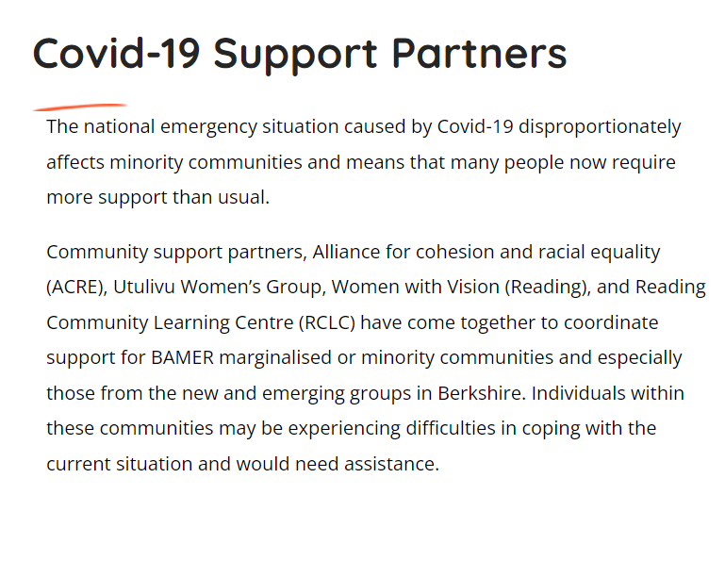
Buckinghamshire, Oxfordshire & Berkshire West
Good Practice examples – People experiencing Homelessness and Individuals sleeping Rough
The system is liaising with temporary accommodation providers to engage and facilitate vaccination through their local vaccine hubs and via outreach programmes.
Vaccination clinics through collaboration between Wycombe Homeless Connection and a local GP with pop-up clinics in a supported housing setting in Aylesbury.
Most recently in October 2022, collaboration with wider local health, social care and voluntary sector partnerships has resulted in providing translation services to homeless population and Asylum seekers to promote vaccination and to engage in vaccine hesitancy conversation where required.
In November 2022, the system is currently exploring MECC options to increase vaccination uptake for homeless population along with other vulnerable cohorts such as asylum-seekers and pregnant women.
Learning from other cohorts are also being applied as appropriate to those who are experiencing homelessness: over Autumn the system has been increasingtheir collaborative working at place level e.g. a PCN led support for a local asylum seeker hotel where there was coordination of a package of health and social care support to encourage GP registration, provide health checks by jointly working with the Council/voluntary sector, local pharmacy, mental health charity input/translators etc. The project is ongoing and now the model is being replicated to support homeless cohort which lends itself well to provider collaborations.
One specific short-term impact of the outreach approach in BOB has been strengthening ties with the Voluntary Sector to serve public health, vaccination and beyond. The system engaged with communities of need and those linking in with vulnerable groups e.g., Homeless population /Asylum & Refugee groups - Salvation Army, Turning Point, (Alliance for Cohesion and Racial Equality) and Utulivu women's group, Healthwatch. (Example right)
.
.

Slide 8
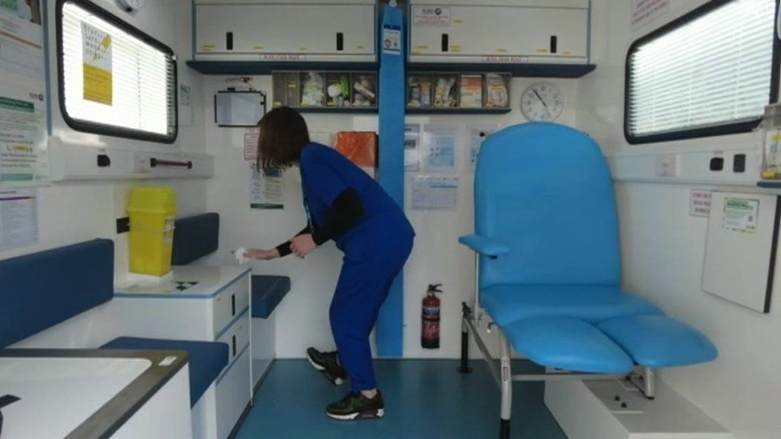
Frimley
Good Practice examples – People experiencing Homelessness and Individuals sleeping rough
Frimley has a mixture of approaches across their system to increase their vaccination uptake:
Slough have held homeless GP clinics, but vaccines mostly done elsewhere, mainly by the Mobile Vaccination Bus in Slough provided by Solutions for Health - Locations have been selected to access homeless populations. The staff not just provide vaccination but are also skilled in addressing vaccine hesitancy conversations without pressuring the homeless cohort to get vaccinated.
Bus schedules to local vaccination clinics are promoted by community homeless teams by partnership working with voluntary organisations.
Opportunistic visits by GPs to administer vaccines at the homeless project in the Royal Borough of Windsor and Maidenhead and at Manor Hotel Datchet and the Windsor Homeless Project .
Bracknell Forest – hold a weekly outreach clinic that delivers vaccination by arranging lifts to get the homeless population to the vaccination centres. This is an ongoing plan.
Frimley homeless population have contact details on the system and PCNs have made continuous efforts to engage with homeless population to find out how to make it easier for this cohort to have their vaccination.
To enable easy access to the vaccination, PCN across the systems accept walk in appointments for homeless population and other vulnerable cohorts.

Slide 9
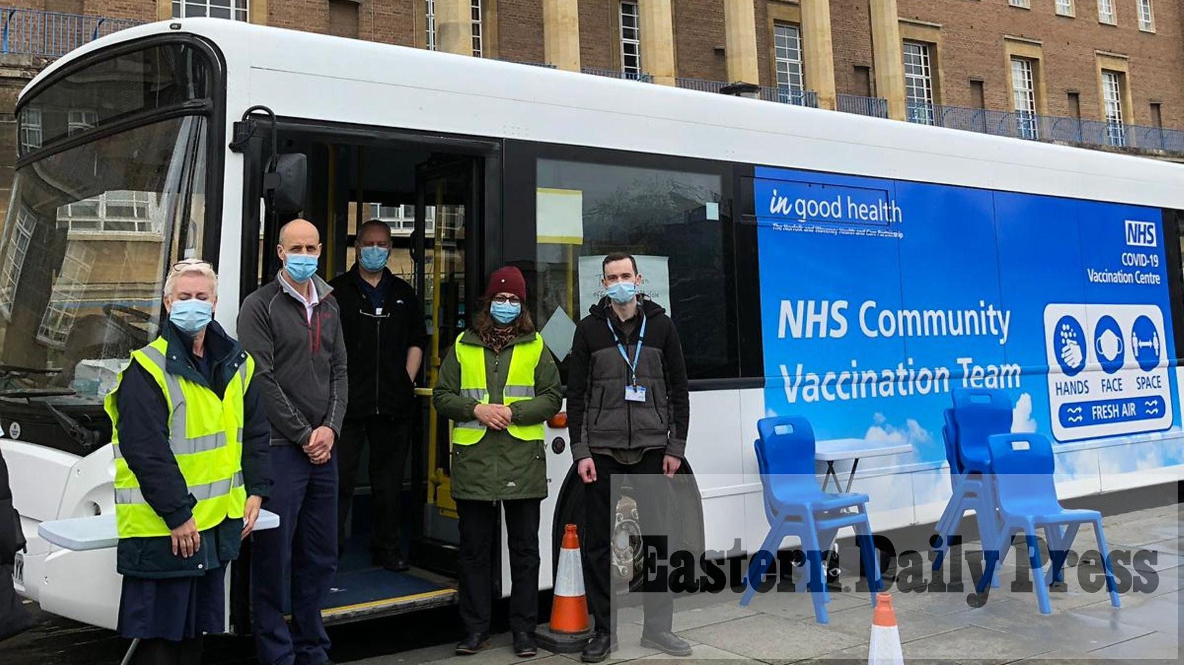
Hampshire and Isle Of Wight
Good Practice examples – People experiencing Homelessness and Individuals sleeping rough
One of the interventions that had a great impact was Breakfast Club for Homeless and Rough Sleepers population.
The system supports Homeless population to register with GP and deliver targeted outreach clinics in the geographical areas that people experiencing homelessness are predominantly located.
Primary Care Network in Winchester has provided vaccination uptake in the temporary accommodation and most of these adults belong in the higher risk cohort.
In Portsmouth, the Primary Care Network partnered with Hampshire Fire and Rescue Service to provide the COVID-19 vaccine to those sleeping rough and hostel residents in the city.
The Solent roving bus carried out activities in foodbanks and have a partnership with C2U homeless shelter in Gosport (October and November, 2022). See right.

Slide 10
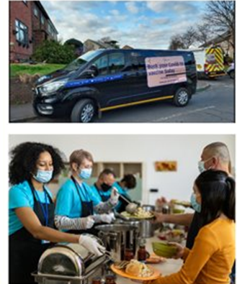
Kent & Medway
Good Practice examples – People experiencing Homelessness and Individuals sleeping rough
Between February and March 2022, the homeless programme in Medway successfully vaccinated 198 people with a couple of successes that were down to familiar contacts and incentives.
For example:
Outreach and education were focussed within shelters, homeless centres and soup kitchens.
6 week programme provided specific contacts to build trust and rapport- using the same staff so they became a familiar face.
Deploying the right temperament of staff and included an Eastern European speaker
Having regular weekly vaccination sessions- 8 sessions in total
Offering individuals an incentive of a £5 'Love to Shop' voucher for having the 1st, 2nd or booster vaccine.

Slide 11
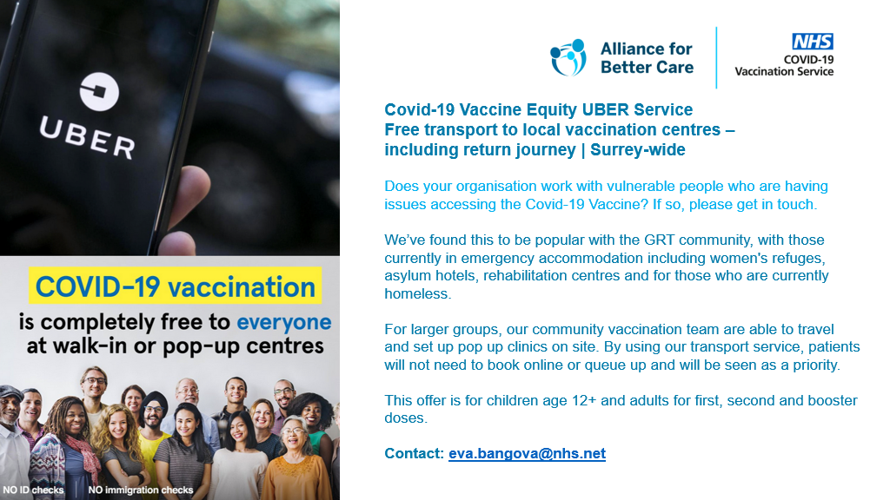
Surrey
Good Practice examples – People experiencing Homelessness and Individuals sleeping rough
Surrey has provided a great incentive of free transportation to local vaccination centres to the vulnerable including those experiencing homelessness and individuals sleeping rough. On the right is a copy of the campaign used.
List of B&Bs that shelter those experiencing homelessness was shared with Alliance for Better Care (ABC), who proactively follow up with house managers and take on any referrals to provide direct pop-up clinics at the B&Bs, helping to increase uptake.
In October 2022, 22 vaccines given and 4 shelters visited, all including health checks and wellbeing sessions to increase vaccine confidence amongst people experiencing homelessness.

Slide 12

Sussex
Good Practice examples – People experiencing Homelessness and Individuals sleeping rough
Close liaison with VCSE orgs to build rapport with homeless population.
Ensure that outreach is closely coordinated with local VCS organisations to increase uptake.
Health on the Move bus operated in Crawley in Sussex and was set up by a Federation of 44 GP services called the Alliance for Better Care (ABC) vaccinated people that are experiencing homelessness.
The “vaxi taxi” free transport offer continues to be available to anyone without other transport options (right) including homeless population and individuals sleeping rough to increase vaccination uptake.

Slide 13

Covid-19 Booster Uptake
Best practice
Jane Cook
Health & Homelessness Adviser
Official Sensitive

Slide 14
Alliance for Better Care – Crawley
A.B.C. – G.P. Federation in Crawley (East Surrey)
Outreach based service
Provide vaccinations to harder-to-reach and vulnerable groups in the local community
Partnered with Metrobus – self-contained, clean and safe location
Targeted – held at specific sites
Also run 7 vaccination sites in accessible sites including pop-up tents
Well advertised
More information: jasmine.plowright@nhs.net

Slide 15
Rough sleeper Intervention Support and Empowerment – Thanet
Accessible health care at a local day centre
Vaccination sessions are part of health offer
Other incentives in place
Holds health days with ABC health inequalities team who worked in the centre but also from mobile units
Referral pathways in place including to housing. Case manage individuals especially those who have complex needs and those who are vulnerable
Good engagement with individuals and especially those who were more vulnerable.
Well advertised

Slide 16
Renewed Hope - Redhill
Based in a well established chapel drop-in centre providing practical solutions and emotional support to people experiencing homelessness, those who were vulnerable housed or isolated in East Surrey
Hold a drop in in Shrewsbury Chapel with warm food and clothes Monday to Friday 11am to 3pm
Good partnerships in place – ABC inequalities team now come there to deliver health checks and immunisations. Also able to refer to other health providers. Can assist with GP registration.
Good leadership
Planning in place – well organised
Health sessions delivered with A.B.C.
Person centred – holistic
Pathways in place including access to a 4-bedroomed shared house
www.renewedhope.org.uk

Slide 17




Case Study
COVID 19 Peer Led Integrated Outreach
COVID-19 Booster Best Practice Webinar
18th Jan 2023
Professor Al Story
Clinical Lead – UCLH Find&Treat
Co-Director UCL Collaborative Centre for Inclusion Health

Slide 18
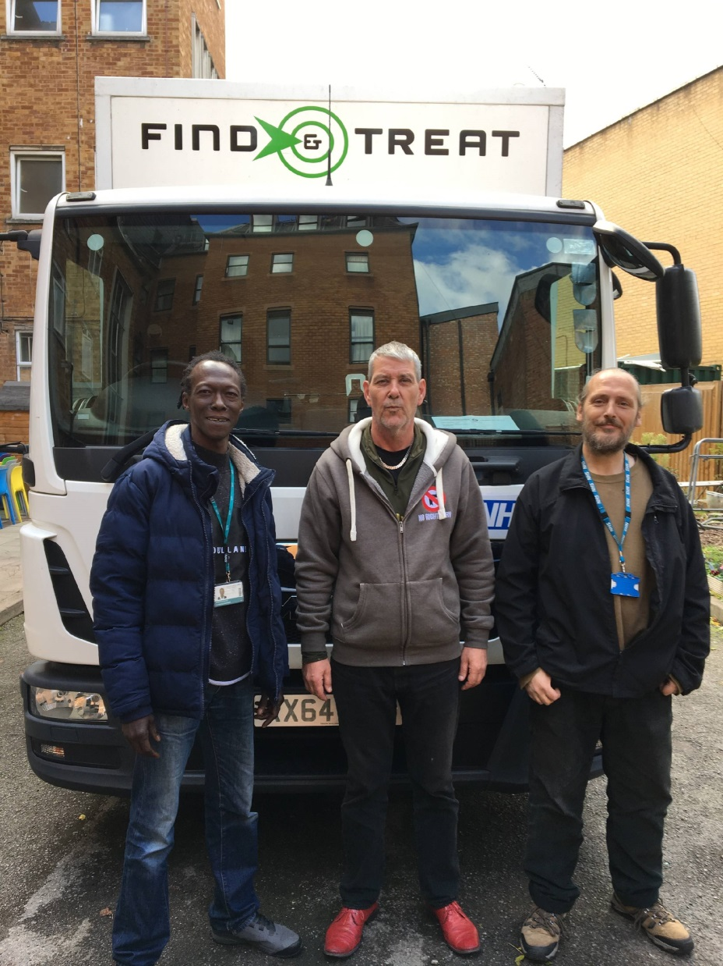
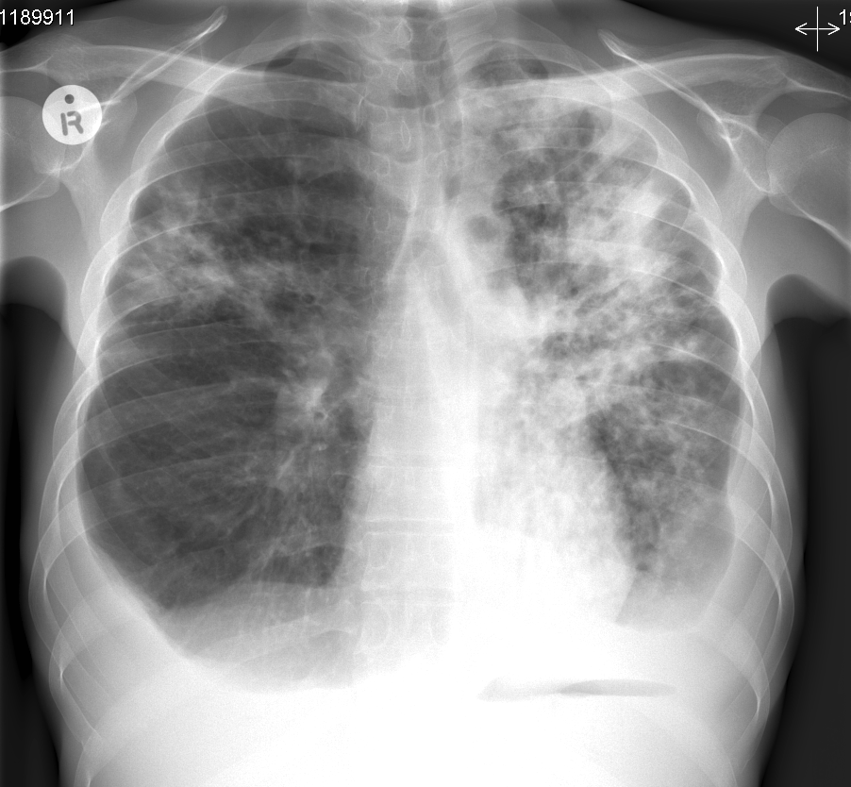
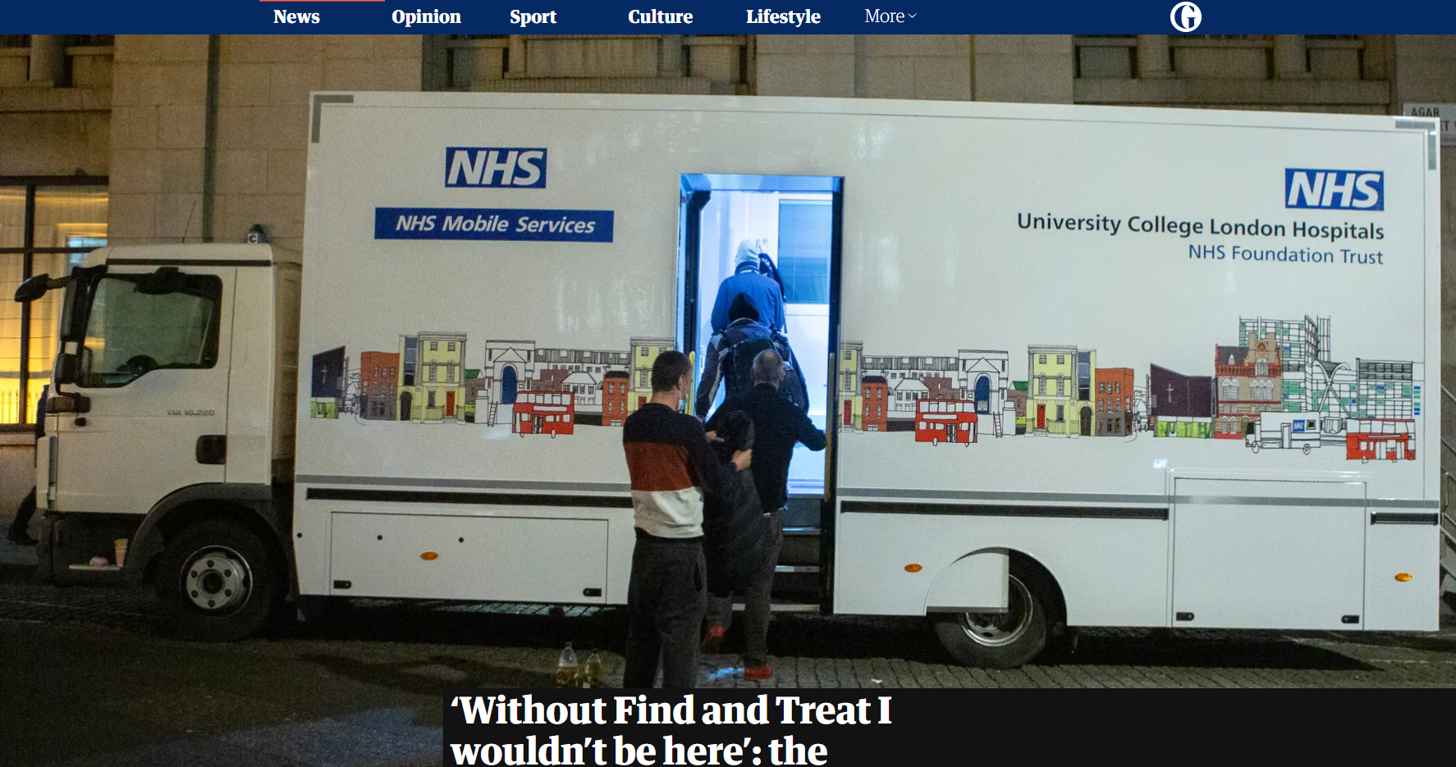
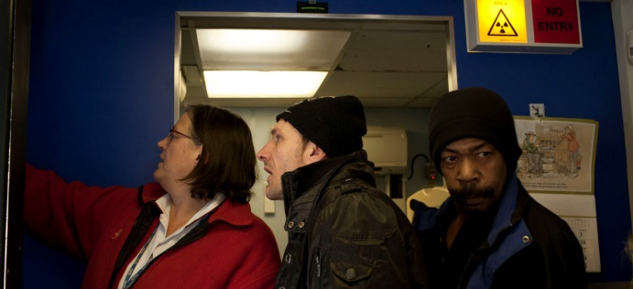
Pan-London Inclusion Health Outreach Team
20 years of Lived (Peers) and Learned (Health and Social Care) Experience – MDT➔MDP
Integration - Innovation - Research – Evidence
Highly cost-effective / cost-saving (NICE)

Slide 19
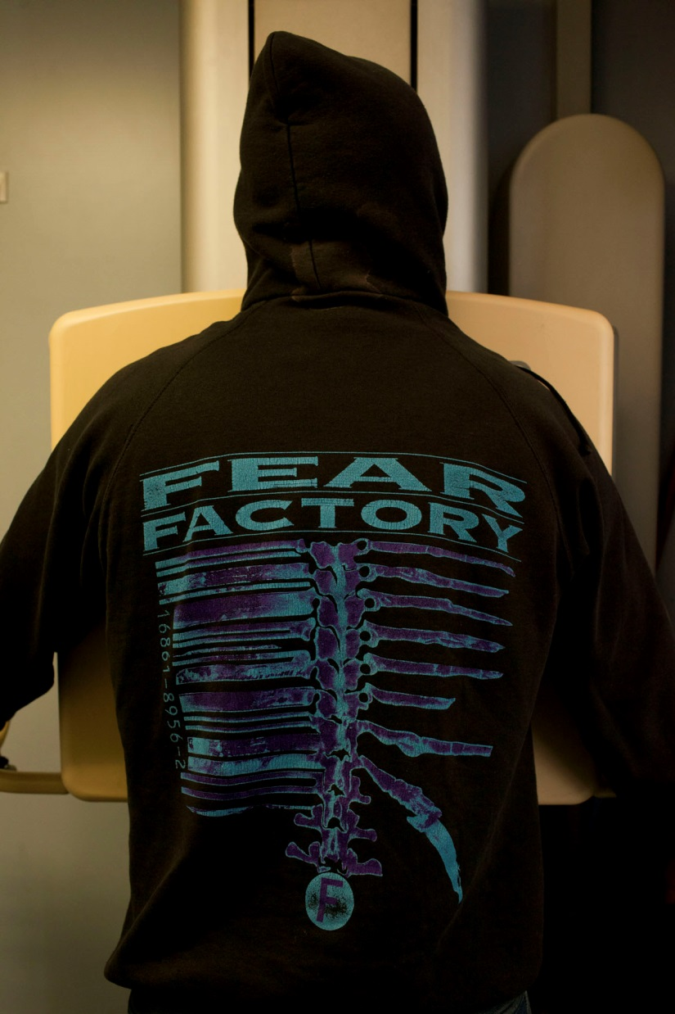
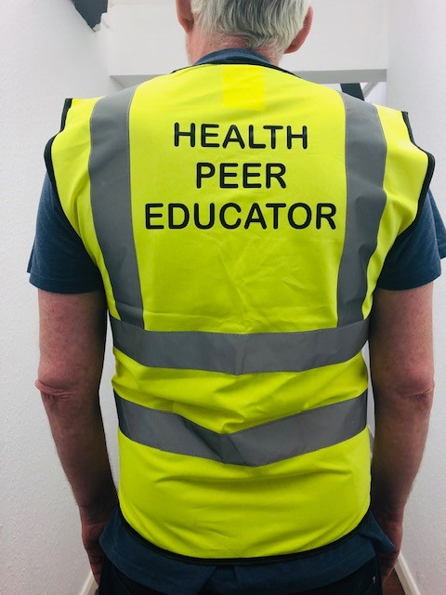
>200 NHS and 3rd sector Partners
‘Take services to people’ NICE guideline NG214
Early diagnoses (POCT) – Onward Care
Infection – TB/BBV/STI/COVID-19
Long-term Chronic conditions
Safeguarding & Linkage to Services
Training, Education & Awareness
Immunisation ➔

Slide 20
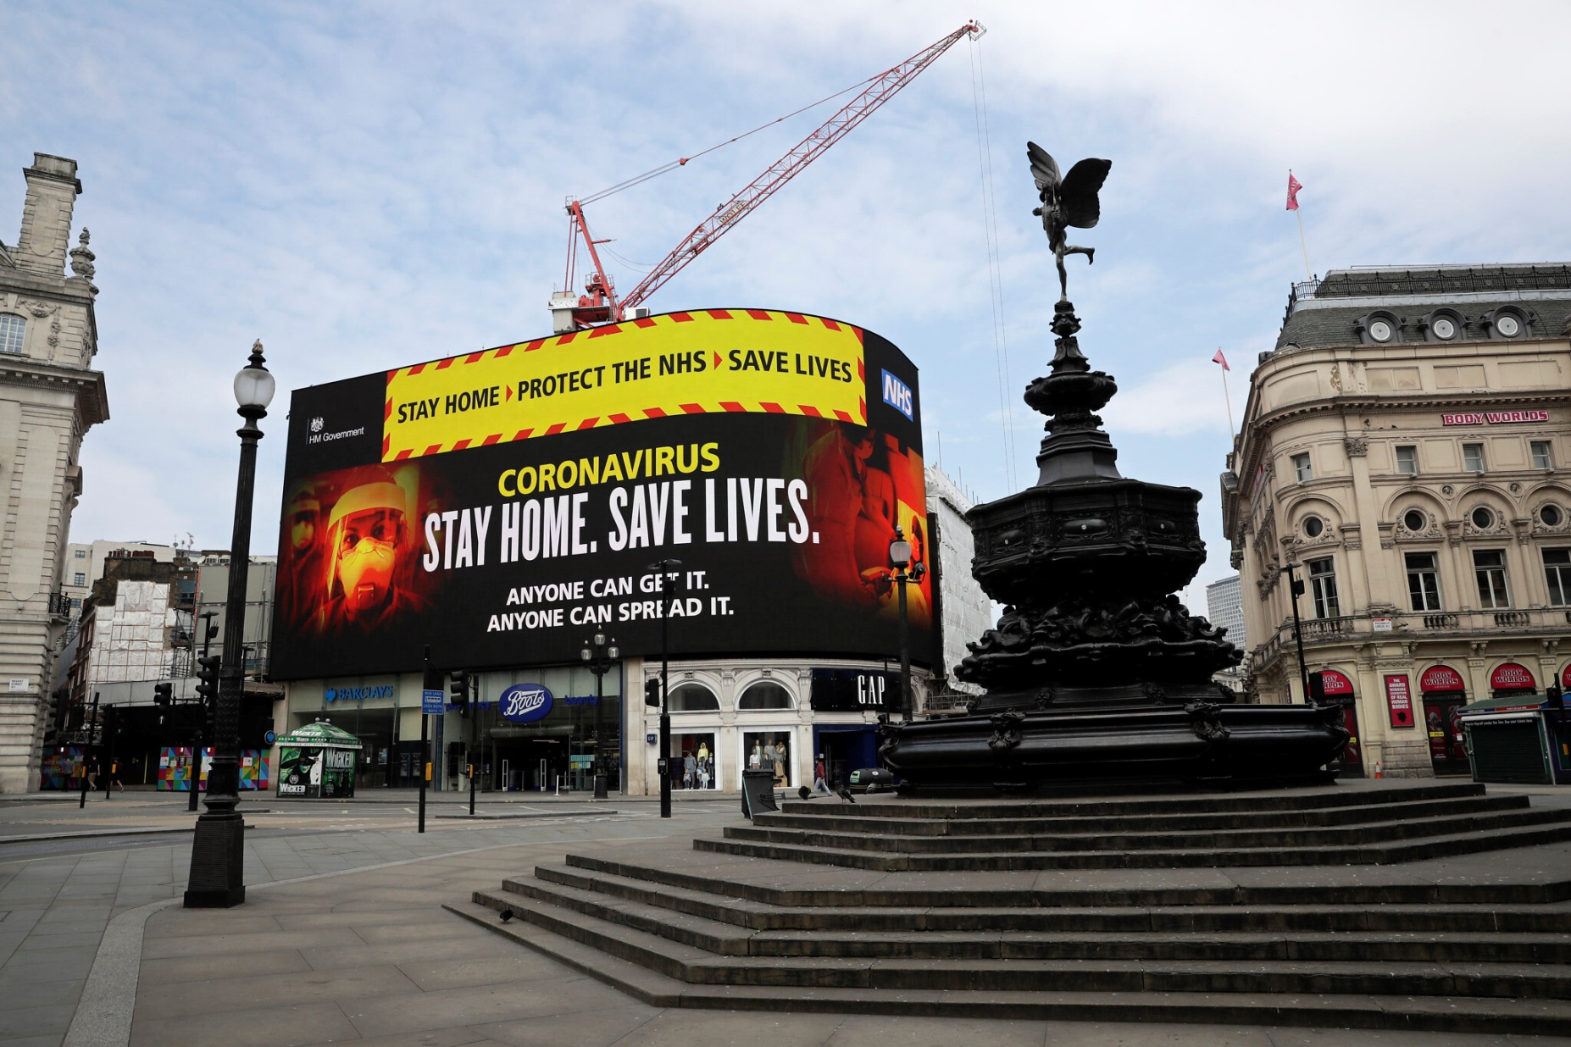

Slide 21
Advocating for vaccine eligibility
Extreme burden of premature mortality and morbidity
High risk of COVID-19 transmission and outbreaks compared to the general population
Lower vaccine coverage compared to the general population
COVID-19 = Inequality amplifier
Already have an effective outreach model

Slide 22
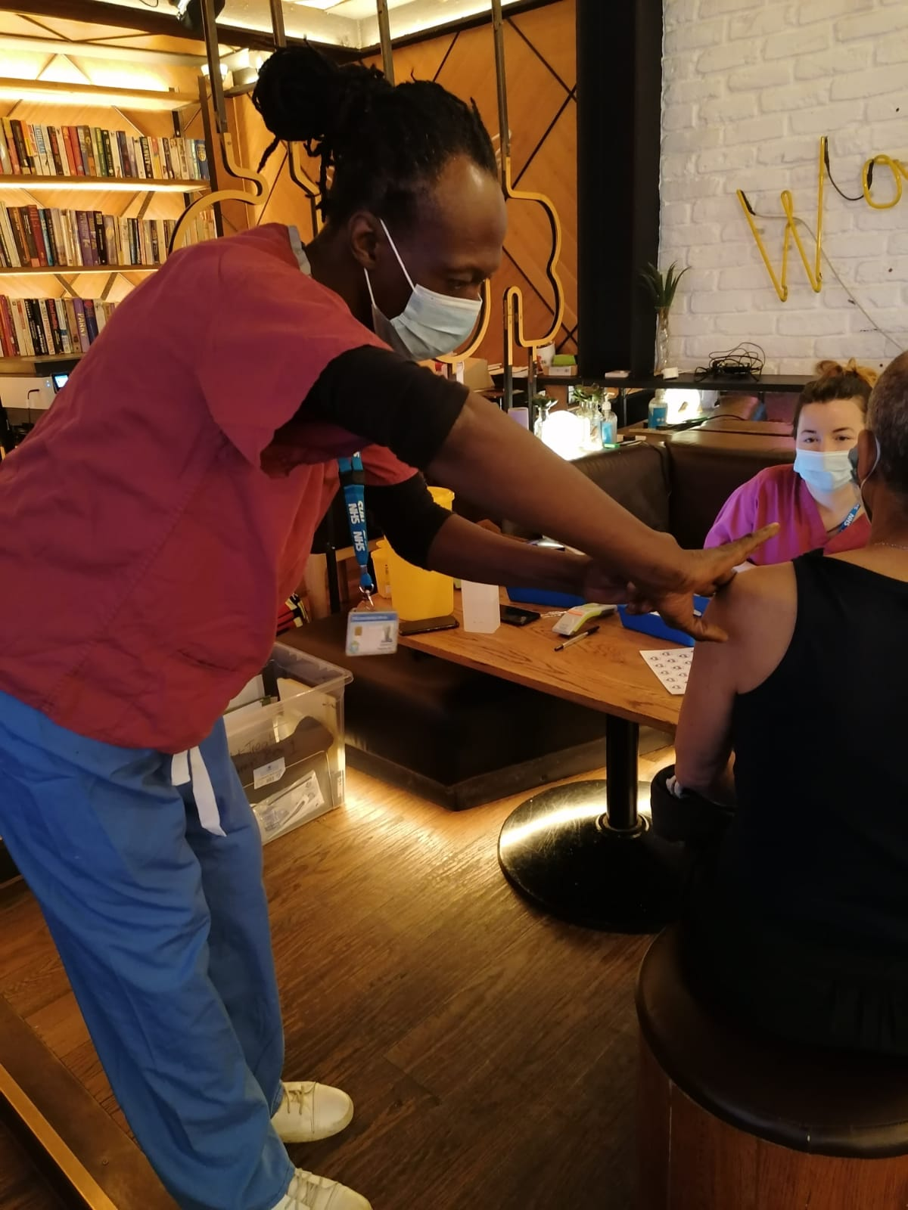
Outreach Immunisation Model
Lived & Learned Experience – What works?
Peer led – extended clinical roles
Universal Offer – Service users & Staff
Continuous offer – don’t miss a trick!
Integrate with other health opportunities
  Flexible / Out-of-Hours
Educate – Reassure - Challenge hesitancy
[Story A, Aldridge RW, Gray T, Burridge S, Hayward AC. Influenza vaccination, inverse care and homelessness: cross-sectional survey of eligibility and uptake during the 2011/12 season in London. BMC Public Health. 2014 Jan 16;14:44
Flu vaccination: increasing uptake NICE guideline Published: 22 August 2018 www.nice.org.uk/guidance/ng103

Slide 23

Hesitancy

Slide 24
Outreach Vaccination Model
Joint planned outreach clinics working alongside local NHS
Planned independent outreach clinics (Find&Treat staff) at the request of local co-ordinators and local NHS
MECC - Opportunistic offer of vaccination alongside other health interventions provided on the MHUs – including to rough sleepers and street sex workers etc.

Slide 25
Reality
Not a Booster Campaign and unlikely to be a Booster campaign any time soon
  Need an integrated (MECC) Outreach offer 365
Co-administration is safe and highly acceptable
  Now all Peer Led – Pandemic legacy
Hesitancy declining…but still a barrier
  Need continued awareness and Education – Peer Led

Slide 26
Living with COVID
Vaccination works and is the best tool in our box
  Not the only tool – Testing - Clinical triage – Escalation - Support to isolate
  Outbreak prevention and control
  Own room as the standard – Welcome Centres
High levels of clinical vulnerability (1:4)
COVID-19 is endemic…and evolving

Slide 27
Thank you
Any questions

Slide 28

What we do
Homeless Link is the national membership charity for frontline homelessness services. We work to improve services through research, guidance and learning, and campaign for policy change that will ensure everyone has a place to call home and the support they need to keep it.
homeless.org.uk
@HomelessLink

