Slide 1
Shingles programme publications July 2023 Cherstyn Hurley UKHSA Immunisation and vaccine preventable diseases division

Slide 2
Shingles leaflet
Product code:C23SGX1EN
Combined leaflet for all eligible groups and includes eligibility, rationale, common side effects, Yellow card scheme and where to find more information.
Translations of the main leaflet are available to order and download in: Albanian, Arabic, Bengali, Bulgarian, Chinese(traditional), Chinese(simplified), Dari, Estonian, Hindi, Italian, Gujarati, Latvian, Lithuanian, Polish, Panjabi, Pashto, Russian, Spanish, Somali, Turkish, Tigrinya, Ukrainian, Urdu, and Yoruba
https://www.gov.uk/government/publications/shingles-vaccination-for-adults-aged-70-or-79-years-of-age-a5-leaflet

Slide 3
Shingles leaflet – accessible versions
BSL video product code:
Large print product code: C23SGX1LP
Audio – product code: C23SGX1AU
Braille product code: C23SGX1BR

Slide 4
Shingles poster for patients
There is a shingles programme poster for patients that should be positioned in GP and clinic waiting rooms, traffic areas in hospitals and trusts and in pharmacy locations.
Product code: 2942856B
2942856B.

Slide 5
Shingles record card
Product code: S23RC01
Packs come in 25 cards so if you order 2 packs you will have 50 cards.
Can be used to record Zostavax or Shingrix.
Please order enough stock to give a record card to each person vaccinated.

Slide 6
Shingles stickers
Product code: S23ST04
Each sheet of stickers contains 24 stickers. If you order 10 sheets you will have 240 stickers in total.
Please order enough stocks to offer anyone who is given a vaccine a choice of sticker.

Slide 7
Shingles full programme poster
Full programme poster product code: S23PFO2
This is the full shingles programme landscape poster guide to eligiblity and copies should be ordered and displayed administration settings.
https://www.gov.uk/government/publications/shingles-vaccination-eligibility-poster

Slide 8
Shingles quick guide poster
Quick guide to eligible patients poster for health professionals
Includes those over 50, turning 70 and 65 in the first 4 years of the programme.
Order your copies using product code: S23PO1
https://www.gov.uk/government/publications/shingles-vaccination-eligibility-poster

Slide 9
Shingles vaccination invitation postcards
Set of two postcards available to order.
Birthday balloon postcard
Product code: S23PC02
Active ageing themed
Product code: S23PC03
https://www.gov.uk/government/publications/shingles-vaccination-for-adults-aged-70-or-79-years-of-age-a5-leaflet

Slide 10
Shingles checklist – plan your programe
This shingles programme checklist is a quick guide to effectively introducing the programme with the new Shingrix vaccine and improving uptake of both Shingrix and Zostavax in all eligible groups.
Every vaccinator and practice or pharmacy team member should be encouraged to promote the shingles vaccine and appointments to eligible patients when they reach eligible age.
Order your copy using product code: S23CHEN

Slide 11
Shingles social media cards
Product code: S23SMWB1
There are 12 social media cards that can be downloaded to share on social media and websites or in text messages.

Slide 12
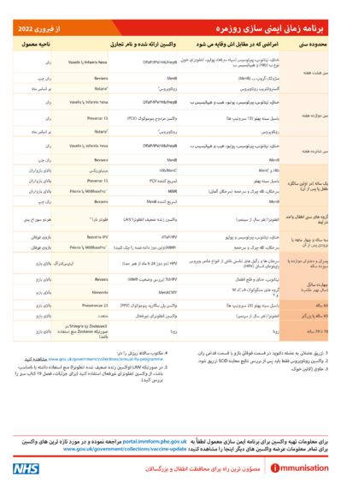
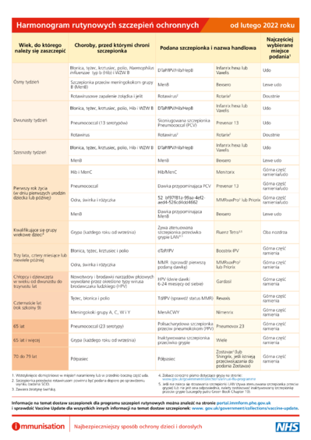
UK complete immunisation schedule – now available in 30 community languages
The UK complete immunisation schedule now available translated into the languages below to download as a PDF in:
Albanian, Arabic, Bengali,
Bulgarian, Chinese (simplified), Chinese (traditional), Dari, Estonian, Farsi,
French, Greek, Gujarati, Hindi,
Italian, Latvian, Lithuanian, Panjabi,
Pashto, Polish, Portuguese, Romanian, Romany, Somali, Spanish, Tagalog,
Tigrinya, Turkish, Twi, Ukrainian, Urdu, Yiddish and Yoruba.

Slide 13
Where to find the shingles publications to order
Health publications website
Free service
Deliveries 3-5 working days
Short link:
https://qrco.de/healthpubs
Resources to support health and social care workers delivering the routine vaccinations

Slide 14
Accessible resources
For example
Polio leaflets for London parents
English, Albanian, Arabic, Bengali, Bulgarian,
Chinese (simplified), Chinese (traditional, Cantonese), Estonian, Farsi, French, Greek,
Gujarati, Hindi, Italian, Latvian, Lithuanian,
Panjabi, Pashto, Polish, Portuguese, Romanian,
Romany, Russian, Somali, Spanish, Tagalog,
Tigrinya, Turkish, Twi, Ukrainian, Urdu,
Yiddish and Yoruba.
Alternative formats:
A Braille version of this leaflet is available to order.
An English large print version is available to order.
British sign language video
Audio versions
Large print for partially sighted/older adults
Easy read with symbols – picture and few words
Braille
HTML is critical for low bandwidth and assistive technology
Simple text version for very low literacy
Translations into community languages
Paper resources are equitable, don’t require
data, connectivity or bandwidth
Critical that everyone gets equitable information!

Slide 15
Vaccine Update – Immunisation bulletin
CQC endorsed – ‘registering and reading Vaccine update is one of the indicators of best practice’
See previous issues here https://www.gov.uk/government/collections/vaccine-update
Audience:
Screening and immunisation teams, clinics, GP practices, practice nurses, midwives, student nurses, health professionals
One stop shop for policy, supply or vaccine programme implementation including the training, guidance documents, examples of best practice, implementation guidance and patient facing resources to promote the campaign.
Register for the free bulletin here: Sign up to receive the Vaccine update newsletter.

Slide 16
Vaccine update shingles special issue 340
Introduction of Shingrix® vaccine for the whole programme and expansion of eligible cohorts
Main changes to the shingles programme
1.Change of vaccine
2.Changes to eligibility
Shingles vaccine supply
Nominate your shingles vaccine lead
Vaccine coverage data collection
Resources to support the national shingles programme
Vaccine supply
Non-routine vaccine supply
Click here to view https://www.healthpublications.gov.uk/ViewArticle.html?sp=Svaccineupdateissue340july2023shinglesspecial

Slide 17
Green book on immunisation – chapter 28a shingles
updated to include the programme changes from 1 September 2023
recommendations for the use of the vaccines
risk groups for the severely immunocompromised see box on page 7
NB previous chapter remains on page ahead of programme change
https://www.gov.uk/government/publications/shingles-herpes-zoster-the-green-book-chapter-28a

Slide 18
Order stocks of all of the resources now Health Publications website https://www.healthpublications.gov.uk/Home.html or phone 0300 123 1002
Reference Guide

