Slide 1
MMR call / recall Communications Toolkit
Regional NHS Communications
February 2024
Notes:
Standard title slide

Slide 2
What is the background?
Measles cases are on the rise, with unvaccinated children and young adults at risk of becoming seriously unwell.
UKHSA announced a national measles incident in January 2024 following an increase in confirmed cases. All regions have measles cases with London and the West Midlands highlighted as having more cases. Without intervention UKHSA predict the measles cases will continue to rise in all regions. For latest figures see here
The uptake figures of the MMR vaccination has been in decline for over ten years, with on average at least one in ten children unvaccinated and at risk of becoming seriously unwell. In some areas this is as high as four in ten children.
NHSE are launching a national call / recall inviting those not fully vaccinated to come forward to catch up on missed doses of the MMR vaccination.
Notes:
Plain slide with subhead and bullets

Slide 3
MMR Vaccine uptake
Lower than the WHO recommended 95% vaccine uptake and the measles virus circulating is creating the perfect storm for infection to spread.
The MMR vaccine has been in decline for over ten years with COVID-19 and misinformation exacerbating the problem. This in line with other childhood vaccinations.
The vaccination rate for both MMR doses at age 5 years is 84.5% for England, lower than the 95% target set by the WHO and as low as 60% in some areas of London. (data from UHKSA published uptake stats)
Millions of children under the age of 16 are not fully protected against measles. This is the number of children who have missed one or both doses of the MMR vaccine.
Notes:
Plain slide with subhead and bullets

Slide 4
The Measles risk
Measles is more than just a rash – it’s serious
In England cases of measles are continuing to increase as is the risk to those unvaccinated. Measles is serious and without intervention, the NHS could see many hospitalised, and there is a real risk of completely preventable measles related deaths.
The risk of measles is perceived by some parents as low, citing it being ‘just a rash’. The media are calling the virus a ‘Victorian disease’, the return of an old virus. Neither are true with measles being present throughout the decades, but that the vaccination programmes had kept it at bay in recent years.
Measles can cause blindness, sepsis and meningitis, with encephalitis being a serious concern years after the infection has passed. Currently there are a number of children in hospital with measles.
Measles is one of the world's most infectious diseases, with an R rate of R15, making it more infectious than COVID-19, a cold and flu. Without an increase in vaccination rates UKHSA modelled that there could be over 160,000 cases in London alone.
Notes:
Plain slide with subhead and bullets

Slide 5
MMR national call / recall – February 2024
Call / recall will target those unvaccinated and partially vaccinated
To target those not fully protected against measles (missing one or both doses of their MMR vaccine) NHSE are launching a call / recall inviting the following cohorts to book an appointment to catch up on their MMR vaccinations;
Cohort one (One to five-year-olds) parents / carers already being contacted through their GP surgeries between November 2023 and March 2024
Cohort two (Six to 11-year-olds) parents / carers in England to receive a communication in February and March 2024
Cohort three (11 to 16-year-olds) parents / carers in London and West Midlands will receive a communication in February and March 2024. Greater Manchester will receive a recall in March only.
Cohort four and five (17 to 25-year-olds) in London, Greater Manchester and West Midlands to receive communications in February and March 2024.
The campaign will see communications sent via text message, email and letters, and for those over 16 years the NHS app will also send a communication.
The communication invites all those contacted to book a catch-up appointment at their GP surgery to receive their next dose of the MMR vaccine. In London, school age children can also contact their School Aged Immunisation Service to arrange a catch up in school or through a clinic.
An MMR invites web page for more information has been launched at www.england.nhs.uk/mmr-invites
Notes:
Plain slide with subhead and bullets

Slide 6
Objectives
To increase awareness of the seriousness of measles and the offer of the MMR vaccine as the best preventative
Increase awareness of ‘measles is more than just a rash’. There is no medical treatment for measles, and it can be life threatening and / or life limiting.
Educate communities of the benefits of the MMR vaccine to prevent children becoming seriously unwell.
To dispel misinformation;
Gelatine - there is a non-porcine MMR vaccine option
Natural immunity - building immunity ‘naturally’ risks children being seriously unwell
Autism – where this is an issue, reiterate there is no link between the MMR vaccine and autism. (National Autism Society state ‘There is no link between autism and vaccines.’)
Remind people the MMR vaccine needs 2 doses; at one year and three years and four months
Increase awareness that young adults also need to catch up on any missed MMR vaccines
Notes:
Plain slide with subhead and bullets

Slide 7
Audience / Insights
Primary audience
Parents / guardians and carers of children aged 6-11 years ( All regions receiving the call / recall for this cohort)
Parents / guardians and carers of children aged 1-5 years (GP call / recall target group)
Secondary audiences
Parents / carers of children aged 12+
Young adults from 17-25 years
Those looking to conceive (MMR vaccs before getting pregnant)
Healthcare professionals
Stakeholders and children's charities
Notes:
Plain slide with subhead and bullets

Slide 8
Key messages
Measles cases continue to rise in England
Over one in ten children across England remain at risk of catching measles without both doses of the MMR vaccine
Measles is not just a childhood disease; adults can become seriously unwell
Measles in pregnancy is serious and can cause stillbirth, premature labour and miscarriage.
One in 15 measles cases can have complications such as meningitis, sepsis and blindness
Measles is one of the world's most infectious diseases, with one infected person giving it to approximately 15 other unvaccinated people.
One in five children will require a hospital visit if they become unwell with measles (source)
Millions of parents will be contacted from today (5th Feb) inviting them to book their child in for any missed doses of the MMR vaccine
Thousands of young adults will today (19th February) be contacted to catch up on missed MMR vaccines (West Midlands, Greater Manchester & London only)
The Measles, Mumps and Rubella (MMR) vaccine is safe and has been used since the 1980s.
There is no medical treatment for measles; MMR vaccination is the best protection against becoming seriously unwell
Over 20 million cases of measles have been prevented since the start of measles vaccination in the UK. Over 4,500 lives have been saved as a result (81 lives per year) *source is UKHSA
MMR vaccination is free on the NHS with the first dose being offered when a child is one year and the second at 3 years and 4 months old. This provides long lasting protection against measles, mumps and rubella
The evidence is clear; there is no link between the MMR vaccine and autism
Call to action
If you or your child may have missed out on the MMR vaccine, contact your GP practice as soon as possible to check your records and to book an appointment to catch up.
For more information visit the NHS website
Notes:
Plain slide with subhead and bullets

Slide 9
Action for Regional Communications
To support the MMR call / recall campaign it would be great for teams to;
Where possible circulate the information to encourage stakeholders to amplify messages
Share content on social media, new assets available
Share content with regional press, including local statistics for children not fully vaccinated
Circulate assets for regional and local teams to use
Encourage primary care teams / ICBs / SAIS to discuss MMR with this unvaccinated
Local outreach work with key demographics in your community who are vaccine hesitant
Contact education settings and head teachers to circulate the information to parents
Notes:
Plain slide with subhead and bullets

Slide 10
MMR inequalities
Examples of innovation in low uptake communities
In some communities where the uptake of the MMR vaccine has been lower, some GP surgeries, primary care teams and the inequalities teams have tried new initiatives to try and increase engagement and intimately uptake of the MMR vaccine. The has included;
Calls to parents of unvaccinated children
Local outreach to key communities
Clinics in religious settings
Working with local community leaders and religious leaders
Health events in communities
Here are some case study examples of what has been achieved in some communities, such as in Sandwell and London.
More information on shared learning, inequalities and innovation for MMR uptake can be found here
Notes:
Plain slide with subhead and bullets

Slide 11
Communications Assets

Slide 12
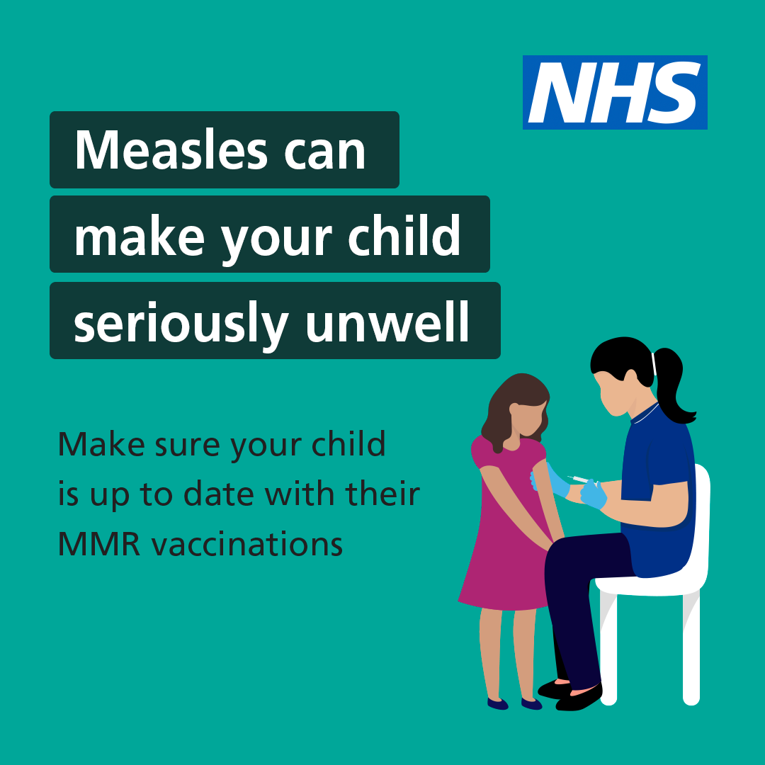
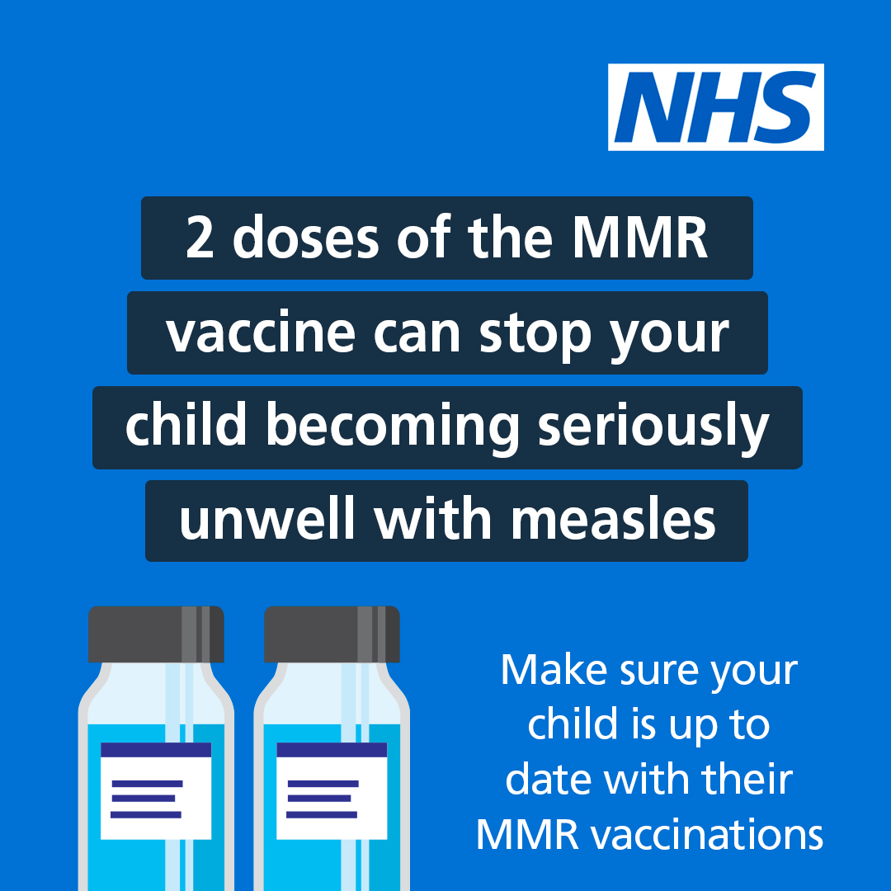
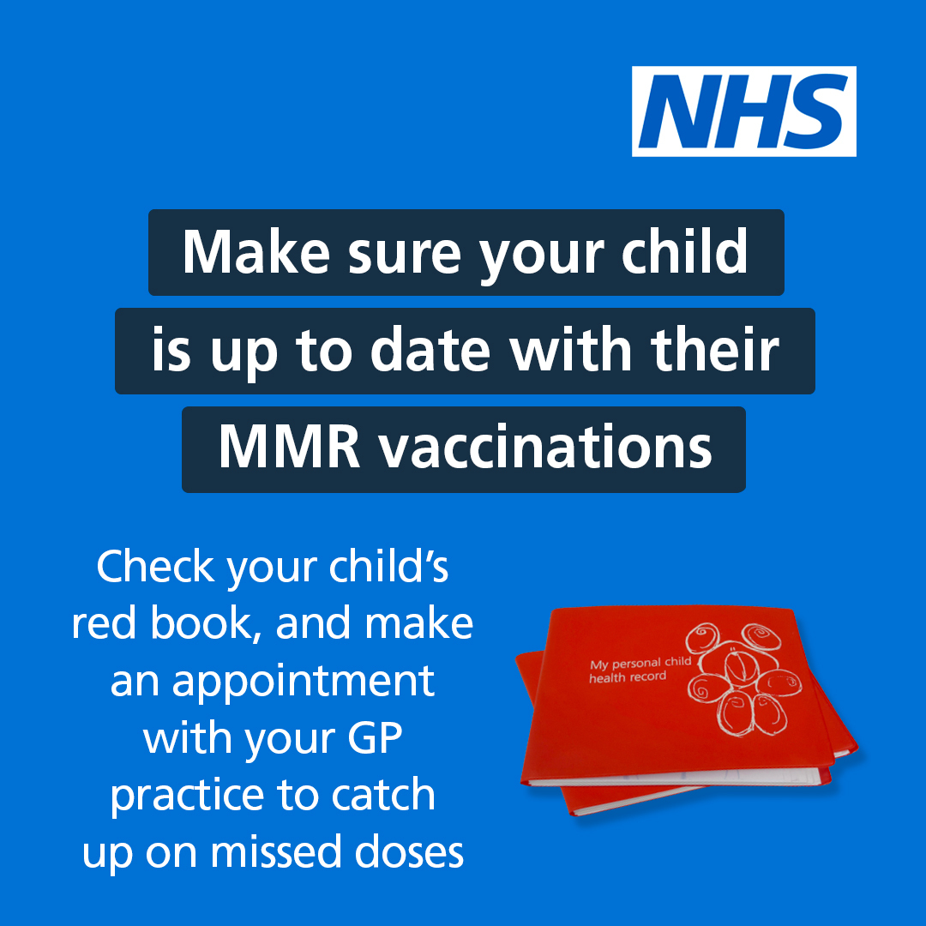
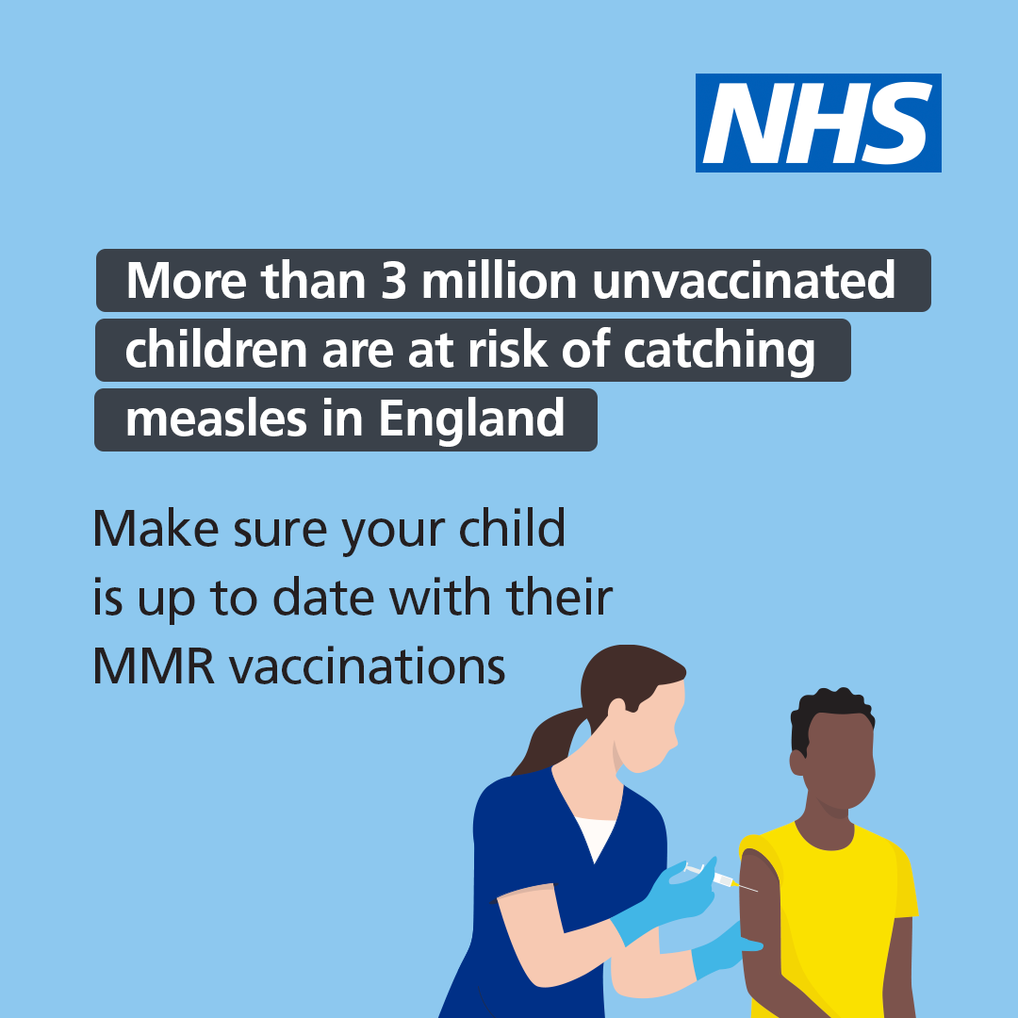
Social Media Assets
Child focused
The following assets can be used to support the call / recall for children
These assets, suggested lines and previous MMR social media assets can be found on Futures here
Notes:
Plain slide with subhead and bullets

Slide 13
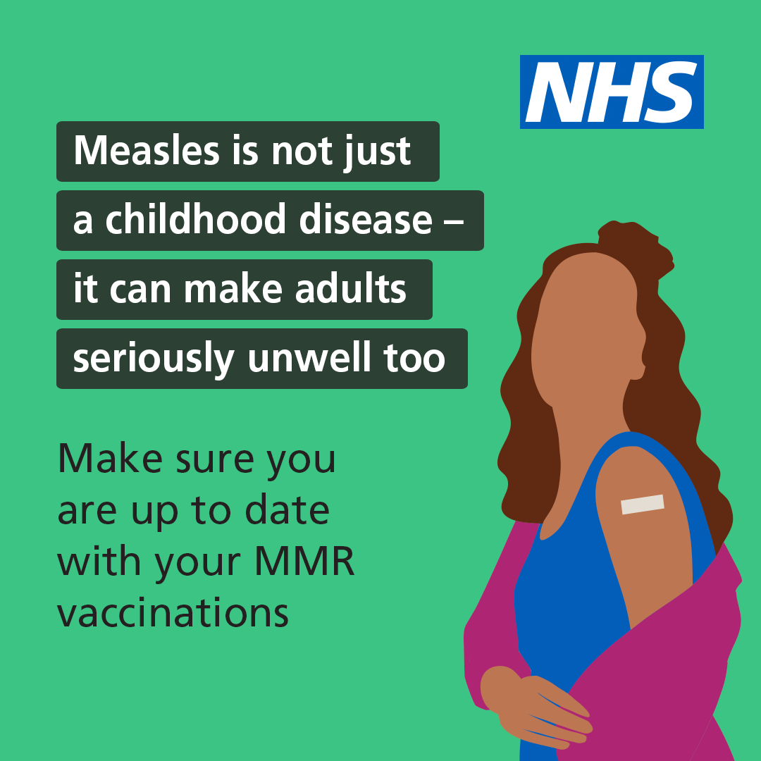
Social Media Assets
Adult focused
The national call / recall will focus on young adults up to the age of 26 years in London, Greater Manchester and the West Midlands.
Any region can also encourage young adults to come forward and catch up on any missed MMR doses at their GP surgery.
These assets, suggested lines and previous MMR social media assets can be found on Futures here
Notes:
Plain slide with subhead and bullets

Slide 14
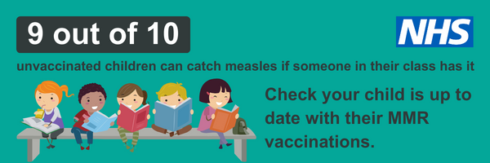
Other assets
More MMR assets have been created to help increase awareness of measles and the MMR vaccine. All can be found on Futures here
Digital Screens Email footers
Notes:
Plain slide with subhead and bullets

Slide 15
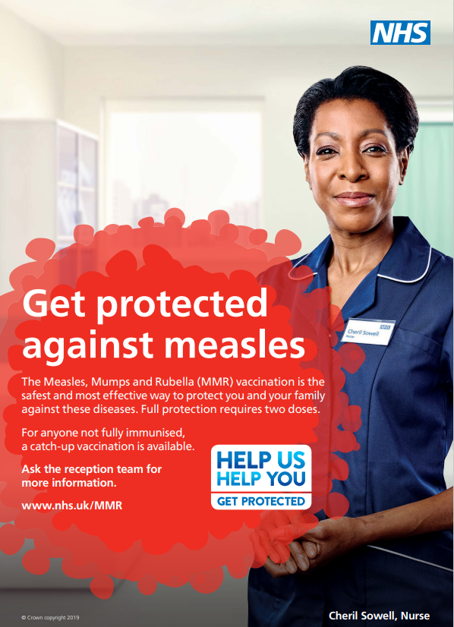
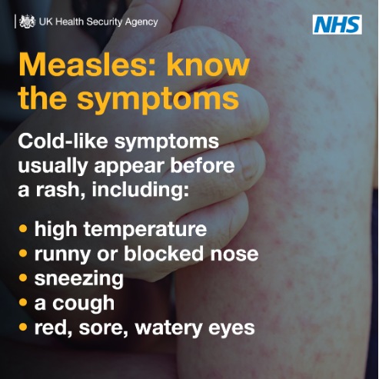
Other assets
Further useful information, reports, shared learning and assets are available on Futures here including;
MMR posters (various languages) UKHSA carousel videos
Notes:
Plain slide with subhead and bullets

Slide 16
Press activity
Measles is expected to continue being high profile into 2024
Following the high profile of measles in the media, on 22nd January NHSE launched a press release around the call / recall and the number of children at risk of catching measles.
The full press release is here and can be used and tailored for regional media / bulletins / communications.
The published number for children in regions that are not fully protected can be found here. These stats and can be used in communications with press and social media.
Further press activity will continue as the measles cases rise with further calls to action for parents and those unvaccinated.
UKHSA will be announcing frequent updates on confirmed measles case numbers
Notes:
Plain slide with subhead and bullets

Slide 17
NHSE Call / recall materials
Template assets available for use in communications
The NHSE national call / recall materials used in the current campaign can use found here. These templates and key messages can be used in local call / recalls where suitable. This includes;
Under 16 years
SMS message to parents
Email template to parents
Letter to parents
Over 16 years
SMS message to unvaccinated individual
Emails template to unvaccinated individual
Letter template to unvaccinated individual
App template to unvaccinated individual
Notes:
Plain slide with subhead and bullets

Slide 18
Bulletin copy
NHSE urges those unprotected against measles to come forward for their vaccinations
Measles cases are continuing to rise across England, with a number of unvaccinated children and young adults requiring hospital as infections take hold.
This month, millions of parents, carers and young adults in England are being contacted by the NHS to book missed measles, mumps, and rubella (MMR) vaccines as part of a major new campaign to protect those at risk from becoming seriously unwell.
NHS figures show millions of children under the age of 16 years are either unprotected or not fully protected and at risk of catching these serious and completely preventable diseases.
Measles is not just a childhood disease and can be serious at any age. If caught during pregnancy it can be very serious causing stillbirth, miscarriage and low birth weight and NHS bosses are also urging young adults to catch up on any missed doses before thinking about starting a family.
Two doses of the safe and effective MMR vaccine are needed for maximum life-long protection, with the first dose given around the child’s first birthday, and the second dose given at around three years and four months old.
However, anyone can catch up at any age on any missed doses and it’s never too late to protect yourself.
If you or your child have not had both dose of the MMR vaccine contact your GP surgery to book an appointment as soon as possible and catch up.
Notes:
Plain slide with subhead and bullets

Slide 19
Useful Links
Social Media Handles
NHS UK
Facebook account: @NHSWebsite
Twitter / X account: @NHSuk
Instagram account: @NHS
NHS England
Facebook account: @NHSEngland
Twitter / X account:@nhsengland
Instagram account: @nhsengland
Department of Health and Social Care
Facebook account: @DHSCgovuk
Twitter / X account: @DHSCgovuk
UK Health Security Agency
Facebook account: @UKHealthSecurityAgency
Twitter / X account: @UKHSA
Weblinks
NHS vaccination schedule
Quarterly Childhood Vaccination Coverage – 2022/23 (Source: Gov.uk)
MMR Shared Learning, Inequalities & Innovation - Vaccinations and Screening - FutureNHS Collaboration Platform
UKHSA Measles leaflets and posters
Notes:
Plain slide with subhead and bullets

Slide 20
End slide

