Slide 1
Flu vaccinations 2024/25
Toolkit for GP Practices: Improving uptake for eligible children and adults
South West Vaccination and Screening Team
NHS England – South West
England.swicars@nhs.net

Slide 2
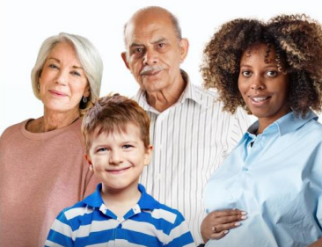
About this toolkit
This toolkit reflects guidance from the national Flu Letter (National flu immunisation programme 2024 to 2025 letter - GOV.UK (www.gov.uk)) and uses evidence from a study into factors associated with higher flu vaccine uptake¹.
High-performing practices will already use several of these tools and follow good practice for encouraging high uptake of the flu vaccine in their setting.
If you need further guidance, please contact the South West Vaccination and Screening Team: england.swvast@nhs.net. For clinical vaccine queries, please email england.swicars@nhs.net
¹ Dexter L et al. (2012) Strategies to increase influenza vaccination rates: outcomes of a nationwide cross-sectional survey of UK general practice.
Image taken from https://www.healthpublications.gov.uk/ViewProduct.html?sp =Sthefluvaccinationwhoshouldhaveitandwhy-4173

Slide 3

The basics
Have a lead individual responsible for the flu programme – this is your flu advocate for the season
Hold an up-to-date and regularly reviewed register that can identify all eligible patients Checking phone numbers, addresses, including newly diagnosed patients, updating pregnancy status etc before and during the season. Keep checking eligibility during the season.
Ensure all eligible patients receive a personalised invitation for flu vaccination by letter, phone call, text or email – this is a requirement of the enhanced service specification
If patients don’t reply or attend, ensure you have a system for recalling non-responders remaining unvaccinated leaves these patients at risk of flu complications. Implementing a plan for practice staff to check if the patient has had their flu vaccination when speaking with them for other reasons (MECC)
Continue to recall until you have an active decline.

Slide 4
This year’s cohorts and timings
Date eligible from: | Cohorts eligible
From 1st September 2024: | Pregnant women or people All children aged 2 or 3 years on 31 August 2024 Primary school aged children (from Reception to Year 6) Secondary school aged children (from Year 7 to Year 11) All children in clinical risk groups aged from 6 months to less than 18 years
From 3rd October 2024: | Those aged 65 years and over Those aged 18 years to 64 years in clinical risk groups (as defined by the Green Book, Influenza Chapter 19) Those in long-stay residential care homes Carers in receipt of carer’s allowance, or those who are the main carer of an elderly or disabled person Close contacts of immunocompromised individuals Frontline workers in a social care setting without an employer led occupational health scheme including those working for a registered residential care or nursing home, registered domiciliary care providers, voluntary managed hospice providers and those that are employed by those who receive direct payments (personal budgets) or Personal Health budgets, such as Personal Assistants All frontline health care workers, including both clinical and non-clinical staff who have contact with patients, should be offered flu vaccine from October as a vital part of the organisations’ policy for the prevention of the transmission of flu. Social care workers directly working with people clinically vulnerable to flu should also have the flu vaccine provided by their employer. There are circumstances where frontline staff, employed by specific social care providers without access to employer led occupational health schemes can access the vaccine through the NHS free of charge.

Slide 5
This year’s national ambitions
Systems should maximise opportunities to co-promote and co-administer (e.g.COVID-19, Flu, RSV, shingles and pneumococcal)
GPs and school providers to demonstrate 100% offer to all eligible patients
Health inequalities plan for all underserved groups and improvement in coverage in those groups who were more than 5% lower than the national average
Cohorts eligible | 2024/25 Ambitions
Children aged 2-3 | Improved uptake from 2023-24
School aged children (Reception to Year 11) | Achieve and aim to exceed 2023-24 uptake
Clinical risk groups | Improved uptake from 2023-24
Pregnant women or people | Improved uptake from 2023-24
Aged 65 and over | Achieve and aim to exceed 2023-24 uptake
Care home residents | Achieve and aim to exceed 2023-24 uptake
Carers | Achieve and aim to exceed 2023-24 uptake
Close contacts of immunocompromised | Achieve and aim to exceed 2023-24 uptake
FHCW without employer led OH schemes | Achieve and aim to exceed 2023-24 uptake
FHCW (though OH) – including primary care | Between 70% and 90% of staff

Slide 6
Reviewing last season
Check your uptake figures on ImmForm or through your practice system to see how you did last year.
Identify what went well and where you could improve – did clinics work or were appointments better?
Set a higher goal for uptake than you achieved in the previous season.
Unvaccinated eligible patients are at risk of the complications of flu – challenge yourself to identify these patients and to make personalised vaccination offers.
Think about your patients who didn’t attend or respond – is vaccination accessible, e.g. can clinic times be adapted for patients to attend before or after work, weekends and evenings? What do they need to enable them to attend?
How did you talk to patients about their risk of flu? How else could you get the message about risk across and the benefits of vaccination?
What was your uptake in the individual ‘at risk’ groups? E.g. patients with chronic respiratory disease, chronic heart disease, COPD etc. Could you pay special attention to making invitations to those groups with the lowest uptake?
Think about your patients who are most at risk and how to encourage their uptake.

Slide 7

Involving all practice staff
Your staff are key to a successful flu programme.
Make sure all staff in all roles understand the importance of the flu programme and the impact that flu can have on vulnerable patients.
All staff should be advocates for flu vaccination.
Make sure non-clinical staff know where they can signpost patients for more information in the practice.
Take every opportunity to discuss vaccination with patients. Think about your MECC offer and how this can be fully incorporated.
Ensure your staff are offered vaccination.
Keep staff enthused during the season – consider an incentive promoting staff competition.
Utilising resources such as posters and leaflets around the practice.

Slide 8

Pre-season checklist
Make sure your practice staff are aware of the named flu lead or flu team within the practice.
Ensure you have a list of your eligible population and have ordered sufficient vaccine considering your ambition to increase your uptake and anticipated population increase.
Confirm you have the right vaccine for the right eligible groups.
Vaccines for under 18s are ordered through Immform and there are caps on ordering, make sure you know how much you can order at a time.
Utilise national letter templates for individual invites to patients: Annual flu programme - GOV.UK (www.gov.uk) Templates will be available nearer to the start of the flu season.
Offer a range of appointments, day-time clinics, evenings, weekends as well as opportunistic vaccination.
Make use of pop-ups on the practice system to remind staff that patients are eligible.
Build in time for admin staff to undertake recall of patients who haven’t attended or responded.
Have plans in place for the vaccination of care home and housebound patients

Slide 9
Vaccine recommendations by age
Eligible group | Type of influenza vaccine
6 months to under 2 in a clinical risk group | Offer QIVc QIVe can also be considered if QIVc is not available. As this is a second line vaccine, it is not supplied by UKHSA’s ImmForm website.
2 years to under 18 years in eligible year groups or in a clinical risk group | Offer LAIV QIVc is available where LAIV is contraindicated or otherwise unsuitable (for example, parents object to LAIV on the grounds of its porcine gelatine content)If QIVc is not available, offer QIVe.
18 years to 64 years⁵ in a clinical risk group and pregnant women | Offer QIVc (or QIV-HD for 60 years and over only) QIVe can also be considered only when every attempt to use QIVc has been exhausted. Evidence of this may be requested by the commissioner before reimbursement is agreed.
65 years and over | Offer QIV-HD or aQIV⁵ QIVc can also be considered only when every attempt to use QIV-HD or aQIV has been exhausted. Evidence of this may be requested by the commissioner before reimbursement is agreed.
⁵ - Those who become 65 years of age before 31 March 2025 may be offered aQIV ‘off-label’.
Information taken from: National flu immunisation programme 2024 to 2025 letter - GOV.UK (www.gov.uk)

Slide 10
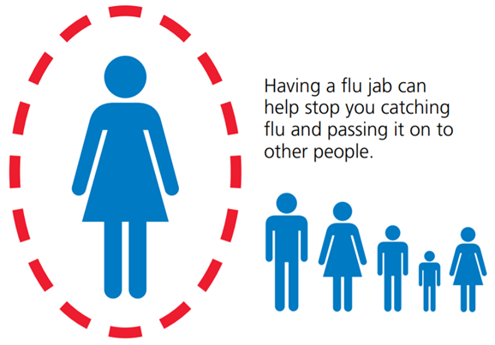
During the flu season
Prioritise pregnant women and people, and children early in the season from 1st September 2024.
To maximise and extend protection during the winter and through the period of greatest risk in December 2024 and early January 2025, systems must commence vaccination for care home residents and care home staff from October 2024, and other eligible flu and COVID cohorts from October.
Monitor your uptake through the season regularly
Keep the patient register up-to-date and proactively contact eligible patients who haven’t attended
Liaise closely with maternity services to ensure your pregnant patient list is up-to-date
Hold regular meetings with staff so everyone knows the practice plan and progress. Make sure you celebrate your success.
Use national resources to create colourful poster displays
If a patient hasn’t attended or responded – recall!

Slide 11
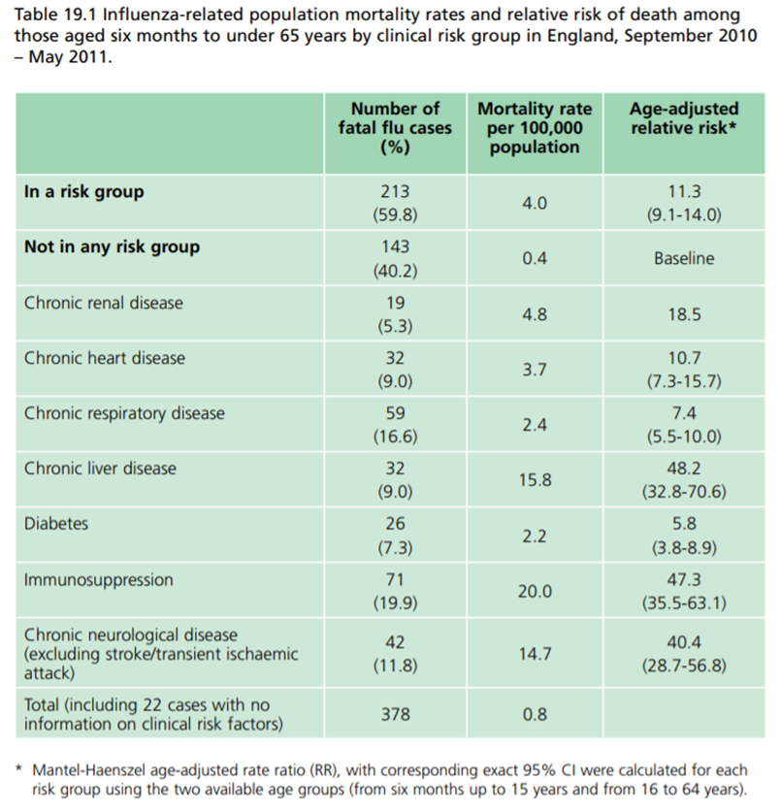
Which patients are most at risk
Increasing flu vaccine uptake in clinical risk groups is important because of increased risk of death and serious illness if people in these groups catch flu
For a number of years only around half of patients aged 6 months to under 65 in clinical risk groups have been vaccinated
Strategies to improve vaccine uptake should be tailored to each risk group to ensure optimum uptake of vaccine in each of them.
Further information on flu vaccination for those with learning disabilities can be found on the GOV.UK website www.gov.uk/government/publications/flu-vaccinations-for-people-with-learning-disabilities/flu-vaccinations-supporting-people-with-learning-disabilities
Slide adapted from national imms team flu slideset found here: Annual flu programme - GOV.UK (www.gov.uk)

Slide 12
Why don’t some patients attend?
A recent study looked at older people’s attitudes towards flu vaccination.
The study found that attitudinal barriers were significant in influencing flu vaccination. They broke attitudinal barriers down into two main types:
Not everyone sees themselves as vulnerable to flu
Not everyone believes that the vaccine works
They found that patients knew that flu was a health concern and that being older meant you could be more vulnerable to disease, but this didn’t translate into seeing themselves as vulnerable. Framing vaccination as part of a healthy lifestyle might generate a more positive response from older patients:
‘…presenting immunisation as a positive and healthy lifestyle choice’ (page 2)
International longevity centre UK (2019) Under the skin: listening to the voices of older people on influenza immunisation. https://ilcuk.org.uk/wp-content/uploads/2019/05/ILC-Under-the-skin.pdf
There is also a possibility of vaccine fatigue following the COVID-19 pandemic.

Slide 13
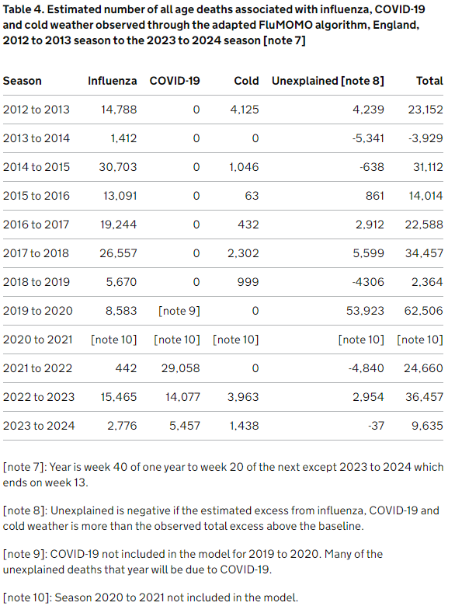
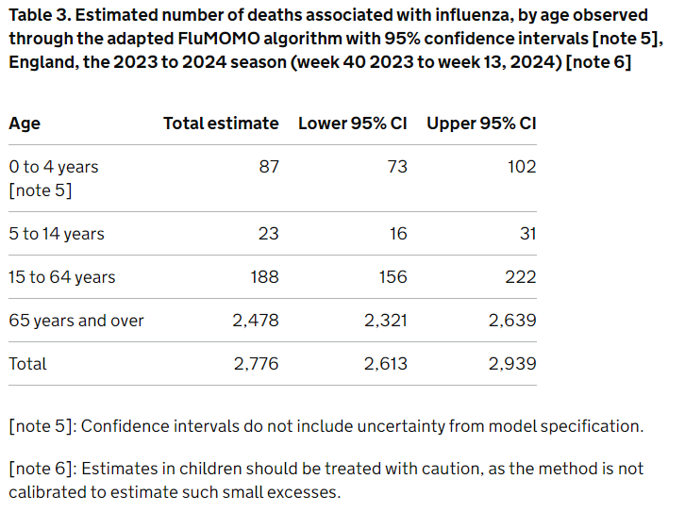
Flu Mortality 23/24
Influenza-related mortality for winter the 2023 to 2024 season is estimated at about 2,800 which is much lower than that seen in the 2022 to 2023 season and lower than all the pre-pandemic years in the model except 2013 to 2014.
Tables extracted from: Surveillance of influenza and other seasonal respiratory viruses in the UK, winter 2023 to 2024 - GOV.UK (www.gov.uk)

Slide 14
Maximising uptake
Raise awareness amongst patients tailoring to their concerns, communication needs and risk factors (including parents and carers of children eligible for vaccination).
Contact patients who don’t respond – phone or text may be more effective than a letter
Take any opportunity to discuss and/or offer flu vaccination – use flagging systems, other clinics and appointments
Create a display in the waiting room and promote through practice screens, website. Ensure you have multilingual literature available for all cohorts, along with easy read documents. Resources can be found here: Annual flu programme - GOV.UK (www.gov.uk). *Hard copies available to order via Home - Health Publications
Make sure patients know how to book an appointment
Make appointments accessible – after working hours, weekends, longer for those with additional needs, alongside other clinics (e.g. diabetes, asthma, CHD etc)
Ensure that all staff in your practice, but also others that you work with (i.e. health visitors, midwives, pharmacists) are promoting the flu vaccination, and find opportunities to work together.
Raise awareness of protecting each other during the flu season I.e. having children vaccinated helps to protect other family members such as grandparents or family with underlying health conditions

Slide 15
Top 10 messages to promote
Flu is much worse than a heavy cold flu symptoms can be severe and can come on suddenly. You’re likely to spend several days in bed and feel very unwell. Some people become seriously ill and are admitted to hospital.
You are at greater risk of complications from flu – you’re eligible for flu vaccination because you need it.
The flu vaccine is very safe.
The flu vaccine is the best protection we have against an unpredictable virus.
The flu vaccine CANNOT give you flu your arm might be a bit sore following vaccination and some people have a slight temperature
The flu vaccine stimulates your body’s immune system to make antibodies to attack the flu virus – if you’re exposed to the virus after you’ve been vaccinated, your immune system will recognise the virus and produce antibodies to fight it.
It can take up to 2 weeks for the flu vaccine to work, so get vaccinated as soon as you can.
You need to have the flu vaccine each year because the circulating strains of the virus change, and so different vaccines are produced to match.
Pregnant people can have the vaccination at any stage of pregnancy, flu can make you and your baby very ill. Vaccination can also protect your baby against flu after they’re born and during their first few months.
Your vaccination helps to protect those around you too, so elderly relatives, those with long-term conditions and other family members are all protected by your vaccination.

Slide 16
Resources
The South West Vaccination and Screening Team, including our flu locality coordinators, can provide support and guidance. To contact us, please email england.swvast@nhs.net. For clinical vaccine queries, please email: england.swicars@nhs.net
Additional resource can be found here:
2024/25 Flu Letter: National flu immunisation programme 2024 to 2025 letter - GOV.UK (www.gov.uk)
2024/25 Statement of Amendment to the annual flu letter: Statement of amendment to the annual flu letter for 2024 to 2025 – 12 June 2024 - GOV.UK (www.gov.uk)
General Practice Enhanced Service Specifications for the Seasonal Influenza Vaccination Programme 2024/25 NHS England » General practice: seasonal influenza vaccination programme enhanced service 2024/25 – additional guidance on recording of influenza vaccination events, payments and collaboration
Order leaflets and posters here: Home - Health Publications (free to order and deliver)
2024/25 Resources and guidance: Annual flu programme - GOV.UK (www.gov.uk)
The national flu immunisation programme training/update slide-sets: Flu immunisation training recommendations - GOV.UK (www.gov.uk)
E-learning:Flu Immunisation - e-Learning for Healthcare (e-lfh.org.uk)
Flu vaccine for children: best practice guide for GPs: Flu vaccine for children: best practice guide for GPs - GOV.UK (www.gov.uk)
NHS England South West Influenza website with further resources: NHS England — South West » Influenza

