Slide 1
Annual flu programme resources for children’s flu vaccination programme 2024 to 2025
UKHSA
25 June 2024

Slide 2
Ordering copies of flu resources
Paper copies of most resources are available to order at: www.healthpublications.gov.uk
Resources which are available to order are marked with a product code stamp. Search for the product code on the Health Publications website to order copies. If the product is currently out of stock, you may put a back order in which will be fulfilled when stock becomes available:
Other resources are download only:
Product code: xxxxxxxxx
Product code: xxxxxxxxx
Download only

Slide 3
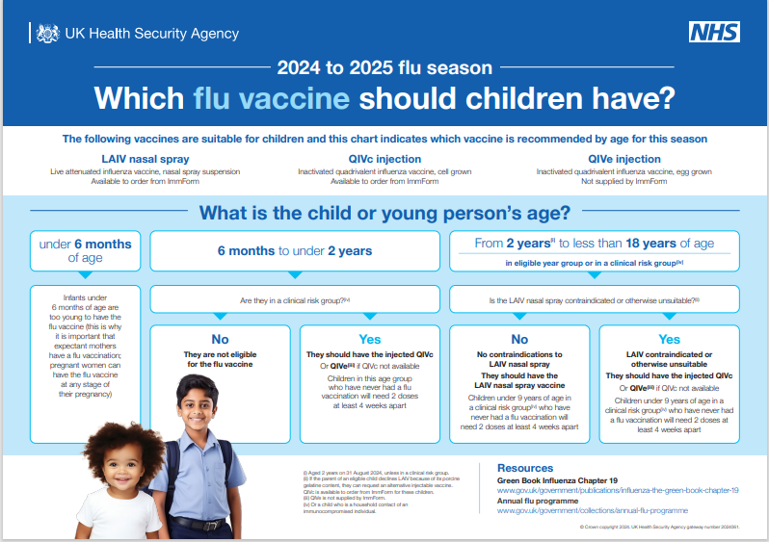
| Resources for healthcare professionals to support the children’s flu programme
Product code: Download only
www.gov.uk/government/publications/which-flu-vaccine-should-children-have

Slide 4
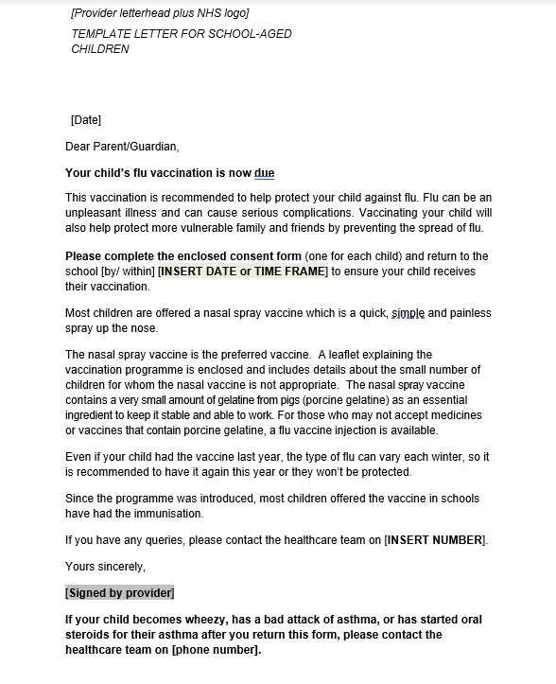
| Primary school resources – briefing, letter & stickers www.gov.uk/government/publications/flu-vaccination-in-schools
Stickers
Product code: FLUPY24
Product code: SCHFLSTK
Link to letter
https://www.healthpublications.gov.uk/ViewProduct.html?sp=Sflustickersforchildrenaged2to11years

Slide 5
| Primary school resources - leaflet
Protect your child against flu – information for parents and carers of preschool and primary school aged children
Paper copies of this leaflet are available to order for free or download in the following languages:
English, Albanian, Arabic, Bengali, Bulgarian, Chinese (simplified), Chinese (traditional, Cantonese), Estonian, Farsi, French, Greek, Gujarati, Hindi, Latvian,
Lithuanian, Panjabi, Pashto, Polish, Portuguese, Romanian, Romany, Russian, Somali, Spanish, Tagalog, Turkish, Twi, Ukrainian, Urdu and Yiddish.
An English large print version is available to order.
A Braille version of this leaflet is available to order.
A British Sign Language video of this leaflet is available to view.
This British Sign Language video is also available to download.
An audio version is available to download.
Please note:
the images on the translated and alternative versions differs to the English version
Product code: 2023FCEN
https://www.healthpublications.gov.uk/ViewProduct.html?sp=Sfluvaccinationprimaryschoolforparents

Slide 6
| Primary school resources - poster
5 reasons to vaccinate your child against flu poster for primary schools and pre-schools
Translations of this poster will be available shortly. We will send a notification when they become available to order. The poster will be available in the following languages:
English, Albanian, Arabic, Bengali, Brazilian Portuguese,
Bulgarian, Chinese, Estonian, Farsi, Greek, Gujarati, Hindi, Latvian,
Lithuanian, Panjabi, Polish, Romanian, Romany,
Russian, Somali, Spanish, Turkish, Twi, Ukrainian, Urdu and
Yiddish.
Product code:
FLU5RY24
https://www.healthpublications.gov.uk/ViewProduct.html?sp=Sflu5reasonstovaccinateyourchildposter011years-4104

Slide 7
| Secondary school resources – letter, leaflet & poster www.gov.uk/government/publications/flu-vaccination-in-schools
Product code: 22SECFLUEN
Product code:
FLU5RS24
Link to letter
https://www.healthpublications.gov.uk/ViewProduct.html?sp=Sprotectyourselffromflusecondaryschoolenglish
https://www.healthpublications.gov.uk/ViewProduct.html?sp=Sflu5reasonspostersecondaryschools

Slide 8
| Secondary school resources - leaflet
Protect yourself against flu – information for secondary school aged young people
Paper copies of this leaflet are available to order for free or download in the following languages:
English, Albanian, Arabic, Bengali, Bulgarian, Chinese (simplified),
Chinese (traditional, Cantonese), Estonian, Farsi, French,
Greek, Gujarati, Hindi, Italian, Latvian, Lithuanian, Panjabi, Pashto, Polish, Portuguese, Romanian, Romany, Russian, Somali, Spanish, Tagalog,
Tigrinya, Turkish, Twi, Ukrainian, Urdu, Yiddish and Yoruba.
A Braille version of this leaflet is available to order.
An audio version is available to download.
A British Sign Language video of this leaflet is available to download.
Product code: 22SECFLUEN
https://www.healthpublications.gov.uk/ViewProduct.html?sp=Sprotectyourselffromflusecondaryschoolenglish

Slide 9
| Secondary school resources - poster
Flu: 5 reasons to have the vaccine poster for secondary schools
Translations of this poster will be available shortly. We will send a notification when they become available to order. The poster will be available in the following languages:
English, Albanian, Arabic, Bengali, Brazilian Portuguese,
Bulgarian, Chinese, Estonian, Farsi, Greek, Gujarati, Hindi, Latvian, Lithuanian, Panjabi, Polish, Romanian, Romany, Russian, Somali, Spanish, Turkish, Twi, Ukrainian, Urdu, Yiddish.
www.gov.uk/government/publications/flu-vaccination-in-schools
Product code:
FLU5RS24
https://www.healthpublications.gov.uk/ViewProduct.html?sp=Sflu5reasonspostersecondaryschools

Slide 10
Briefing for secondary schools on adolescent vaccination programme
This guide explains the NHS adolescent vaccination programmes delivered to children in secondary schools and the important role that schools play in the delivery of them. It includes information on the flu vaccination programme.
Product code:
FLUSY24

Slide 11
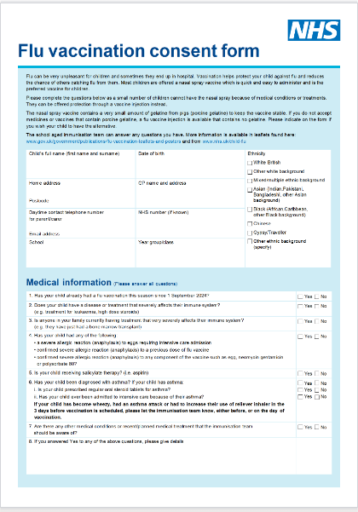
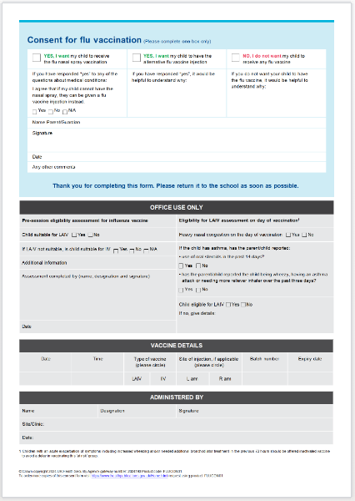
| Flu vaccination consent form (combined form for nasal spray and injectable vaccine) www.gov.uk/government/publications/flu-vaccination-in-schools
Link to consent form

