Slide 1
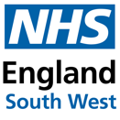
Immunisations Update
Southwest Winter Preparedness
September 2025
Lisa Harrison / Annette McHardy
Screening & Immunisation Coordinator
27th September 2022
Updated on 15th August 2025
NHS England – South West

Slide 2
Thank you
On behalf of the NHSE SW Vaccination & Screening Team (VaST), thank you to you and your teams for everything you are currently doing to ensure routine screening and immunisations are delivered despite the difficult current circumstances.
Please see the following few slides for potentially useful updates/reminders.

Slide 3
Pneumococcal, Shingles, RSV, Influenza & Covid Vaccines 2025/26
Pneumococcal, Shingles and RSV vaccines
Scene setting - Influenza
Eligible groups and target uptake
Types of vaccine
Key messages
Where can social care staff be vaccinated this season
Benefits of vaccination for care homes
Monitoring uptake
Resources for care homes
Resources including training and comms

Slide 4
Contacts
Please feel free to get in touch.
For screening queries and incidents contact the generic inbox:
  england.swvast@nhs.net
For immunisation and Covid queries and incidents contact the Immunisations Clinical Advice and Response Service (ICARS):
  england.swicars@nhs.net
Notes:
HM – contact for care homes

Slide 5
The pneumococcal vaccine
The pneumococcal vaccine protects against serious and potentially fatal pneumococcal infections. It's also known as the pneumonia vaccine.
Pneumococcal infections are caused by the bacterium Streptococcus pneumoniae and can lead to pneumonia, blood poisoning (sepsis) and meningitis.
People aged 65 and over only need a single pneumococcal vaccination. This vaccine is not given annually like the flu jab.
Pneumococcal polysaccharide vaccine (PPV) is given to people aged 65 and over and people at high risk because they have long-term health conditions.
You can receive the vaccine at any time of the year, and it can be co-administered with Flu and COVID vaccines.
Notes:
People over 65 or certain at risk conditions
Be offered one vaccine – can present way after 65
Can be delivered or codelivered
For more info: Pneumococcal: the green book, chapter 25 - GOV.UK (www.gov.uk)

Slide 6
Shingles
Shingles is caused by the reactivation (generally decades later) of a latent varicella zoster virus infection, more commonly known as chickenpox.
Approximately 1 in 4 people will develop shingles during their lifetime. Both the incidence and the severity of the condition increases with age. Older individuals are also more likely to develop secondary complications, such as bacterial skin infections and post-herpetic neuralgia (intractable pain).
Those aged 70-79 are eligible for the vaccine. From 1 September 2025 the severely immunosuppressed cohort has been expanded to offer Shingrix to individuals aged 18 years and over, with no upper age limit.
The programme is in the process of also inviting individuals aged 60 - 70 for vaccination, with the details of the timeline outlined here: Shingles vaccination – all year round! Eligibility poster (publishing.service.gov.uk)
The 2-dose vaccine programme can be given all year round and can be co-administered with Flu, COVID, RSV and Pneumococcal vaccines.
Notes:
Not for 80 or over as then not as effective
For more info: Shingles Green Book chapter 28a (publishing.service.gov.uk)

Slide 7
Respiratory Syncytial Virus (RSV)
RSV is a common cause of respiratory tract infections. It usually causes a mild self-limiting respiratory infection, but it can be severe in older adults.
RSV symptoms include rhinitis, cough, shortness of breath, wheeze, lethargy and sometimes fever.
The exact burden of disease in elderly adults is comparatively poorly understood due to a relative lack of testing, although it is considered to have a substantial morbidity and mortality. RSV has been estimated to account for 175,000 annual GP episodes in those age 65 years and older in the UK and an estimated 5000-7500 deaths in older adults in England and Wales every winter, the vast majority of which occur in adults over 75 years.
Individuals aged 75-79 are eligible to receive the vaccine.
The vaccine can be co-administered with the Shingles, Pneumococcal and COVID-19 vaccines
It is advised that the RSV vaccine is not routinely scheduled to be given at the same time as the Flu vaccine. However, If it is thought that the individual is unlikely to return for a second appointment or immediate protection is necessary, Abrysvo® can be administered at the same time as influenza vaccination
Notes:
Not for 80 or over as then not as effective
For more info: Green Book on immunisation - Chapter 27a Respiratory Syncitial Virus (RSV) (publishing.service.gov.uk)

Slide 8
Scene setting
Acute services saw high demand in Autumn/Winter 2024/2025, some of which was caused by Flu cases
As well as keeping staff and residents safe and well, reducing the threat of flu and Covid also helps you to ensure business continuity; reducing the likelihood of your staff being ill and off work and the associated costs of providing bank or agency cover for them. Vaccination is also of benefit as it helps to reduce transmission to the wider public and, in times of increased pressure on health and social care services, helps to reduce the burden of ill health, and therefore demand on the wider health system at a time when services are already under pressure.

Slide 9
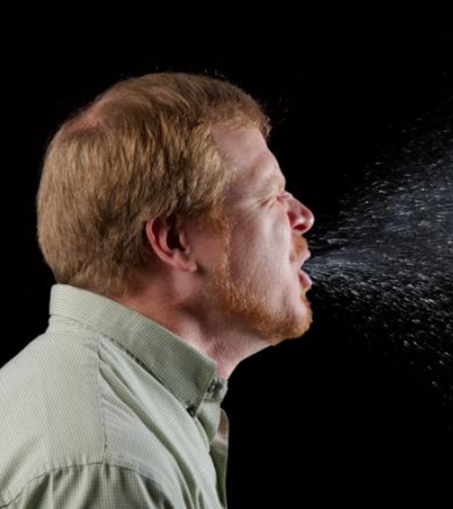
Its all about flu!
Flu is a viral infection of the respiratory tract (nose, mouth, throat, bronchial tubes and lungs.
Flu is spread by germs from coughs and sneezes which can live on hands and surfaces for 24 hours
Flu is highly contagious and spreads rapidly in closed communities
Most cases in the UK occur during an 8-10 week period during the winter
Even people with only mild or no symptoms can affect others
The incubation period is around 1-5 days (avg 2-3 days)
Notes:
A lot more general knowledge on IPC – same applies for flu

Slide 10
Flu vaccine eligibility 25/26
From 1 September 2025:
pregnant women
all children aged 2 or 3 years on 31 August 2025
primary school aged children (from Reception to Year 6)
secondary school aged children (from Year 7 to Year 11)
all children in clinical risk groups aged from 6 months to less than 18 years
From October 2025, exact start date to be confirmed by NHS England in due course:
those aged 65 years and over
those aged 18 years to under 65 years in clinical risk groups (as defined by the Green Book, Influenza chapter 19 )
those in long-stay residential care homes
carers in receipt of carer’s allowance, or those who are the main carer of an elderly or disabled person
close contacts of immunocompromised individuals
frontline workers in a social care setting without an employer led occupational health scheme including those working for a registered residential care or nursing home, registered domiciliary care providers, voluntary managed hospice providers and those that are employed by those who receive direct payments (personal budgets) or Personal Health budgets, such as Personal Assistants
Notes:
Further information: https://www.gov.uk/government/publications/national-flu-immunisation-programme-plan-2025-to-2026/national-flu-immunisation-programme-2025-to-2026-letter#co-administration

Slide 11
Frontline health and social care workers
All frontline health and social care workers with direct patient/service user contact should be provided with flu vaccination by their employer. This includes staff in all NHS trusts, general practices, care homes, and domiciliary care
Employers are encouraged to :
  Commission a service which makes access to the vaccine easy for all staff
  Encourage staff to get vaccinated
  Monitor the delivery of their programme
NHS England (NHSE) will continue to support vaccination of social care and hospice workers, with vaccination available through community pharmacy or their registered GP practice

Slide 12
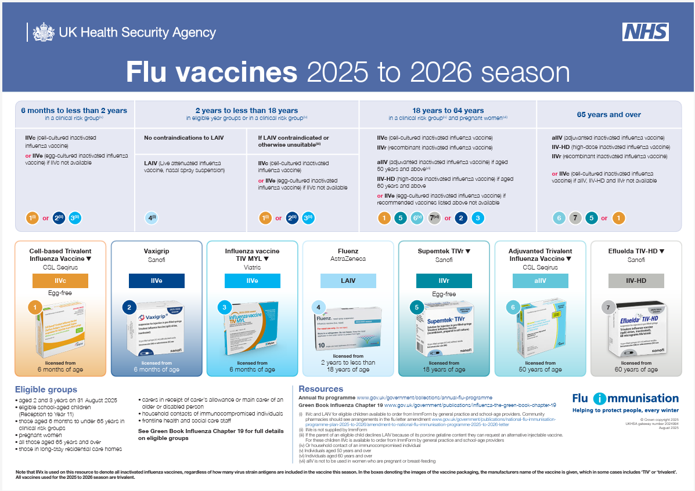
Flu vaccine available for 2025 to 2026
Posters detailing these available from GOV.UK website:
Flu vaccines: 2025 to 2026 flu season

Slide 13
Where can care/nursing home residents and staff be vaccinated
The community pharmacy seasonal influenza advanced service framework has been amended to enable community pharmacies to vaccinate both residential care/nursing home residents and staff in the home setting in a single visit to increase uptake rates
GP practices are also able to vaccinate residents and staff who are registered with the practice in the residential/care home
Attend a GP or Pharmacy appointment

Slide 14
Key messages to health and social care workers
getting vaccinated against flu and Covid can help protect you, your patients and family
everyone is susceptible to flu and Covid, even if you are in good health and eat well
you can be infected with the virus and have no symptoms but can still pass on the virus/s to others including patients or residents
good infection control measures reduce spread of acute respiratory infections in healthcare settings but are not sufficient alone to prevent them
throughout the last ten years there has generally been a good to moderate match between the strains of flu virus in the vaccine and those that subsequently circulated
impact of flu on frail and vulnerable patients can be fatal and outbreaks can cause severe disruption in communities, care homes and hospitals
The flu vaccine has a good safety record and will help protect you. It cannot give you flu. Having the vaccination can encourage your colleagues to do likewise
staff act as positive role models for patients aged 65 and over, those with long-term health conditions and pregnant women to take up the offer too
duty of care as professionals to patients or residents to do everything in your power to protect them against infection, including being immunised against flu

Slide 15
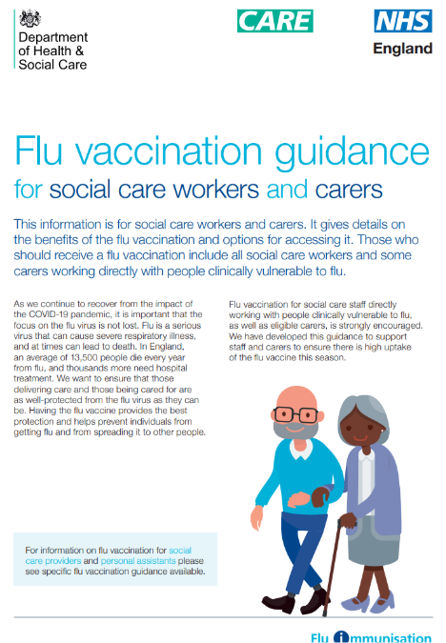

Benefits of vaccination for Care Homes
Less staff sickness due to flu / COVID-19
Less chance of needing expensive agency staff
Less chance of residents becoming ill
Reduced chance of having a flu or COVID-19 outbreak
Your employer investing in you

Slide 16
Monitoring Uptake
Keeping records of staff and patients vaccinated
Ensuring that staff GP records are updated to capture social care vaccinations
You / your staff may fall into numerous categories, but we need to know that they work in Social Care
Notes:
Tell GP that you work for a care home as this can be logged and recorded by GP

Slide 17
Resources for Care Home Workers
Resources including the care home tool kit and training resources for care home workers have been updated for the 2025/26 flu season. When available they can be accessed via the link below
The care home tool kit will offer guidance / resources for the following;
  Information and guidance
  Employer responsibility
  Overcoming barriers to vaccination
  Displaying uptake
  Links to video materials
  NICE guidance
  Useful resources
  Found here: NHS England — South West » Influenza

Slide 18
Resources, including Training and Comms
Influenza vaccine written instruction templates for adoption – SPS - Specialist Pharmacy Service – The first stop for professional medicines advice
NHS England — South West » Patient Group Directions (PGDs)
Flu vaccination programme 2025 to 2026: information for healthcare practitioners - GOV.UK (www.gov.uk)
UKHSA Campaign Resource Centre - Resources for the autumn/winter campaigns available to order
Home - Health Publications (Easy-read and simple text resources can be ordered free of charge from Health Publications)
Annual flu programme webpage and the e-learning for healthcare Flu Immunisation web page.

Slide 19
Links to other key documents
Green Book Influenza chapter
Joint Committee on Vaccination and Immunisation
National Institute for Health and Care Excellence (NICE) guidelines on increasing influenza vaccine uptake
NHS England Public Health Commissioning information
Flu vaccine uptake figures
Flu immunisation Patient Group Direction (PGD) templates
ImmForm website for ordering child flu vaccines
UKHSA Information for healthcare practitioners about the flu vaccination programme
Vaccine update – UKHSA monthly newsletter
UKHSA flu immunisation programme
Shingles (herpes zoster): the green book, chapter 28a - GOV.UK (w.gov.uk)
Pneumococcal: the green book, chapter 25 - GOV.UK (www.gov.uk)
Respiratory syncytial virus: the green book, chapter 27a - GOV.UK (www.gov.uk)

Slide 20
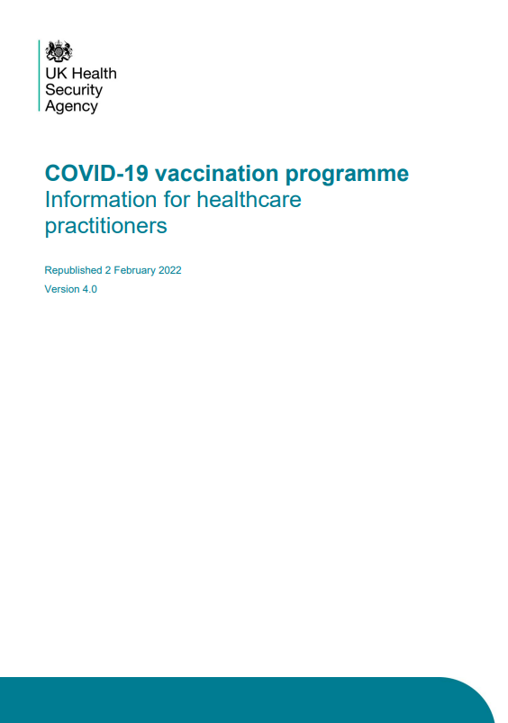
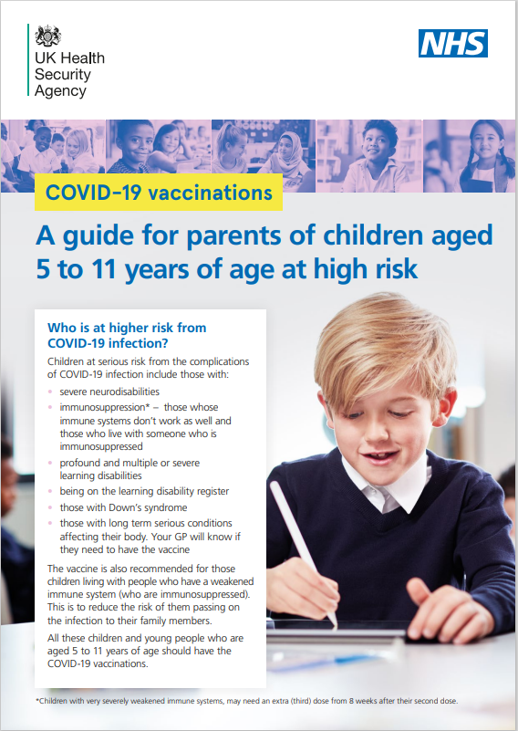
Covid-19 vaccination programme – resources
COVID-19 vaccination programme
COVID vaccination Information for Health Professionals guidance
COVID-19: the green book, chapter 14a
HealthPublications order site
Patient group direction (PGD)
South West PGDs

Slide 21

Adult Vaccination Programmes
The adult immunisations toolkit has been prepared to support the effective delivery of routine adult immunisations delivered in Primary Care for Shingles, Pneumococcal and RSV programmes.
It’s available here and the NHS England — South West website.

