Slide 1
Annual flu programme resources
2025 to 2026
UKHSA 31 July 2025

Slide 2
| Resources to support the flu programme
Healthcare professional (HCP) facing

Slide 3
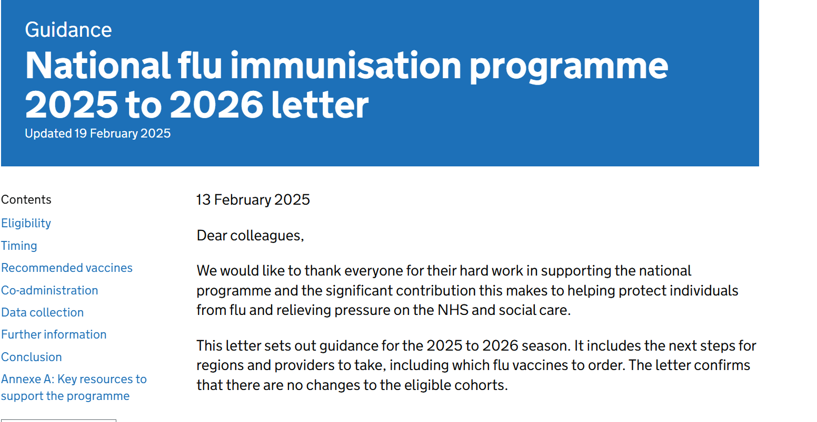
Tripartite annual flu letter 2025 to 2026
Flu letter published 13 February 2025
www.gov.uk/government/publications/national-flu-immunisation-programme-plan-2025-to-2026

Slide 4
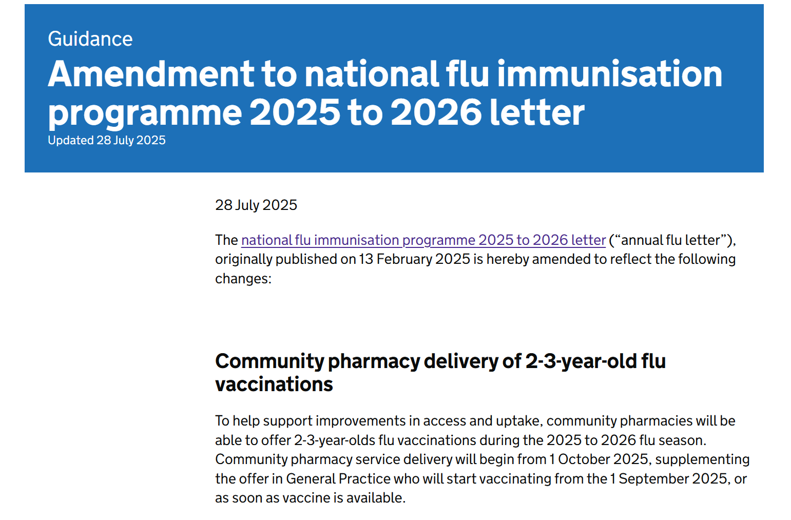
Amendment to tripartite annual flu letter 2025 to 2026
Flu letter amendment published 28 July 2025
www.gov.uk/government/publications/national-flu-immunisation-programme-plan-2025-to-2026

Slide 5
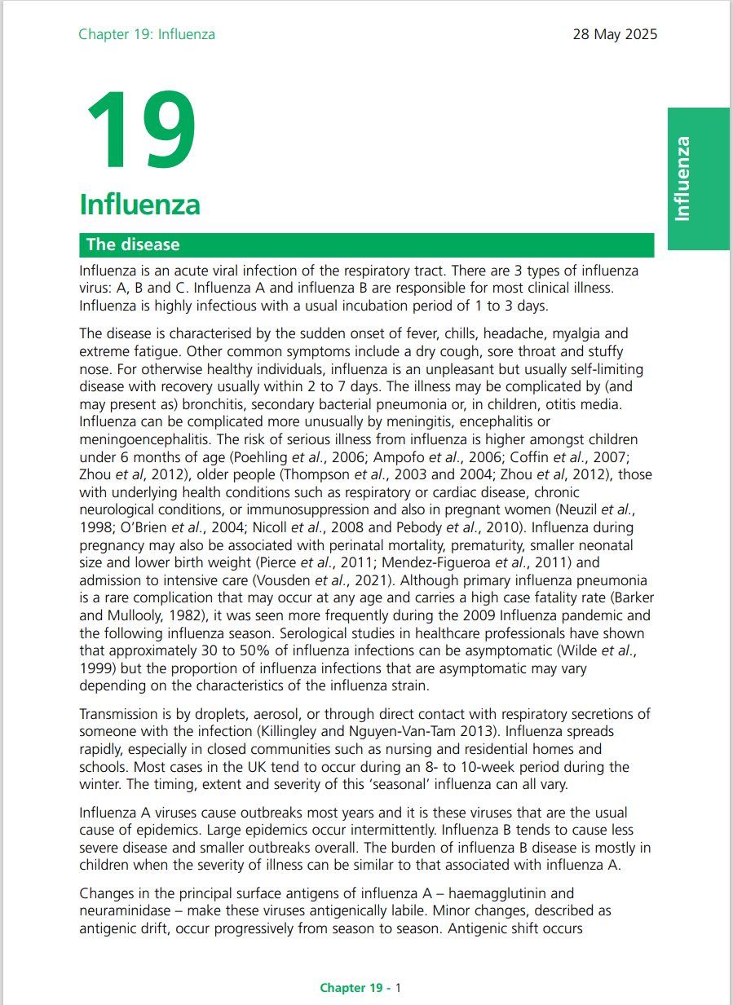
| Green Book - Influenza: chapter 19
www.gov.uk/government/publications/influenza-the-green-book-chapter-19
Published 28 May
Updates include:
The vaccine name is now agnostic of trivalent or quadrivalent formulation e.g.: IIVx instead of QIVx or TIVx.
Examples of previous seasons has been updated from primary care to secondary care data (the RCGP data figure has been changed to the SARI watch data).
The timing of the programme implementation has been updated
There was a reformat on age specific vaccine and vaccine type
Occupational health vaccination update
Co- administration with other vaccines including RSV update
Guidance on vaccination for those with unrepaired craniofacial malformations

Slide 6
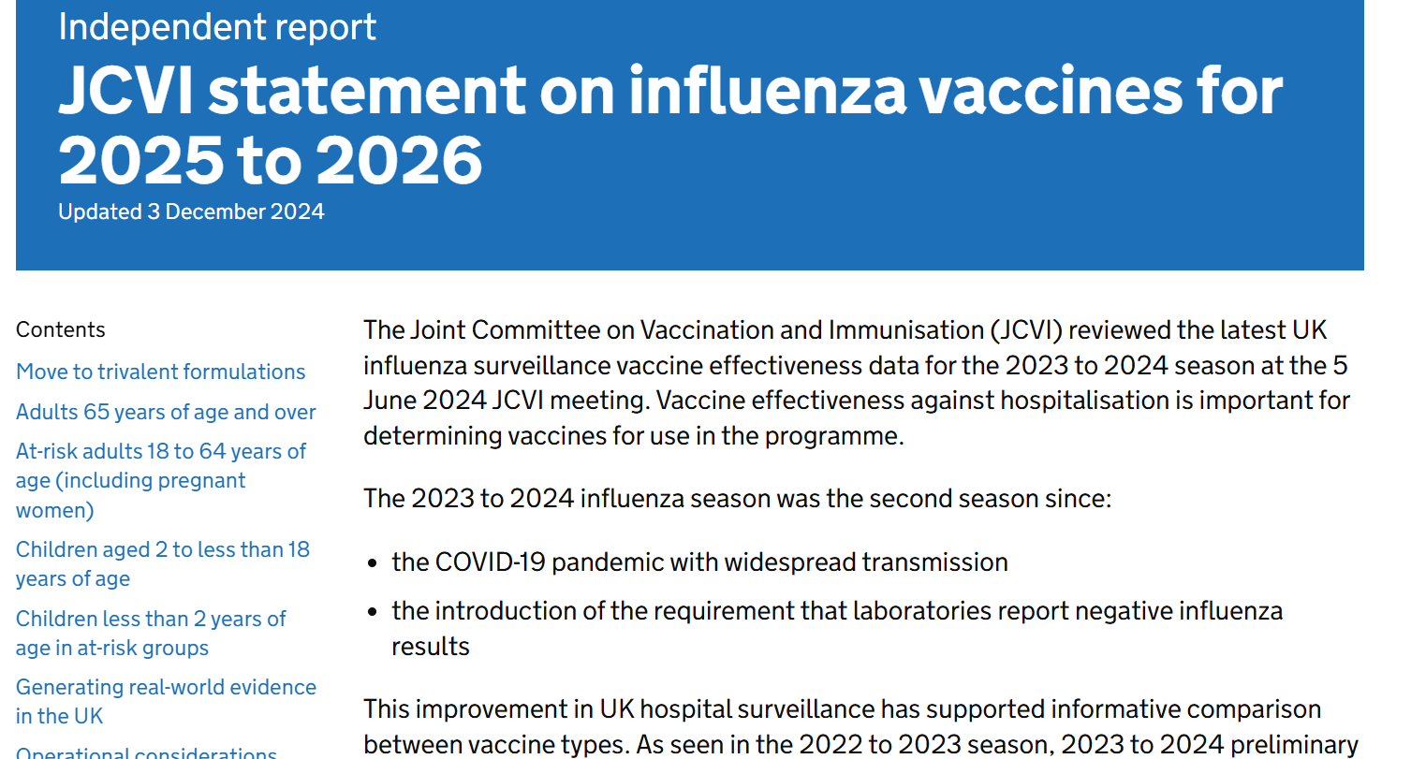
JCVI advice on influenza vaccines for 2025 to 2026
www.gov.uk/government/publications/flu-vaccines-2025-to-2026-jcvi-advice/jcvi-statement-on-influenza-vaccines-for-2025-to-2026

Slide 7
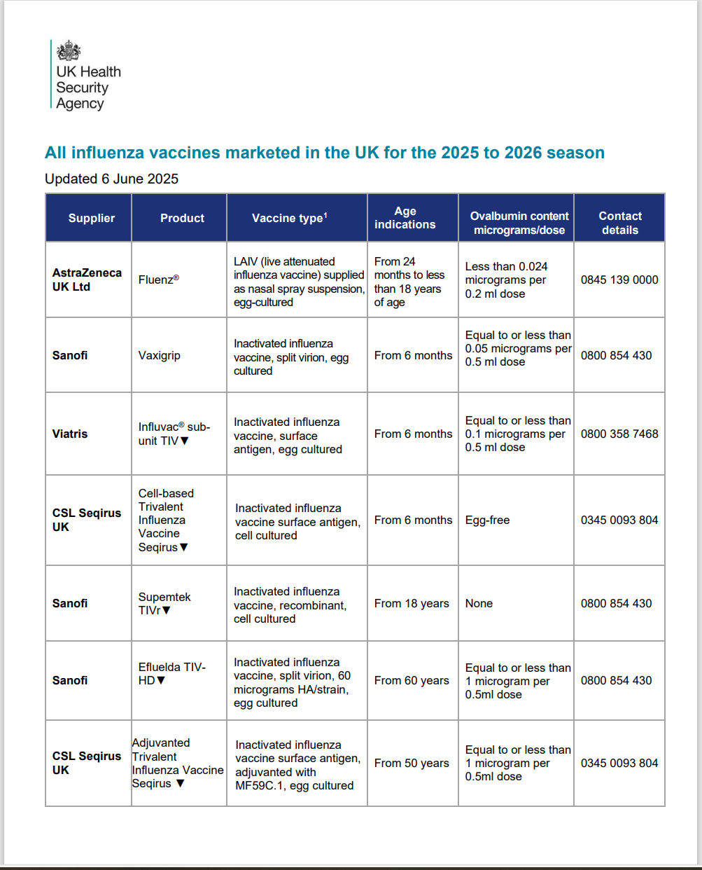
All influenza vaccines marketed in the UK for the 2025 to 2026 season
https://www.gov.uk/government/publications/influenza-vaccines-marketed-in-the-uk
Note for the 2025 to 2026 season this resource was first published on 13 February 2025.
On 1 April 2025 all manufactures confirmed that all inactivated vaccines would be supplied in trivalent formulation for the 2025 to 2026 season.
This resource was therefore republished on 6 June 2025, with the ‘vaccine type’ column update and footnote added to reflect wording is agnostic to the number of virus strains included in the vaccine.

Slide 8
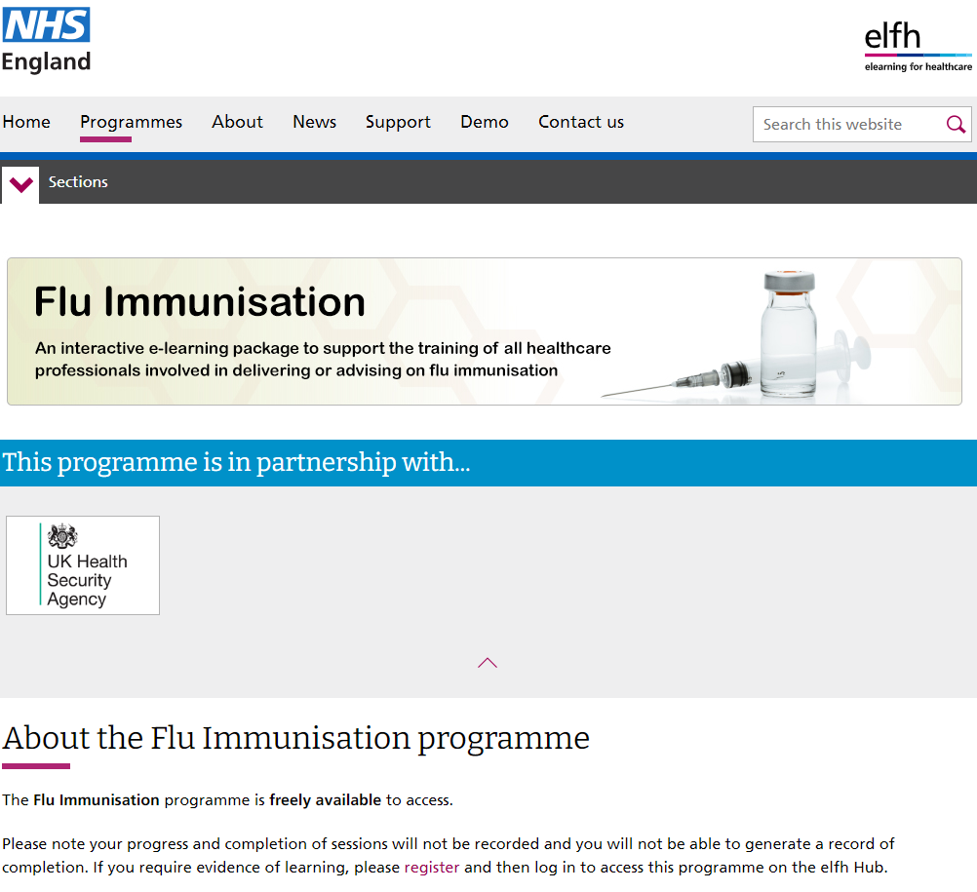
| Flu vaccination programme 2025 to 2026: e-learning programme
www.e-lfh.org.uk/programmes/flu-immunisation/ Published 25 July 2025

Slide 9
Flu surveillance and vaccine uptake
Flu surveillance reports: www.gov.uk/government/statistics/national-flu-and-covid-19-surveillance-reports-2025-to-2026-season
  (currently published fortnightly during the summer months. Weekly reporting will commence from week 41)
Flu vaccine uptake data: www.gov.uk/government/collections/vaccine-uptake#seasonal-flu-vaccine-uptake:-figures
  Weekly national level flu vaccine uptake reporting in GP patients will commence in week 41 (October 2025) with monthly data published from November 2025

Slide 10
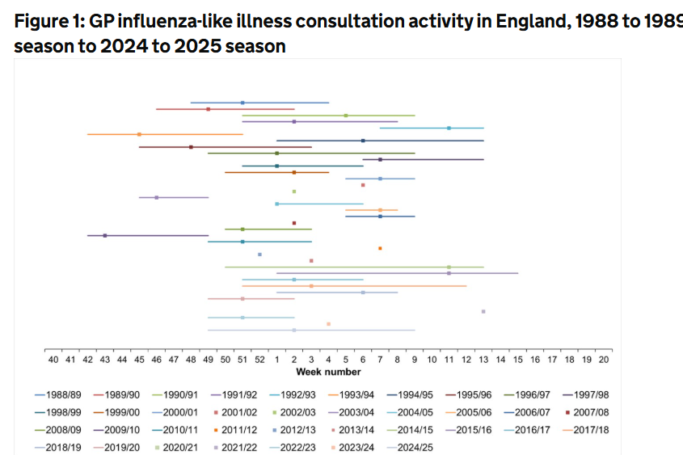
Timing of flu seasons
www.gov.uk/government/publications/respiratory-virus-circulation-england-and-wales/timing-of-influenza-seasons
Updated 21 July 2025 to include data from 2023/24 and 2024/25 seasons

Slide 11
Ordering copies of flu resources
Paper copies of most resources are available to order at: www.healthpublications.gov.uk
Health Publications Website note: Around the end of August 2025, Health Publications will be moving to a new and improved site named Find Public Health Resources. There may be disruptions on or around the day we move. If you have any items in your basket, make sure you place your order before then.
You’ll receive an email with more information to help you prepare for this change if you have an account with us. If you created an account after 15 July 2025, you will have to create one again once we're live. We apologise for any inconvenience this might cause and look forward to welcoming you to the new site.
Resources which are available to order are marked with a product code stamp. Search for the product code on the Health Publications website to order copies. If the product is currently out of stock, you may put a back order in which will be fulfilled when stock becomes available:
Other resources are download only:
Product code: xxxxxxxxx
Download only

Slide 12
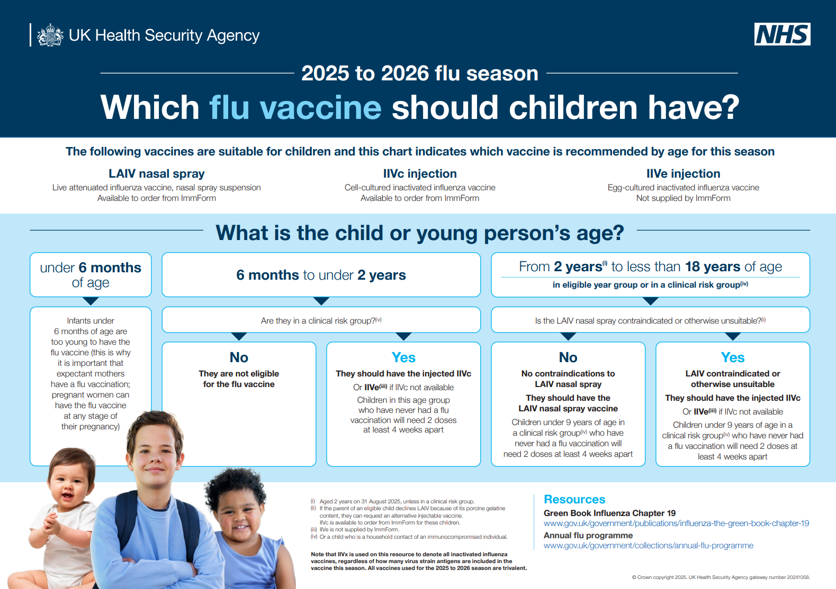
| Resources to support the children’s flu programme - HCP
Download only
www.gov.uk/government/publications/which-flu-vaccine-should-children-have

Slide 13
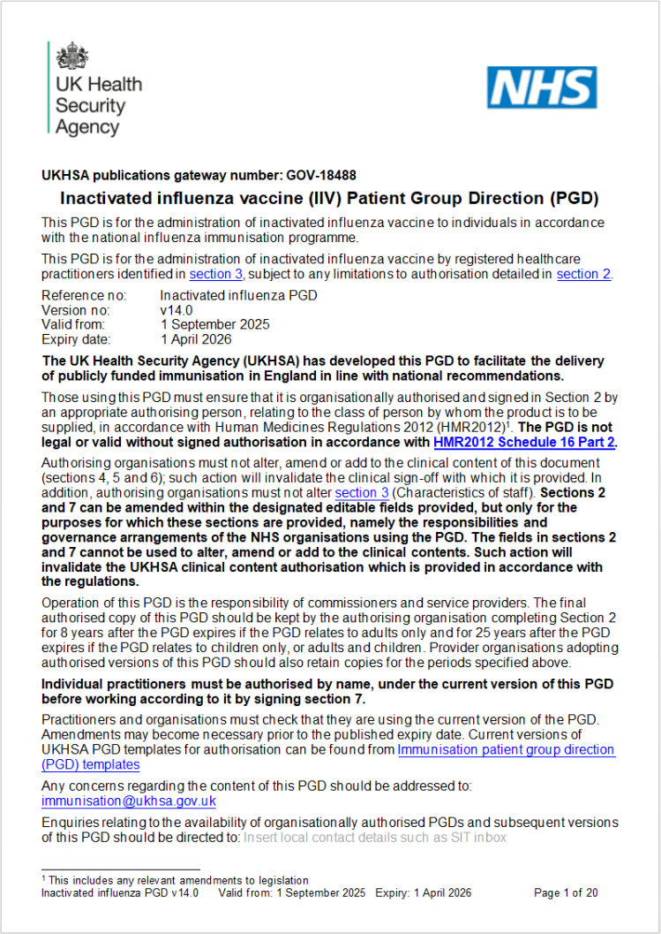
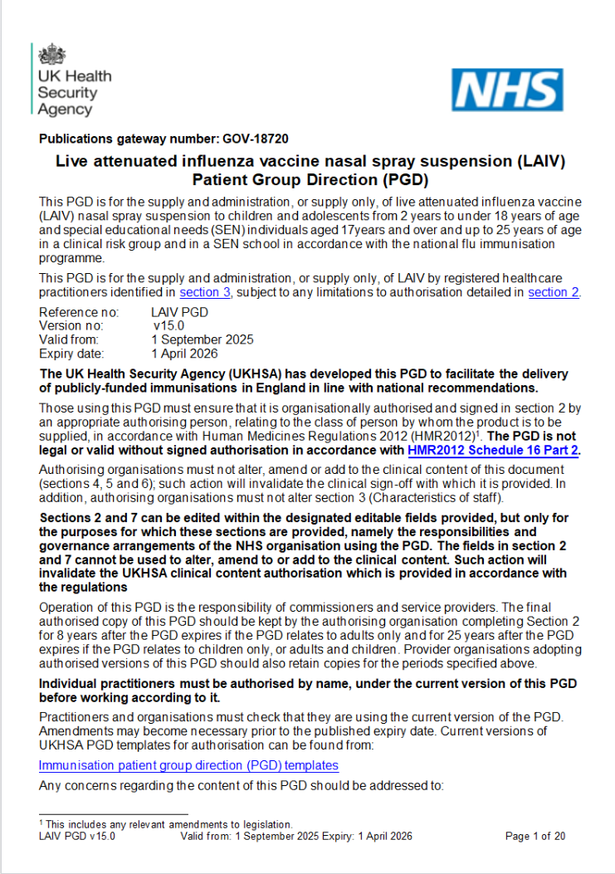
| Patient Group Directions (PGDs)
IIV PGD
LAIV PGD
Please note that a combined
PGD (LAIV and IIV) for use in
community pharmacy for
2- and 3-years olds will be
issued by 1 September 2025
https://www.gov.uk/government/publications/intramuscular-inactivated-influenza-vaccine-patient-group-direction-pgd-template Published 28 July 2025
www.gov.uk/government/publications/influenza-vaccine-fluenz-tetra-patient-group-direction-pgd-template Published 1 July 2025

Slide 14
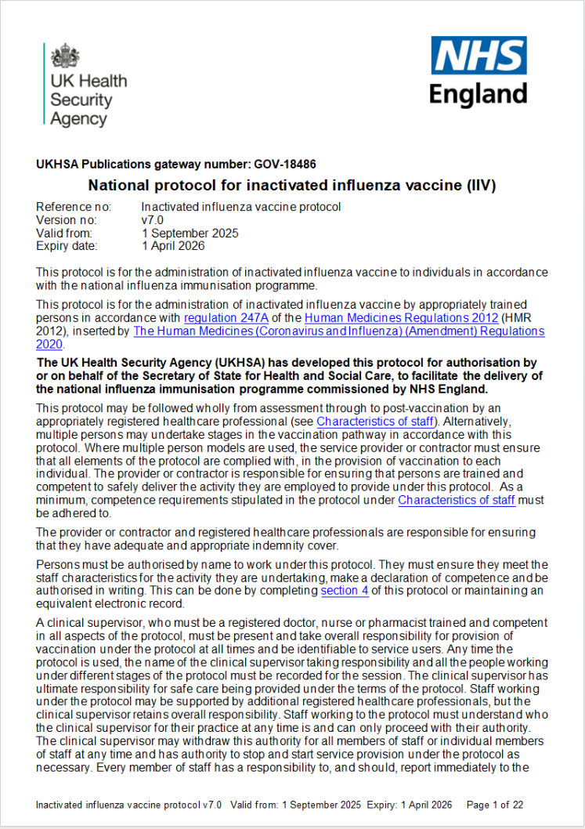
| National protocol
https://www.gov.uk/government/publications/national-protocol-for-inactivated-influenza-vaccine
Published 28 July 2025

Slide 15
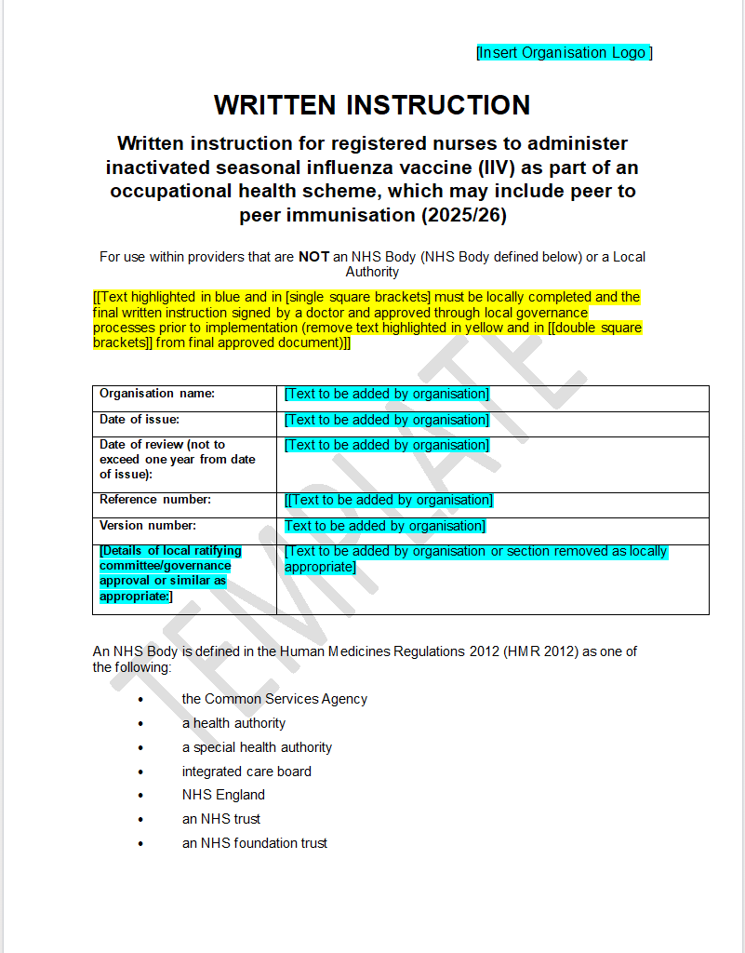
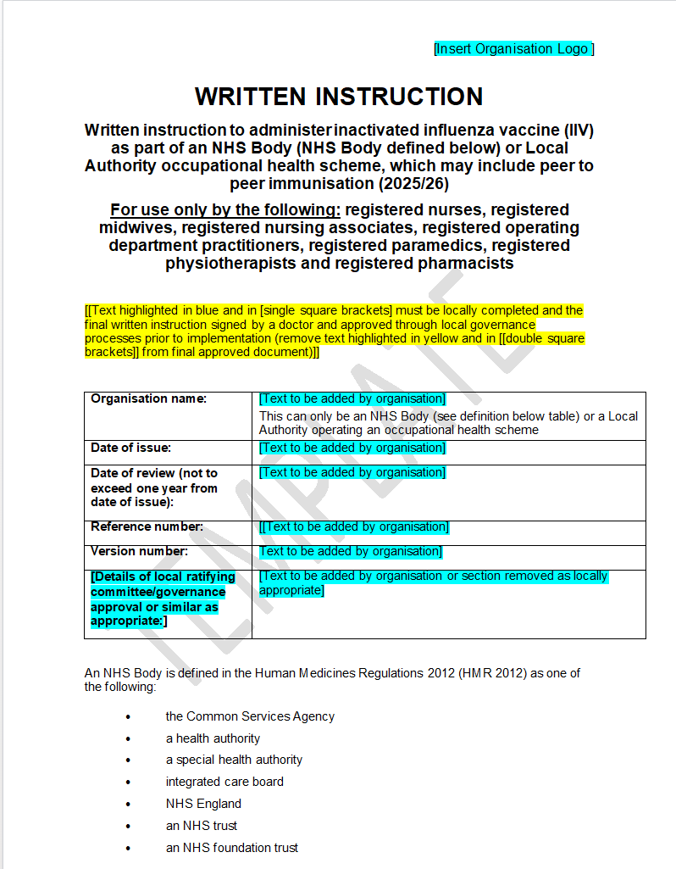
| Written Instruction for the administration of seasonal flu vaccination (for NHS bodies or local authorities and for independent and other providers)
https://www.sps.nhs.uk/articles/influenza-vaccine-written-instruction-templates-for-adoption/ published 2 June 2025

Slide 16

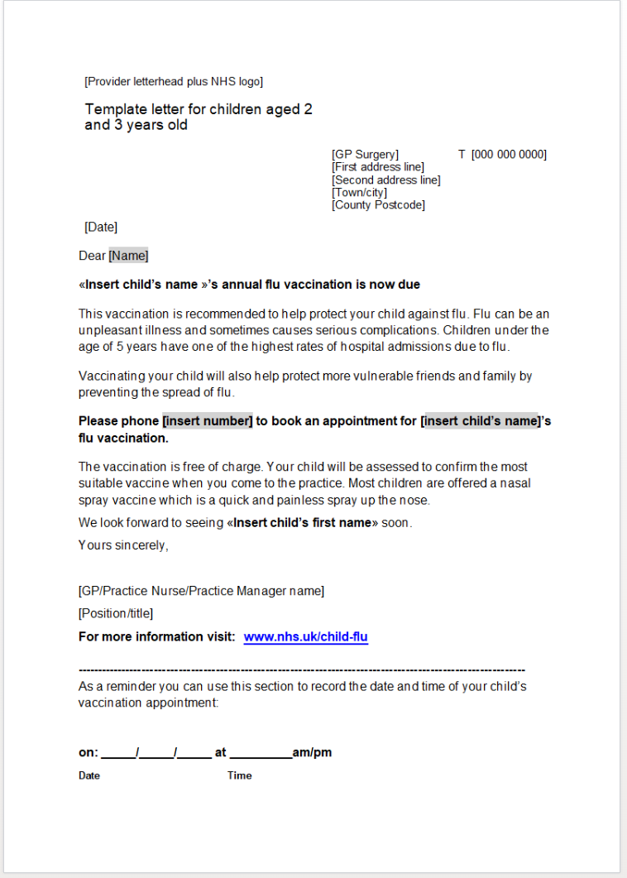
| Pre-school resources leaflet
Download only
www.gov.uk/government/publications/flu-immunisation-for-early-years-settings-including-child-minders Published 23 July 2025
www.gov.uk/government/publications/flu-vaccination-invitation-letter-template-for-children-aged-2-3-and-4-years Published 20 May 2025

Slide 17
| Resources to support the flu programme
Public Facing

Slide 18
Ordering copies of flu resources
Paper copies of most resources are available to order at: www.healthpublications.gov.uk
Health Publications Website note: Around the end of August 2025, Health Publications will be moving to a new and improved site named Find Public Health Resources. There may be disruptions on or around the day we move. If you have any items in your basket, make sure you place your order before then.
You’ll receive an email with more information to help you prepare for this change if you have an account with us. If you created an account after 15 July 2025, you will have to create one again once we're live. We apologise for any inconvenience this might cause and look forward to welcoming you to the new site.
Resources which are available to order are marked with a product code stamp. Search for the product code on the Health Publications website to order copies. If the product is currently out of stock, you may put a back order in which will be fulfilled when stock becomes available:
Other resources are download only:
Product code: xxxxxxxxx
Download only

Slide 19

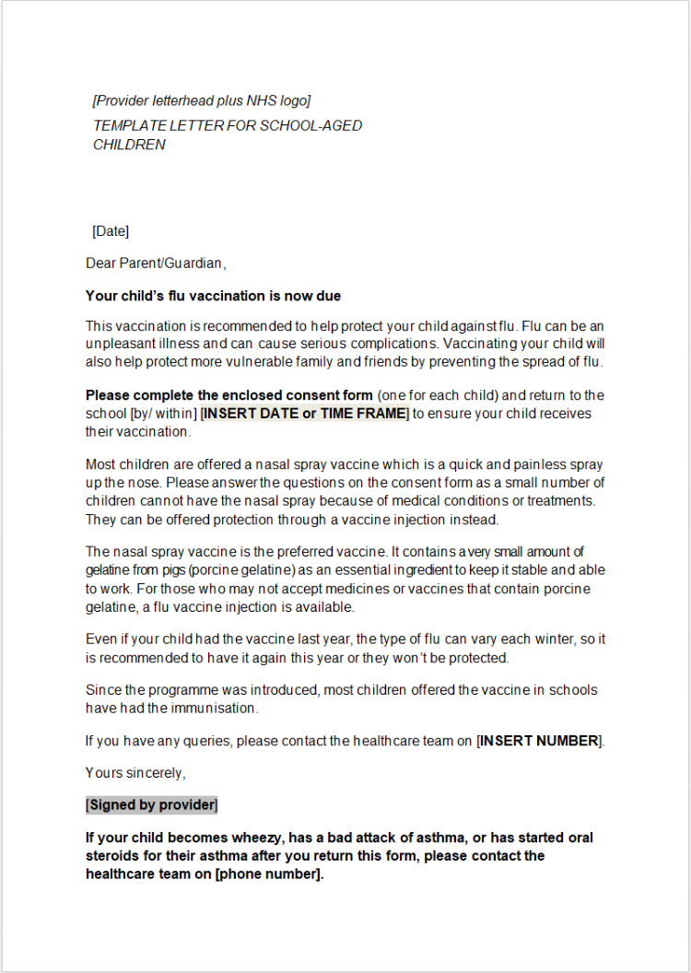
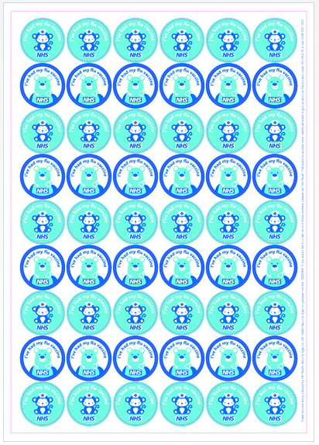
| Primary school resources – briefing, letter & stickers www.gov.uk/government/publications/flu-vaccination-in-schools (Note that links to .gov.uk will remain unchanged when ‘Health Publications’ is replaced with ‘Find Public Health Resources’ )
Stickers
Product code: FLUPY25
Product code: SCHFLSTK
Link to letter
https://www.healthpublications.gov.uk/ViewProduct.html?sp=Sflustickersforchildrenaged2to11years
https://www.gov.uk/government/publications/flu-vaccination-leaflets-and-posters (scroll down the page for the link to stickers)

Slide 20

| Primary school resources - leaflet
Protect your child against flu – information for parents and carers of preschool and primary school aged children
Paper copies of this leaflet are available to order for free or download in the following languages:
English, Albanian, Arabic, Bengali, Bulgarian, Chinese (Simplified), Chinese (Traditional), Dari, Estonian, Farsi, French, Greek, Gujarati, Hindi, Italian, Latvian, Lithuanian, Nepali, Panjabi, Pashto, Polish, Portuguese, Romanian, Romany, Russian, Somali, Spanish, Tagalog, Tigrinya, Turkish, Twi, Ukrainian, Urdu, Yiddish and Yoruba.
https://www.healthpublications.gov.uk/ViewProduct.html?sp=Sprotectyourchildagainstfluinformationforparentsandcarersofchildreninprimaryschoolorpreschool
Product code: 2025FCEN
https://www.gov.uk/government/publications/flu-vaccination-leaflets-and-posters

Slide 21
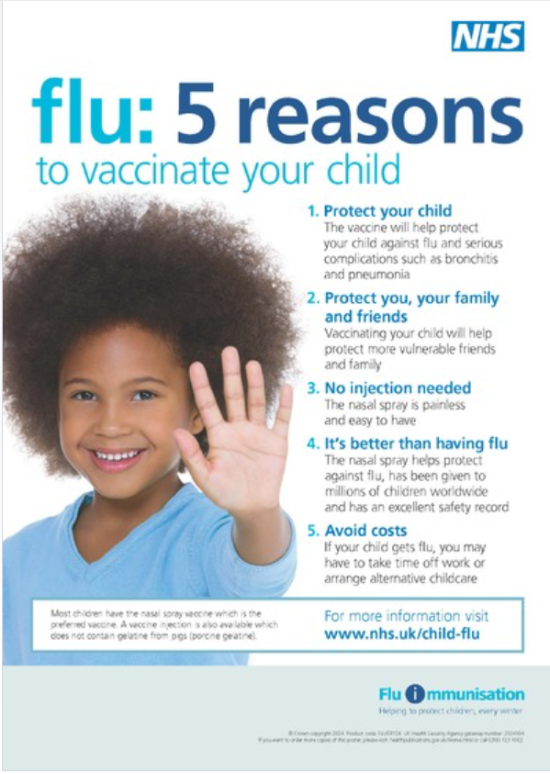
| Primary school resources - poster
5 reasons to vaccinate your child against flu poster for primary schools and pre-schools
Paper copies of this leaflet are available to order for free or download in the following languages:
Albanian, Arabic, Bengali, Brazilian Portuguese, Chinese (simplified), Estonian, Farsi, French, Greek, Gujarati, Hindi, Latvian,
Lithuanian, Panjabi, Polish, Romanian, Romany, Russian, Somali, Spanish,Turkish, Twi, Ukrainian, Urdu and Yiddish.
Product code:
FLU5RY24
https://www.healthpublications.gov.uk/ViewProduct.html?sp=Sflu5reasonstovaccinateyourchildposter011years-4104
https://www.gov.uk/government/publications/flu-vaccination-leaflets-and-posters

Slide 22

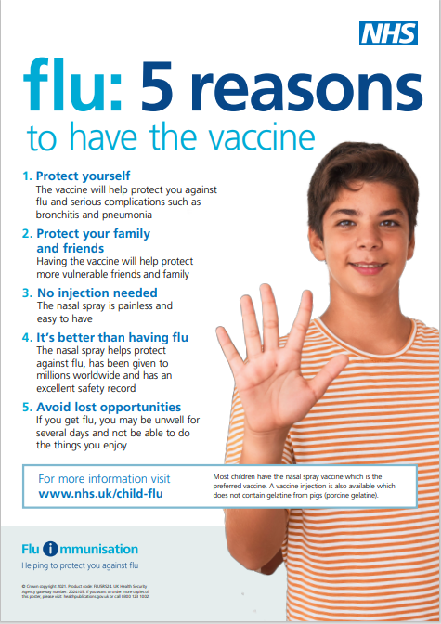
| Secondary school resources – letter, leaflet & poster www.gov.uk/government/publications/flu-vaccination-in-schools
Product code: 25SECFLUEN
Product code:
FLU5RS24
Link to letter
https://www.healthpublications.gov.uk/ViewProduct.html?sp=Speterprotectyourselfagainstfluinformationforthoseinsecondaryschool
https://www.healthpublications.gov.uk/ViewProduct.html?sp=Sflu5reasonspostersecondaryschools

Slide 23
| Secondary school resources - leaflet
Protect yourself against flu – information for secondary school aged young people
Paper copies of this leaflet are available to order for free or download in the following languages:
English, Albanian, Bengali, Bulgarian, Chinese (Simplified), Chinese (Traditional), Dari, Estonian, Farsi, French, Greek, Gujarati, Hindi, Italian, Latvian, Lithuanian, Nepali, Panjabi, Pashto, Polish, Portuguese, Romanian, Romany, Russian, Somali, Spanish,Tagalog, Tigrinya, Turkish, Twi, Ukrainian, Urdu, Yiddish, and Yoruba.
Product code:
25SECFLUEN
https://www.healthpublications.gov.uk/ViewProduct.html?sp=Speterprotectyourselfagainstfluinformationforthoseinsecondaryschool

Slide 24
| Secondary school resources - poster
Flu: 5 reasons to have the vaccine poster for secondary schools
Translations of this poster are available to order in the following languages:
Albanian, Arabic, Bengali, Bulgarian, Chinese(simplified),
Chinese(traditional), Dari, Estonian, Farsi, French, Greek,
Gujarati, Hindi, Italian, Latvian, Lithuanian, Nepali, Panjabi,
Pashto, Polish, Portuguese, Romanian, Romany, Russian,
Somali,Spanish, Tagalog, Tigrinya, Turkish, Twi, Ukrainian,
Urdu, Yiddish and Yoruba.
www.gov.uk/government/publications/flu-vaccination-in-schools
Product code:
FLU5RS24
https://www.healthpublications.gov.uk/ViewProduct.html?sp=Sflu5reasonspostersecondaryschools

Slide 25

Briefing for secondary schools on adolescent vaccination programme
This guide explains the NHS adolescent vaccination programmes delivered to children in secondary schools and the important role that schools play in the delivery of them. It includes information on the flu vaccination programme.
Product code:
FLUSY25

Slide 26
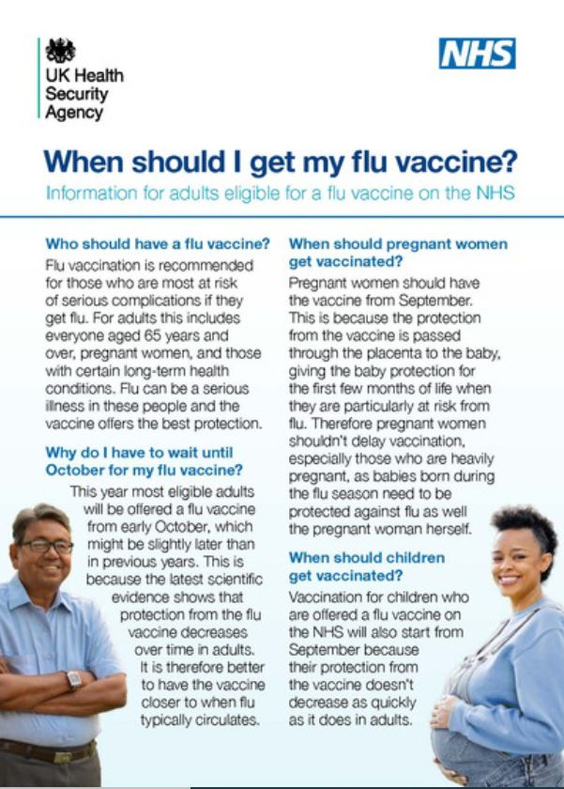
| All eligible groups – When should I have my flu vaccine?
This flyer explains why adults eligible for the flu vaccine are offered it from early October. This is based on the evidence that shows that protection from the flu vaccine decreases over time in adults. It is therefore better to have the vaccine closer to when flu typically circulates.
https://www.gov.uk/government/publications/flu-vaccine-supply-when-can-you-get-your-vaccination
Product code:
24FLUWEN
www.healthpublications.gov.uk/ViewProduct.html?sp=Swhencanigetmyfluvaccine

Slide 27
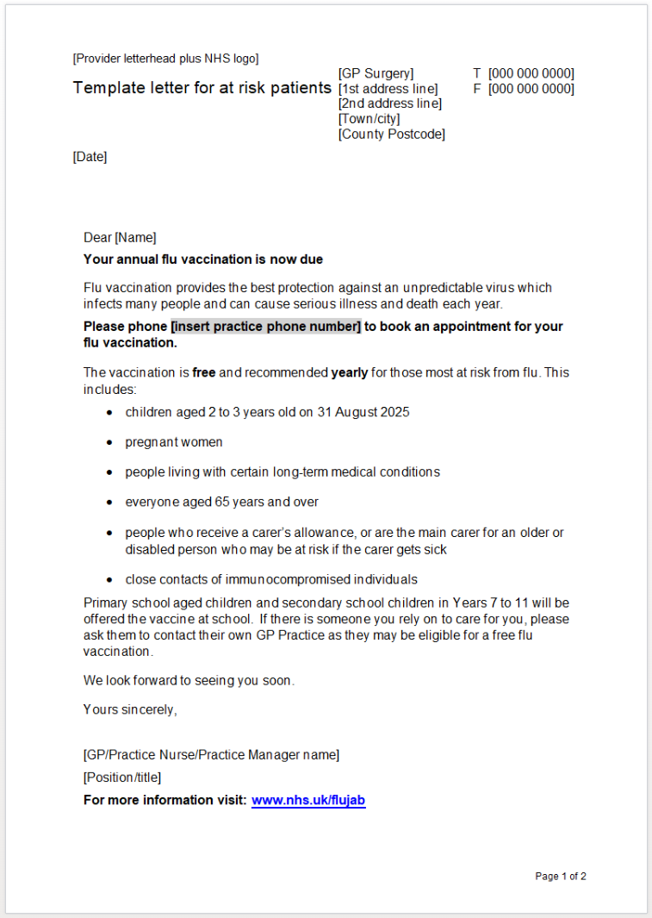

| All eligible groups
Flu vaccination: who should have it this winter and why
Paper copies of the leaflet are available to order or download in the following languages:
Albanian, Arabic, Bengali, Bulgarian, Chinese (simplified), Chinese (traditional, Cantonese), Estonian, Farsi, French, Greek,
Gujarati, Hindi, Italian, Latvian, Lithuanian,
Panjabi, Pashto, Polish, Portuguese, Romanian,
Romany, Russian, Somali, Spanish, Tagalog,
Tigrinya, Turkish, Twi, Ukrainian, Urdu, Yiddish
and Yoruba.
Accessible formats such as Audio, Braille, BSL video and Large Print are also available.
www.gov.uk/government/publications/flu-vaccination-who-should-have-it-this-winter-and-why
www.gov.uk/government/publications/flu-vaccination-invitation-letter-template-for-at-risk-patients-and-their-carers
Product code:
FLUMW24EN
https://www.healthpublications.gov.uk/ViewProduct.html?sp=Sthefluvaccinationwhoshouldhaveitandwhy-4173

Slide 28
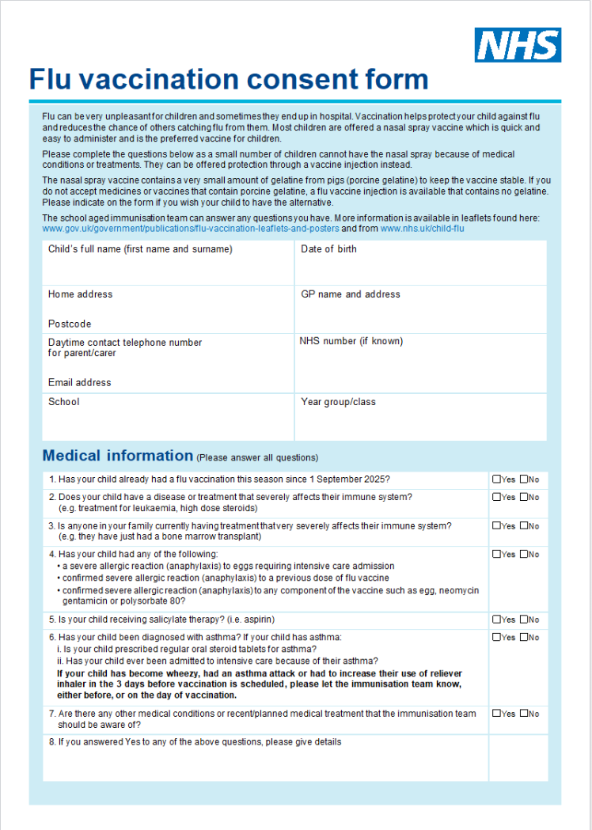
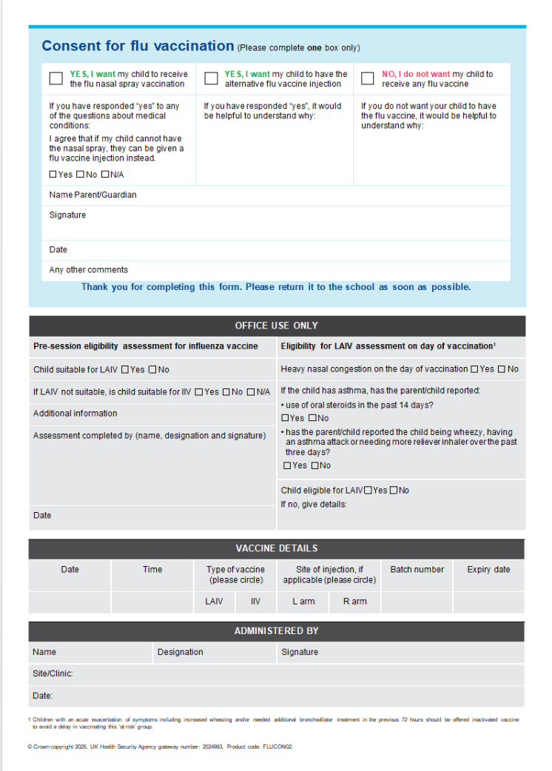
| Flu vaccination consent form (combined form for nasal spray and injectable vaccine) www.gov.uk/government/publications/flu-vaccination-in-schools
Link to consent form

Slide 29

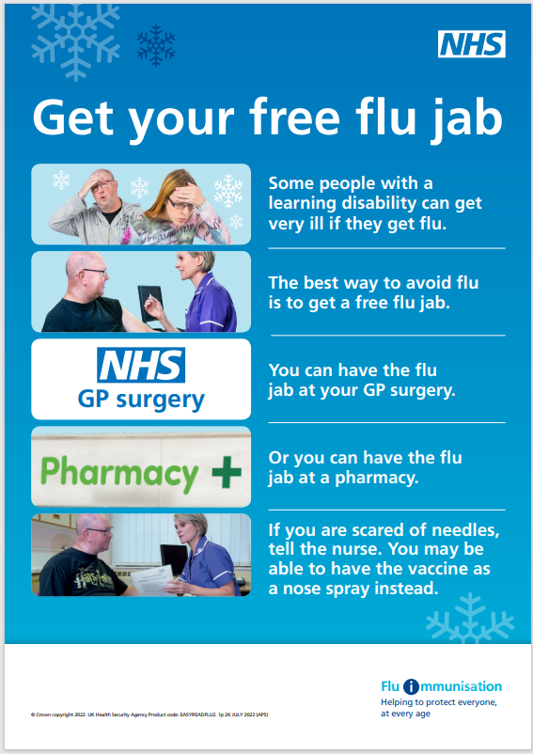
| Easy read for those with a learning disability
Product code: EASYREADFLU2
Product code: EASYREADFLU1
https://www.healthpublications.gov.uk/ViewProduct.html?sp=Sprotectyourselffromflueasyreadleaflet
www.gov.uk/government/publications/flu-leaflet-for-people-with-learning-disability
https://www.healthpublications.gov.uk/ViewProduct.html?sp=Sprotectyourselffromflueasyreadposter

Slide 30
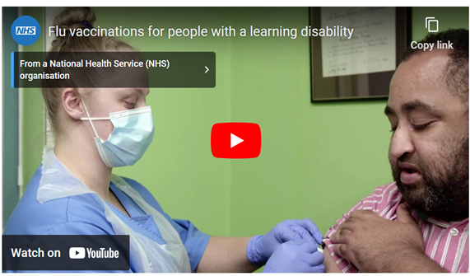
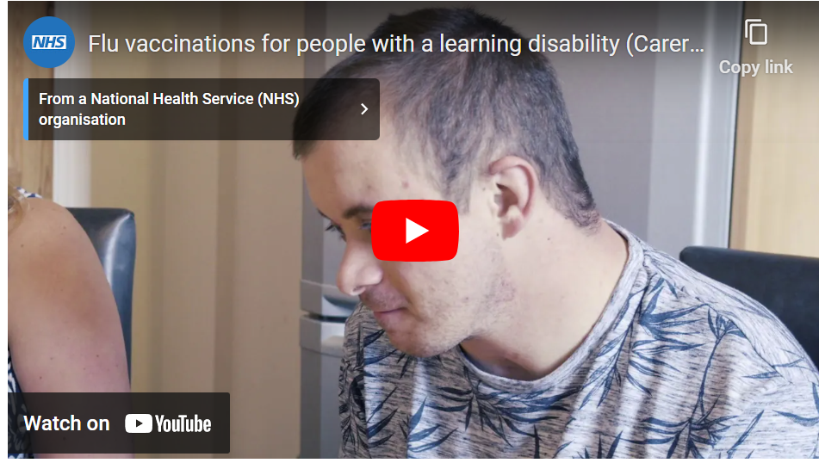
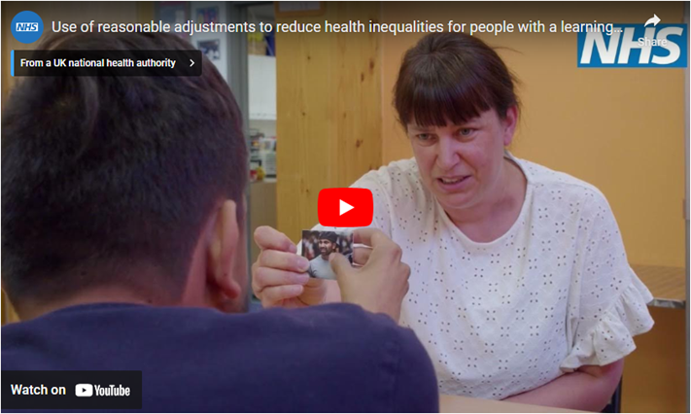
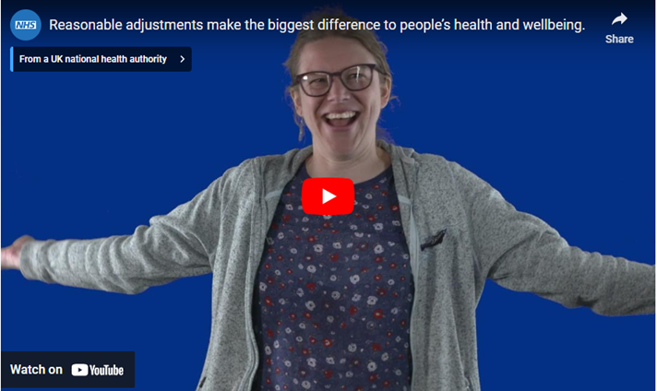
Flu vaccination films for people with a learning disability and autistic people and their family or carers
Flu vaccination video for people with a learning disability
Flu vaccinations for carers of people with a learning disability
www.gov.uk/government/publications/flu-leaflet-for-people-with-learning-disability
YouTube links:
https://www.youtube.com/watch?v=OqGSm0jaF9A
https://www.youtube.com/watch?v=jJ9QdwUitFg
Use of reasonable adjustments to reduce health inequalities video
How reasonable adjustments make a big difference to health and wellbeing video
www.england.nhs.uk/learning-disabilities/improving-health/reasonable-adjustments/

Slide 31


| Simple text resources for those with low literacy
Product code: FLU2025STA
Product code: FLU2025STC
https://www.healthpublications.gov.uk/ViewProduct.html?sp=Sallaboutfluandvaccinationsimpletextforadults
https://www.healthpublications.gov.uk/ViewProduct.html?sp=Sallaboutfluandvaccinationsimpletextforchildren-4666

Slide 32
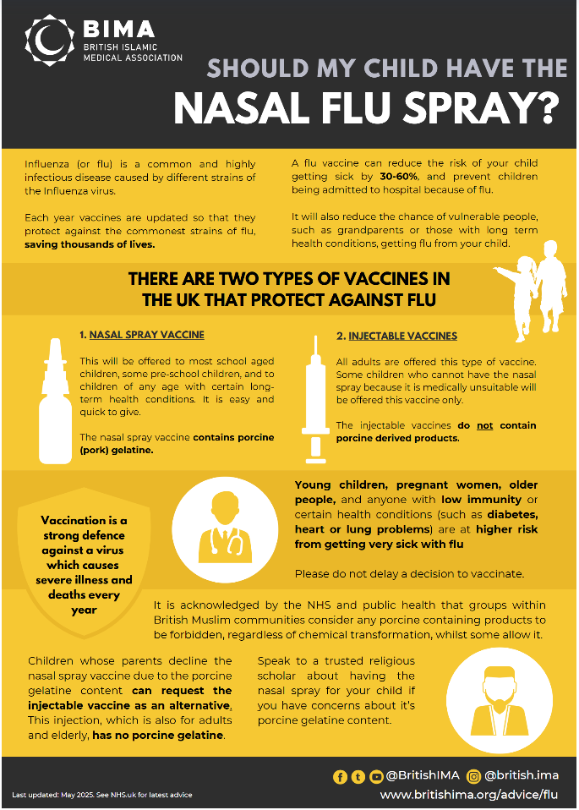
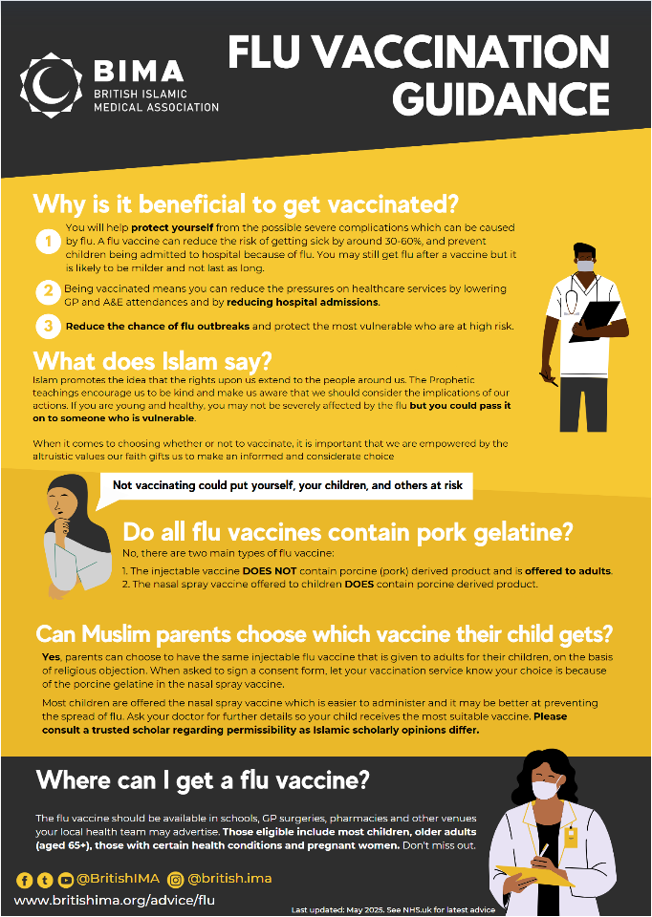
British Islamic Medical Association Flu Resources
The British Islamic Medical Association (BIMA) have updated their 2 resources which explain the benefits of flu vaccination, the Islamic position on taking up the vaccine, and how to weigh up whether your children should have the nasal spray vaccine given the porcine gelatine content and conflict with a halal diet. BIMA are happy to be contacted for any local queries on info@britishima.org and you can download these resources from: https://britishima.org/advice/flu/

Slide 33
| Weblinks
Healthcare professionals
www.gov.uk/government/publications/influenza-the-green-book-chapter-19 (for ‘Green Book’ chapter 19)
www.gov.uk/government/collections/immunisation-patient-group-direction-pgd#seasonal-influenza (for inactivated and LAIV PGDs)
www.gov.uk/government/publications/national-protocol-for-inactivated-influenza-vaccine (national protocol)
www.e-lfh.org.uk/programmes/flu-immunisation (flu immunisation e-learning programme)
www.government/publications/flu-vaccination-programme-information-for-healthcare-practitioners (information for healthcare practitioners)
Public facing
www.gov.uk/government/collections/annual-flu-programme (resources on GOV.UK)
https://campaignresources.dhsc.gov.uk (for marketing resources on the Campaign Resource Centre).
www.nhs.uk/flujab (NHS website)
www.healthpublications.gov.uk (Health publications ordering)
Surveillance data
www.gov.uk/government/statistics/national-flu-and-covid-19-surveillance-reports-2025-to-2026-season (weekly disease surveillance reports)
www.gov.uk/government/collections/vaccine-uptake#seasonal-flu-vaccine-uptake:-figures (current and previous seasons flu vaccine uptake figures)
www.gov.uk/government/publications/respiratory-virus-circulation-england-and-wales/timing-of-influenza-seasons (timing of flu seasons)

