Slide 1
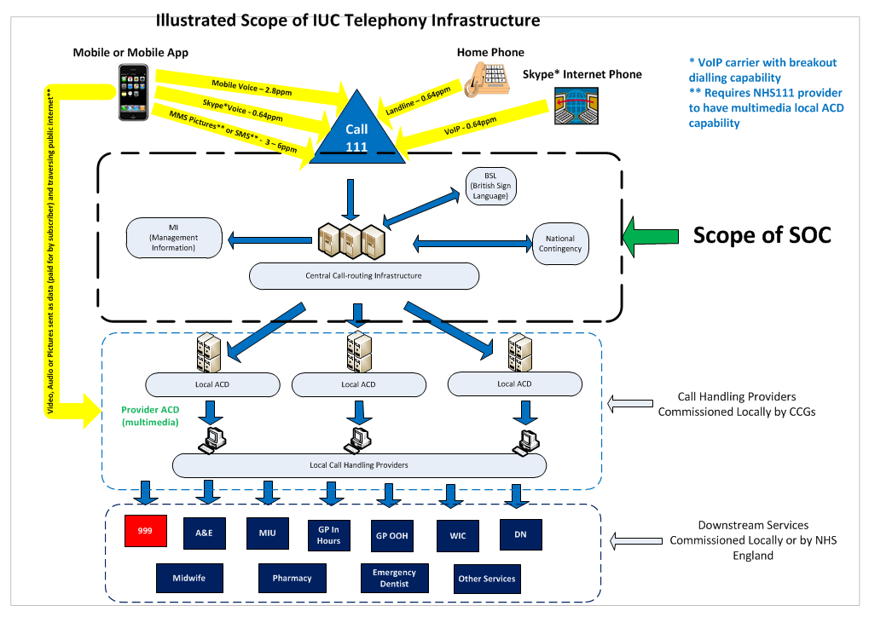
NHS111 Call Routing
Vodafone
London PRM

Slide 2
Call Flow Scenarios
Vodafone
Redwood (PRM)
Provider ACD
1 - Normal
Not applicable
30 sec abn. threshold
Phantom Detect
Location
*..
Welcome
IVR
Queue
Online
* Line scripts
Offered
Answer in 60 clock start
2 - Storm / PRM
Other HLP Providers
30 sec abn. threshold
Phantom Detect
Location
Repeat
IVR
*..
Local
Welcome / Busy
Queue
Online
Offered
Answer in 60 clock start
* Line scripts
3 - National IVR
* Line scripts
Not applicable
30 sec abn. threshold
Phantom Detect
Location
*..
Answer S
Queue
Online
Welcome
Offered
IVR
Answer in 60 clock start

