Slide 1
The CareMaker programme

Slide 2
Who are CareMakers?
People committed to making the NHS the best it can be.
Caring, passionate people who act as ambassadors of the 6Cs - Care, Compassion, Communication, Courage, Competence, Commitment.
CareMakers spread the word about Leading Change, Adding Value (LCAV); the national framework for nursing, midwifery and care staff.
CareMakers can be staff at all levels and disciplines within a health or care setting.
CareMakers create a unique link between national policy and frontline colleagues.

Slide 3
The history
First cohort of 55 CareMakers was recruited to in 2012.
The CareMakers made a commitment to supporting the implementation and delivery of Compassion in Practice (2012) and the 6Cs.
The idea was to capture the ‘spirit’ of London 2012 Olympics – learn from the energy and enthusiasm of the ‘Games Makers’ and instil this into a role to promote the values and behaviours of the NHS.
Programme initially aimed at students and newly qualified staff.
It is tremendous to now see that there are now over 900 CareMakers on the national database.

Slide 4
The 6Cs
Care
Compassion
Competence
Communication
Courage
Commitment

Slide 5
Principles of the programme
To help transform relevant parts of the NHS culture via the skills and behaviours of our staff.
To represent the whole of the NHS.
To encourage creativity.
To promote diversity.
To provide an opportunity for individuals to be exposed to a wide variety of experiences, activities, and people all across the NHS.

Slide 6
Why become a CareMaker?
An opportunity to influence, be heard, become a leader.
To build a network within the system through learning and development opportunities.
To help transform care for individuals and populations.
To build personal and professional confidence in your practice.
To develop skills to support the identification and reduction of unwarranted variation in practice.
Access to regional and national events.
Networking opportunities – a chance to be part of a large network of like-minded people.

Slide 7
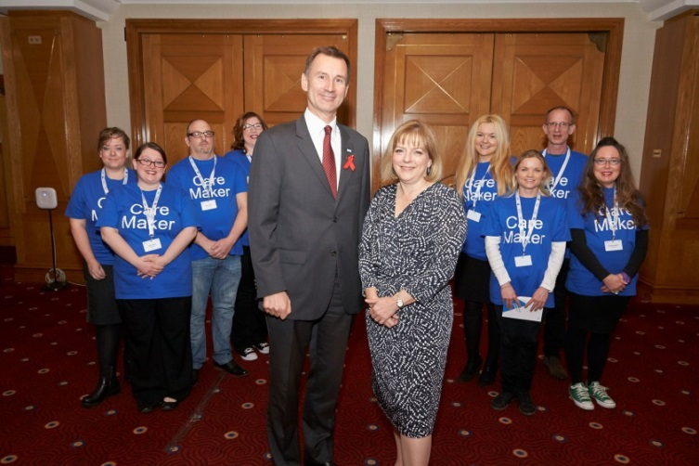
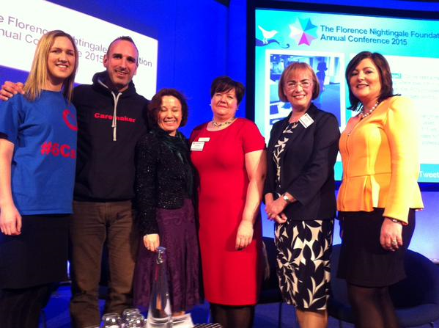
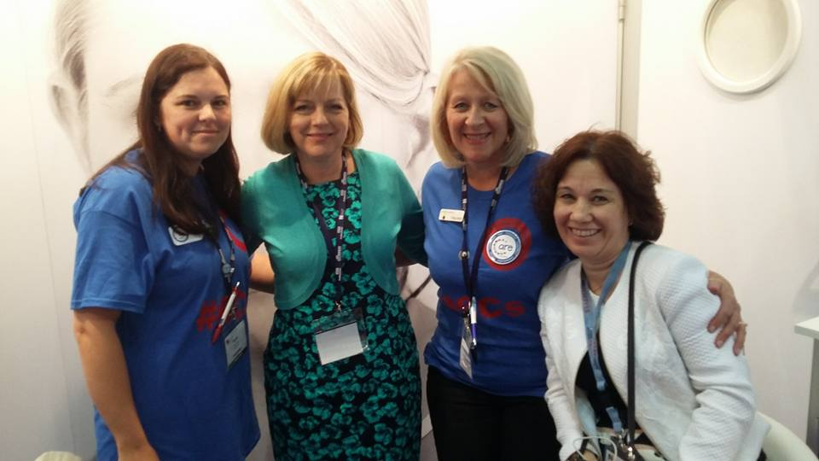
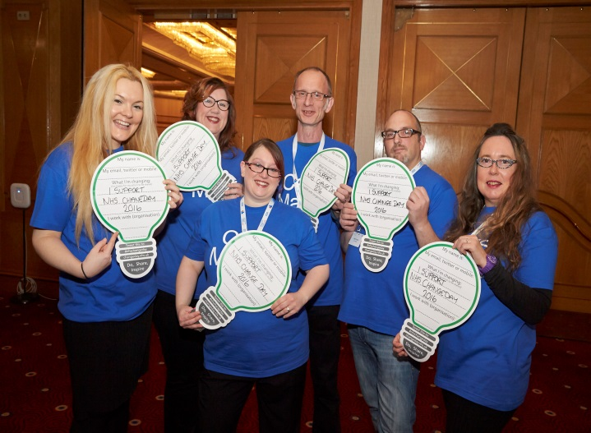
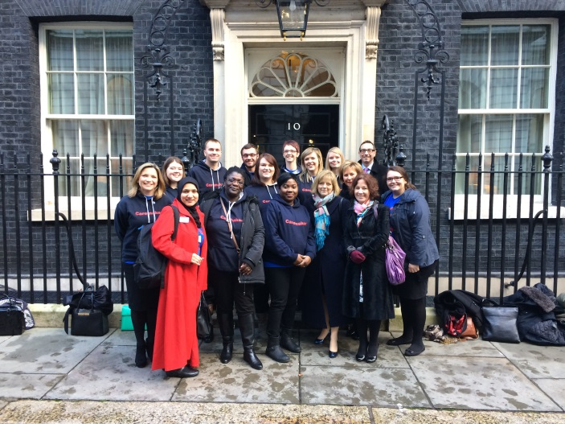
What do CareMakers do?
CareMakers are given the opportunity
to attend national events such as:
CNO summit
Florence Nightingale Foundation
conference
Royal College of Nursing congress
EXPO

Slide 8
CareMakers are encouraged to help promote and get involved with national campaigns, such as:

Slide 9
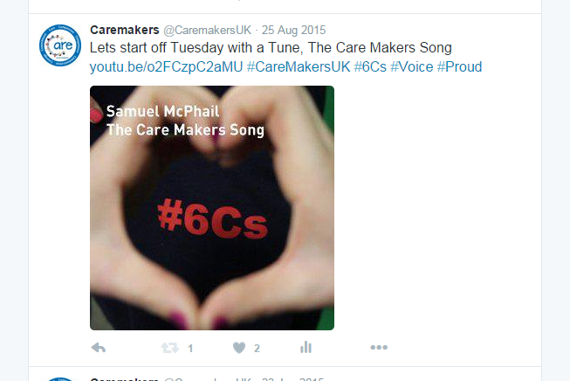
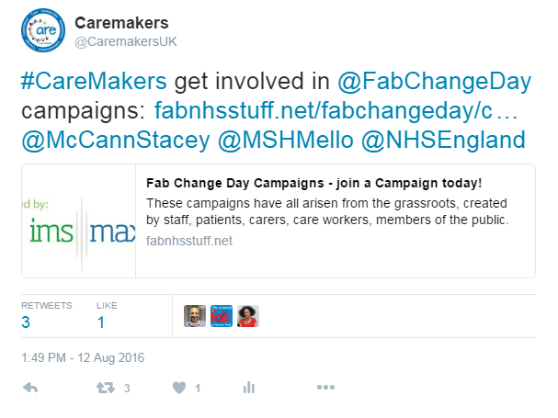
CareMakers have a significant leadership presence on social media:

Slide 10
Recruitment
CareMaker recruitment is open.
The process for recruitment is:
Applicant to complete an application form.
Applicant’s manager/tutor to complete a reference form.
Both forms submitted to the CareMaker central team for processing: england.caremaker-application@nhs.net
Relevant regional nurse lead contacted for review.
Outcome sent to CareMaker central team.
Applicant informed on whether application has been a success by the end of the following month.
Application forms are available on the CareMaker hub.

Slide 11
The CareMaker webpages
https://www.england.nhs.uk/leadingchange/leading-change-adding-value/care-makers/
The CareMaker webpages contain information on the following:
Recruitment
Regional coordinators and regional nurse leads
Events
Resources
CareMakers as leaders
Photos
CareMakers are encouraged to get involved with the webpages by submitting ‘CareMakers as leaders’ pieces and photos. Contact england.caremakers@nhs.net for more information.

Slide 12
Regional coordinators and Regional nurse leads
There are four regional nurse leads; North, Midlands and East, London and South. They are responsible for:
reviewing and approving CareMaker applications, providing the clinical perspective to this process;
promoting the CareMaker programme regionally.
The CareMaker regional coordinator:
supports the delivery of the CareMaker programme within their region, acting as a link between the central NHS England CareMaker team and the regional nurse leads;
acts as a champion for CareMakers in local settings.
Regional coordinators are available to:
answer any questions you might have;
share their experiences and ideas;
encourage attendance at regional and national events;
support CareMaker recruitment in their region.

Slide 13
The CCG placement scheme
The scheme provides CareMakers with an opportunity to gain knowledge and experience of how a CCG operates within a local health economy.
Two core objectives:
By the end of the scheme, each CareMaker will have a greater understanding of the quality assurance processes within the CCG.
By the end of the scheme, each CareMaker will be able to outline the structure of the CCG and will have an understanding of how commissioning high quality services impacts on the local population.
Placement scheme runs once a year, contact england.caremakers@nhs.net for more information.

Slide 14
CareMakers and Leading Change, Adding Value: a framework for nursing, midwifery and care staff
Explains how nursing, midwifery and care staff can help to close the three gaps identified in the Five Year Forward View:
the health and wellbeing gap
the care and quality gap
the funding and efficiency gap
Central to the framework is the focus on reducing unwarranted variation, and the ability to meeting the ‘triple aim’ measures of better outcomes, experiences and use of resources;
Highlights the need to focus on unwarranted variation; variation in health and care outcomes, patients’ experience, and use of resources that cannot be justified by reasons of geography, demography, or infrastructure.
The framework is underpinned by ten commitments which help align efforts to areas where unwarranted variation is recognised and support the transition needed to build sustainable services of the future.

Slide 15
LCAV: The 10 Commitments
We will promote a culture where improving the population’s health is a core component of the practice of all nursing, midwifery and care staff.
We will increase the visibility of nursing and midwifery leadership and input in prevention.
We will work with individuals, families and communities to equip them to make informed choices and manage their own health.
We will be centred on individuals experiencing high value care.
We will work in partnership with individuals, their families, carers and others important to them.

Slide 16
LCAV: The 10 Commitments
We will actively respond to what matters most to our staff and colleagues.
We will lead and drive research to evidence the impact of what we do.
We will have the right education, training and development to enhance our skills, knowledge and understanding.
We will have the right staff in the right places and at the right time.
We will champion the use of technology and informatics to improve practice, address unwarranted variations and enhance outcomes.

Slide 17
CareMakers – Champions of Leading Change, Adding Value (LCAV)
CareMakers are encouraged to:
Use energy and enthusiasm to support the understanding and implementation of LCAV.
Champion the framework and participate in work to identify and reduce unwarranted variation.
Contribute to a case study or a short film around work they have undertaken to reduce unwarranted variation.
Get involved in webinars, regional events and national events in relation to implementing the framework.

Slide 18
CareMakers are encouraged to:
Spread the word – use #Lead2Add to highlight LCAV with others.
Host a presentation in their workplace to increase awareness about LCAV.
Access the new content on the NHS England website to build on their understanding of LCAV.
Keep an eye on the CareMaker hub for upcoming events and opportunities.
Visit https://www.england.nhs.uk/leadingchange/ for more information about the framework and find out how colleagues are implementing it across the country.

Slide 19
‘To me, being a CareMaker is about remembering, practising and spreading the word about the 6Cs. I hope that leading through example as a CareMaker, I might inspire more people to also deliver care with the 6Cs’.
Evaluation of NHS England’s CareMakers programme, Edge Hill University

Slide 20
Contact information
england.caremakers@nhs.net
england.caremakerapplication@nhs.net
Twitter: @CaremakersUK #CareMakers #6CS #Lead2Add
Facebook: facebook.com/caremakersuk
Publications Gateway Reference 05734

