Slide 1
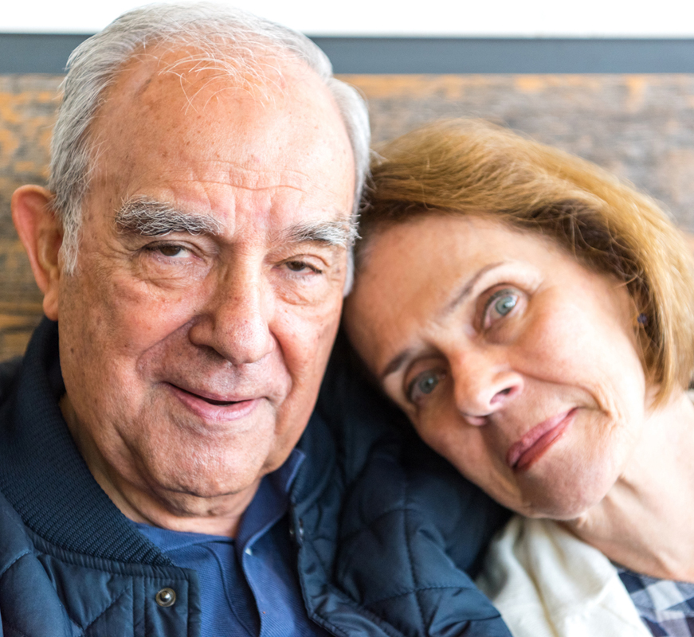
NHS RightCare scenario: Getting the dementia pathway right
Tom and Barbara’s story: Dementia
Appendix 2: Short summary slide pack
April 2017

Slide 2
Tom and the sub-optimal pathway
Tom (a retired engineer) lives with his wife Barbara and is 77 years old when he first starts to experience symptoms
Tom is reluctant to go to the GP. Barbara adjusts and keeps on keeping on, but tension is building (e.g. Tom was lost for several hours whilst walking)
It is not until the fourth year (after symptoms started) that Tom becomes violent and entered the secondary care system
He is admitted to hospital for five weeks; he is moved frequently and needs two security guards to keep him in bed. Barbara is not allowed to stay with him and can only visit during regular visiting hours. In a period of confusion, Tom falls out of bed and bruises his leg quite seriously
Given Tom’s deterioration it is now already too late for him to be able to grant Power Of Attorney
In year 6, (aged 82) Tom is admitted to hospital again after significant confused episode and is found to have a severe infection from tooth decay
Barbara is undertaking a super human effort and is increasingly isolated and exhausted
By year 9, Tom is reluctant have help with feeding and this results in significant loss of weight and admission to hospital with pneumonia
Tom is discharged to a care home where he dies after three months aged 85.

Slide 3
Tom and the optimal pathway
Tom, aged 77, goes to his GP with Barbara who recommends he has a memory assessment with someone from the memory clinic
Three weeks after seeing the GP Tom is assessed by someone from the memory clinic at the GP practice
Tom is told he is likely to have dementia, but a brain scan will confirm this.
Tom receives a diagnosis and is prescribed an acetylcholinesterase inhibitor. He is also introduced to the local dementia advisor. A care plan is developed that includes a series of local post diagnostic support activities
In year 2, Tom sees his GP and it is considered that he most likely has a urinary tract infection and is prescribed antibiotics (avoiding secondary care)
The Dementia advisor also offers high quality support (a lifeline to Barbara) including guidance around Power of Attorney
Tom gets involved in lots of post diagnostic support groups including a walking group. Later he has a fall and is taken to A&E – but it’s only a bruise, good healthcare communication results in a very short stay
Tom and Barbara maintain active lives together until year 8, with also Barbara receiving valuable respite
In year 10, Tom is admitted to a care home as his needs can no longer be met in the home with Barbara as his primary carer. (10 good years together post diagnosis).

Slide 4
Financial information (1)
Analysis by provider | Sub-optimal | Optimal
Acute | £17,428 | £600
Ambulance service | £233 | £233
Care Home | £7,670 | £7,670
Primary care | £7,119 | £8,136
Third Sector | £0 | £1,675
Grand total | £32,450 | £18,315
Not only is Tom’s (and his wife’s) health and quality of life significantly better in the optimal scenario, but the costs to the health economy are reduced by 43%*. The impact is significant on outcomes, quality and finance.
*Costs calculated as at 15/16 prices.

Slide 5
Financial information (2)
Analysis by cost category | Sub-optimal | Optimal
Primary care management | £7,075 | £8,136
Urgent and Emergency Care | £461 | £233
Secondary Care Management | £17,200 | £600
Intermediate Care | £7,670 | £7,670
Community Care | £0 | £1,675
Grand total | £32,450 | £18,315
This scenario is using a fictional patient, Tom. It is intended to help commissioners and providers understand the implications (both in terms of quality of life and financial costs) of shifting the dementia care pathway.
Primary care expenditure is 15% more in the optimal scenario. Most of this investment is centred on: a) a dedicated dementia advisor (£7.4k) and b) early diagnosis and earlier prescriptions for inhibitor drugs. The % increase is relatively small because there are significant cost savings associated with incontinence products (£6.9k variance between the two scenarios).
Secondary care expenditure is radically different, ranging from three hospital admissions totalling 43 days as an inpatient, compared to one day’s stay in the optimal scenario (£17k vs £1k)
The third sector also makes a significant contribution in the optimal case with the provision of the ‘singing for the brain’ programme (£1.7k)

Slide 6
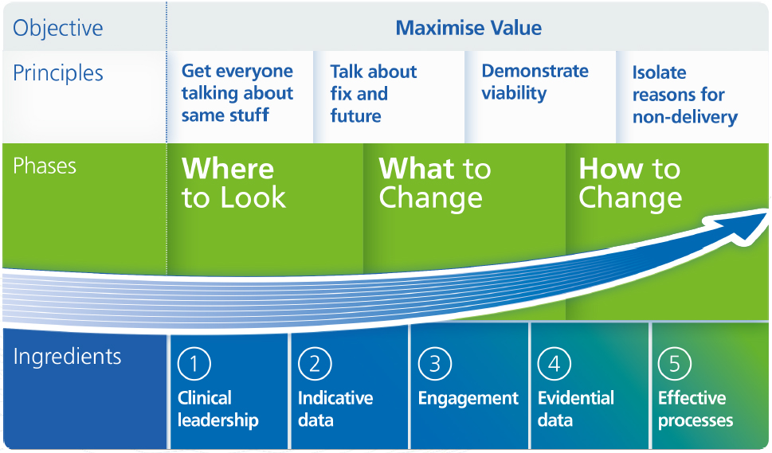
The NHS RightCare approach

Slide 7
Further information
For more information about Tom’s journey, NHS RightCare or long term conditions you can:
Email
rightcare@nhs.net
england.longtermconditions@nhs.net
Visit
https://www.england.nhs.uk/rightcare/
Tweet
@NHSRightCare

