Slide 1
Experience of Care: Patients and Staff Together
Introductory Workshop

Slide 2
Let’s break the ice: What are you grateful for?
Spend a moment thinking about something you are grateful for.
Today, this morning, right now.
Big or small, it’s all good.
Tell the person next to you what it is
Let them tell you what they are grateful for
= Ice broken
Notes:
This slide and the next cover the icebreaker we propose for this workshop. Of course you may prefer to switch the icebreaker proposed here for one that you prefer to use. If you are working with a group who all know each other you may not need an icebreaker at all and so can delete these two slides.
This icebreaker is consistent with the theme of positive experience for both staff and patients together. There is good quality research evidence that practising gratitude has a number of personal and interpersonal benefits, so this icebreaker enables you to both get your participants talking to each other and spread some good practice that supports compassion for all. What’s not to like? :-)

Slide 3
Why #gratitude?
People who practise gratitude tend to be:
happier
have more positive emotions
sleep better
more satisfied with life
are more compassionate to others
Not just any icebreaker – an evidence-informed icebreaker that is also good for you!
Positive Psychology Progress: Empirical Validation of Interventions.
Seligman, Martin E. P.; Steen, Tracy A.; Park, Nansook; Peterson, Christopher
American Psychologist, Vol 60(5), Jul-Aug 2005, 410-421.http://dx.doi.org/10.1037/0003-066X.60.5.410 and http://greatergood.berkeley.edu/pdfs/GratitudePDFs/6Emmons-BlessingsBurdens.pdf

Slide 4
#gratitude and showing appreciation in the workplace
Associated with:
more positive emotions
less stress and fewer health complaints
a greater sense that we can achieve our goals
fewer sick days
higher satisfaction with our jobs and with our coworkers.
“I see gratitude as a gateway drug to empathy….. grateful employees are more concerned about social responsibility, for example. Grateful employees - as well as employees who receive more gratitude - perform more “organisational citizenship” behaviours: kind acts that aren’t part of their job description, like welcoming new employees and filling in for coworkers.”
https://greatergood.berkeley.edu/article/item/how_gratitude_can_transform_your_workplace
“You create an environment where people feel valued and appreciated for who they are, not just what they do.”
http://greatergood.berkeley.edu/pdfs/GratitudePDFs/6Emmons-BlessingsBurdens.pdf
Notes:
This slide and the next two cover the icebreaker we propose for this workshop. Of course you may prefer to switch the icebreaker proposed here for one that you prefer to use. If you are working with a group who all know each other you may not need an icebreaker at all and so can delete these two slides.
This icebreaker is consistent with the theme of positive experience for both staff and patients together. There is good quality research evidence that practising gratitude has a number of personal and interpersonal benefits, so this icebreaker enables you to both get your participants talking to each other and spread some good practice that supports compassion for all. What’s not to like? :-)

Slide 5
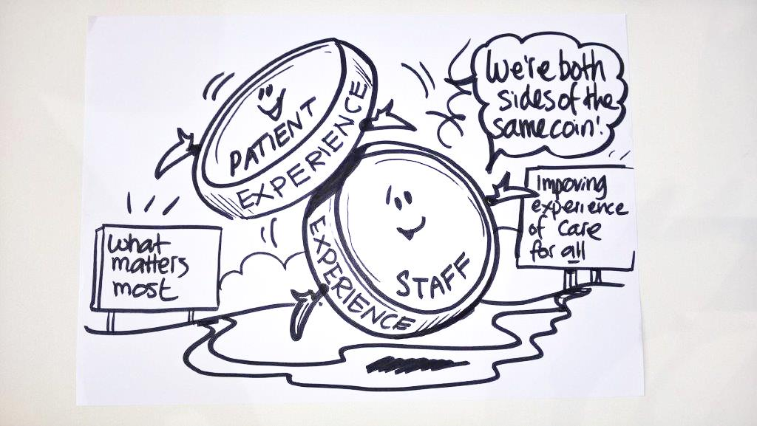
Plan for the day
Consider the relationship between staff experience and patient experience
Introduction to the Experience of Care: Patients and Staff Together improvement approach

Slide 6
Exploring the relationship between staff experience and patient experience

Slide 7
Notes:
You can get copies of the infographics shown on this slide and the previous slide for printing and copying here: https://www.england.nhs.uk/publication/why-caring-for-the-people-who-care-matters/
There is an additional infographic in the supporting workplace compassion resource pack which you might also like to print as a handout.
Tips:
This slides shows some of the benefits of positive staff experience for patient care.
It enables you to make the point that whilst a good staff experience is of course important for NHS staff it is also important for patients too.
Supporting positive staff experience is one way of ensuring positive patient experience.
In summary: We can all agree that high quality patient care matters to everyone in the NHS. We tend to focus less on high quality NHS staff experience yet we can see that staff experience is hugely important too, for both staff themselves and for patients too.

Slide 8
Notes:
You can get copies of the infographics shown on this slide and the next slide for printing and copying here: https://www.england.nhs.uk/publication/why-caring-for-the-people-who-care-matters/
There is an additional infographic in the supporting workplace compassion resource pack which you might also like to print as a handout.
Tips:
This slides shows some of the consequences of the nature of staff experience for staff, the NHS and for patients.
On the left hand side we can see data from the NHS staff survey, that shows that a quarter of NHS staff report bullying and harassment from their colleagues, approximately a third of staff have been off work sick through stress, and that 4/5 staff in work think that their own health affects the care they give to patients. This suggests that there is plenty of scope in the NHS for making improvements to the experience that staff have in the NHS workplace.
What benefits might we expect to see if we were to seek to improve NHS staff experience? The information in the central panel shows the benefits of positive staff experience for staff and for NHS organisations.
On the right hand side we can see the cost to the NHS of staff absence and replacing staff. As employers, NHS organisations have a duty of care towards staff. In addition to the duty to act to protect staff wellbeing, there are also financial benefits to the NHS from improving staff experience. If we can reduce staff absence and recruitment costs, by improving staff experience, then we can use NHS resources more efficiently.
.

Slide 9
Balancing two global phenomena
Patients
Growing demand
Intensity
Acuity
Compassionate care
Staff
Stress
Burnout
Bullying
Compassion fatigue
Notes:
Tips
So the NHS, like healthcare organisations across the globe, is balancing two sets of inter-connected factors: more patients and more care and treatment, and scarcer staff who are stressed.

Slide 10
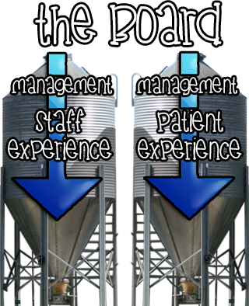
BUT…
working in silos?
Notes:
Tips:
How do we manage these two factors in the NHS? By and large we manage patient and staff experience in two separate processes, with separate lines of management, separate teams, separate objectives and priorities.
Most of the time, we manage and make plans for these two factors, staff and patients, factors that as we have seen actually impact each other, separately. In silos.

Slide 11
Table discussion
To what extent, and in what ways, do you perceive staff experience and patient experience to be related?
In what ways does your organisation help or hinder you to integrate patient experience and staff experience functions?
What does the relationship between staff and patient experience mean for your role and its function within the organisation?
Notes:
This slide is for the table discussion which is next on the agenda, based on the slides you have presented so far, so that people can discuss how this big picture you have painted relates to their own experience of the NHS.
Following the agenda, you likely have about 30 minutes for people to have this discussion at their tables and to then follow the table discussion with some whole group facilitated discussion.
Here’s our summary of what people have said in their discussions when we have run this workshop previously, you will likely hear similar points. We cover this on the next slide:
Workshop participants described the striking organisational disconnect between what they clearly knew and understood about the interconnectedness of staff experience and patient experience, and the lack, and sometimes the total absence, of joint planning of staff experience and patient experience activities. Discussions that had previously taken place between these key individuals in different teams within organisations had tended to be sporadic and reactive.
These disconnects included data analysis and reporting, working relationships between teams leading on staff and patient experience programmes and improvement initiatives within NHS organisations.
Causes of this disparity: capacity pressures, silo working, separate drivers, performance indicators and objectives for staff and patient experience teams, which were rarely co-located, served to keep patient and staff experience functions siloed.
This situation was reinforced by a more general failure to explicitly leverage staff experience in order to improve patient experience, despite the known associations between the two.

Slide 12
What other NHS organisations have found:
Workshop participants describe the striking organisational disconnect between the interconnectedness of staff experience and patient experience, and the lack of joint planning of staff experience and patient experience activities. Joint work that does take place has tended to be sporadic and reactive.
These disconnects include data analysis and reporting, working relationships between teams leading on staff and patient experience programmes and improvement initiatives within NHS organisations.
Causes of this disparity: capacity pressures, silo working, separate performance indicators and objectives for staff and patient experience teams, which were rarely co-located, patient and staff experience functions siloed.
A general failure to explicitly leverage staff experience in order to improve patient experience, despite the known associations between the two.
This workshop was, for some, the first time they had discussed staff and patient experience together across the organisation.

Slide 13
Is there another way?
Experience of Care: Patients and Staff Together Improvement Approach
Use standard improvement approaches (PDSA cycles, aim statements, fishbone diagrams, etc) but crucially also:
Co-creation approach: The improvement project team must include people representing the relevant service area plus the following management functions, all working together:
patient experience, staff experience, finance, IT & data analysis, clinical governance, plus staff and patient representatives, from the outset
Adoption of a ‘scrap the silos’ mindset
Utilisation of data to measure impact on both patient and staff experience
Notes:
This slide and the next slide summarise the Experience of Care: Patients and Staff Together Improvement Approach.
Tips:
Highlight that the approach does not involve learning new improvement techniques. It’s business as usual, using whatever improvement approaches are adopted in your organisation.
The key difference is:
who is in the room when it happens
a focus on ensuring that the impact of the improvement activity on staff and patients is planned in tandem.
The changes that you might initiate as part of the improvement activity might involve only a change in patient care in some way or just changing some aspect of staff working, but the purpose of the change is to plan and improve things keeping both staff and patient experience in mind simultaneously, with involvement of staff and patients (or their representatives) in the change from start to finish.
It’s a small but powerful change.

Slide 14
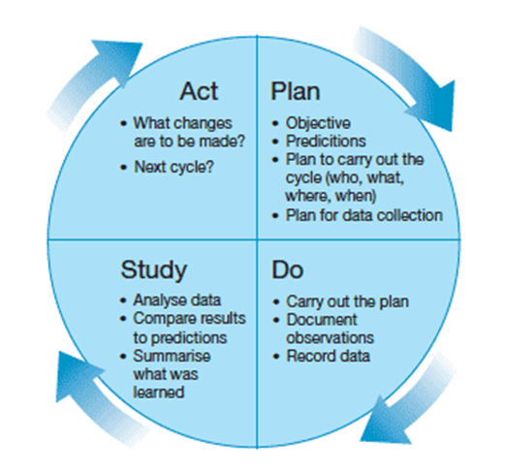
Experience of Care: Patients and Staff Together Improvement Approach in a slide
plus
Notes:
This is the key slide that you will present today.
Remember, its a small but powerful change to business as usual.
It’s a small change but it may have quite profound implications for your organisation:
People stepping out of their silo’s and talking and working together, across department, directorates, functions.
People making joined up, integrated changes to how they work and how they develop services, teams, functions.
Staff and patients (or staff and patient representatives) understanding each others’ position, and planning for improvement together.
You will all need a break /lunch at this point. After the break you will be working through some case studies so that your audience can ‘try before they buy’, testing out this approach before considering how they might use it in your organisation.

Slide 15
Want to give this approach a try? You will need:
the will, the time and the resources to plan, do, study, act an improvement/transformation initiative
we recommend a discrete improvement initiative that can be delivered within a relatively short timescale, e.g., 3 months
could be part of a larger transformation plan within the organisation if that works
Notes:
This slide and the next slide simply describe what is involved in using this approach to improvement.

Slide 16
And to step out of your silos to create a
Experience of Care: Patients and Staff Together Improvement Approach Team, or,
a Together Team, for short
With members from:
Staff experience
Patient experience
Finance
IT & data
Clinical governance
Service manager (from unit implementing the improvement activity)
Patients
Staff

Slide 17
“Try before you buy”
3 case studies*:
a Patients First Acute Trust
b Reconfigurations R Us Trust
c “Outstanding” Trust
* Disclaimer: All characters and organisations appearing in these case studies are fictitious. Any resemblance to real persons or organisations is purely coincidental ☺.
Group task for each case study:
1. Discuss the extent to which the Trusts are currently delivering compassion for all and the potential challenges and opportunities that lie ahead
2. Agree a strategy to improve the experience of care for patients and staff together
3. Agree actions to improve the experience of care for patients and staff together
Notes:
Most of the rest of the workshop is group work based on discussion of the case studies. These can be found in the workplace compassion resource pack. This exercise gives your participants a chance to think through the issues involved in working in this way, and also to consider the distance between current improvement practice and this approach.
You will need to organise your participants into smaller groups, up to 8 per group works well. If you have people present in your workshop who come from the same department or ward, try to arrange it so that the groups discuss the case studies with other people they usually work with. That way, the discussion can focus on the issues in the case study rather than the different ways of working across your organisation.
As you circulate and talk to the teams as they work through the case studies, ask them:
whether this seems to be a different way of working from their usual approach
whether they think considering staff and patients together is leading them to consider different factors or solutions
whether they are forming the view that the approach could usefully be applied in their own work setting.

Slide 18
Experience of Care: Patients and Staff Together takeaway
What are you taking away from the workshop today?
Notes:
We suggest you spend 15 minutes or so inviting participants to describe what they are taking away from the workshop.
What have they learned?
What, if anything, are they going to do differently in future?
And importantly, does anyone want to work with you on using this approach back in their department/team/directorate?

Slide 19
Next steps
When I get back to work I will…….
Notes:
Finally, invite people to complete the sentence above.
Ideally, you are hoping that people will want to implement the Experience of Care: Patients and Staff Together Improvement Approach in their day job and join or form a ‘Together Team’. Good luck!

