Slide 1
Workplace compassion: Why does caring for the people who care matter?
Notes:
This slideset is part of a pack of resources for you to adapt and use in your local NHS organisation to support the experience of compassion in the workplace.
You can find the background to NHS England’s initiative to support and improve staff experience, and workplace compassion in particular, in our support guide: https://www.england.nhs.uk/wp-content/uploads/2018/10/towards-commissioning-for-workplace-compassion-a-support-guide-v2.pdf
The resource pack for workplace compassion includes handouts for you to use in conjunction with these slides.
This set of slides is intended to introduce a series of resource materials that support workplace compassion for you to adapt and apply in your workplace.
All the resources can be adapted or tailored, so do please add your own logo, and adapt and change the slides to suit your own workshop or presenting style and your local situation and audience.

Slide 2
High quality patient experience cannot be achieved - ethically or sustainably - at the expense of staff
Experiences of care - the reality
Notes:
This and the following four slides highlight some of the key messages and data that can be found in the background to why it is so critically important to focus increased attention of the workplace experiences of NHS staff.
You can find further details about this in the guide that these resources have been developed to accompany and support.https://www.england.nhs.uk/wp-content/uploads/2018/10/towards-commissioning-for-workplace-compassion-a-support-guide-v2.pdf
The following slides cover the headline messages to engage your audience in this agenda and to set the scene for further work. You may wish to add further details or include further information about your local data to build on the national picture that these slides refer to.
All of these resources can be adapted or tailored, so do please add your own logo, and adapt and change the slides to suit your own workshop or presenting style and your local situation and audience.

Slide 3
NHS serves more than 52 million people
Around 1.3 million staff members
54% of staff professionally clinically qualified
The NHS deals with over 1 million patients every 36 hours
13% of all people in employment in the UK work in healthcare. https://www.nhsconfed.org/resources/key-statistics-on-the-nhs
NHS context
Notes:
This slide and the next one set out the scale of the issue not only for the NHS organisationally but as an issue for the health service but also for the health and well being for our communities.
Most people in the UK will have a friend, neighbour or family member with many stories to tell about their daily work and experiences in the NHS. This point in itself gives a real sense of the potentially far reaching impact. Of workplace compassion.

Slide 4
More than 60% of NHS staff in England report having recently attended work despite not feeling well enough to perform their duties (Boorman, 2009)
Poor mental health = ¼ of staff absences (Boorman, 2009)
Self-reported stress affects around 1/4 of NHS employees (NHS Employers 2014).
Death by suicide is highest amongst the caring professions (Meltzer et al, 2008).
NHS staff are all more prone to work-related illness (CIPD, 2013).
Stress and mental health issues have overtaken musculoskeletal disorders as the main reason for sickness absence (NHS Employers 2014).
So how are NHS staff feeling?
Notes:
Further details and references can be found in the appendices in the Shareable infographic reflecting the business case: Why caring for the people who care matters

Slide 5
‘NHS staff are more likely than the rest of the working population to become patients’ (Michael West, 2016)
A critical issue
Notes:
This slide sets out into clear and stark context the need for a call to action to address this major issue.

Slide 6
Balancing two global phenomena
Patients
Growing demand
Intensity
Acuity
Compassion
Staff
Stress
Burnout
Bullying
Compassion fatigue
Notes:
This slide summarises and reminds us about the fine balance between the experiences of staff and those of their patients. The following two slides develop this theme further setting out specifically why caring for the people who care matters.

Slide 7
Notes:
This and the following slide illustrate the connections between staff and patient experience and summarise the business case for investing in improving the workplace experiences of NHS staff. You may wish to further develop these slides adding further details of available local data.
You may wish to supplement this slide with a more detailed infographic that you can print out as a handout. It is included in the appendices of these resource materials as resource B in the section ‘Materials in support of introducing workplace compassion’

Slide 9
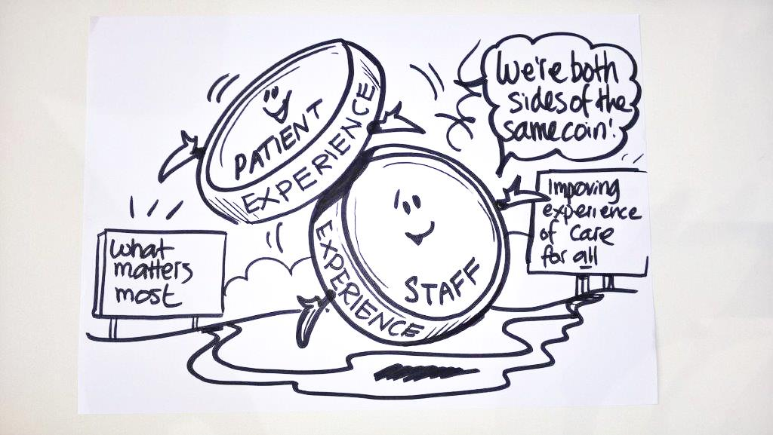
Put simply….two sides, one coin
Notes:
You may wish to draw on the connections between staff and patient experience as two sides of the same coin. We know that asking patients ‘what matters to them’ rather than ‘what is the matter’ with them can have a transforming impact on their experience of care. This slide captures the importance of understanding ‘what matters most’ to staff and how that question underpins the creation of compassionate workplaces.

Slide 10
Higher priority for experiences of staff
It is becoming critical that we do all we can to look after staff better than we have ever done before, both for their own and their patients’ health and well being.
Notes:
Taking together the information in previous slides about how NHS staff are feeling and the implications of this for outcomes and experiences of patients, it has never been more important to regard looking after NHS staff as a critical priority.

Slide 11
Wide range of measures to support health and wellbeing…and…
Special attention is needed to the importance and significance of compassionate workplaces.
Consistently thoughtful, caring and empathetic towards one another.
A wide examples and case studies about this in the NHS England guide
Notes:
We know that many organisations have put in place and support a wide range of different measures, activities and ways of supporting staff . The research and insights that informed the development of the NHS England guide point specifically to the importance of workplace compassion.
The next two slides focus our attention on workplace compassion and how it exists in the interactions between people and is influenced by our thoughts, words and actions.

Slide 12
‘Health is all about people. Beyond the glittering surface of modern technology, the core space of every health care system is occupied by the unique encounter between one set of people who need services and another who have been entrusted to deliver them.’ Frenk et al. (2010)
Experiences of care for all
Notes:
This slide reflects a key finding of the research and insights that informed the development of the NHS England guide for workplace compassion – essentially the despite our policies and procedures, our strategies and plans that workplace compassion is embodied in the interactions between people and especially between members of staff as they work together to deliver care.

Slide 13
Workplace compassion is evidenced in the interactions between people in the workplace, the manner in which people interact with each other at work, (and the associated expectations of, and responses to, that interaction) and the culture this gives rise to. Workplace compassion is experienced by staff as a result of the thoughtful, caring, and empathetic actions of others.
Our definition of workplace compassion

Slide 14
“We must show the same care and consideration to ourselves and our colleagues, as we do to those we serve... providing an appropriate culture, terms and conditions will mean we gain the most from our staff.” NHS England (2016) “Sustained compassion needs time and space to flourish and to safeguard against burn out. Doctors show significant compassion to our patients, but we also need to be shown compassion ourselves. Healthcare organisations must show compassion to their teams and staff - the NHS must develop a culture of compassion.” Trimble (2017)
National calls to action
Notes:
You may wish to use this and the next two slides to move towards a call to action for your colleagues or workshop participants. This slide covers some of the recent national calls to action regarding workplace compassion.
Here are the full references for the quotations used in this slide:
NHS England (2016) Leading change, adding value: A framework for nursing, midwifery and care staff. https://www.england.nhs.uk/wpcontent/ uploads/2016/05/nursing-framework.pdf
Michael Trimble (2017) Professionalism: Compassion, calling and citizenship (part one). https://www.rcplondon.ac.uk/news/professionalismcompassion-calling-and-citizenship-part
You will find more examples and references in the NHS guide.

Slide 15
“Everyone can take action now, today, to create a more compassionate workplace for themselves and for others.” NHS England (2018) Towards commissioning for workplace compassion: a support guide
Your call to action…
Notes:
Having explored and clarified the rationale for focusing on creating more compassionate workplaces you may now wish to encouraging participants to identify the actions they can take.

Slide 16
Table Discussion: What practical steps can you personally take straight away - today - to support positive staff experience/compassionate workplaces in your own teams/services/organisations?
Your compassionate actions
Notes:
The final slide contains a direct question for colleagues, team members of workshop participants to prompt discussion and the identification of practical actions.

