Slide 1
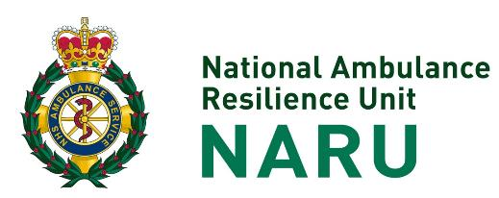

Ten Second Triage
(TST)
For Non-Clinical Responders

Slide 2
Presentation History
Ten Second Triage (TST) – For Non-Clinical Responders v1.0
Date Created 15th February 2023 |  |  | Author Sean Brayford-Harris |  | Approver Dave Bull | Approver
Superseded Presentation |  | N/A
Videos/Linked Objects |  | N/A
Amendments
Date | Summary of Change |  |  | Amended by |  | Approved By

Slide 3
Ten Second Triage (TST)
TST is recommended as the first line prehospital triage tool for all emergency services including ambulance services
It provides a framework for approaching any multiple casualty incident to ensure:
Life Saving Interventions are provided in a timely manner
Extrication occurs in priority order

Slide 4
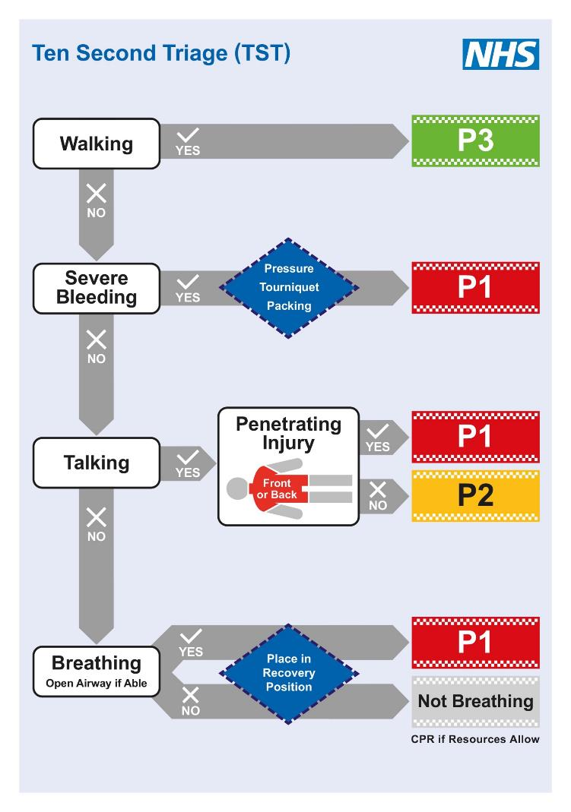
Rapidly filters ‘Walking’
Pragmatic = Replicates real world assessment
No physiological measurements
Prioritises ‘Severe Bleeding’
Simple response check
Prioritises central ‘Penetrating Injury’
Prioritises airway management
Supports CPR where able

Slide 5
Initial Mass Casualty response requires a mindset ‘Switch’
ONLY
Life Saving Interventions
&
Triage
ON
OFF

Slide 6

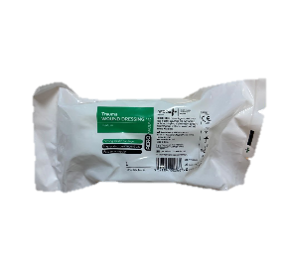
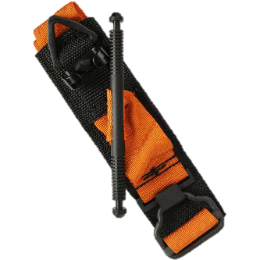
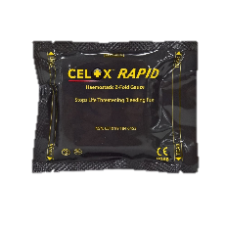

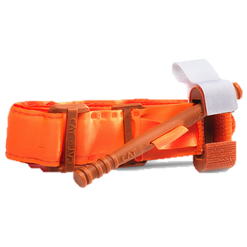
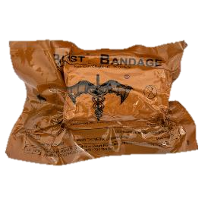
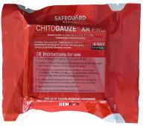
Life Saving Interventions (LSIs)
Pressure
Tourniquet
Packing
Airway Management

Slide 7
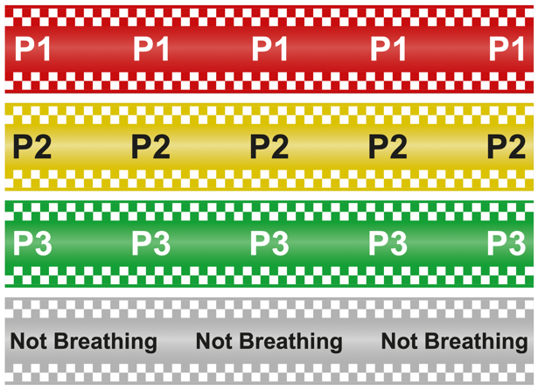
Triage Bands
Immediate
Urgent
Delayed / Walking
Not Breathing

Slide 8
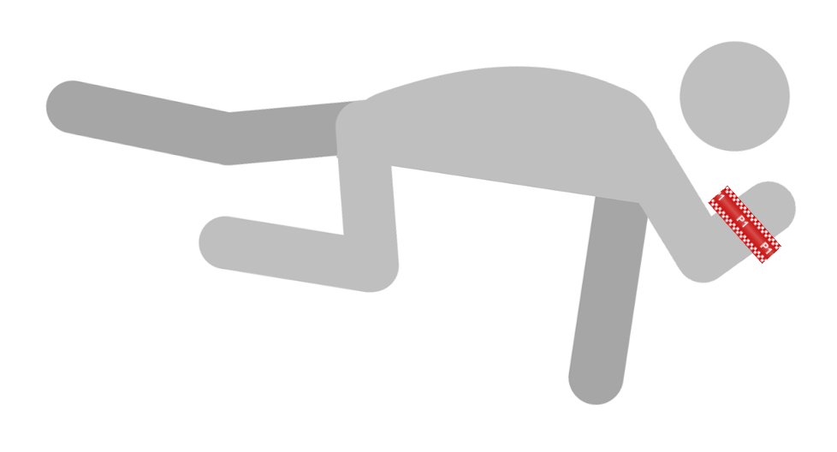
Triage Bands should be attached to a casualty’s wrist unless injured or amputated.
Ensure visibility:
Place on the upper most limb if being placed into the recovery position.
Avoid the band being obscured by clothing

Slide 9
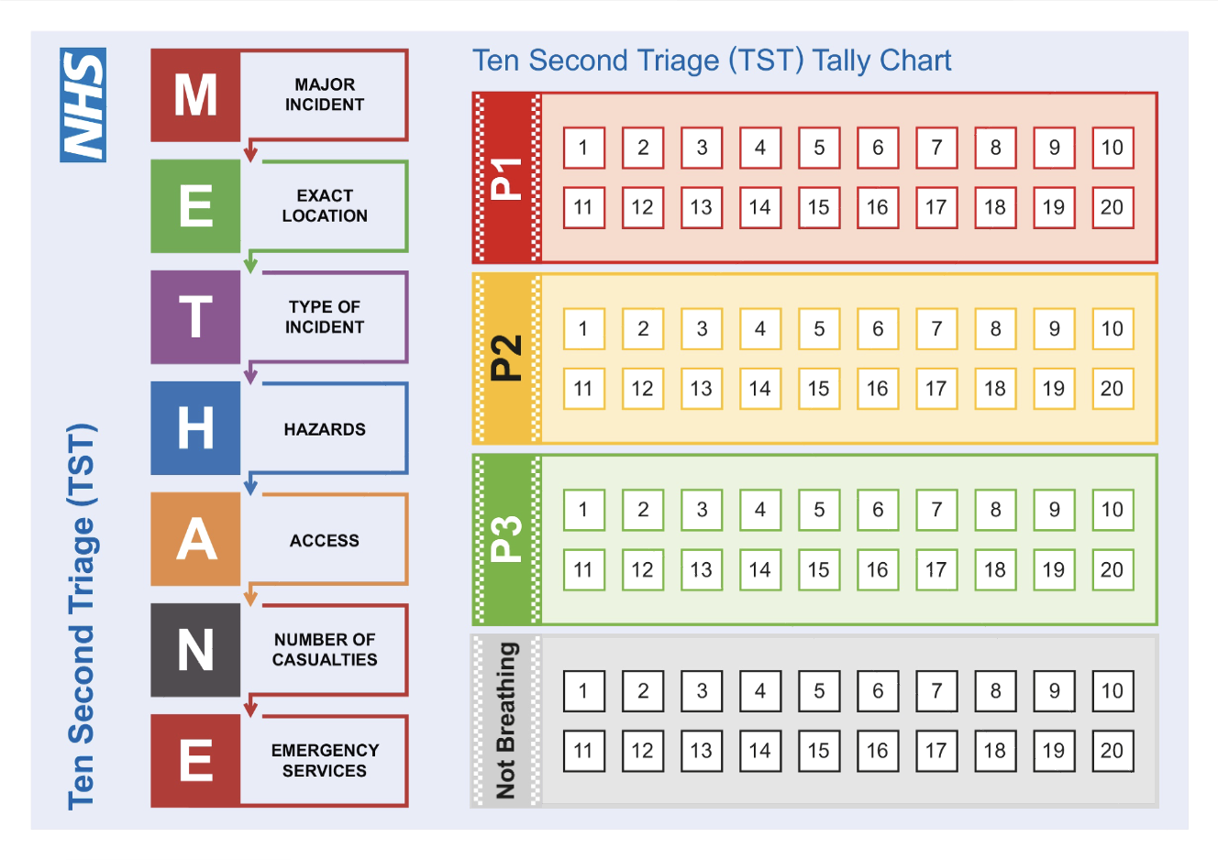

Slide 10



Life Saving
Interventions
Triage Categories
Questions
YES
NO

Slide 11
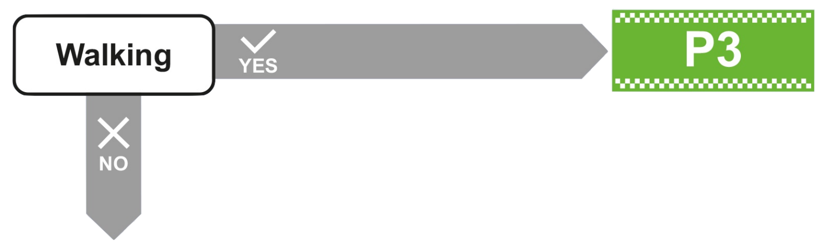

Slide 12
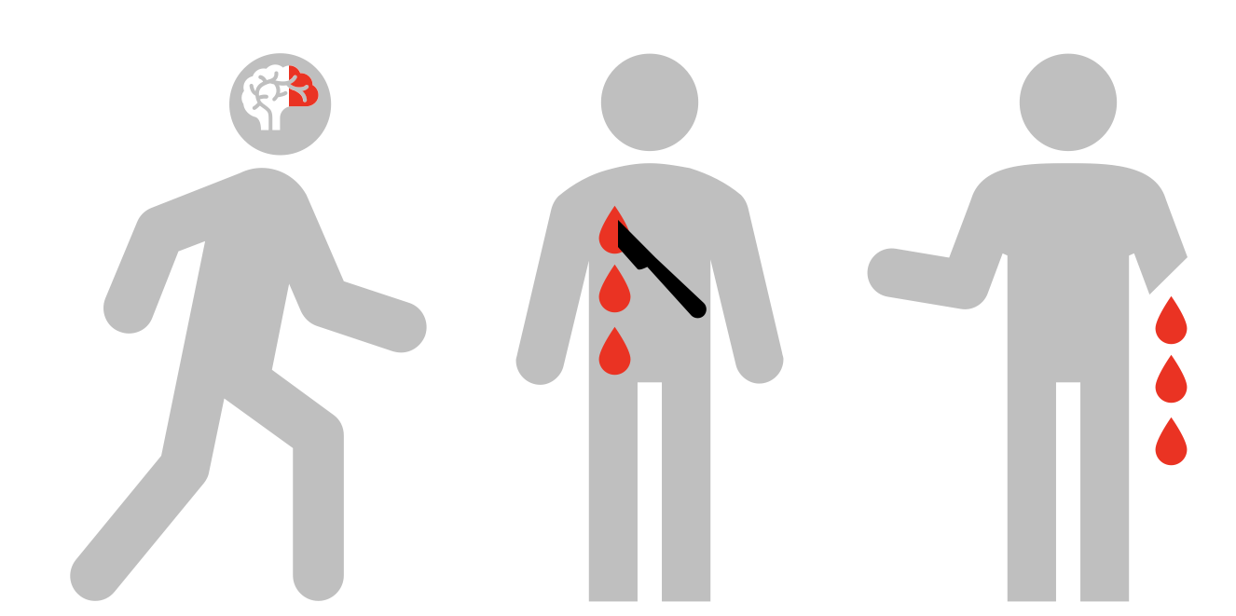
Critically Injured but Walking

Slide 13
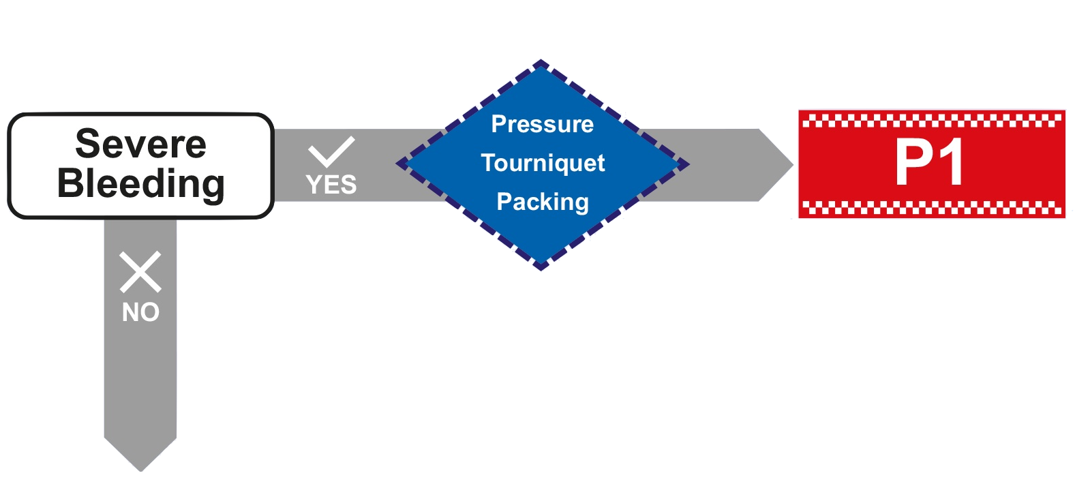

Slide 14
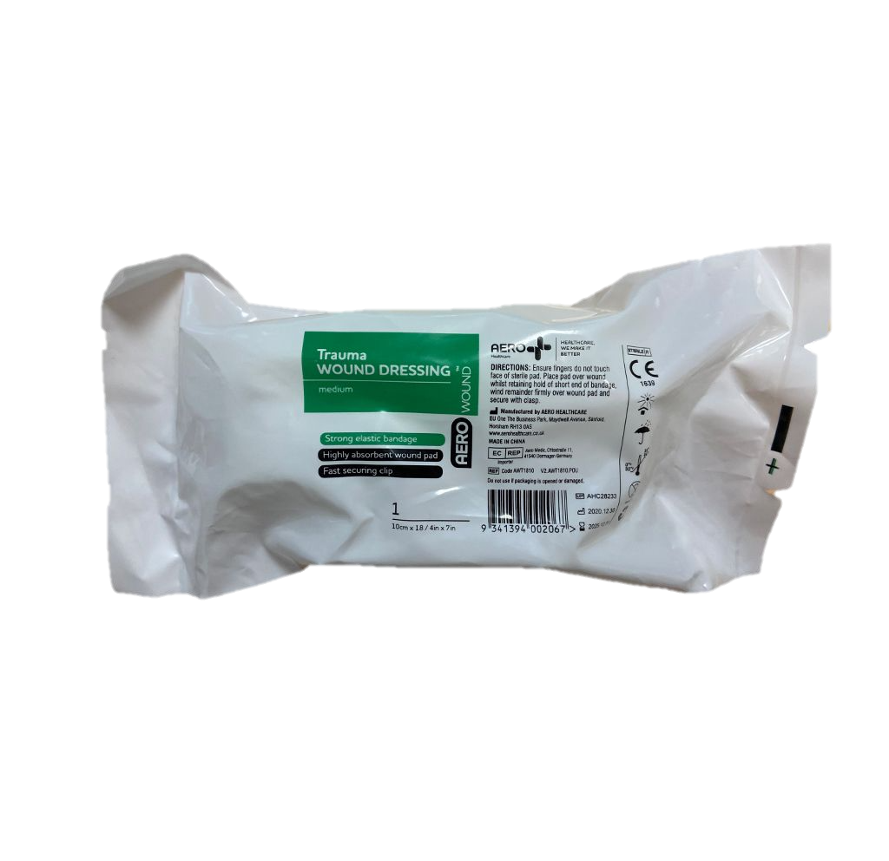

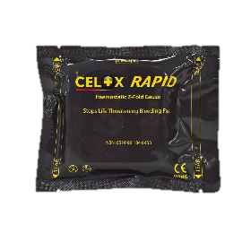
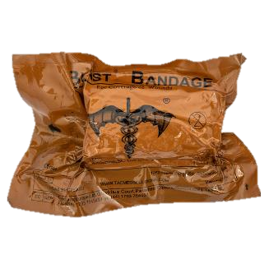
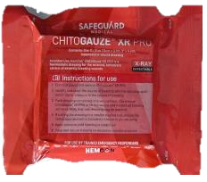
Pressure
Tourniquet
Packing

Slide 15
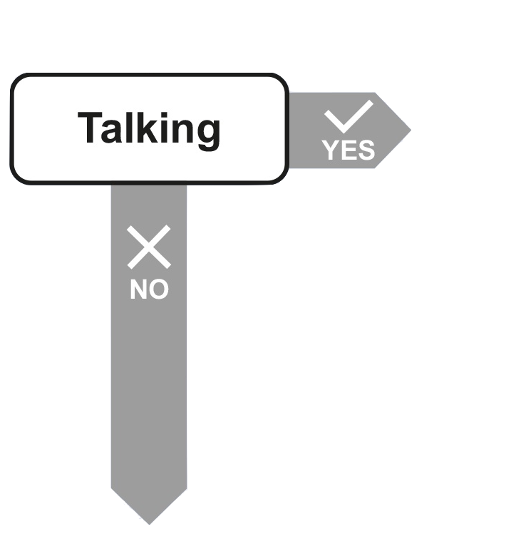
Are they Talking?
Are they Talking normally?
Are they too young to Talk?
(less than 2)

Slide 16
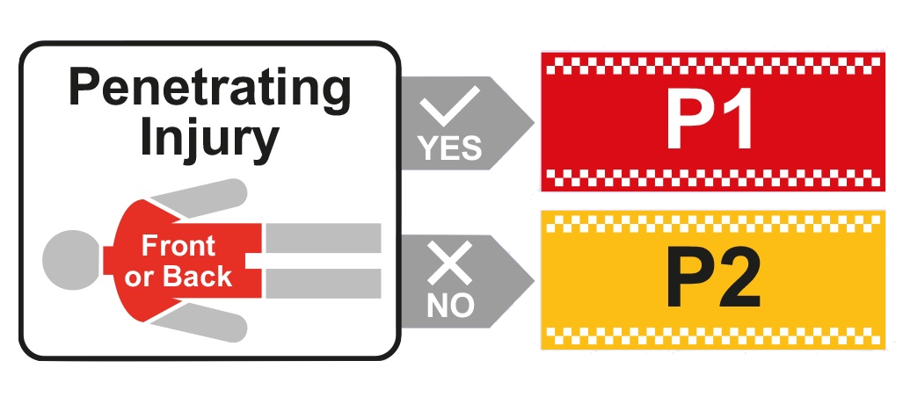

Slide 18
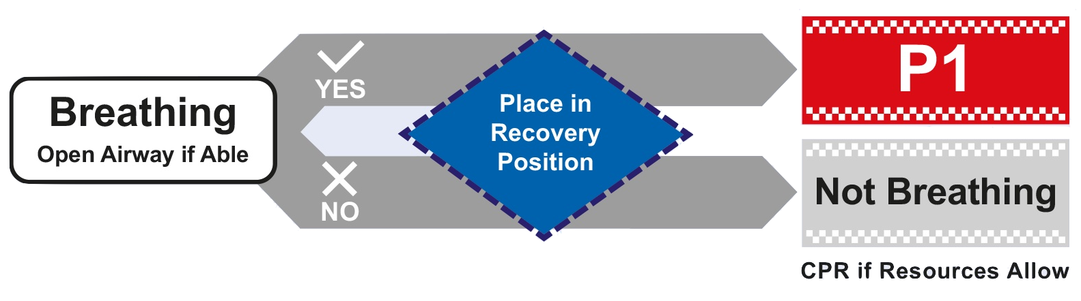

Slide 19

Cognitive Shortcuts
‘Clinical Presentation’
Severe Bleeding
Central Penetrating Injury
Not Talking

Slide 20

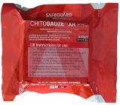
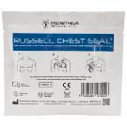

Cognitive Shortcuts
‘Intervention Applied’
*
*Chest Seals are not considered LSIs

Slide 21
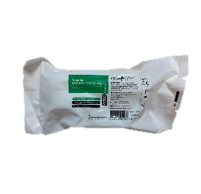



Summary
ON
Talking
OFF
Mindset Switch
Penetrating Injury Check
Response Check
Cognitive Shortcuts
Reference Card
LSIs

Slide 22
Practical Vignettes

Slide 23
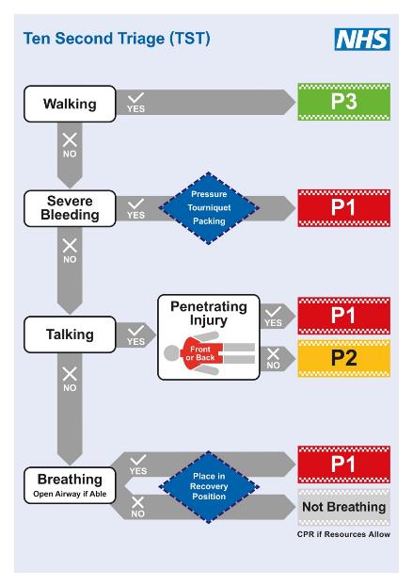

Casualty 1
Adult female
Lying on the floor
Severe bleeding stab wound to right thigh
LIFE SAVING
INTERVENTIONS?
TOURNIQUET
TRIAGE
CATEGORY?

Slide 24
Casualty 2
Adult male
Sat against a wall
No severe bleeding
Talking
7 x stab wounds to back
LIFE SAVING
INTERVENTIONS?
NONE
TRIAGE
CATEGORY?

Slide 25
Casualty 3
Adult female
Lying on the floor
No severe bleeding
Talking
2 x stab wounds to chest
LIFE SAVING
INTERVENTIONS?
NONE
TRIAGE
CATEGORY?

Slide 26

Casualty 4
Adult male with an obvious head injury
Lying down on his back
No severe bleeding
Not talking
Snoring
LIFE SAVING
INTERVENTIONS?
RECOVERY
POSITION
TRIAGE
CATEGORY?

Slide 27

Casualty 5
Adult female
Runs up to responder
Grazes to palms after falling
Talking
LIFE SAVING
INTERVENTIONS?
NONE
TRIAGE
CATEGORY?

Slide 28
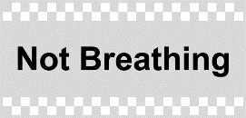
Casualty 6
Adult male with gun shot wound to head
Face down in the street
No severe bleeding
Not talking
Not breathing
LIFE SAVING
INTERVENTIONS?
RECOVERY
POSITION
TRIAGE
CATEGORY?

Slide 29
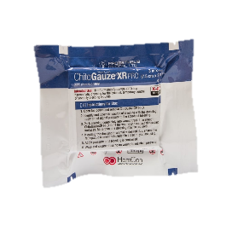
Casualty 7
Adult male
Sat on the floor
Severely bleeding groin injury
LIFE SAVING
INTERVENTIONS?
WOUND
PACKING
TRIAGE
CATEGORY?

Slide 30
Casualty 8
Adult female, struck by large vehicle
Lying on the pavement
No severe bleeding
Awake but staring and silent
Breathing
LIFE SAVING
INTERVENTIONS?
RECOVERY
POSITION
TRIAGE
CATEGORY?

Slide 31
Casualty 9
12 week old male, carried by parent
Was in close proximity to an explosion
No severe bleeding
Too young to talk, inconsolable crying
TRIAGE
CATEGORY?

Slide 32
Casualty 10
Adult male with a head injury
Slumped in drivers seat of vehicle
No severe bleeding
Making grunting noises
Breathing
LIFE SAVING
INTERVENTIONS?
RECOVERY
POSITION
TRIAGE
CATEGORY?

Slide 33

Casualty 11
Adult female
Obvious lower limb fractures
No severe bleeding
Talking
No penetrating injury to torso
LIFE SAVING
INTERVENTIONS?
NONE
TRIAGE
CATEGORY?

Slide 34
Casualty 12
Teenage female
Lying in the street
Double below knee amputations
Not talking.
Breathing
LIFE SAVING
INTERVENTIONS?
TOURNIQUETS & RECOVERY POSITION
TRIAGE
CATEGORY?

Slide 35
Post TST

Slide 36




Post TST Priorities
Casualties should be moved to a place of safety such as a Casualty Collection Point (CCP) as soon as possible after TST has been completed in order of the priority on their triage bands
Those with Silver ‘Not Breathing’ triage bands will remain in situ and will be reassessed by healthcare responders when appropriate

Slide 37
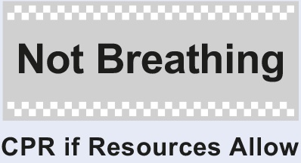

Silver ‘Not Breathing’ Reassessment by Healthcare
DEAD
Resuscitation

Slide 38
DEAD
Where a casualty is considered to be amenable to ongoing resuscitation, they should be re-triaged as P1 and prioritised for treatment and evacuation
Where full assessment shows that resuscitation will be futile, or where resources required to allow any chance of successful resuscitation are unavailable, they will be recognised as dead.

Slide 39
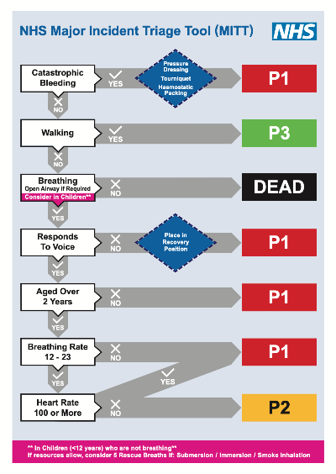
Major Incident Triage Tool (MITT)
MITT is an additional triage tool, designed and validated as a replacement to existing NHS adult and paediatric tools.
MITT may be used by healthcare responders after TST.
The decision for ambulance responders to use MITT will be taken by the ambulance on scene commander and will not occur until all casualties have been triaged with TST and have been evacuated to a CCP.

