Slide 1
Major Incident
Triage Tool (MITT)

Slide 2
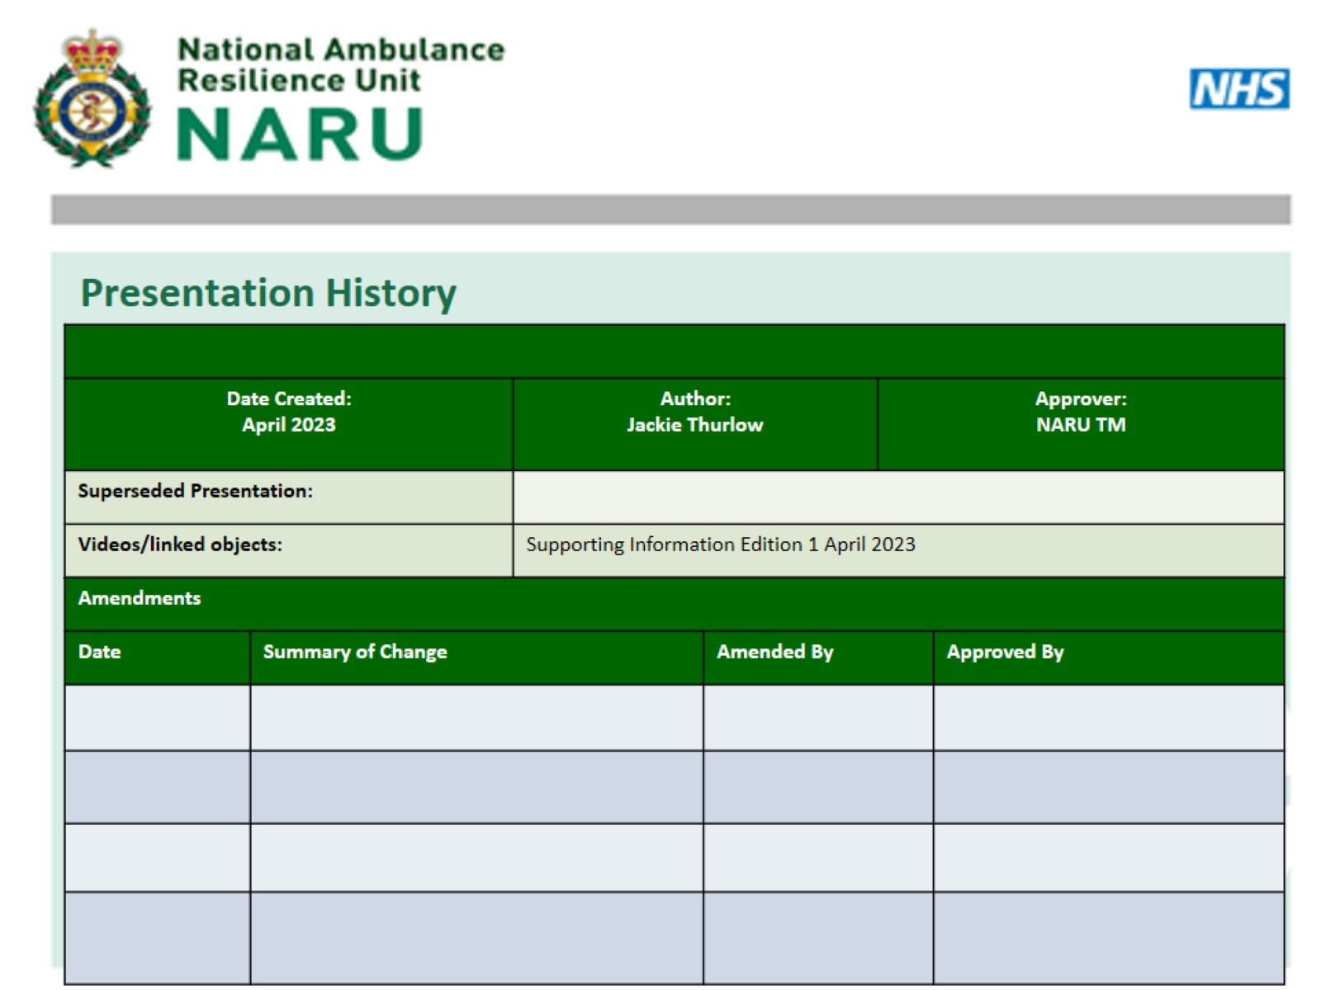

Slide 3
Objectives

Slide 5
Initial Problem

Slide 6
Objective

Slide 7
Ten Second Triage

Slide 8
TST Triage Bands

Slide 9
Major Incident Triage Tool (MITT)

Slide 10
TST to MITT Transition

Slide 11
MITT

Slide 12
Not Breathing

Slide 13
Triage Categories P1 (Immediate)

Slide 14
P2 (Urgent)

Slide 15
P3 (Delayed)

Slide 16
P1 Hold

Slide 17
DEAD

Slide 18
SURVIVORS

Slide 19
Paediatrics

Slide 20
Clinical Interventions in the CCP

