Slide 1
Articulate your change: Logic Model
SITUATION:
Text here
ACTIVITIES:
OUTCOMES:
GOAL:
Text here
Text here
Text here
ASSUMPTIONS:
Text here

Slide 2
Articulate your change: Maximise health & well-being for frail elderly (logic model)
SITUATION:
Inequality in provision of care and wide variation in quality of care
Fragmented health and care system and inefficiencies
Health organisations and local Authorities are under financial pressures
Over dependence on in-patient care - high number of avoidable admissions
ACTIVITIES:
OUTCOMES:
GOAL:
Early intervention & proactive support
Person centred & planned care delivery
Coordinated care across health, social care & mental health
Joint approaches to budgets & contracts
Ready access to community-based care
Faster, more consistent care across the local system
Increased choice and control over own health & care needs
Improved collaboration & coordination of care
Improved experience of care
Reduced avoidable admissions, A&E visits etc.
Reduced overall cost of care & support
All the frail elderly living in the area receive the most appropriate care and support they need in the right place and at the right time
ASSUMPTIONS:
There will be a realignment of resources as stakeholders work together; Cultural change takes place; There are national levers to support the programme; Partners will have freedom to implement changes to work differently.

Slide 3
Articulate your change: Narrative
Your programme
 | Your Programme
Once upon a time
Every day
One day
Because of that…
Because of that…
Until finally

Slide 4
Articulate your change: Narrative
Your programme
 | Your Programme
Once upon a time | There was inequality in provision of care and wide variation in quality of care. A fragmented health and care system and inefficiencies led to duplication; inadequate collaboration and coordination of care.
Every day | Health organisations and local authorities struggle with financial pressures and there is an over dependence on in-patient care with high numbers of avoidable admissions.
One day | A group decides to work together to apply the principles of large scale change to tackle the problems.
Because of that… | We achieve improved collaboration and greater coordination of care needs, which leads to faster, more consistent care across the local system. Service users experience increased choice and control over own health and care needs.
Because of that… | We see improved experience of care and support. There is a reduction in voidable admissions, A&E visits etc. This leads to a reduction in overall cost of care and support and a more productive health economy.
Until finally | People with or at risk of developing complex care needs receive the most appropriate care and support they need in the right place and at the right time.

Slide 5
Articulate your change: Driver diagram
Secondary driver
Activities or interventions
Primary driver
Secondary driver
Activities or interventions
Activities or interventions
Secondary driver
Key aim or outcome
Primary driver
Activities or interventions
Secondary driver
Activities or interventions
Secondary driver
Activities or interventions
Primary driver
Secondary driver
Activities or interventions

Slide 6
Articulate your change: Maximise health & well-being for frail elderly (driver diagram)
Person centred & planned care delivery
Personalised care plans available for all
Increased choice and control over own health & care needs
Coordinated care across health, social care & mental health
All the frail elderly living in the area receive the most appropriate care and support they need in the right place and at the right time
Improved experience of care
Ready access to community-based care
Faster, more consistent care across the local system
Early intervention & proactive support
Improved signposting to community-based services
Reduced overall cost of care & support
Reduced avoidable admissions, A&E
visits etc.
Joint approaches to budgets & contracts

Slide 7
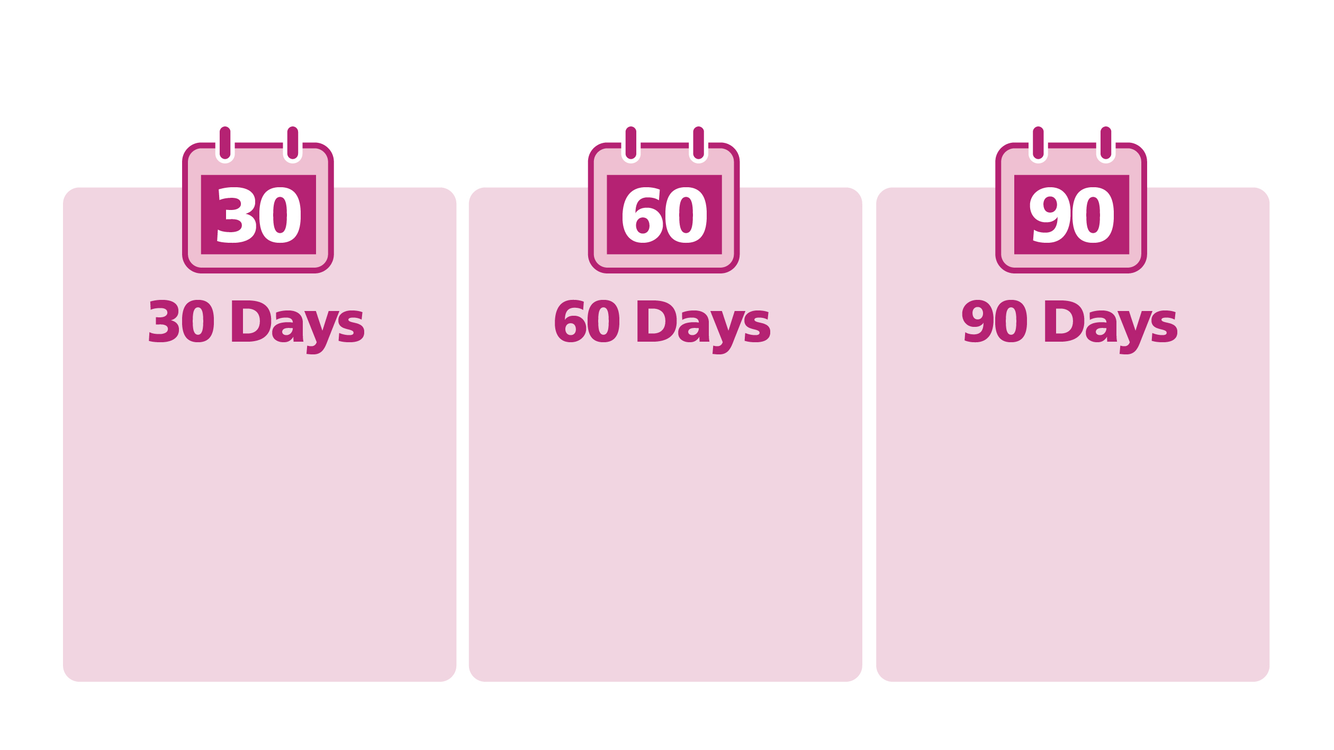
Articulate your change: 30, 60, 90 day plan
Activity & outcome
Activity & outcome
Activity & outcome
Activity & outcome
Activity & outcome
Activity & outcome
Activity & outcome
Activity & outcome
Activity & outcome
Activity & outcome
Activity & outcome
Activity & outcome
Activity & outcome
Activity & outcome
Activity & outcome

Slide 8
Articulate your change: 30, 60, 90 day plan
Improve signposting to community based services – reduced A&E admissions
Early intervention & proactive support – reduced A&E admissions
Person centred & planned care delivery – improved experience of care
Joint approaches to budgets – improved collaboration and co-ordination of care

Slide 9
Choose measures
Evidence of.. Activity/outcome/goal/ assumptions? | Measure How will you measure it? | Priority | Rationale Why choose this measure? | Issues or limitations

Slide 10
Choose measures
Evidence of.. Activity/outcome/goal/ assumptions? | Measure How will you measure it? | Priority | Rationale Why choose this measure? | Issues or limitations
Outcome - Reduction in overall cost of care and support | Cost / number of admissions or attendances, ambulance transmissions, ongoing social care packages, practice nurse contracts, GO contracts, OoH GP contracts, Age UK and other volunteer intervention | High | Must have - Include all end-to end costs to understand overall cost. High priority – key to sustainable service | Cost data from various sources, varying time-frames.
Outcome - Improved experience of care and support | Adapted Friends and Family test for patients and staff GP patient survey | Medium | Should have – faster and more appropriate care should have improved the patient experience. Well known and understood tool, easy to roll-out GP patient survey is already carried out nationally – no cost to use | Test is very simple – some aspects of care may be good and others not so good, difficult for people to score complex care and services Good data, but slow in getting results
Provision of person centred, planned and proactive care and support | Proportion of cohort with person centred care plan in place (social or health care or both) | High | Should have – shows evidence of new activity to support frail elderly. | Definitions of care plans in health and social care, data available. Is there a desired target value – would we want 100% of cohort to have a plan?

