Slide 1
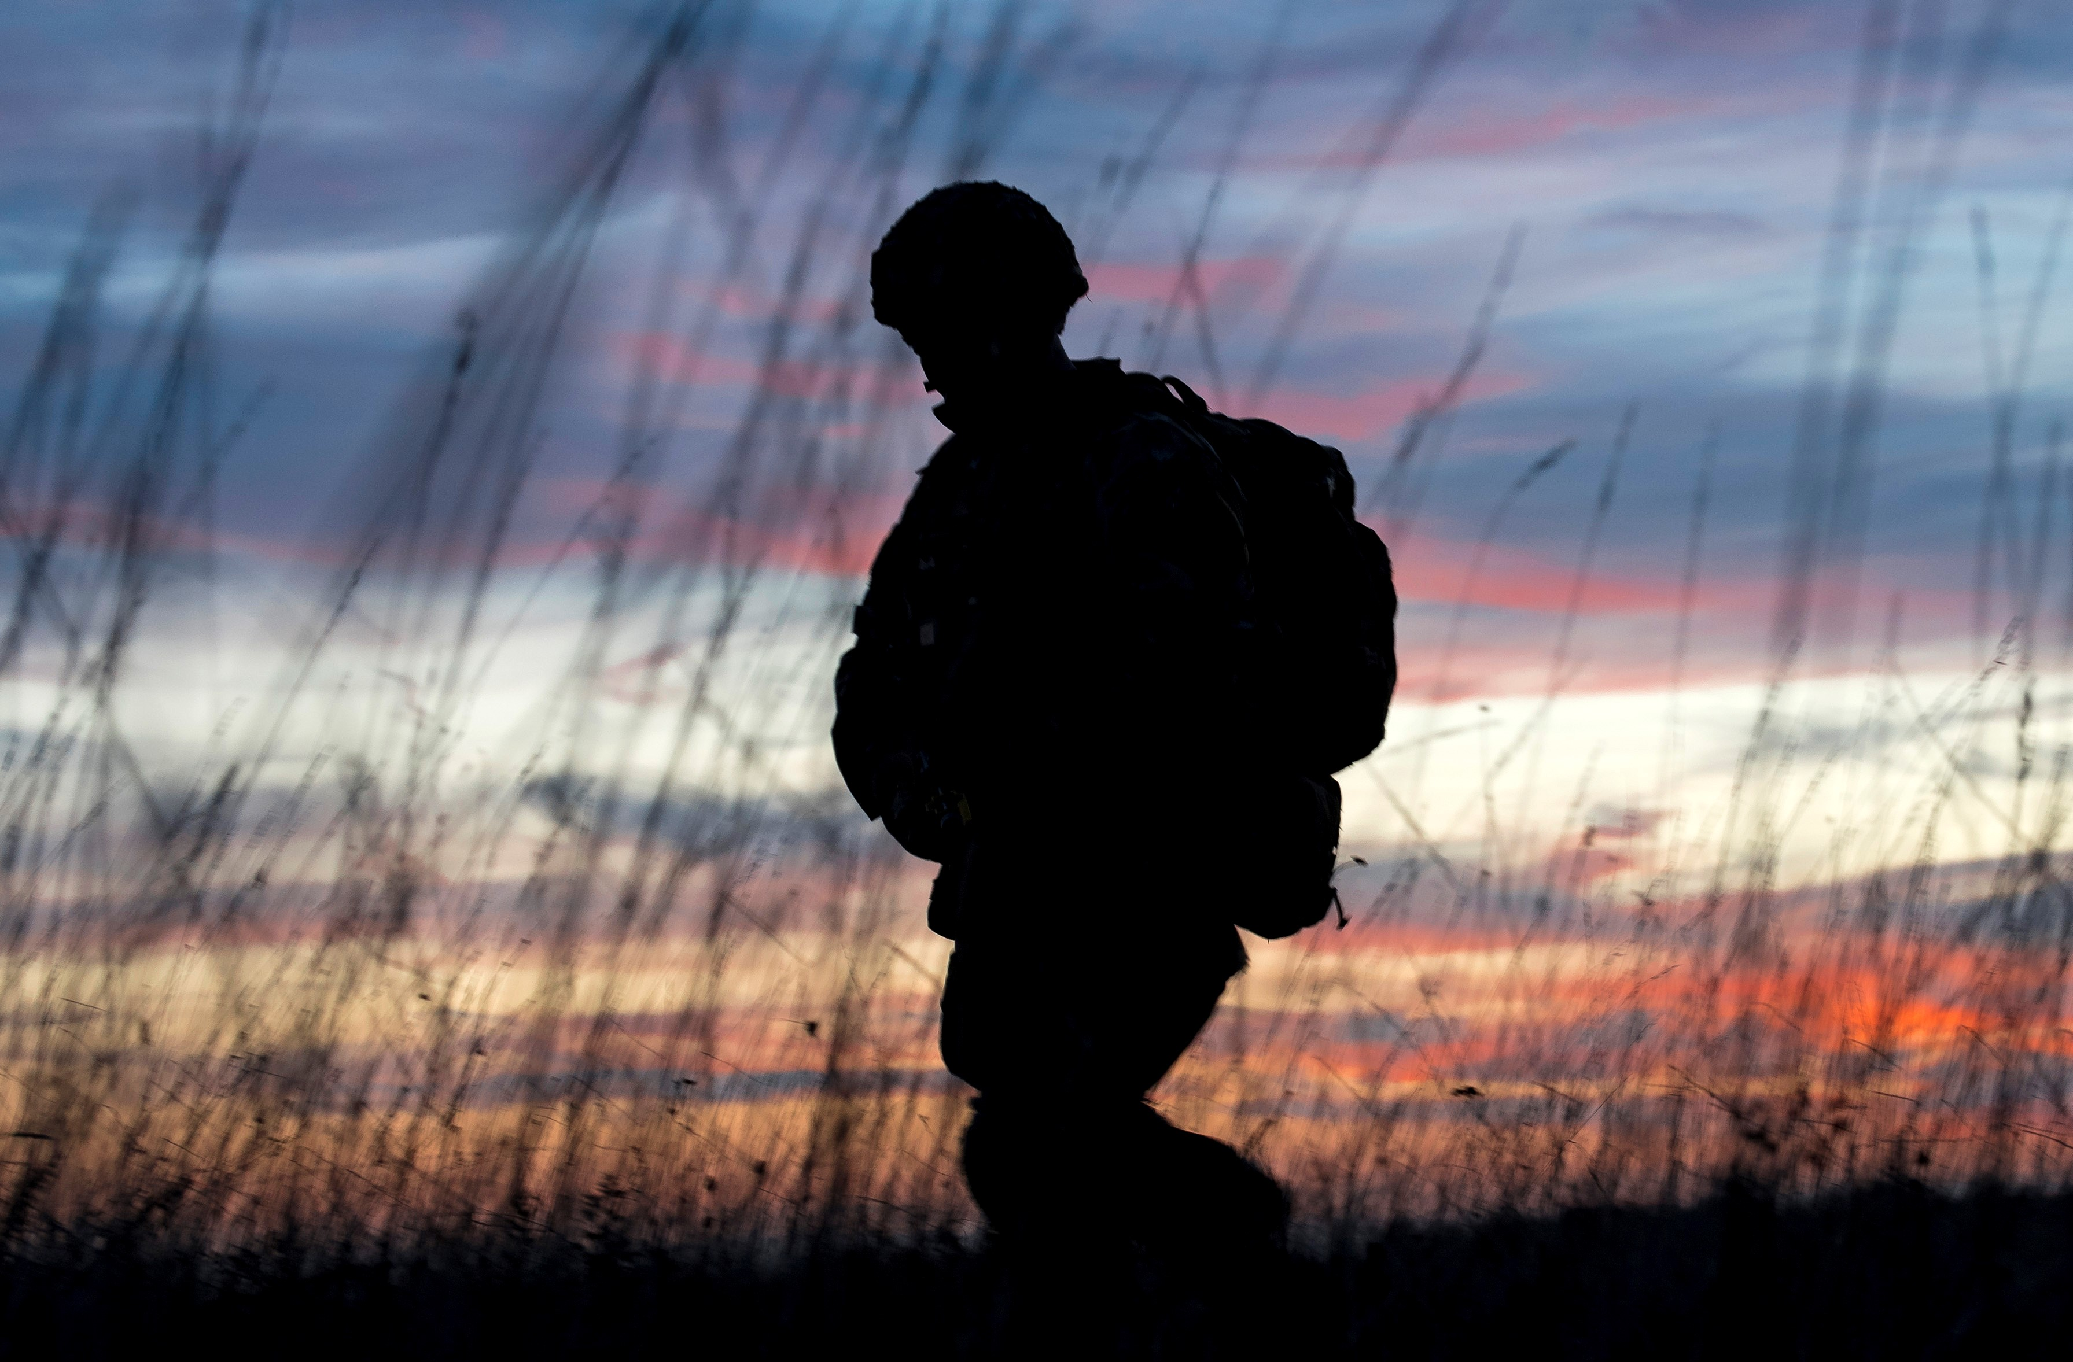
Staff information Veteran Aware NHS trust
January 2020
[Insert x trust] has been accredited as Veteran Aware.
Our Veteran Aware pledges
We strive to be an exemplar of the best care for veterans and their families.
We encourage all patients to let us know if they have ever served in the UK armed forces so that we can best support their care needs.
We are committed to learning from our patients and their families to improve quality of care.
Improving veteran care across the NHS [Insert x trust] is a member of the Veterans Covenant Healthcare Alliance (VCHA). The VCHA is a network of over 40 NHS providers that have volunteered to share and drive the implementation of best practice in NHS care for people who serve or have served in the UK armed forces and their families, in line with the Armed Forces Covenant.
What should veterans and their families expect from us?
We are committed to applying the Armed Forces Covenant and giving special consideration where appropriate.
All staff will be able to explain the health commitments of the Armed Forces Covenant.
All relevant staff will be trained and educated in veterans’ needs. If you haven’t been trained, please [Insert contact or steps to receive training].
Relevant staff will ask patients if they or a close family member serve or have ever served in the UK armed forces, so that the hospital can best support their care needs and refer to other services.
Identifying patients who are veterans
[You might want to add information about how staff flag a patient’s veteran status on the Patient Administration System or notes]

Slide 2
Services at [Insert X Trust]
Required: A name and contact for the Trust’s Veterans Champions or someone who can be a point of contact for staff
List any embedded services, for example: The Defence Medical Welfare Service is a charitable organisation that specialises in emotional and practical support when someone is in hospital, and when they are discharged but still receiving treatment. They will arrange to speak to the patient to help identify services and support, and enable referrals to a range of military and non-military organisations.
You might also be able to add contacts at the Royal British Legion, SSAFA, Combat Stress, Help for Heroes etc.
Other local services for referral
The Veterans’ Gateway is a first point of contact for veterans and their families and can put them in touch with the organisations best placed to help with the information, advice and support they need. The Veterans’ Gateway can be contacted by phone (0808 802 1212), text (81212) or online at www.veteransgateway.org.uk.
Required: NHS Transition, Intervention and Liaison mental health Service (TILS) is for veteran and armed forces personnel approaching discharge. The service provides a range of treatment, from access to early support to therapeutic treatment for complex mental health difficulties and psychological trauma. It also provides help, where appropriate, with other problems, for example money, employment or housing. Please include the relevant local contact: 0191 441 5974 North of England. 0300 323 0137 Midlands or East of England. 020 3317 6818 London or the South East of England. 0300 365 0300 South West of England.
The Veterans and Families’ Directory of Services is an online and searchable map of services for the Armed Forces Community. All NHS staff can access the app at www.vfds.co.uk
Other suggested contacts
The Veterans’ Trauma Network provides specialist care to veterans with service-specific injuries. Veterans benefit from a personalised care plan implemented by top military and civilian trauma experts in health centres across England. Referrals can be made via a GP at england.veteranstraumanetwork@nhs.net. For more information, visit blesma.org.
The Royal British Legion Veterans’ Hearing Fund provides additional support for hearing loss and/or tinnitus relating to time in service. The fund can be accessed via a GP referral to the relevant local NHS audiology department or by downloading an application form from www.rbl.org.uk/vmf.
The Royal British Legion has a Veterans’ Mobility Fund, which provides specialist wheelchairs, orthotic equipment and other mobility-related items for veterans who have a serious physical injury and whose needs cannot be met through statutory services. Eligibility for the fund requires the condition to be attributable to service and typically applicants will be in receipt of a War Pension or relevant award under the Armed Forces Compensation Scheme. To find out more, visit www.rbl.org.uk/vmf.
How can veterans get a job in the NHS?
The NHS can benefit significantly from the skills and experience veterans and reservists bring from military training and service. As a Veteran Aware hospital we support the employment of veterans and reservists in the NHS workforce and will be involved in either the ‘Employer Recognition Scheme’ or the ‘Step Into Health’ scheme. More information is available at www.militarystepintohealth.nhs.uk
To learn more about the Veterans Covenant Healthcare Alliance and what it means for NHS trusts to be Veteran Aware, please visit: gettingitrightfirsttime.co.uk/veterans

