Slide 1
Culture and Leadership Programme
Sub-heading
Author & date

Slide 2
Purpose of this presentation
Aim: to seek our board’s engagement and advice on beginning a programme of work on culture and leadership across our Trust.
This Photo by Unknown Author is licensed under CC BY

Slide 3
Contents of this presentation
1. What is culture and collective leadership?
Concept and evidence of this programme.
The impact of compassionate and inclusive culture outcomes on patients and staff.
3. What is the culture and leadership programme and how our organisation can benefit from it?
Benefits of implementing the culture and leadership programme.
2. Why culture is important in our organisation?
4. How does this programme work?
Phases and timelines of the CLP programme
5. What is the board’s responsibility to support our compassionate and inclusive culture change programme?
Resources, involvement, leadership, finance.

Slide 4
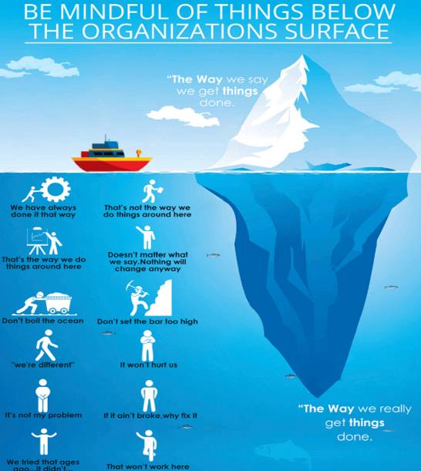
1. What is culture and collective leadership?

Slide 5
Bringing culture to life through leadership
Collective Leadership
Compassionate Leadership
Inclusive Leadership
Leadership by all, and for all
Listens to understand and takes action
Enables equity, true inclusion and belonging
A culture where all are empowered as individuals and in teams to provide leadership at various points in their daily work and in their careers.
A culture where all feel supported, listened to and where action is taken which leads to improvement.
A culture which recognises the unique needs of individuals, so that all feel valued and have the opportunity to thrive.

Slide 6
What are the elements of high quality care cultures?
Evidence shows that there are six key elements in high quality care cultures.
Cultural Elements | Values | The way we do things
Vision and Values | Constant commitment to quality of care | Everyone taking responsibility in their work for living a shared vision and embodying shared values
Goals and performance | Effective, efficient, high quality performance | Everyone ensuring that there are shared priorities and objectives at every level and intelligent data constantly informing all about performance
Support and compassion | Support and compassion for all patients and staff | Everyone making sure that all interactions involve careful attention empathy and intent to take intelligent helping action
Learning and innovation | Continuous learning, quality improvement and innovation | Everyone taking responsibility for improving quality, learning and developing better ways of doing things
Equity and Inclusion | Trust, transparency, health equalities, civility, pride, staff wellbeing, and innovation​ | Everyone demonstrates equity, diversity, and inclusion. Promoting inclusion at every level, ensuring equity, helping all to grow and lead and ensuring diversity is positively valued and developed
Teamwork | Enthusiastic cooperation, team working and support within and across organisations | Everyone taking responsibility for effective team-based working, interconnectedness within and across organisations, systems thinking and acting

Slide 7
Our vision and values
Populate with the vision and values for your organisation on this page.
Ask the Leaders of the system:
Do you identify with a particular set of values?
Are they being lived in your member organisations?
Provide the data by showing your Trust’s cultural dashboard with real life examples (Available via Model Health System or using the blank template available on www.england.nhs.uk/culture)
Explain to them why it’s important to implement it now?

Slide 8
2. Why culture is important in our organisation?
This Photo by Unknown Author is licensed under CC BY

Slide 9
The importance of culture: effect on outcomes
All levels of the NHS
The culture of an organisation impacts behaviour at all levels within and across organisations.
Leadership behaviours
Leadership is the most powerful factor influencing culture because leaders signal, through their behaviour, the values and the norms – ‘ the way we do things around here.’
Cultural elements
The six specific cultural elements are associated with high quality healthcare cultures. They are grouped into two overarching categories of performance and people.
Outcomes
Staff performance and engagement are affected by organisation culture. This in turn impacts patient satisfaction, care quality, financial performance and patient mortality.
Workforce capacity
Numbers
Diversity and demographics
Knowledge, skills and abilities

Slide 10
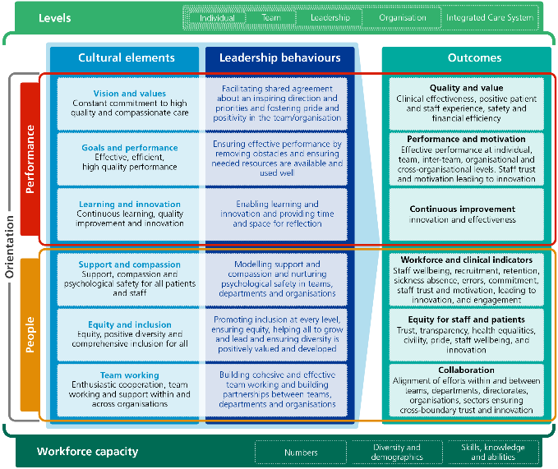
The importance of culture: the concept framework

Slide 11
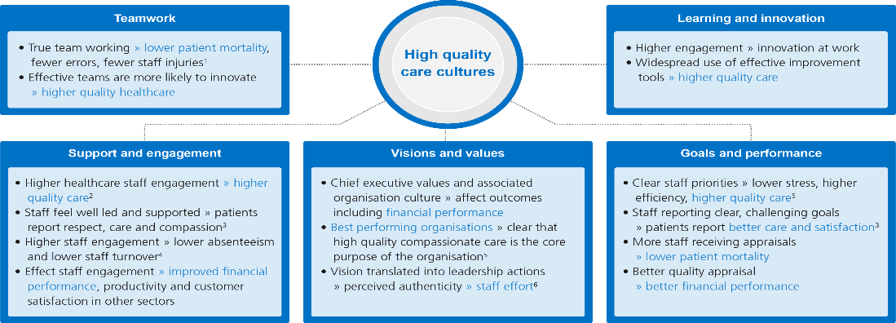
The importance of culture: improved patient and financial outcomes
¹ Lyubovnikova, J. and West, M. A. (2013) In: Developing and Enhancing Teamwork in Organizations, Jossey Bass, San Francisco, pp.331-72.
² Bakker, A. B. (2011), Current Directions in Psychological Science, Vol. 20 No. 4, pp. 265-69
³ Dawson, J.F et al.. (2011), Department of Health, London
………………………………Equity and Inclusion………………………………………….
Positively inclusive teams are more >> productive, effective and innovative than those which are less inclusive.
According to McKinsey, organisations in the top quartile for racial, ethnic and gender diversity are up to 35% more likely to have higher financial returns 7 and patient satisfaction results.
The organisations known for equity and inclusion >> higher rate of recruitment and retention from diverse backgrounds.
⁴ West M and Dawson J (2012), King’s Fund, London
⁵ Dixon-Woods, M et al. (2013), British Medical Journal Quality and Safety, Vol. 23 No. 2, pp. 106-15
⁶ Avolio, B. J. and Gardner, W. L. (2005) Leadership Quarterly, Vol. 16 No. 3, pp. 315-38.
7. https://peopleinsight.co.uk/employee-surveys/diversity-and-inclusion/?gclid=EAIaIQobChMIsuCnosWZ8gIVhoBQBh1fOgm6EAAYASAAEgJwdfD_BwE

Slide 12
The importance of culture: Case Study for equity, inclusion & diversity
North East London NHS Foundation Trust (NELFT), a mental health and community services provider employing 6,000 staff working over 200 sites, has achieved sustained improvements across all WRES indicators from 2016 - 2018.
Equality and inclusion-related issues were discussed by the board, the ethnic minority network (EMN), and at all meetings and levels in the trust, including inductions for new starters.
There was a clear message that race inequality was an issue that required the concerted effort of everyone in the trust. The board reviewed and endorsed a strategy to address racial inequality at the trust, and each executive board member worked with an EMN strategic ambassador to deliver specific actions for which they were accountable.
The organisation came up with a strategy that focused their attention and took specific actions in the following areas: recruitment, career progression, formal disciplinary methods, reverse mentoring.
Conclusion
NELFT has the highest proportion in London of minority ethnic group staff reporting that the organisation provides equal opportunities for career progression.
It also has the second lowest proportion of minority ethnic group staff (and the fourth lowest proportion of white staff) reporting discrimination, harassment and bullying from colleagues in London
For more, see: https://www.england.nhs.uk/wp-content/uploads/2019/11/nelft-case-study.pdf

Slide 13
The importance of culture: national ambitions for the NHS
A focus on culture and leadership can enable NHS organisations to address the areas highlighted in past reports which talked about the following : compassion, inclusion, speaking up, no bullying, continuous improvement, learning, quality, need for system leadership.
After the failings of Mid-Staffordshire Hospital, the Francis Inquiry recommended that in order to transform the experience of patients and staff, it is critical to strengthen leadership and change the culture in which care is provided. ​

Slide 14
The importance of culture: Our NHS People Promise
The People Promise has come from those who work in the NHS.
People in different healthcare roles and organisations have made it clear what matters most to them, and what would make the greatest difference in improving their experience in the workplace.
The culture and leadership programme can enable our organisation to address the aims of the people promise: compassionate and inclusive, recognition for job well done, a voice that counts, a workplace which is safe and healthy, continuous improvement, work flexibility, the feeling of belonging and a need for system leadership.

Slide 15
3. What is the Culture and Leadership Programme?

Slide 16
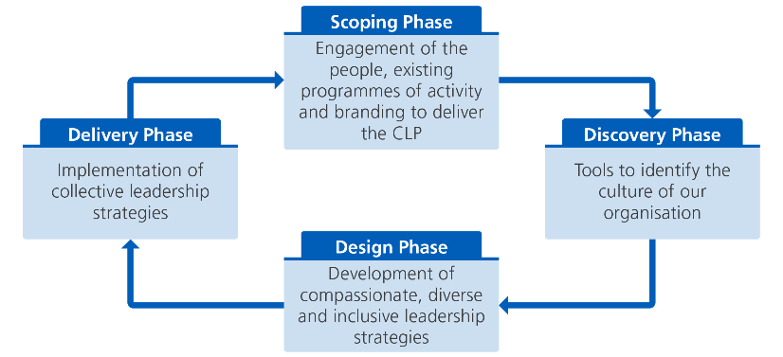
What is the Culture and Leadership Programme?
Our Culture and Leadership Programme consists of four phases to develop and implement strategies for collective leadership which result in cultures that deliver high quality, inclusive, continuously improving, compassionate care.

Slide 17
What happens in the Scoping Phase?
In the Scoping Phase, we take the time to discover and visualise our purpose, to understand why we are undertaking the Culture and Leadership programme. It’s the time to build our resources, funding, comms and putting our project plan in place before we begin diagnosing the culture of our organisation in the Discovery Phase.
Below is a simple checklist to focus on in the Scoping Phase:
Build our case
Identify our purpose
Conceptualise and communicate our purpose
Recruit our change team
Develop our change team
Create a project plan
Create an evaluation plan

Slide 18
What happens in the Discovery Phase?
The purpose of this phase is to identify and establish the culture of our organisation through the six cultural tools listed below. Gathering the information to piece together the puzzle in the synthesis workshop.

Slide 19
Why do we need this programme?
Explain your organisation’s context and why it might benefit you.
You may wish to include:
reference to the evidence on outcomes detailed above or that the programme will allow your organisation to address areas highlighted in the national reports mentioned
That the programme can contribute to the ‘culture and capability’ domain of the well-led framework for governance reviews, and improve results in governance reviews
key findings from the NHS staff survey which indicate areas of focus
any other issues that suggest the need to improve culture, leadership and overall employee health and wellbeing
Alternatively, you may want to ask this as a question for the board to answer

Slide 20
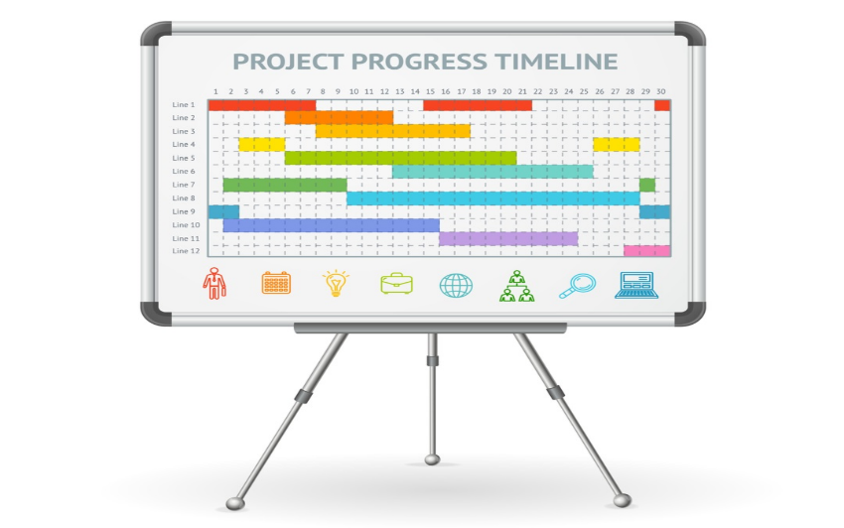
4.How does this programme work?

Slide 21
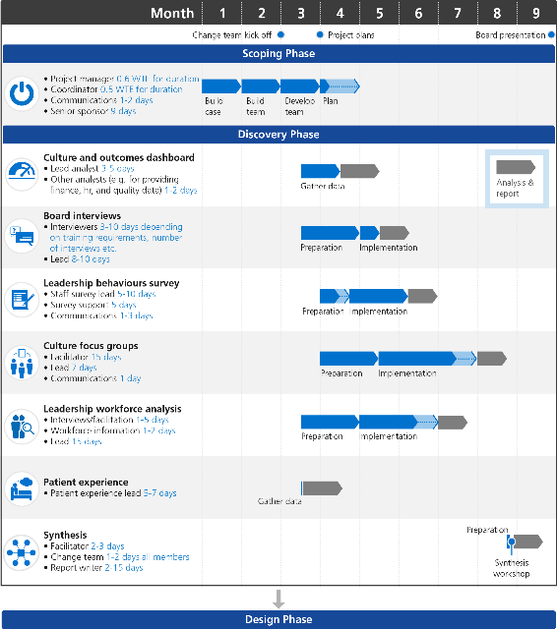
Sequencing of Scoping and Discovery Phase
Tip: This Gantt chart gives an idea of how many days we should spend on each of the tools, however it depends on how much resource we have.
The independent evaluation commissioned by NHS England and NHS Improvement recommends time spent preparing during the Scoping Phase will help the Discovery Phase run smoother and on time.

Slide 22
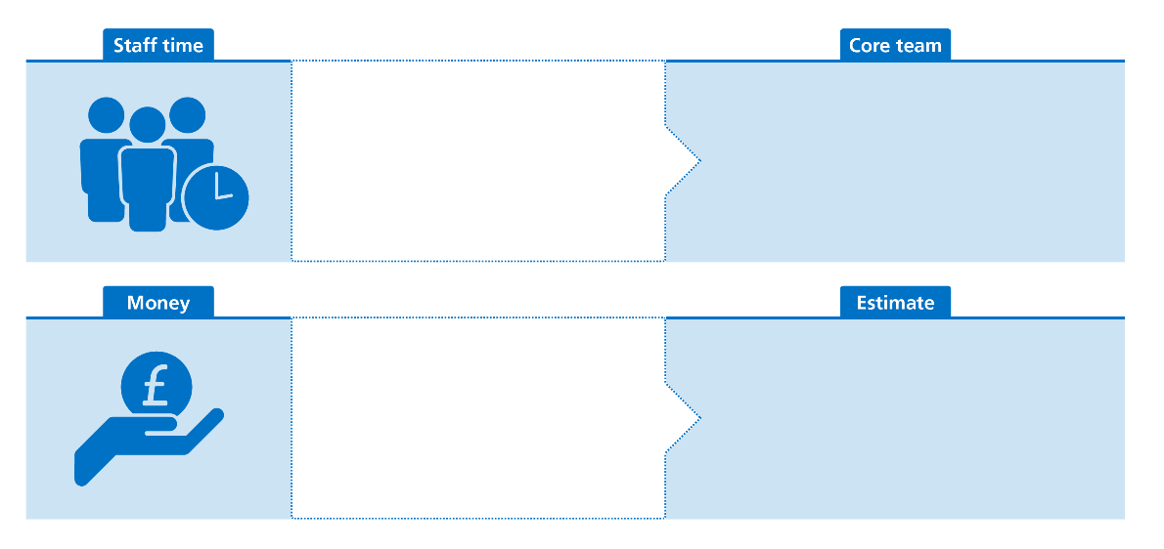
What resources are needed for the programme?
The programme team will need to be supported with both protected time and work space to carry out the culture and leadership programme.
Many people will be involved across the organisation. However, the core team will include:
At least one executive sponsor, eg: chief executive or executive director with responsibility for organisational development (OD)
OD/HR representatives
Medical/clinical/service leads
The resources to support the programme are freely available
We estimate £XXXX will be needed for XXXX

Slide 23
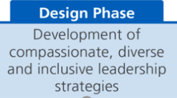
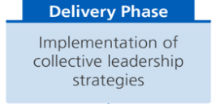
Main heading
Based on the findings of the Discovery Phase, we will design and develop initiatives that build on our strengths and address development areas. There are many initiatives we could include in our collective leadership strategy.
Vision and values
Communications, listening
Goals and performance
Performance management
Information/knowledge management
Learning and innovation
Quality improvement systems, support systems for innovation and QI
QI training
Leadership development
Patient/service user involvement and stakeholder engagement
Values-based recruitment
Business planning, organisation development
Management training
Empowering and enabling staff
Quality strategy
Leadership training
Support and compassion
Reduced hierarchy/command and control
Equity and inclusion
Inclusion and diversity strategy
Team work
Board development
Communications strategy
Engagement strategy
Health and wellbeing strategy
An assessment framework to support equity and inclusion
Leadership development to role model equity and inclusion
Whole person approach plan – openness/uniqueness, connection/attachment, opportunity/respect
Team assessments
Team-based working, inter0team working
Reduced layers of hierarchy
Leadership coaching for team leaders

Slide 24
5.What is the Board’s Responsibility?

Slide 25
Main heading
Backing from the Board is essential for the success of this programme.
This might include:
Supporting the
change team
Acting as executive sponsor
for the programme
Participating in Board Interviews
Raising awareness and
encouraging wider participation
in the programme

Slide 26
Questions
What outcomes would you like to see from this programme?
What would the challenges be?
What areas should this programme focus on?
What is your advice/insight?
[Modify the above as required]

