Slide 1
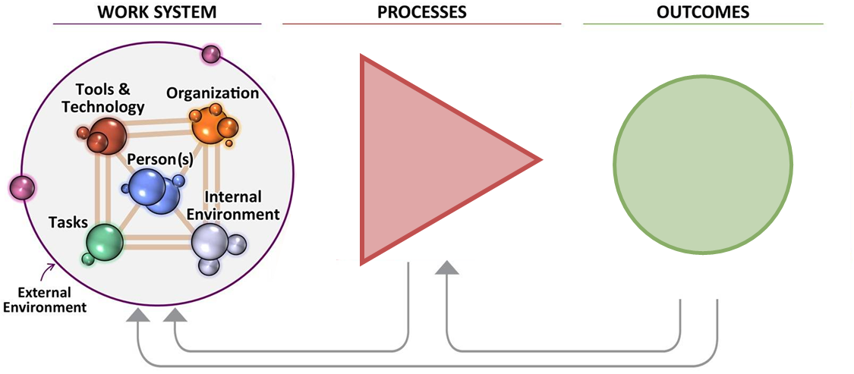
Tools & Technology
Organisation
Tasks
Person
Internal environment
Desired Outcomes
System Performance:
Human Wellbeing:
Appreciative inquiry question:
The SEIPS model sets out desired outcomes– what are you aiming to achieve when you deliver patient care?
External environment

