Slide 1
Business Continuity Management NHS Workshop
NHS England – Emergency Preparedness, Resilience and Response (EPRR)

Slide 2
House Keeping
Fire Safety
Breaks and Refreshments
Toilets
Mobiles/Electronic Devices
Notes:
This slide provides the basics health and safety briefing at the beginning of the workshop. Facilitators to add any additional information as needed.

Slide 3
Introduction
Respect and value each others contributions​.
What is said in the room stays in the room​
Share your experiences to add value to the workshop
Notes:
These are elements that should be agreed between the facilitator and delegates at the start of the course. This is to remind the group to maintain confidentiality. Delegates may identify risks which may affect the organisation’s reputation. These need to be identified but confidentiality may be necessary.

Slide 4
Aim and Objectives
Aim
To develop an understanding of how to implement a BCMS within your organisation.
Objectives
To develop an understanding of business continuity.
To understand how to use the business continuity toolkit.
To understand how to undertake a business impact analysis for your organisation
To understand how to develop a business continuity plan for your organisation
Notes:
These are the basic objectives. The facilitator may add additional objectives to this slide to ensure the workshop meets the organisation’s requirements

Slide 5
Ice Breaker
Tell the group:​
Your name​
Your role and department you work in​
What role you have in business continuity​
Have you ever been involved in responding to a business continuity incident ​
What do you know about business continuity?
Favourite sweet you had when you were growing up!
Notes:
An icebreaker has been included. This is ideal for medium workshops of up to 15 people. Above this number, ask participants to introduce themselves to the other participants at their table.

Slide 6
Definitions – ISO 22301:2019
Business Continuity ​
The capability of the organisation to continue delivery of products or services at acceptable predefined levels following a disruptive incident.
Business Continuity Management
A holistic management process that identifies potential threats to an organisation and the impacts to business operations those threats, if realized, might cause, and which provides a framework for building organisational resilience with the capability of an effective response that safeguards the interests of its key stakeholders, reputation, brand and value-creating activities.
Business continuity management system​
Part of the overall management system that establishes, implements, operates, monitors, reviews, maintains and improves business continuity.

Slide 7
Business Continuity Management System ISO 22301/22313
A business continuity management system emphasises the importance of
Understanding the organisation’s needs and the necessity for establishing a business continuity management policy and objectives​
Implementing and operating controls and measures for managing an organisation’s overall capability to manage disruptive incidents​
Monitoring and reviewing the performance and effectiveness of BCMS, and ​
Continual improvement based on management of objectives
Notes:
This is the definition from ISO 22313 which is the guideline behind the specification document ISO 22301.

Slide 8
Elements of Business Continuity Management
Operational planning and control
Business impact analysis and risk assessment
Business Continuity Strategy/ Leadership
Establish and implement BC procedures
Exercising and Testing
ISO22313
Notes:
Operational planning and control
Effective operational planning and control is at the heart of business continuity management. It should be led by a responsible person nominated by top management.
b) Business impact analysis and risk assessment
Gaining agreement and understanding of priorities and requirements for business continuity is achieved through business impact analysis (BIA) and risk assessment. The business impact analysis enables the organisation to prioritise for resumption the activities that support its products and services. Risk assessment promotes understanding of the risks to prioritised activities and their dependencies and the potential consequences of a disruptive incident. This understanding enables the organisation to select appropriate business continuity strategies.
c) Business continuity strategy
The identification and evaluation of a range of business continuity strategy options enables the organisation to choose appropriate ways of preventing disruption of its prioritised activities and dealing with any disruptions that take place. Selected business continuity strategies will provide for the resumption of activities at an acceptable level of operation and within agreed timeframes.
NOTE The chosen strategies need to take into account any risk treatment that is already in place within the organisation.
d) Establish and implement business continuity procedures
Implementing business continuity arrangements results in the creation of an incident response structure, the means for detecting and responding to an incident, business continuity plans and procedures for returning to business as usual.
e) Exercising and testing
Exercising and testing allows the organisation to:
— promote personnel awareness and competency development
— ensure that business continuity plans/procedures are complete, current and appropriate
— identify opportunities to improve its business continuity arrangements

Slide 9
Plan, Do, Check, Act Cycle
The ISO 22301 and 22313 uses a ‘Plan, Do, Check, Act’ cycle in planning, establishing, implementing, operating, monitoring, reviewing, maintaining and continually improving the effectiveness of an organisations business continuity management system
Notes:
The ISO 22301 and ISO 22313 use this cycle.
Plan
Context of the organisation - this sets out what the organisation has to do to meets its requirements, taking into account all relevant external and internal factors including:
the needs and expectations of interested parties
legal and regulatory obligations
the required scope of the business continuity management system
Leadership - sets out the key role of management in terms of demonstrating commitment, defining policy and establishing roles,
responsibilities and authorities within the organisation
Planning describes the actions required to establish strategic objectives and guiding principles for the business continuity management system. The strategic objectives set the context for the business impact analysis and risk assessment and business continuity strategy.
Support – identifies the key elements that need to be in place to support the business continuity management system:
resource, competence, awareness, communication and documented information.
Do
Operation – identifies the elements of business continuity management that are needed to achieve continuity of business operations
Check
Performance evaluation – provides the basis for improvement of the business continuity management system through measurement and evaluation of its performance.
Act
Improvement – covers the corrective action needed to address nonconformity identified through performance evaluation.
Plan Do Check Act illustrates how a business continuity management system inputs the business continuity requirements and expectations of the interested parties and through the necessary actions and processes, produces business continuity outcomes that meet those requirements and expectations.

Slide 10
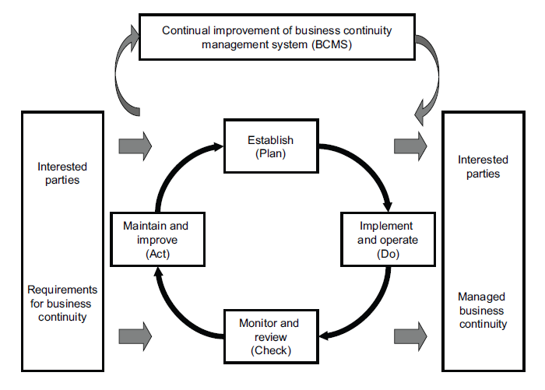
Plan, Do, Check, Act Cycle
Notes:
Plan Do Check Act illustrates how a business continuity management system inputs the business continuity requirements and expectations of the interested parties and through the necessary actions and processes, produces business continuity outcomes that meet those requirements and expectations.

Slide 11
Activity 1
In your groups discuss what the legal and/or regulatory responsibilities for business continuity are for your organisation and the wider NHS
Notes:
Allow approximately 15 minutes for this exercise. Delegates can make notes in the participant booklet.

Slide 12
Activity 1- Summary
Civil Contingencies Act 2004 and Civil Contingencies Act 2004 (Contingency Planning) Regulations 2005
ISO 22313:2020 and ISO 22301: 2019
NHS England Emergency Preparedness, Resilience and Response Framework last revised 2022
NHS England Business Continuity Framework last revised 2022
Health and Safety at Work etc. Act 1974
NHS Standard Contract
Notes:
This slide allows the facilitator to reinforce the legal and statutory duties e.g. NHS Standard Contract requires Providers of NHS- funded services to comply with EPRR guidance.

Slide 13
Activity 1 – Summary Continued
Apart from the legal side – common sense prevails for the:
  Public we serve
  The staff we employ
  Our partners we work with
  And those who commission our organisation
Notes:
This slide allows the facilitator to reinforce the legal and statutory duties.
The ruling is: “When guidance is handed down from an “august body” such as the Home Office, it should carry almost equal weight with law.”
Case reference: Justice Orr in Cardiff City and Others v Robinson and Others (1978).

Slide 14
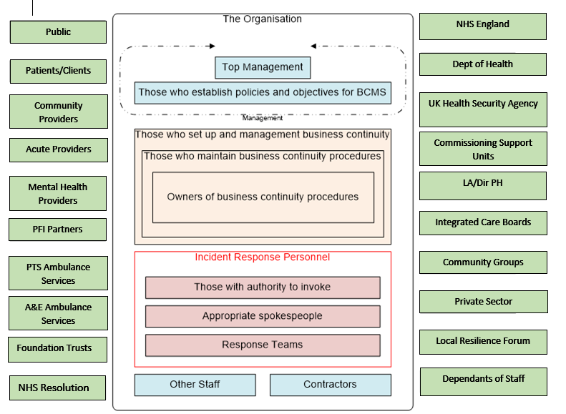
Interested Parties
Adapted for the NHS from ISO22313
Notes:
This is a diagram to show an example of interested parties to be considered in the health sector. The list is not definitive. Each organisation will have additional stakeholders who they will need to engage with.
It is taken from a stakeholder diagram in ISO22313. There is an example of good practice for organisations to engage with when producing business continuity response plans.

Slide 15
Elements of Business Continuity Management 1
Operational planning and control
Business impact analysis and risk assessment
Business Continuity Strategy
Establish and implement BC procedures
Exercising and Testing
ISO22313
Notes:
These are the elements and where they are addressed in ISO22313:
a) Operational planning and control
Effective operational planning and control is at the heart of business continuity management. It should be led by a responsible person nominated by top management.
b) Business impact analysis and risk assessment
Gaining agreement and understanding of priorities and requirements for business continuity is achieved through business impact analysis (BIA) and risk assessment. The business impact analysis enables the organisation to prioritise for resumption the activities that support its products and services. Risk assessment promotes understanding of the risks to prioritised activities and their dependencies and the potential consequences of a disruptive incident. This understanding enables the organisation to select appropriate business continuity strategies.
c) Business continuity strategy
The identification and evaluation of a range of business continuity strategy options enables the organisation to choose appropriate ways of preventing disruption of its prioritised activities and dealing with any disruptions that take place. Selected business continuity strategies will provide for the resumption of activities at an acceptable level of operation and within agreed timeframes.
NOTE The chosen strategies need to take into account any risk treatment that is already in place within the organisation.
d) Establish and implement business continuity procedures
Implementing business continuity arrangements results in the creation of an incident response structure, the means for detecting and responding to an incident, business continuity plans and procedures for returning to business as usual.
e) Exercising and testing
Exercising and testing allows the organisation to:
— promote personnel awareness and competency development
— ensure that business continuity plans/procedures are complete, current and appropriate
— identify opportunities to improve its business continuity arrangements

Slide 16
Business Impact Analysis
The BIA identifies business continuity requirements, providing information to determine the most appropriate business continuity solutions.
The BIA also identifies the urgency of each activity undertaken by the organisation by assessing the impact over time caused by any potential or actual disruption to this activity on the delivery of products and services.
Notes:
This section describes the elements of the business impact analysis. Gaining agreement and understanding of priorities and requirements for business continuity is achieved through business impact analysis and risk assessment.
The business impact analysis enables the organisation to prioritise for resumption those activities that support its products and services.
Risk assessment promotes understanding of the risks to prioritised activities and their dependencies and the potential consequences of a disruptive incident. This understanding enables the organisation to select appropriate business continuity strategies.

Slide 17
Understanding the Organisation
Adapted for the NHS from ISO22313
Notes:
Through understanding itself better, the organisation is able to ensure that its business continuity aligns with its purpose, statutory duties and obligations to its interested parties.
Understanding is achieved through the processes of business impact analysis and risk assessment.
These processes provide the information that the organisation needs to determine and select business continuity strategies.
The business impact analysis and risk assessment should enable the organisation to identify measures that:
• limit the impact of a disruption on the organisation
• shorten the period of disruption
• reduce the likelihood of a disruption
The context, evaluation criteria and format of the outcome of the business impact analysis and risk assessment should be defined and agreed in advance. Information collected should be regularly reviewed, particularly during periods of change.

Slide 18
Business Impact Analysis Template
Risk assessment and treatment
Prioritisation of activities including recovery time objectives (RTO) and maximum tolerable period of disruption (MTPoD)
Identify resources required for maintenance of priority services
Notes:
Business impact analysis is the process of analysing activities and the affect that a business disruption might have on them. In the discussion, please make reference to the time in which the activity needs to be recovered from, both partially and fully.

Slide 19
Business Impact Analysis
Activities which can tolerate very short periods of disruption
Activities which could be scaled down if necessary for short periods of time
Activities which could be suspended if necessary
Activities that cannot tolerate any disruption
Source: ISO 22313
Notes:
Please discuss the prioritisation of activities required to help support any completed BIA.
ESSENTIAL, Activities, Class 0, MPTD: None Permissible
Activities which cannot tolerate any disruption. If activities are not resumed immediately it may result in the loss of life.
RED, Activities, Class A, MPTD: 24hrs
Activities which can tolerate very short periods of disruption. If activities are not resumed within 24hrs patient care may be compromised, infrastructure may be lost and/or may result in significant loss of revenue.
AMBER, Activities, Class B, MPTD: 48hrs
Activities which can tolerate disruption between 24hr & 48hr. If service / functions are not resumed in this time frame it may result in deterioration in patient(s) condition, infrastructure or significant loss of revenue.
GREEN, Activities, Class C, MPTD: 72hrs+
Activities that could be delayed for 1 week or more but are required in order to return to normal operation conditions and alleviate further disruption to normal conditions.

Slide 20
Activity 2
In your groups:
  Identify your organisation’s/department’s essential activity/service
  Also identify your organisations legislative requirements.
  What are the resources required to deliver these?
  Are there any apparent risks to maintaining these prioritised activities?
  How will you reorganise to maintain these prioritised activities in the event of a disruptive incident?
Notes:
This activity is the key stage in the workshop. Allow approximately 30 minutes for this activity.
Using the questions facilitate the identification of the critical services/activities, the resources required to deliver them and risks that are foreseeable or known.
Once identified, ask the groups how they are going to deliver these critical services or activities if a disruptive incident occurs, i.e. loss of power, supply chain failure, flooding, fuel shortage etc.

Slide 21
Element of Business Continuity Management 2
Operational planning and control
Business impact analysis and risk assessment
Business Continuity Strategy
Establish and implement BC procedures
Exercising and Testing
ISO22313
Notes:
These are the elements and where they are addressed in ISO22313:
a) Operational planning and control
Effective operational planning and control is at the heart of business continuity management. It should be led by a responsible person nominated by top management.
b) Business impact analysis and risk assessment
Gaining agreement and understanding of priorities and requirements for business continuity is achieved through business impact analysis (BIA) and risk assessment. The business impact analysis enables the organisation to prioritise for resumption the activities that support its products and services. Risk assessment promotes understanding of the risks to prioritised activities and their dependencies and the potential consequences of a disruptive incident. This understanding enables the organisation to select appropriate business continuity strategies.
c) Business continuity strategy
The identification and evaluation of a range of business continuity strategy options enables the organisation to choose appropriate ways of preventing disruption of its prioritised activities and dealing with any disruptions that take place. Selected business continuity strategies will provide for the resumption of activities at an acceptable level of operation and within agreed timeframes.
NOTE The chosen strategies need to take into account any risk treatment that is already in place within the organisation.
d) Establish and implement business continuity procedures
Implementing business continuity arrangements results in the creation of an incident response structure, the means for detecting and responding to an incident, business continuity plans and procedures for returning to business as usual.
e) Exercising and testing
Exercising and testing allows the organisation to:
— promote personnel awareness and competency development
— ensure that business continuity plans/procedures are complete, current and appropriate
— identify opportunities to improve its business continuity arrangements

Slide 22
Business Continuity Strategy Options
People
Premises
Technology
Information
Suppliers
Stakeholders
Adapted from PAS 2015
Notes:
The identification and evaluation of a range of business continuity strategies enables the organisation to choose appropriate ways of preventing disruption of prioritised activities and deal with any disruptions that take place.
Selected business continuity strategies will provide for the resumption of activities at an acceptable level of operation and within agreed timeframes.
NOTE the chosen strategies need to take into account any risk treatment that is already in place within the organisation.

Slide 23
Activity 3
In your groups discuss:
  Does your organisation have a business continuity strategy?
  What do you think a business continuity strategy should contain and why?
  Who is the organisation’s senior business continuity champion?
  Does your organisation have an agreed essential/priority service list?
Notes:
Allow approximately 30 minutes for this activity.
The aim of this activity is to reinforce the need for an organisation to embed business continuity into daily activities.
Refer to the NHS England Core Standards for EPRR.
http://www.england.nhs.uk/ourwork/eprr/gf/

Slide 24
Elements of
Business Continuity Management 3
Operational planning and control
Business impact analysis and risk assessment
Business Continuity Strategy
Establish and implement BC procedures
Exercising and Testing
Notes:
Implementing business continuity arrangements results in:
the creation of an incident response structure
the means for detecting and responding to an incident
business continuity plans
procedures for returning to business as usual
a) Operational planning and control
Effective operational planning and control is at the heart of business continuity management. It should be led by a responsible person nominated by top management.
b) Business impact analysis and risk assessment
Gaining agreement and understanding of priorities and requirements for business continuity is achieved through business impact analysis (BIA) and risk assessment. The business impact analysis enables the organisation to prioritise for resumption the activities that support its products and services. Risk assessment promotes understanding of the risks to prioritised activities and their dependencies and the potential consequences of a disruptive incident. This understanding enables the organisation to select appropriate business continuity strategies.
c) Business continuity strategy
The identification and evaluation of a range of business continuity strategy options enables the organisation to choose appropriate ways of preventing disruption of its prioritised activities and dealing with any disruptions that take place. Selected business continuity strategies will provide for the resumption of activities at an acceptable level of operation and within agreed timeframes.
NOTE The chosen strategies need to take into account any risk treatment that is already in place within the organisation.
d) Establish and implement business continuity procedures
Implementing business continuity arrangements results in the creation of an incident response structure, the means for detecting and responding to an incident, business continuity plans and procedures for returning to business as usual.
e) Exercising and testing
Exercising and testing allows the organisation to:
— promote personnel awareness and competency development
— ensure that business continuity plans/procedures are complete, current and appropriate
— identify opportunities to improve its business continuity arrangements

Slide 25
Activity 4 Continuity Requirements
People
Premises
Technology
Information
Suppliers and Partners
Notes:
Allow approximately 30 minutes for this activity. This element of the workshop can be carried in both in groups or as an individual.
Describe these headings to the groups.
Using the table in their workbook ask the delegates to categorise their risks, critical activities/services into the different categories.
This will then enable delegates to develop their business continuity incident response plans.
Slide 27 can be used to help stimulate further questions for each of the risks, activities/services.

Slide 26
Activity 4 Continuity Requirements
People
What number of staff do you require to carry out critical activities?
Premises
What locations do your prioritised activities operate from?
Technology
Is the service dependant on electrical medical equipment?
What is the minimum staffing level you will need to deliver these?
What skills/level of expertise are required to undertake these activities?
What alternative premises do you have?
What machinery, equipment and other facilities are essential?
What IT is essential to carry out your prioritised activities?
What systems and means of communication are required to carry out your prioritised activities
Information
What Information is essential to carry out your prioritised activities?
How is this information stored?
Suppliers and Partners
Who are your priority suppliers?
Are key services contracted out?
Do both you and your suppliers/ partners have mutual aid arrangements in please?
Notes:
These columns will focus the group on the types of questions to ask concerning each of the pillars.

Slide 27
Definitions
Recovery Time Objective (RTO)
A period of time following an incident within which a product or service must be resumed, or activity must be resumed, or resources must be recovered.
Maximum Tolerable Period of Disruption (MTPoD)
The time it would take for adverse impacts, which might arise as a result of not providing a product/service of performing an activity, to become unacceptable.
Source: ISO 22301
Notes:
For the facilitator to give further information and background to the terms:
RTO – Recovery Time Objective – target time set for resumption of product, service or activity after an incident
MTPD – Maximum Tolerable Period of Disruption – duration after which an organisations viability will be irrevocably threatened if a product, service or cannot be resumed

Slide 28
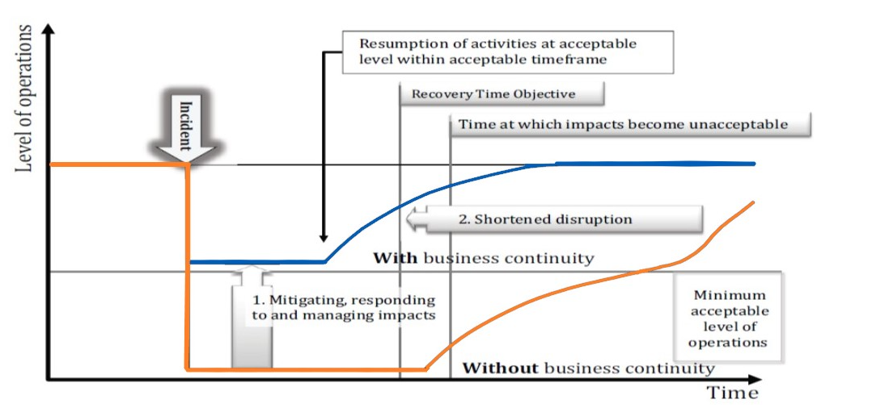
Mitigating Impacts Through Effective Business Continuity: Sudden Disruption
ISO22313
Notes:
Facilitator to discuss the stages and how they differ, from the previous slide, with the group. A business continuity plan may be activated as a result of a sudden incident with no advance warning (for example a fire), or rising tide incident developing over time (an example of this is pandemic influenza).
This diagram relates to a major incident (sudden disruption), e.g.. a fire within a building, a power failure or a telecoms failure.

Slide 29
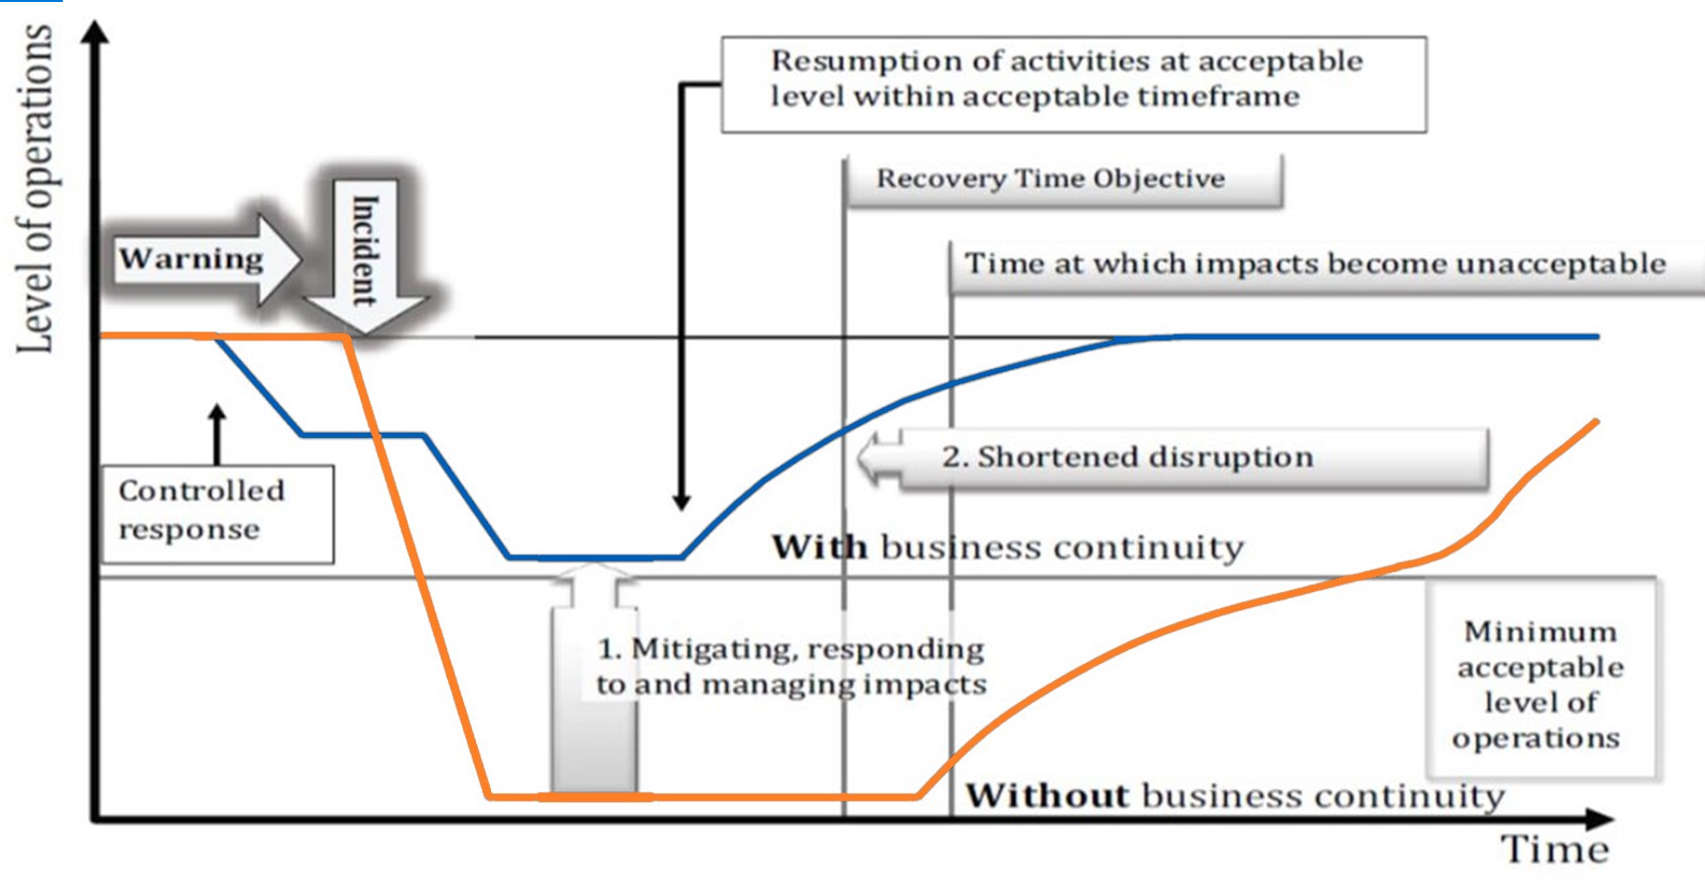
Mitigating Impacts through effective business continuity: Gradual disruption
ISO22313
Notes:
Facilitator to discuss the stages and how they differ, from the previous slide, with the group. A business continuity plan may be activated as a result of a sudden incident with no advance warning (for example a fire), or rising tide incident developing over time (an example of this is pandemic influenza).
This diagram relates to a slow-burn incident (gradual disruption), e.g.. an approaching pandemic influenza outbreak, or a severe weather event.

Slide 30
Incident Timeline
What mechanism could be used to ensure that during and following an incident the matter is escalated to the appropriate level in the organisation?
What are your organisational command and control arrangements?
Notes:
This slide emphasises the need for early escalation to ensure executive leadership is present.
The effective use of the on call management structure is an example.
Should there be anything in notes for each organisation to refer to action cards

Slide 31
Activity 5
List as many examples as you can of measures which could be considered in the context of flooding due to failure of internal plumbing systems to:
  Reduce the likelihood of a disruption
  Shorten any period of disruption
  Limit the impact of a disruption
Notes:
Allow approximately 15 minutes for this activity.
Facilitate a group discussion.
These will vary depending on NHS environment/organisation.

Slide 32
Business Continuity Incident Examples
Notes:
Facilitator – At this point offer delegates the opportunity to leave as you will be covering BC incidents that they may have been involved in.
There are 7 examples therefore, it is advisable to use 3 examples when delivering this slide deck.

Slide 33


Example – NHS staff strikes
NHS staff strikes in 2013 and 2014, Junior Doctors in 2016
Disputes over staff pay
The strikes were the first by NHS staff over pay in more than 30 years
Notes:
Give an overview of these incidents to delegates if time permits, you may replace these with appropriate local examples to make these more relevant to your own organisation.

Slide 34
Example – Severe Weather (Storms)
During the winter of 2021/22 the UK had experienced 5 storms.
Storm Malik – 28/01/22
Storm Corrie – 29/01/22
Storm Dudley – 14/02/22
Storm Eunice – 18/02/22
Storm Franklin – 21/02/22
The NHS experienced various business continuity issues throughout this period, some of which are mentioned below:
Travel disruptions
Structural damage impacted NHS Buildings across the country.
Outpatient appointments being rescheduled as a result of the severe weather.
Roads, bridges and railway lines closed, with delays and cancellations to transport.
Notes:
Give an overview of these incidents to delegates if time permits, you may replace these with appropriate local examples to make these more relevant to your own organisation.

Slide 35
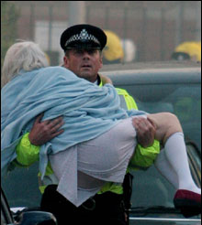
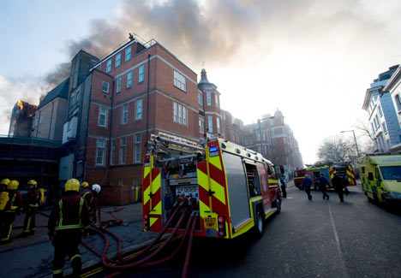
Example – Royal Marsden 2008
More than 100 firefighters in 25 fire engines were deployed on the blaze
Between 80-90 patients were helped onto the streets whilst the hospital was filled with thick smoke
The fire could be seen across the London skyline
Further information:
http://www.webarchive.org.uk/wayback/archive/20130304124419/http://www.london.nhs.uk/webfiles/Corporate/NHSL_FIRE_LR_2.pdf

Slide 36
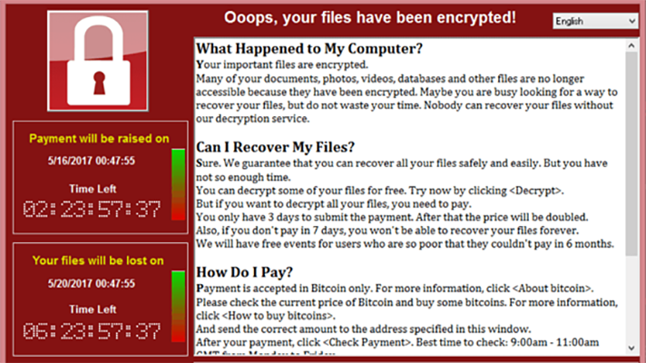
Example – WannaCry – Cyber Attack
On Friday 12th May 2017, the NHS, was affected by the WannaCry outbreak, affecting hospitals and GP surgeries across England and Scotland.
Although the NHS was not specifically targeted, the global cyber-attack highlighted security vulnerabilities and resulted in the cancellation of thousands of appointments and operations, together with the frantic relocation of emergency patients from stricken emergency centres.
Staff were also forced to revert to pen and paper and use their own mobiles after the attack affected key systems, including telephones.
The WannaCry ransomware exposed a specific Microsoft Windows vulnerability, not an attack on unsupported software.
Most of the NHS devices infected with the ransomware, were found to have been running the supported, but unpatched, Microsoft Windows 7 operating system, hence the extremities of the cyber-attack.
The ransomware also spread via the internet, including through the N3 network (the broadband network connecting all NHS sites in England), but fortunately, there were no instances of the ransomware spreading via NHSmail (the NHS email system).
NHS England reported at least 80 out of the 236 trusts were affected in addition to 603 primary care and other NHS organisations, including 595 GP practices.

Slide 37

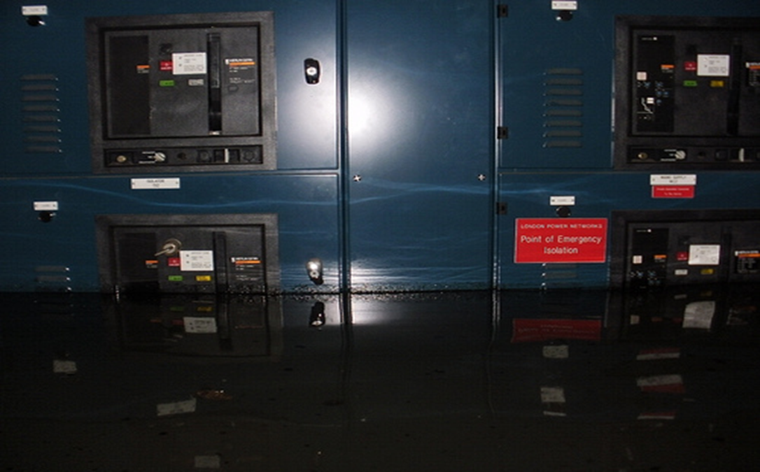
Example – BT Flood and Fire March 2010
‘...tens of thousands of customers in parts of North and West London may be experiencing a loss of broadband and/or telephone service [...] as this is a complex incident we cannot accurately predict when all services will be restored. We will issue further updates as the situation changes.
Any customers needing to make calls to the emergency services who have a problem using their phones are advised to do so by using their mobile phone, or alternatively by using a friend or neighbour's working phone

Slide 38
Example – Coronavirus (COVID 19)
What is Coronavirus?
Coronavirus, also called COVID-19, is part of a family of viruses that includes the common cold and more serious respiratory illnesses such as SARS.
It affects your lungs and airways. For many people, it causes mild symptoms, while for others it can be much more serious and require hospital treatment.
Coronavirus is very infectious, which means it spreads very easily. It spreads in much the same way as the common cold or flu – through infected respiratory droplets like coughs and sneezes – and passes from person to person.
On Wednesday 29 2020 the UK’s first two patients
The average ‘incubation period’ – the time between coming into contact with the virus and experiencing symptoms – is 5 days, but it could be anything between 1 and 14 days.
As of 21/04/22 there have been over 22 million cases of COVID in the UK and over 173,000 deaths.
As of 15/04/22 there have been a total of 831,579 patients who have been admitted to hospital with COVID-19.
NHS Impacts
Additional pressures in conjunction with winter pressures on emergency departments
Staff shortages due to sickness
Impact on the availability of PPE
Supply Chain disruption
Shortage of equipment
Mental and physical trauma

Slide 39


Example – Chase Farm Hospital 2010
Loss of water supply due to burst water main in Enfield.
Bowsers (water tanks) are still on site to ensure the main patient areas continue to receive water [...] Bottled water is available for staff and patients.
The A&E department is open to all walk-in patients however all other emergencies are being transferred to Barnet Hospital. Once the water has resumed A&E services will return to normal.

Slide 40
Example – Grenfell Tower
14th June 2017 is when a high rise fire broke out in the 24-storey Grenfell Tower block of flats in North Kensington, West London, at 00:54 BST due to an electrical fault in a refrigerator.
74 people died, 70+ People Injured and 223 escaped.
Escalated to the external cladding of the building.
Mutual aid was in place over a period of time.
There was a multi-agency response.
NHS Impacts
More than 100 London Ambulance Service Crews were on site.
At least 20 Ambulances present.
London hazardous area response team took part in the response.
Casualties were taken to 5 different hospitals.
Mental and physical trauma for responding NHS colleagues.
Additional pressures on surrounding NHS trusts e.g. Kings College Hospital, Chelsea and Westminster, Royal Free, Guys and St Thomas’, St Marys and Charing Cross in conjunction with undertaking BAU activities.
Building inspections around cladding for NHS buildings across the country..

Slide 41
Activity 6: Business Continuity
Strategy Options Discussion
  What strategies might be needed for maintaining core skills and knowledge?
  What elements should your premises strategy consider to reduce the impact of the unavailability of one or more worksites?
  What technology strategies for business continuity could your organisation adopt in the event of a disruption to the main area of your building following a fire, with an recovery time objective of three months?
Notes:
Allow approximately 20 minutes for this activity.
Facilitator to have a tailored discussion on the strategies needed for the organisation to ensure they have robust plans.
The questions prompt delegate to consider possible solutions for critical activities.

Slide 42
Business Continuity Response Plans
Organisations may have numerous plans.
These may include:
  Strategic organisational incident response plan
  Department/service response plans
  Building or site response plans
  Technical response plans for IT or clinical systems

Slide 43
Business Continuity Response Plan Content
Document control
Purpose and scope
Document owner and reviewer
Roles and responsibilities
Plan activation
Contact details
Incident management structure and plan
Action cards
Appendences
Training and Exercising
Notes:
These slides describe the elements to be considered in the development of business continuity plans.

Slide 44
Business Continuity Response Plan Content
The plan should:
  set out the prioritised activities to be recovered, the timescales in which they are to be recovered and the recovery levels needed
  detail the resources available at different points in time to deliver the prioritised activities
  outline the process for mobilising the necessary resources
  include actions and tasks needed to ensure the continuity and recovery of prioritised activities
  be stored in a place that’s easily accessible e.g. storing on a shared drive or hard copies
Notes:
These slides describe the elements to be considered in the development of business continuity plans.

Slide 45
Elements of Business Continuity Management
Operational planning and control
Business impact analysis and risk assessment
Business Continuity Strategy
Establish and implement BC procedures
Exercising and Testing
Notes:
These are the elements and where they are addressed in ISO22313:
a) Operational planning and control
Effective operational planning and control is at the heart of business continuity management. It should be led by a responsible person nominated by top management.
b) Business impact analysis and risk assessment
Gaining agreement and understanding of priorities and requirements for business continuity is achieved through business impact analysis (BIA) and risk assessment. The business impact analysis enables the organisation to prioritise for resumption the activities that support its products and services. Risk assessment promotes understanding of the risks to prioritised activities and their dependencies and the potential consequences of a disruptive incident. This understanding enables the organisation to select appropriate business continuity strategies.
c) Business continuity strategy
The identification and evaluation of a range of business continuity strategy options enables the organisation to choose appropriate ways of preventing disruption of its prioritised activities and dealing with any disruptions that take place. Selected business continuity strategies will provide for the resumption of activities at an acceptable level of operation and within agreed timeframes.
NOTE The chosen strategies need to take into account any risk treatment that is already in place within the organisation.
d) Establish and implement business continuity procedures
Implementing business continuity arrangements results in the creation of an incident response structure, the means for detecting and responding to an incident, business continuity plans and procedures for returning to business as usual.
e) Exercising and testing
Exercising and testing allows the organisation to:
— promote personnel awareness and competency development
— ensure that business continuity plans/procedures are complete, current and appropriate
— identify opportunities to improve its business continuity arrangements

Slide 46
Exercising and Testing
Exercises provide an opportunity to test plans in order to assess how our plans would stand up in a disruption
Ensures that plans are fit for purpose
Identify gaps and learning actions
Continuous updating of core information i.e. contact lists
Notes:
Exercising and testing allows the organisation to:
promote personnel awareness and competency development
ensure business continuity plans/procedures are complete, current and appropriate
identify opportunities to improve business continuity arrangements
The delegates need to understand that they need to exercise and test different parts of their business continuity response plans regularly.
Highlight to delegates that testing and exercising plans is an ongoing process. This is in line with NHS England Core Standards for EPRR.

Slide 47
Types of Business Continuity Exercises
It is important for those who are responsible for business continuity to determine which type of business continuity exercise is appropriate based on the desired outcomes. This is because exercises vary in levels and resources required.
There are five main types of exercise:
  Discussion based exercise - These exercises are considered to be the most cost effective and the least time consuming of exercise types. They are commonly structured events where participants can explore relevant issues and walk through plans in an unpressurised environment. This type of exercise can focus on a specific area for improvement that has been identified with the aim being to find a possible solution.
  Table top exercise - These are commonly used where the discussion is based on a relevant scenario with a time line which may run in ‘real time’ or may include ‘time jumps’ to allow different phases of the scenario to be exercised. Participants are expected to be familiar with the plans being exercised and are required to demonstrate how these plans work as the scenario unfolds
  Command post exercise - These typically involve management teams at a strategic, tactical or operational level. Participants can be located across the whole organization (and could potentially involve willing interested parties), all working from their usual day to day locations. In these exercises, participants are given information in a way that simulates a real incident. Participants can be invited to respond as they would for real, they are expected to deal with the situations that they encounter, linking in to others as necessary
  Live exercise - These exercises can range from a small scale rehearsal of one component of the response, for example evacuation, through to a full scale rehearsal of the whole organization and potentially participating interested parties. Live exercises are designed to include everyone likely to be involved in that part of the response.
  Test - A test is a unique and particular type of exercise, which incorporates an expectation of a pass or fail element within the goal or objectives of the exercise being planned. It is usually applied to equipment, recovery procedures or technology, not to individuals.
Notes:
Discussion based exercise
These exercises are considered to be the most cost effective and the least time consuming of exercise types. They are commonly structured events where participants can explore relevant issues and walk through plans in an unpressurised environment. This type of exercise can focus on a specific area for improvement that has been identified with the aim being to find a possible solution.
Table top exercise
These are commonly used where the discussion is based on a relevant scenario with a time line which may run in ‘real time’ or may include ‘time jumps’ to allow different phases of the scenario to be exercised. Participants are expected to be familiar with the plans being exercised and are required to demonstrate how these plans work as the scenario unfolds. Table top exercises can be a realistic, cost effective and efficient method. This type of exercise can be greatly enhanced by the use of media which can make a scenario more realistic.
Command post exercise
These typically involve management teams at a strategic, tactical or operational level. Participants can be located across the whole organization (and could potentially involve willing interested parties), all working from their usual day to day locations. In these exercises, participants are given information in a way that simulates a real incident. Participants can be invited to respond as they would for real, they are expected to deal with the situations that they encounter, linking in to others as necessary. These exercises have the added advantage of testing information flow, communication and equipment, in addition to procedures, decision making and coordination.
Live exercise
These exercises can range from a small scale rehearsal of one component of the response, for example evacuation, through to a full scale rehearsal of the whole organization and potentially participating interested parties. Live exercises are designed to include everyone likely to be involved in that part of the response. This type of exercise is particularly useful where there is a legal or regulatory requirement or where a high risk to an organization has been identified and the response and recovery plans need to be fully tested. They are considered to be the most appropriate and realistic way to train people and test plans. However, there are a number of challenges that by their nature might not always make a live exercise the most effective exercise format, for example; the resources required can be significant and there may be financial implications.
Test
A test is a unique and particular type of exercise, which incorporates an expectation of a pass or fail element within the goal or objectives of the exercise being planned. It is usually applied to equipment, recovery procedures or technology, not to individuals.

Slide 48
Why undertake A Business Continuity Exercise?
Exercises are undertaken with three main purposes:
  Validation - to validate and identify improvement opportunities in existing arrangements
  Training - to develop staff competencies and confidence by giving them practice in carrying out their roles in an incident
  Testing - to test existing procedures, plans and systems to ensure they function correctly and offer the degree of protection expected

Slide 49
Business Continuity Off The Shelf Exercise
UK Health Security Agency have developed a business continuity off the shelf exercise.
The business continuity off the shelf exercise uses three short scenarios to facilitate the review of local business continuity preparedness plans and enhance organisational resilience in case of disruption to the organisations core functions.
To request an off the shelf exercise email exercises@ukhsa.gov.uk

Slide 50
Embedding Your Business Continuity Plan
To embed business continuity within your organisation you must ensure that business continuity plans are:
  Communicated to staff, as well as the staff having the appropriate experience and skills to deliver their roles.
  Have buy in and owned by the senior management team.
  Continually exercised.
  Version controlled, so the correct plan is being followed.
Notes:
Highlight to delegates that the process is ongoing and there is a requirement to embed and communicate business continuity plans.
Embedding ensures that the organisation links business continuity into its routine operations and management processes. This ensures that business continuity management becomes part of its core values and effective management.
Embedding can be achieved by raising the awareness of business continuity and communicating the importance of;
Meeting business continuity objectives
Conforming to the business continuity policy
Continual improvement

Slide 51
Reviewing Business Continuity
Plans should be reviewed and updated when:
  Changes to key staff or partners take place
  The organisation is restructured
  Prioritised activity is delivered differently
  Change to the external environment e.g.. statutory change, NHS England requirement
  Following lessons identified from an incident or exercise
  As a result of a debrief.
  At agreed periodic intervals.
Notes:
Ensure delegates understand that the process is ongoing, highlighting the need for continual development and review of the business continuity management system.

Slide 52
Maintaining Business Continuity
A clearly defined and documented maintenance programme for business continuity management should be established.
This programme should:
  ensure that there is an on-going programme for business continuity training and awareness
  ensure that any changes that impact on business continuity are reviewed
  identify any new products and services, and their dependent activities that need to be included in the business continuity management system
  ensure that the business continuity plans remains effective, fit for purpose and up to date
  enable existing exercise schedules to be modified when there has been a significant change in any of the business continuity processes

Slide 53
Record Keeping
When responding you need to keep records, but why is record keeping so important?
Notes:
An opportunity for the facilitator to reinforce the understanding that the delegates need to log action takes, decision made and the rationale for those decisions during a business continuity response, not just in a major incident response.

Slide 54
Record Keeping
Documents a timeline of the incident
Documents decisions not made and why
Logs vital information about the incident
Documents decisions made
Undertake record keeping training
Why is record keeping so important?
Details of casualties or near misses that occur
Helps keep track about financial impact
Clarifies communication channels if protracted incident
Legal follow up

Slide 55

Questions
Notes:
An opportunity for the facilitator to reinforce the understanding that the delegates need to log action takes, decision made and the rationale for those decisions during a business continuity response, not just in a major incident response.

Slide 56
Next Steps……
Notes:
Ask for questions and ensure to collect all scribing notes taken to develop exercise report.

