Slide 1
The Provider Selection Regime (PSR)
Practitioner Reference Slides
Notes:
Standard title slide

Slide 2
The Provider Selection Regime (PSR)
Practitioner Reference Slides
These reference slides are intended to support relevant authorities with their application of the new Provider Selection Regime (PSR); however, they are not exhaustive and should not be used as guidance. Relevant authorities must follow the regulations and associated statutory guidance when applying the PSR.
Throughout this slide deck requirements set out in the PSR regulations that relevant authorities must comply with are denoted by blue circles in the top left corner. The relevant regulations are inserted into the middle of the circle.
Throughout this slide deck recommendations by NHS England as set out in the statutory guidance are denoted by orange circles in the top left corner.

Slide 3
PSR implementation toolkit
This slide deck is aimed at procurement practitioners who will be applying the PSR day-to-day. This slide deck is part of the PSR implementation toolkit, containing the following:
Overview slide deck, providing a quick introduction to the PSR and is aimed at senior leaders
Policy slide deck, providing some more detail about the key features of the PSR and is aimed at commissioners and procurement leads
Practitioner slide deck (this one), providing in-depth information about the steps in the PSR processes and is aimed at practitioners
End-to-end process maps for all provider selection processes in the PSR, aimed at practitioners
FTS guide, providing information about which notices need to be published on FTS and is aimed at practitioners
Flow-charts, providing a visual representation of some of the key processes in the PSR.

Slide 4
How to use these slides
These slides cover:
a brief overview of the PSR, including its aims and scope
a walkthrough of the PSR provider selection processes, including:
the direct award processes (direct award processes A, B, and C)
the most suitable provider process
the competitive process
the transparency requirements
reviewing decisions during the standstill period
contract modifications
how to return to an earlier step in the process or abandon a selection process

Slide 5
Legislative changes
The Health and Care Act 2022 introduced a new procurement regime for selecting providers of healthcare services in England: the Provider Selection Regime (PSR). ​
The PSR came into force on 1 January 2024 and replaced:​
Public Contracts Regulations 2015​ when arranging health care services
National Health Service (Procurement, Patient Choice and Competition) Regulations 2013.
The relevant authorities (RAs) required to follow the PSR when procuring health care services, irrespective of whether the providers they are considering are from the NHS, the independent, or the voluntary sector are:​
NHS England
Integrated Care Boards (ICBs)
NHS trusts and NHS foundation trusts
Local authorities or combined authorities

Slide 6
Aims of the PSR
The PSR has been designed to introduce:
a flexible and proportionate process for selecting providers of health care services so that all decisions are made in the best interest of people who use the services
1.
the capability for greater integration and enhanced collaboration across the system, whilst ensuring that all decisions about how health care is arranged are made transparently
2.
opportunities to reduce bureaucracy and cost associated with the current rules.
3.

Slide 7
Procurement principles
Regulation 4
The procurement principles require relevant authorities to act:
with a view to secure the needs of the people who use the services, including through integrated service delivery
1.
with a view to improve the quality of the services, including through integrated service delivery
2.
with a view to improve the efficiency of the services, including through integrated service delivery
3.
Transparently, fairly, and proportionately.
4.

Slide 8
Other obligations
When exercising functions to comply with the PSR, relevant authorities must continue to comply with other legal obligations. These include the:
2006 Act
Local Government and Public Involvement in Health Act 2007
Equality Act 2010
Modern Slavery Act 2015
Local Authorities (Executive Arrangements) (Meetings and Access to Information) (England) Regulations 2012
Subsidy Control Act 2022.
Relevant authorities should also be aware of other requirements and duties not set out in legislation. Central government commercial policies should be considered and applied where relevant.

Slide 9
Scope
Regulation 3,
Schedule 1
The PSR applies to the procurement of health care services in England.
Broadly, services within scope are:
services arranged by the NHS such as hospital, community, mental health, primary health care, palliative care, ambulance, and patient transport services for which the provider requires CQC registration
substance use treatment services, sexual and reproductive health, and health visits arranged by local authorities.
Not in scope of the PSR are:
goods (i.e., medicines, medical equipment, personal protective equipment)
social care services
non-healthcare services or health-adjacent services (i.e., capital works, business consultancy, catering) that do not provide health care to an individual.

Slide 10
Mixed Procurements
Regulation 3
The PSR allows relevant authorities to arrange a contract comprising of a mixture of in-scope health care services and out of scope services or goods when both of the below statements are true:
The main subject matter of the procurement is health care services. This means that the health care service element must be more than 50% of the value of the contract.
1.
The relevant authority is of the view that the other goods or services could not reasonably be supplied under a separate contract. This means that the relevant authority is of the view that procuring the health care services and the other goods and services separately would, or would be likely to, have a material adverse impact on the relevant authority’s ability to act in accordance with the procurement principles.
2.

Slide 11
Mixed Procurements
Regulation 3
Examples of the types of services that may require an element of mixed procurement:
Patient transport, which includes health care services (for which the provider requires CQC registration) and non-health care service (where no CQC registration is required)
Mental health aftercare services, such as support services arranged under Section 117 of the Mental Health Act
Discharge to assess services
Section 75 partnership arrangement or joint commissioning between local authority and ICBs
Prison services, asylum seekers services and veteran services which include health care

Slide 12
Record Keeping
Regulation 24
Relevant authorities must keep records of their considerations throughout the award process. These records may be requested as part of a review during the standstill period. Records must include:​​
the relative importance of each of the key criteria and the rationale for their relative importance and how the basic selection criteria were assessed​
name and address of the provider
the decision-making process followed to select a provider​
the rationale for the decision
for mixed procurements, how the procurement meets the requirements for mixed procurement
details of the individual/individuals making the decision
any declared or potential conflicts of interest for individuals involved in decision making and how these were managed.

Slide 13
Making a Decision
Regulation 6
Relevant authorities must identify which provider selection process is applicable for the health care service they are arranging.
The processes are:
Direct award processes: A, B, and C
The most suitable provider process
Competitive process

Slide 14
Overview of direct award process A
Regulation 6
Regulation 7
There is an existing provider.
Direct award process A must be used.
There is no realistic alternative to the existing provider due to the nature of the health care services.
Direct award process A cannot be used to award a contract for a newly established service. A provider must already be in place for the service in question.
Direct award process A cannot be used to establish a framework agreement.

Slide 15
Overview of direct award process B
Regulation 6
Regulation 8
The relevant authority offers a contract to all providers eligible.
Patients are offered a choice of providers.
Direct award process B must be used.
The number of providers is not restricted by the relevant authority.
Patients are offered a choice of providers.
The relevant authority has arrangements in place to enable providers to express an interest in providing the health care services in question.
The relevant authority offers a contract to all eligible providers.
Direct award process B must be used to award contracts for existing and newly established services, provided that all the criteria, as detailed above, are met. Direct award process B cannot be used to establish a framework agreement.

Slide 16
Overview of direct award process C
Regulation 6
Regulation 9
Regulation 6(5)
There is an existing provider for the healthcare services, and their contract is ending.
Direct award process C may be used.
The proposed contracting arrangements are not changing considerably.
The relevant authority is of the view that the existing provider is satisfying the original contract and is likely to satisfy the proposed contract to a sufficient standard.
The relevant authority is not required to follow Direct Award Processes A or B.
Direct award process C cannot be used to award a contract for a newly established service.
Direct award process C cannot be used to establish a framework agreement.

Slide 17
Overview of the most suitable provider process
Regulation 6
Regulation 10
Regulation 6(5)
The relevant authority is not required to follow Direct Award Processes A or B, and does not wish to or cannot follow Direct Award Process C.
The most suitable provider process may be used.
The relevant authority is of the view, taking into account likely providers and all relevant information available to the relevant authority at the time, that it is likely to be able to identify the most suitable provider.
The most suitable provider process cannot be used to establish a framework agreement.
Relevant authorities are advised to follow this provider selection approach only when they are confident that they can, acting reasonably, clearly identify all likely providers capable of providing the relevant health care services.

Slide 18
Overview of the competitive process
Regulation 6
Regulation 11
Regulation 6(5)
The relevant authority is not required to follow direct award processes A or B.
The competitive process must be used.
The relevant authority cannot or does not wish to follow direct award process C or the most suitable provider process.
The relevant authority wishes to establish a framework agreement.

Slide 19
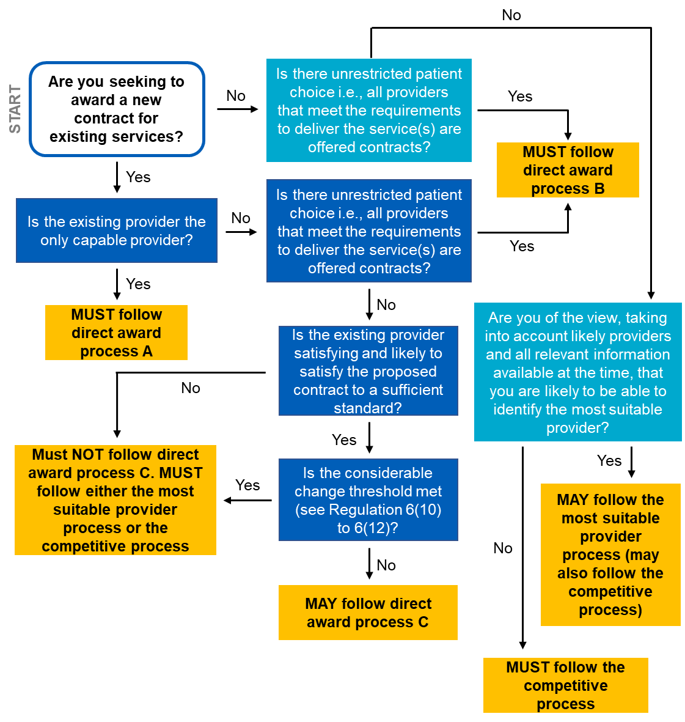
Getting to the right decision
Regulation 6

Slide 20
Overview of the direct award processes
The direct award processes were designed to allow relevant authorities the flexibility to:
take a proportionate approach when selecting a provider
award a contract without running a competitive exercise
develop sustainable and integrated partnerships with providers.
If the circumstances for direct award processes A and B are met, a contract may be awarded without observing a standstill period. The contract award notice must be published.

Slide 21
Overview of direct award process A
Regulation 6 Regulation 7
Start:
Existing provider’s contract is coming to an end.
Step 1:
RA establishes that there is only one realistic provider for the service.
Step 3:
RA publishes notice confirming award.
Step 2:
RA awards the contract.
RA: relevant authority

Slide 22
START & STEP 1 of direct award process A
Regulation 6 Regulation 7
START: the existing provider’s contract is coming to an end.
STEP 1: the relevant authority must establish that there is no realistic alternative to the existing provider. Examples of services that may fall under direct award process A:
Type 1 and 2 urgent and emergency services and associated emergency inpatient services ​​
999 emergency ambulance services ​​
NHS urgent mental health crises services

Slide 23
STEPS 2 & 3 of direct award process A
Regulation 7 Schedule 2
Step 2
Once the relevant authority established that there is only one realistic provider, then they can award the contract to that provider.
Step 3
Next, they must publish a notice setting out that they have awarded a contract. This must be done using the Find a Tender Service (FTS) website, including the information required under Schedule 2. This notice must be published within 30 days of the contract award.

Slide 24
Overview of direct award process B
Regulation 6 Regulation 8
START:
The RA wishes to provide, or currently provides an ‘unrestricted patient choice’ service.
Step 1:
RA sets any qualifying criteria, ensuring there are arrangements for providers to express interest in the service.
Step 3:
RA publishes notice confirming award.
Step 2:
RA awards contract to each eligible provider.
RA: relevant authority

Slide 25
START of direct award process B
Regulation 6
Regulation 8
The relevant authority intends to, or is providing a service where:
patients have a choice of providers
1
the relevant authority is not restricting the number of providers from which patients can choose
2
the relevant authority will offer contracts to all providers to whom an award can be made
3
If a relevant authority wants to restrict the number of providers that patients can choose from, then they cannot use this approach, and must use direct award process C, the most suitable provider process or the competitive process instead.

Slide 26
STEP 1 of direct award process B
Regulation 6
Regulation 8
Relevant authorities must ensure that there are arrangements in place to enable providers to express an interest in providing the service. They must set out:
1.
a description of the health care services to be provided
2.
how a provider can express their interest in providing the service
3.
any minimum requirements that providers must meet

Slide 27
STEPS 2 & 3 of direct award process B
Regulation 8 Schedule 2
Step 2
Once the relevant authority have met the requirements set out in Step 1, then they can award contracts to all eligible providers.
Step 3
Next, the relevant authority must publish a notice setting out that they have awarded a contract. This must be done using the Find a Tender Service (FTS) website, including the information required under Schedule 2. This notice must be published within 30 days of the contract award.

Slide 28
Summary of direct award processes A & B
Regulation 6
Regulation 7
Regulation 8
These processes must be used in the previously defined circumstances.
When using these processes to award a contract, the relevant authority does not need to refer to the key criteria (covered in slide 30). This is not the case for the other processes.
Once the relevant authority has decided that one of these is the appropriate process to use, they can award a contract. The sole transparency requirement is to publish a contract award notice. This is in contrast to the other processes, which require a number of additional transparency notices to be published.
When following either of these processes, the standstill period (covered in slide 61) does not have to be observed. This is not the case for the other processes.

Slide 29
Steps in common for the below provider selection processes
Next, the following provider selection processes will be covered:
1
.
Direct award process C
2.
The most suitable provider process
3.
The competitive process
These have a number of common features:
1
.
The use of the key criteria and the basic selection criteria
2.
the standstill period must be observed
3.
multiple transparency notices must be published

Slide 30
Key criteria and the basic selection criteria
Regulation 5 Regulation 19 Schedule 16
When following direct award process C, the most suitable provider process, or the competitive process, the relevant authority must take into account the key criteria and the basic selection criteria.
Quality and innovation
Value
The provider’s ability to pursue a particular activity
key criteria
Integration, collaboration, and service sustainability
basic selection criteria
Economic and financial standing
Improving access, reducing health inequalities, and facilitating choice
Technical and professional ability
Social value

Slide 31
Key criteria
Regulation 5
When assessing a provider against the Key Criteria, all five Key Criteria must be considered, and none can be discounted. However, the relative importance of the criteria is not pre-determined and there is no prescribed hierarchy or weighting for each criterion.
Example 1: Equal weighting
Example 2: Unequal weighting
Example 3: Pass/Fail
Social value | 20%
Improving access, reducing health inequalities, and facilitating choice | 20%
Value | 20%
Integration, collaboration, and service sustainability | 20%
Quality and innovation | 20%
Social value | 15%
Improving access, reducing health inequalities, and facilitating choice | 15%
Value | 25%
Integration, collaboration, and service sustainability | 20%
Quality and innovation | 25%
Social value | 10%
Improving access, reducing health inequalities, and facilitating choice | 50%
Value | Must meet minimum standard
Integration, collaboration, and service sustainability | 40%
Quality and innovation | Must meet minimum standard

Slide 32
Basic selection criteria
Regulation 19 Regulation 20 Schedule 16
The relevant authority must also assess providers against the basic selection criteria and is expected not to award a contract to a provider that does not meet these. These may relate to:
a provider’s ability to pursue a particular activity, e.g., a requirement to hold a specific authorisation or membership of a professional organisation
necessary economic and financial standing, e.g., a minimum annual turnover, holding indemnity insurance
necessary technical and professional ability, e.g., a certain level of experience, not having conflicting interests
Furthermore, the relevant authority should not award a contract to a provider that meets the exclusion criteria.

Slide 33
Overview of direct award process C
Regulation 6 Regulation 9
START:
The existing provider’s contract is coming to an end.
*Step 1:
RA reviews whether the existing provider is doing a sufficiently good job, and likely to continue to do so.
*Step 2:
RA confirms that the new contract is not changing considerably.
Step 3:
RA publishes Intention to Award a Contract notice.
Step 6:
RA publishes Contract Award notice
Step 5:
RA awards contract.
Step 4:
RA observes the standstill period.
* These steps in the process may be carried out in the reverse order or simultaneously.
RA: relevant authority

Slide 34
START of direct award process C
Regulation 6(5)
There is an existing provider in place whose contract is coming to an end.
The relevant authority wishes to award a new contract, for the same services, to the same provider again.
The relevant authority cannot use direct award process A and direct award process B.
The existing provider wishes to continue providing the services.

Slide 35
STEP 1 of direct award process C
Regulation 9
Once the relevant authority has established that the service is not changing considerably, they must assess whether the existing provider is:
Satisfying the existing contract (according to the detail outlined in the existing contract), taking into account the key criteria and applying the basic selection criteria.
AND
Be likely able to satisfy the new contract to a sufficient standard (according to the detail outlined in the new contract), taking into account the key criteria and applying the basic selection criteria.
To do this, the relevant authority must decide on the relative importance of the key criteria for the service in question, before assessing the existing provider’s performance with regard to each of the key criteria.

Slide 36
STEP 2 of direct award process C
Regulation 6(5) Regulation 6(10)
A change is deemed ‘considerable’ if: ​​
the proposed contracting arrangements are materially different in character to the existing contract when that existing contract was entered into
or ALL the following apply:
the change is attributable to a decision made by the relevant authority
the lifetime value of the proposed new contract is at least £500,000 higher than the lifetime value of the existing contract when it was entered into
the lifetime value of the proposed new contract is at least 25% higher than the original lifetime value of the existing contract when it was entered into.

Slide 37
STEP 2 of direct award process C
Regulation 6(5) Regulation 6(10) Regulation 6(11)
The considerable change threshold is not met where: ​​
The material difference applies solely as a result of a change in the identity of the provider following corporate changes, for example a takeover or merger
and NONE of the following apply:
the change is attributable to a decision made by relevant authority
the lifetime value of the proposed contract is at least £500,000 or higher than the lifetime value of the existing contract
the lifetime value of the proposed contract is at least 25 % or higher than the lifetime value of the existing contract

Slide 38
STEP 2 of direct award process C
Regulation 6(5) Regulation 6(10) Regulation 6(12)
The considerable change threshold is not met where: ​​
The proposed contracting arrangements are not materially different in character
and ALL of the following apply:
the changes are attributable to decision made by the relevant authority due to external factors beyond its control (for example, change in patient volumes, or due to indexing)
lifetime value of the proposed contract is at least £500,000 or higher than the lifetime value of the existing contract
the lifetime value of the proposed contract is at least 25 % or higher than the lifetime value of the existing contract

Slide 39
STEP 2 of direct award process C
Regulation 6(5) Regulation 6(10) Regulation 6(11)
Regulation 6(12)
In summary, a contract award procedure may continue under direct award process C if:
The new contract (including its value) is identical to the previous contract (the same services will be provided).
Any change to the contract is minor and does not materially change the nature of the contract (and the associated services provided).
The change in value of the proposed new contract is less than £500,000 over the original value of the existing contract. ​​
The change is caused by external factors such as inflation or changes in patient volume, or it’s a change due to a merger or takeover.
The change in value between the existing and proposed new contracts does not equal to or exceed 25% of the lifetime value of the existing contract.
If these conditions are not met, then the change is deemed considerable and direct award process C must not be used to award the contract.

Slide 40
STEP 2 of direct award process C
Regulation 6(5) Regulation 6 (10) Regulation 6(11)
Regulation 6(12)
START
Is the new contract identical to the previous contract?
Yes
May continue with direct award process C
No
Are the proposed contracting arrangements materially different in character to the existing contract when that existing contract was entered into?
No
Is the change to the contract below the value element of the considerable change threshold and does not make the proposed contract materially different in character?
Yes
No
Yes
Are any of the below true:
the change to the proposed contract attributable to a decision of the relevant authority
the change in value over £500,000
the change is over 25% of the value of the existing contract when that existing contract was entered into?
No
Are the proposed contracting arrangements materially different in character only because of change in provider identity, for example, due to a merger?
Yes
Is the change to the value of the proposed contract in response to external factors beyond the control of the relevant authority and the provider?
Yes
May continue with direct award process C
Yes
No
Considerable change, must not use direct award process C

Slide 41
STEP 2 of direct award process C
Regulation 6(5) Regulation 6(10) Regulation 6(11)
Regulation 6(12)
Relevant authority holds a contract with an original value of £3 million. The contract is coming to an end and the relevant authority wants to continue with the current provider but wishes to add £1 million to the contract value.
Change in the value of the contract = 33% of the original contract value (> the 25% threshold) Change in the value of the contract = £1 million (> the £500,000 threshold). Therefore, this is a considerable change, and the relevant authority must not continue to award the contract under Direct Award Process C.
Relevant authority holds a contract with an original contract value of £1 million. It has made a contract modification that increases the value of the contract by £400,000. The contract is now coming to an end and the relevant authority wishes to keep the modification in the new contract.
The change in the lifetime value of the contract = 40% (> the 25% threshold.) Change in value of the contract = £400,000 (< the £500,000 threshold) Therefore, this is not a considerable change, and the relevant authority can proceed with the approach under direct award process C.

Slide 42
STEP 3 of direct award process C
Regulation 9
Once the relevant authority has confirmed that the service is not changing considerably and the provider is satisfying the existing contract and likely to satisfy the new contract, they must publish their intention to award a contract notice.
This must be done using the Find a Tender Service (FTS) website.
The information that must be included in the notice is detailed in Schedule 3 of the Regulations.
The standstill period starts the day after the publication of this notice. This, and all subsequent steps, are identical across direct award process C, the most suitable provider process, and the competitive process.
Therefore, these steps and any subsequent steps will be described later in the presentation.

Slide 43
Overview of the Most Suitable Provider Process
Regulation 10
Guidance
Start: Provider’s contract is coming to an end, or a new service needs to be established.
Step 1:
RA undertakes a pre-market engagement exercise.
Step 2:
RA considers the key criteria and decides their importance for the service.
Step 3:
RA considers that it can identify the most suitable provider without a competitive process.
Step 7:
RA assesses the providers identified and chooses the most suitable provider(s).
Step 6:
RA requests additional information from providers, if necessary.
Step 5:
RA publishes a notice of their intention to follow the Most Suitable Provider Process.
Step 4:
RA contacts providers it is considering.
Steps established by the Regulations. Relevant authorities must comply with these.
Step 8:
RA publishes a notice of their attention to award a contract.
Step 9: RA observes the standstill period.
Step 10: RA awards the contract.
Steps recommended by NHS England and are described in the statutory guidance.
RA: relevant authority

Slide 44
START of the most suitable provider process
Regulation 6 Regulation 10
Guidance
Regulation 6(6)
Relevant authorities may consider using the most suitable provider process when:
1.
The existing provider’s contract is coming to an end, or the existing provider is not able to continue providing the service, or a new service needs to be established.
2.
The relevant authority cannot use direct award processes A or B, and either cannot or does not wish to follow direct award process C.
If the above circumstance are met, the relevant authority may consider using the most suitable provider process or the competitive process.

Slide 45
STEP 1 of the most suitable provider process
Guidance
Relevant authorities are expected to be aware of the provider landscape within the relevant geographical footprint (i.e., local, regional, national). Pre-market engagement is an important tool to ensure that relevant authorities have a ‘sufficiently detailed’ understanding of the market.
When using the most suitable provider process, relevant authorities are advised to undertake pre-market engagement to help them identify all suitable providers and develop the service specification. They may do this through:
market research
regular engagement with providers
a register of relevant providers
engaging with providers who have previously expressed interest in delivering similar services

Slide 46
STEP 2 of the most suitable provider process
Regulation 5
Regulation 10
The relevant authority must consider the requirements for the new service and must consider the key criteria and the basic selection criteria, including their relative importance. The key criteria are:
Quality and innovation
1.
Value
2.
Integration, collaboration, and service sustainability
3.
Improving access, reducing health inequalities, and facilitating choice
4.
Social Value
5.
Relevant authorities are advised to carefully consider the relative importance of the value criterion.

Slide 47
STEP 3 of the Most Suitable Provider Process
Regulation 10
Guidance
Relevant authorities are expected to consider all the providers they think will be able to deliver the services and consider whether they will be able to identify the most suitable provider to deliver the healthcare services to the relevant population (local/regional/national).
It is advised that relevant authorities follow this provider selection approach only when they are confident that they can, acting reasonably, clearly identify all likely providers capable of providing the relevant healthcare services.
If relevant authorities are unable to identify the most suitable provider, then they must use the competitive process.

Slide 48
STEP 4 of the most suitable provider process
Guidance
The relevant authority has identified a number of suitable providers and is planning to select the most suitable provider from this group.
The relevant authority is advised to inform all providers it is considering.
This should not be through a published notice; it can be through e-mail or verbally.
This step is to help ensure that when the intention to follow the Most Suitable Provider Process notice is published (next step), providers being considered do not unnecessarily contact the relevant authority to express their interest in providing the service in question.
This would also allow the providers being considered to let the relevant authority know if they are unable to provide the services.

Slide 49
STEP 5 of the most suitable provider process
Regulation 10(2)
Schedule 5
The relevant authority must publish a notice setting out their intention to follow the most suitable provider process.
This must be done using the Find a Tender Service (FTS) website.
The information that must be included in the notice is detailed in Schedule 5 of the Regulations.
The relevant authority must publish the notice at least 14 calendar days before assessing the providers against the key criteria.

Slide 50
STEP 6 of the most suitable provider process
Guidance
The notice published in Step 5 allows all providers to learn about the intention of the relevant authority to award a contract for a particular service using the most suitable provider process.
At this point interested providers could contact the relevant authority and ask to be considered as the ‘most suitable provider’.
The relevant authority is advised to consider these requests to help them identify all suitable providers.
The relevant authority may ask the providers they are considering (including those that expressed an interest following the publication of the notice from Step 5) for further information. This can help them evaluate the likely providers.

Slide 51
STEP 7 of the most suitable provider process
Regulation 10
Guidance
The relevant authority is expected to consider all the providers they understand are likely to have the ability to deliver the services, including any providers that have responded to the Intended Approach Notice and identify potential providers.
The relevant authority must assess the likely providers against the key criteria and the basic selection criteria in a fair way (i.e., on the same basis), and choose the most suitable provider(s) to make an award to. They must record their decisions and their rationale.
The relevant authority should not award a contract to a provider that does not meet the basic selection criteria.
Furthermore, the relevant authority must not award a contract to provider that meets the exclusion criteria, for example corruption, bribery, fraud etc.

Slide 52
STEP 8 of the most suitable provider process
Regulation 10(6)
Schedule 6
Once the relevant authority has selected the most suitable provider, they must publish their intention to award a contract notice.
This must be done using the Find a Tender Service (FTS) website.
The information that must be included in the notice is detailed in Schedule 6 of the Regulations.
The standstill period starts the day after the publication of this notice. This, and all subsequent steps, are identical across direct award process C, the most suitable provider process, and the competitive process.
Therefore, these steps and any subsequent steps will be described later in the presentation.

Slide 53
Overview of the competitive process
Regulation 11
Guidance
START :
Existing provider’s contract is coming to an end, or a new service needs to be established.
Step 2:
RA decides on the contract award criteria for the new (or altered) service.
Step 3:
RA publishes notice advertising opportunity.
Step 4:
RA assesses offers and selects the successful provider to award the contract to.
Step 6:
RA publishes an intention to award notice.
Step 5:
RA informs successful bidder(s) and unsuccessful bidder(s).
Step 8:
RA awards the contract.
Step 7:
RA observes the Standstill Period.
Step 1:
RA develops a service specification and undertakes a pre-market engagement exercise.
Steps established by the Regulations. Relevant authorities must comply with these.
Steps recommended by NHS England and are described in the statutory guidance.
RA: relevant authority

Slide 54
START of the competitive process
Regulation 6(6)
Relevant authorities must follow the competitive process when:
1.
The existing provider’s contract is coming to an end, or the existing provider is not able to continue providing the service, or a new service needs to be established.
2.
The relevant authority cannot use direct award processes A or B, and either cannot or does not wish to follow direct award process C.
3.
The relevant authority does not wish to use or is unable to identify the most suitable provider using the most suitable provider process.

Slide 55
STEP 1 of the competitive process
Guidance
The relevant authority is expected to determine the service specification requirements. To do this they may consider:
The aims and objectives of the service
The population to be covered by the service
The required service standards – whether these need to be in compliance with relevant NICE guidelines or other guidance/recommendations issued by a professional body.
A description of the services that will need to be delivered

Slide 56
STEP 2 of the competitive process
Regulation 5
Regulation 11
The relevant authority must consider the key criteria, including their relative importance, and the basic selection criteria. As a reminder the key criteria are:
Quality and innovation
1.
Value
2.
Integration, collaboration, and service sustainability
3.
Improving access, reducing health inequalities, and facilitating choice
4.
Social value
5.
The relevant authority is advised to carefully consider the relative importance of the value criterion.

Slide 57
STEP 3 of the competitive process
Regulation 11(3)
Schedule 8
The relevant authority must next publish a notice inviting offers.
This must be done using the Find a Tender Service (FTS) website.
The information that must be included in the notice is detailed in Schedule 8 of the Regulations.
Relevant authorities must also include a link to further documentation, which sets out how the contract award criteria will be evaluated – including the weighting or relative importance of the key criteria.

Slide 58
STEP 4 of the competitive process
Regulation 11(5)
The relevant authority must assess the likely providers against the key criteria and the basic selection criteria in a fair way across the assessed providers (i.e., on the same basis) and choose the provider(s) to whom to make an award.
They must record their decisions and their rationale.
The relevant authority should not award a contract to a provider that does not meet the basic selection criteria.
Furthermore, the relevant authority should not award a contract to provider that meets the exclusion criteria.

Slide 59
STEP 5 of the competitive process
Regulation 11(8)
Schedule 9
Once the relevant authority has selected the successful bid(s), they must:
1.
Inform the successful provider (or group of providers) of their intention to award them the contract.
Inform the unsuccessful providers (or group of providers) in writing that their bid has been unsuccessful. The information that must be communicated to unsuccessful providers is set out in Schedule 9 of the Regulation.
Relevant authorities may also choose to give feedback to unsuccessful providers on what they have done well and what they could have done to improve the bid.
2.

Slide 60
STEP 6 of the competitive process
Regulation 11(9),
Schedule 10
Once the relevant authority has communicated their decision to the successful and unsuccessful provider(s), they must publish their intention to award a contract notice.
This must be done using the Find a Tender Service (FTS) website.
The information that must be included in the notice is detailed in Schedule 10 of the Regulations.
The standstill period starts the day after the publication of this notice. This, and all subsequent steps, are identical across direct award process C, the most suitable provider process, and the competitive process.

Slide 61
The standstill period
Regulation 12
When following direct award process C, the most suitable provider process, and the competitive process – following the publication of the Intention to Award a Contract – the relevant authority must observe the standstill period.
It is a period of eight working days (which may be extended; see guidance for how to calculate this) during which representations can be made and must be responded to.
The standstill period then allows the relevant authority to consider these representations and respond as appropriate.

Slide 62
Standstill period: representations
Regulation 12(3)
Regulation 12(4)
Relevant authorities are only obliged to respond to representations if:
The representation comes from a provider who might otherwise have been a provider of the services to which the contract relates.
1.
The provider is aggrieved by the decision of the relevant authority.
2.
The provider believes that the relevant authority has failed to apply the PSR correctly and they are able to set out reasonable grounds to support their belief.
3.
The representation is submitted in writing to the relevant authority before midnight at the end of the eighth working day after the day the standstill period begins.
4.

Slide 63
Standstill period: representations
Regulation 12 Regulation 24
Guidance
If a representation is received, then the relevant authority:
1
must ensure that the provider has been afforded the opportunity to explain or clarify their representation
2
is expected to provide an indicative timeframe for when the representation might be considered by
3
must provide any information requested by the provider that the relevant authority is required to keep under Regulation 24
4
must consider the representation(s) made, and review evidence and information used to make the original decision
5
must consider whether the representation has merit i.e., in identifying that process has not been correctly followed
6
must decide whether to return to an earlier step, abandon the process, or award the contract as originally intended
7
must communicate the decision promptly to the provider and must leave five working days for the provider to consider their decision before the standstill period can close and the contract can be awarded.

Slide 64
Standstill period: the PSR review panel
Guidance
Throughout the standstill period, there should be ongoing communication between the relevant authority and provider about the representations that were made.
If the provider remains unsatisfied with the response of the relevant authority to its representation and remains of the view that the PSR has not been applied correctly, the provider may submit a representation to the Independent Patient Choice and Procurement Panel (the panel).
The panel will be an independent panel, made available by NHS England. It will review representations made by a provider and will share their advice with the relevant authority about whether they applied the PSR correctly.
The standstill period should not be closed, and the contract awarded, until the panel has concluded their review.

Slide 65
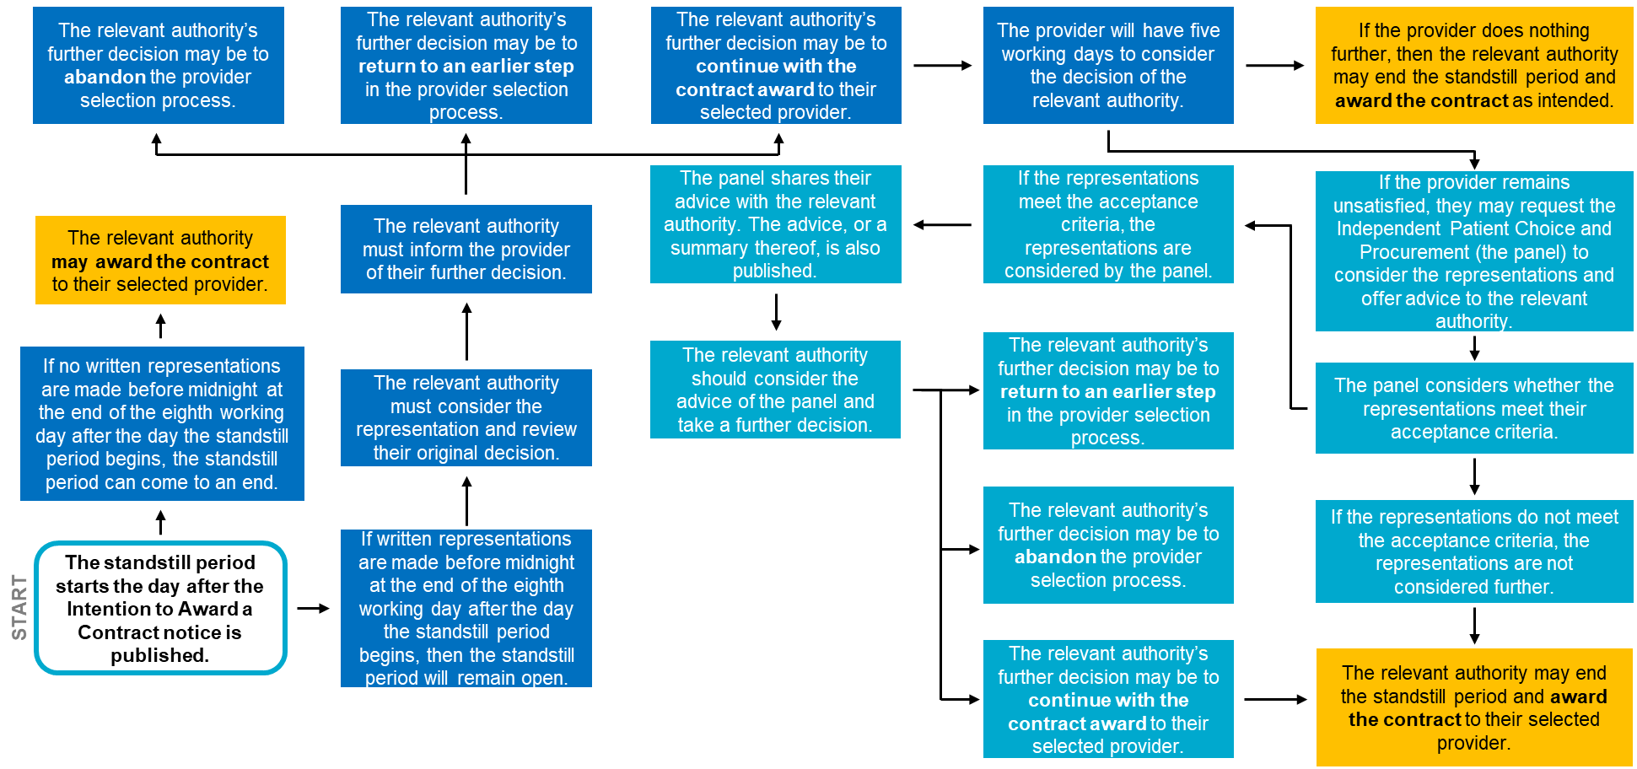
Reviewing decision during the standstill period
Regulation 12
Guidance

Slide 66
Confirmation of award
Regulations 9, 10, 11
Schedules 4, 7 & 11
Once the standstill period has ended, the relevant authority must publish the confirmation of the award notice on the Find a Tender Service website. This must be a corrigendum to the Contract Award notice (that was published prior to the standstill period as an intention to award).
The information that must be included in the notice is detailed in Schedules 4, 7, and 11 of the Regulations for direct award process C, the most suitable provider process, and the competitive process, respectively.

Slide 67
Summary: direct award process C
Direct award process C can be used to award a new contract for the same services to an existing provider who is satisfying the original contract and will likely satisfy the proposed new contract to a sufficient standard.
Relevant authorities must apply the key criteria and basic selection criteria when following direct award process C.
Relevant authorities must observe the standstill period and must consider any representations. The standstill period must come to a close before a new contract can be awarded.
Relevant authorities always have the option to repeat a step or abandon this provider selection process if they find that they have made a mistake or that the selected process is not suitable.

Slide 68
Summary: most suitable provider process
The most suitable provider process can be used for new or considerably changed services, where the relevant authority can identify the ‘most suitable’ provider without running a competitive process.
Relevant authorities must be confident that they know their provider landscapes when following the most suitable provider process. They are encouraged to undertake pre-market engagement before proceeding with this process.
Relevant authorities must apply the key criteria and basic selection criteria when following the most suitable provider process.
Relevant authorities must observe the standstill period and must consider any representations. The standstill period must come to a close before a new contract can be awarded.

Slide 69
Summary: competitive process
The competitive process can be used for new or considerably changed services, for existing services where the relevant authority wishes to test the market. It must be used to establish a framework agreement.
Where relevant authorities follow the competitive process, they may develop their own procedures within the limits of the legislation.
Relevant authorities must observe the standstill period and must consider any representations. The standstill period must come to a close before a new contract can be awarded.
Relevant authorities must apply the key criteria and basic selection criteria when following the competitive process.

Slide 70
Repeating a step in the process
Regulation 15
Relevant authorities may decide to return to an earlier step in the process to rectify an issue that was identified – for example, following a review in the standstill period.
Providers that have previously been made aware in the selection process that they are being considered for the award of a contract must be notified that the provider selection process will be returning to an earlier stage, including information on the stage the relevant authority will be returning to, and any changes to timeframes. ​
Relevant authorities must not return to an earlier step in a decision-making process to modify the parameters of the selection process – for example to reconsider the importance of the key criteria.
To note, relevant authorities can also decide earlier in the process (i.e., before the standstill period) to return to an earlier step in the process.

Slide 71
Abandoning a provider selection process
Regulation 15
Relevant authorities may decide to abandon the provider selection process and to not continue with the award of the contract.
Relevant authorities must publish a notice of their decision to abandon a provider selection process. They should also notify, in advance of the notification being published, providers that were aware of being considered for the award of the contract.
Relevant authorities must keep a record of their reasoning for abandoning a provider selection process.
To note, relevant authorities can decide earlier in the process (i.e., before the standstill period) to abandon the process. For example, to switch provider selection approach from the most suitable provider process to the competitive process.

Slide 72
Framework agreements
Regulation 16
Relevant authorities may establish framework agreements under the PSR to arrange in-scope health care services. To note:
Establishment of the framework agreement must follow the competitive process.
1.
After a framework agreement has been established, relevant authorities who are included in the agreement may award contracts to providers who are also part of the agreement.
2.
Relevant authorities can award contracts based on a Framework Agreement in two ways:
1. Without competition, so long as this is provided for in the terms and conditions of the Framework Agreement.
Following the Competitive Process
Relevant authorities can award contracts based on a framework agreement in two ways:
Without competition, so long as this is provided for in the terms and conditions of the framework agreement
Following the competitive process.
3.
3.

Slide 73
Contract modifications
Regulation 13
Modifications are permitted under the PSR, if the modification is:
1.
1.
Clearly and unambiguously provided for in the original contract
If this modification is £500,000 or over and is attributable to the relevant authority, then a transparency notice must be published.
2.
2.
Solely a change in the identity of the provider
If this modification is £500,000 or over and is attributable to the relevant authority, then a transparency notice must be published.
Made in response to external factors beyond the control of the relevant authority and the provider, such as changes in patient or service user volume or changes in indexing; but do not render the contract materially different in character.
3.
If this modification is £500,000 or over and is attributable to the relevant authority, then a transparency notice must be published.

Slide 74
Contract modifications
Regulation 13
Modifications are permitted under the PSR, if the modification is:
Attributable to a decision of the relevant authority and does not materially alter the character of the contract or framework agreement, and the cumulative change in the lifetime value of the contract or framework agreement, compared to its value when it was entered into, is under £500,000 or under 25%.
1.
4.
If this modification is £500,000 or over, then a transparency notice must be published.
Made to a contract that was originally awarded under direct award process A or direct award process B and the modification does not render the contract materially different in character.
5.
If the modification is attributable to the relevant authority, and the cumulative change in the lifetime value of the contract is £500,000 or more, then a transparency notice must be published.

Slide 75
Contract modifications
Regulation 13
Modifications are NOT permitted under the PSR, if the modification is attributable to a decision made by the relevant authority and:
The changes render the contract materially different in character
OR
The changes are £500,000 or over AND represent 25% or more of the original contract value.

Slide 76
Urgent circumstances
Regulation 14
In some limited circumstances, relevant authorities may need to act rapidly to address immediate risks to safety and quality of care. An urgent award or modification can be made when all the following are true:
The award or modification must be made urgently.
The reason for the urgency was not foreseeable by and is not attributable to the relevant authority.
Delaying the award of the contract to conduct a full application of the PSR would be likely to pose a risk to patient or public safety.

Slide 77
Urgent circumstances
Regulation 14
In urgent situations, relevant authorities may make the following decisions without following the steps normally required under this regime:
Re-award contracts with existing providers
Award contracts for new services
Award contracts for considerably changed services
Make contract modifications (without limitation)

Slide 78
Urgent awards and urgent contract modifications
Regulation 14 Schedule 13
In these urgent circumstances, relevant authorities must:
Set the length of contract to be only as long as is strictly necessary to address the urgent situation and to conduct a full award process for that service at the earliest feasible opportunity. If the term is to be longer than 12 months relevant authorities must justify and record this decision.
Keep records of their decision-making, including justification of using an urgent award or an urgent modification.
Be transparent about their decision by issuing an Urgent Award or an Urgent Modification Notice. The Urgent Award Notice must be published as a Contract Award Notice, the Urgent Modification Notice must be published as a Modification Notice, on Find A Tender Service within 30 days of the contract being awarded or modified.

Slide 79
Contract award procedures started before 1 January 2024
Regulation 29
All contract award processes commenced on or after 1 January 2024, must use the PSR, including awards based on an existing framework agreement.
All contract modifications on or after 1 January 2024, including to existing contracts, must follow the PSR rules.
Contract award procedures commenced before 1 January 2024, including when awarding a contract based on a framework agreement, must conclude under the regime they were started under. This applies even if the process is ongoing and completed after the PSR has taken effect.
Contract award procedures commenced before 1 January 2024 may be abandoned under the regime they were commenced under. We recommend that any relevant authorities considering this should take legal advice before doing so.

Slide 80
Contract award procedures started before 1 January 2024
Regulation 29
A contract award process is considered to have started under the PCR is any of the following occur before the PSR comes into forces:
a contract notice has been submitted to the UK e-notification service for publication in accordance with Regulation 51(1) of the Public Contracts Regulations 2015
the relevant authority has contacted any provider to seek expressions of interest or offers in respect of a proposed contract
the relevant authority has contacted any provider to respond to an unsolicited expression of interest or offer received from that provider in relation to a proposed contract.

Slide 81
Further Resources
If you have any questions, please contact psr.development@nhs.net.

