Slide 1
Integrated Performance Report
NHS Somewhere ICB
March 2024 data
[This sample report contains a range of visualisations and page formats which are useful in guiding board level conversations.
ICBs are encouraged to consider the most appropriate format for local use and which view of data is most useful for each measure (place or provider).
It is recommended that once agreed, a consistent format and style is adopted for all sections of the integrated performance report.]

Slide 2
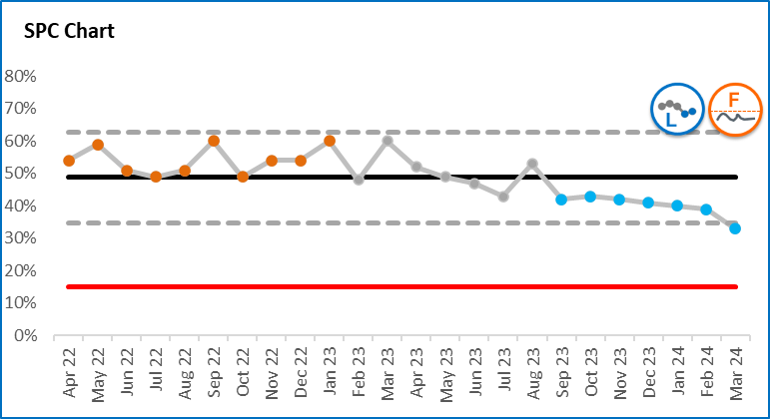
Interpreting SPC charts
A statistical process control (SPC) chart is a useful tool to help distinguish between signals (which should be reacted to) and noise (which should not as it is occurring randomly).
The following colour convention identifies important patterns evident within the SPC charts in this report.
Orange – there is a concerning pattern of data which needs to be investigated and improvement actions implemented
Blue – there is a pattern of improvement which should be learnt from
Grey – the pattern of variation is to be expected. The key question to be asked is whether the level of variation is acceptable
The dotted lines on SPC charts (upper and lower process limits) describe the range of variation that can be expected.
Process limits are very helpful in understanding whether a target or standard (the red line) can be achieved always, never (as in this example) or sometimes.
SPC charts therefore describe not only the type of variation in data, but also provide an indication of the likelihood of achieving target.
Summary icons have been developed to provide an at-a-glance view. These are described on the following page.
Concerning variation
Expected variation
UPL
Average
LPL
Improving variation
Target
To be less than

Slide 3








Interpreting summary icons
These icons provide a summary view of the important messages from SPC charts
 | Variation / performance icons
Icon | Technical description | What does this mean? | What should we do?
 | Common cause variation, NO SIGNIFICANT CHANGE. | This system or process is currently not changing significantly. It shows the level of natural variation you can expect from the process or system itself. | Consider if the level/range of variation is acceptable. If the process limits are far apart you may want to change something to reduce the variation in performance.
 | Special cause variation of a CONCERNING nature. | Something’s going on! Something, a one-off or a continued trend or shift of numbers in the wrong direction | Investigate to find out what is happening or has happened. Is it a one off event that you can explain? Or do you need to change something?
 | Special cause variation of an IMPROVING nature. | Something good is happening! Something, a one-off or a continued trend or shift of numbers in the right direction. Well done! | Find out what is happening or has happened. Celebrate the improvement or success. Is there learning that can be shared to other areas?
 | Assurance icons
Icon | Technical description | What does this mean? | What should we do?
 | This process will not consistently HIT OR MISS the target as the target lies between the process limits. | The process limits on SPC charts indicate the normal range of numbers you can expect of your system or process. If a target lies within those limits then we know that the target may or may not be achieved. The closer the target line lies to the mean line the more likely it is the target will be achieved or missed at random. | Consider whether this is acceptable and, if not, you will need to change something in the system or process.
 | This process is not capable and will consistently FAIL to meet the target. | If a target lies outside of those limits in the wrong direction then you know the target cannot be achieved. | You need to change something in the system or process if you want to meet the target. The natural variation in the data is telling you that you will not meet the target unless something changes.
 | This process is capable and will consistently PASS the target if nothing changes. | If a target lies outside of those limits in the right direction then you know the target can consistently be achieved. | Celebrate the achievement. Understand whether this is by design (!) and consider whether the target is still appropriate; should be stretched, or whether resource can be directed elsewhere without risking the ongoing achievement of this target.

Slide 4
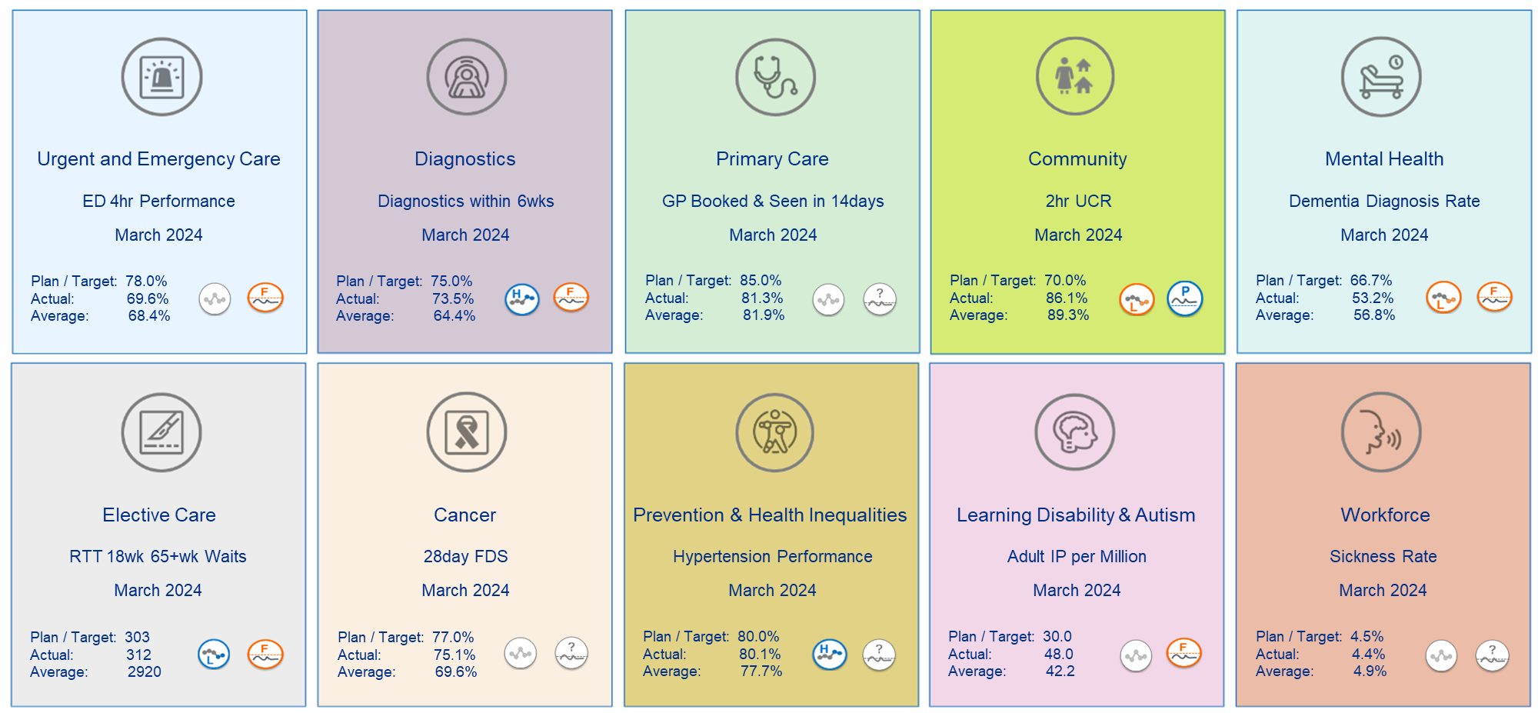


Infographic

Slide 5
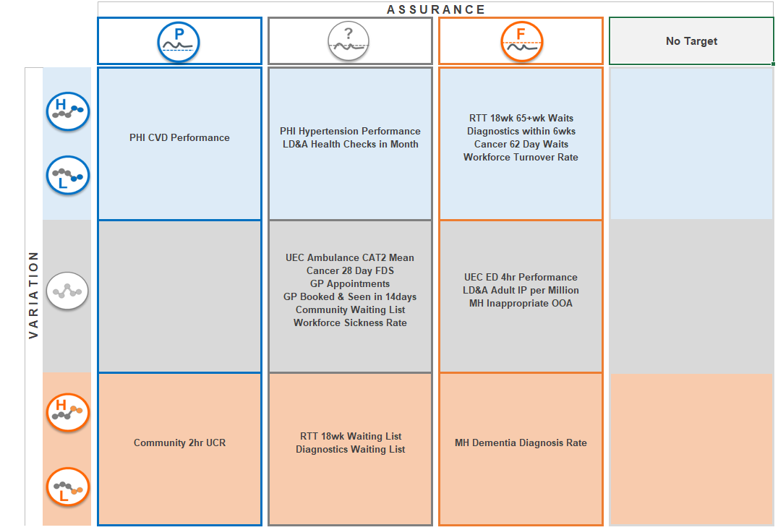
Overview matrix

Slide 6
Executive summary
Areas showing improvement
Prevention and health inequalities for CVD and hypertension have improved, with CVD now consistently able to achieve the target.
Learning disability and autism health checks has also shown improvement with performance this month at 10% against the target of 6%. Mean performance is 7%.
Improvement continues in the following areas, however the position remains that none of these targets can be achieved without further improvement occurring:
RTT 18 week 65+ week waits
Diagnostics within 6 weeks
Cancer 62 day waits
Workforce turnover rate
Areas of concern
The dementia diagnosis rate continues to deteriorate with most recent performance at 53.2% compared to the target of 66.7%. The target is currently unachievable.
There has been a concerning deterioration in both the diagnostics and RTT 18 week waiting list position driven by capacity challenges in 3 provider organisations.
2 hour urgent community response has seen a recent deterioration in performance. Currently, the target of 70% will still be comfortably achieved. Performance this month was 86.1% and mean performance 89.3%. This deterioration is being investigated as a matter of urgency due to the risk of ED 4 hour performance being further challenged.
The following targets continue to be unachievable with performance remaining unchanged:
ED 4 hour performance
Learning disability and adult inpatient per million
Mental health inappropriate out of area placements

Slide 7
Mental health: performance summary

Slide 8
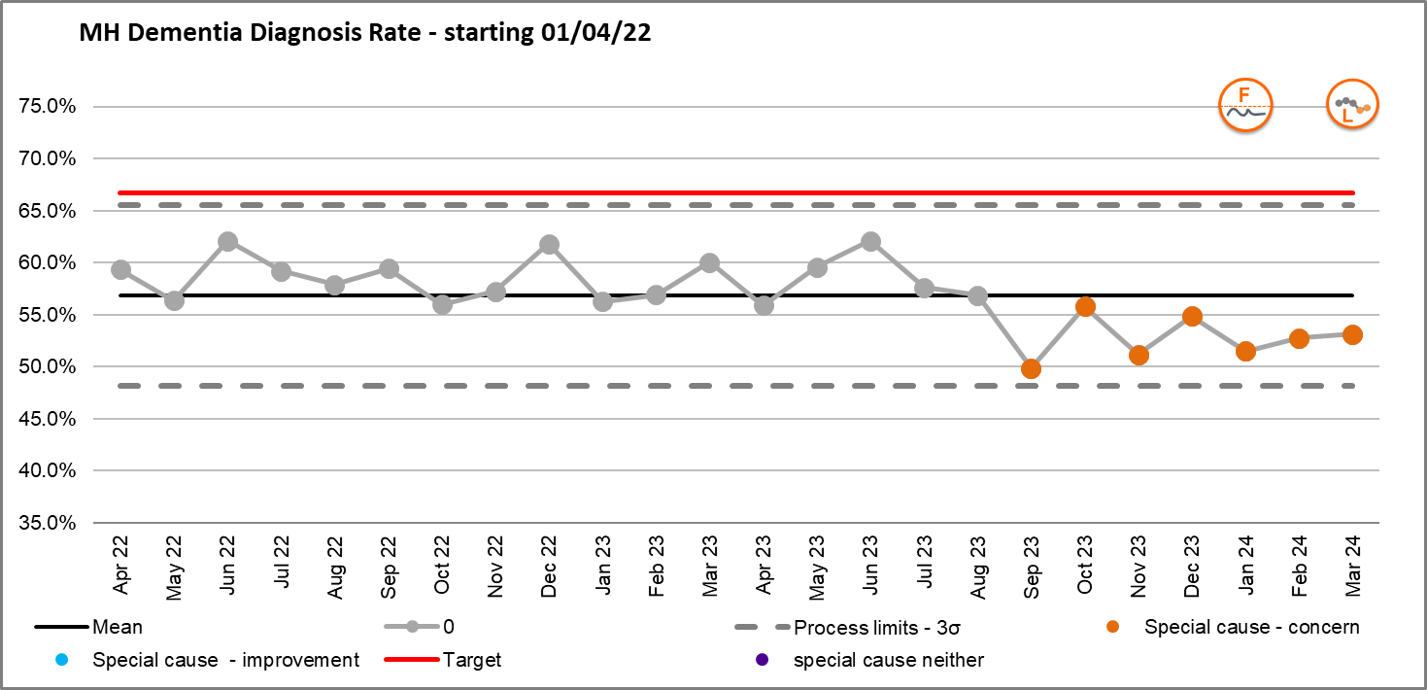
Key indicator: Dementia Diagnosis Rate
Dementia Escalation Points
ICB performance is 53.2%, which is below the target of 66.7%. Performance since September has shown 7 months of statistically significant deterioration.
Only Place C met the local target in March (69.4%), however this target cannot be achieved consistently. Performance is deteriorating in Places A, B and D (actual performance figures appear in the table to the left). Place E is showing statistical improvement with performance at 65.6% in March.
The ICB will not meet the 66.7% national ambition this year. The plan that has been submitted is an improving position to 57%.
Primary Care Coding and backlog in Memory Assessment Services have been attributed to a reduced rate of performance.
Key actions
Work has commenced to complete a focused programme to cleanse GP registers and develop a toolkit to improve coding. We know that issues with coding are contributing to the current performance being reported in some of our local places. Efforts will focus primarily in Places A and B initially given their particularly low levels of performance.
We have assessed service specifications for memory assessment services and are developing recommendations to address variation within these pathways.
The ICB is a partner ICB for the national blood biomarker scheme and is helping to lead work at a regional level on the introduction of disease modifying drugs.
We are supporting the implementation of new neuroimaging guidance across NHS Somewhere.
Memory Assessment Services update logs to be reviewed 6 weekly in line with dementia steering group to track demand vs capacity. Where contract reports are available these will be reviewed as an alternative.
How indicator links to long term priorities:
Improving Dementia Diagnosis Rate directly supports the ICB long term ambition of transforming people’s health and care experiences and outcomes.
Earlier diagnosis of often vulnerable patients empowers them and their families and carers to take control of their situation, leading to better management of the disease, better time to plan and therefore an enhanced quality of life.
Notes:
Table subject to change depending on what detail is needed.
Consider keeping the original table for this slide and change the table header to the dark blue for consistency.

Slide 9

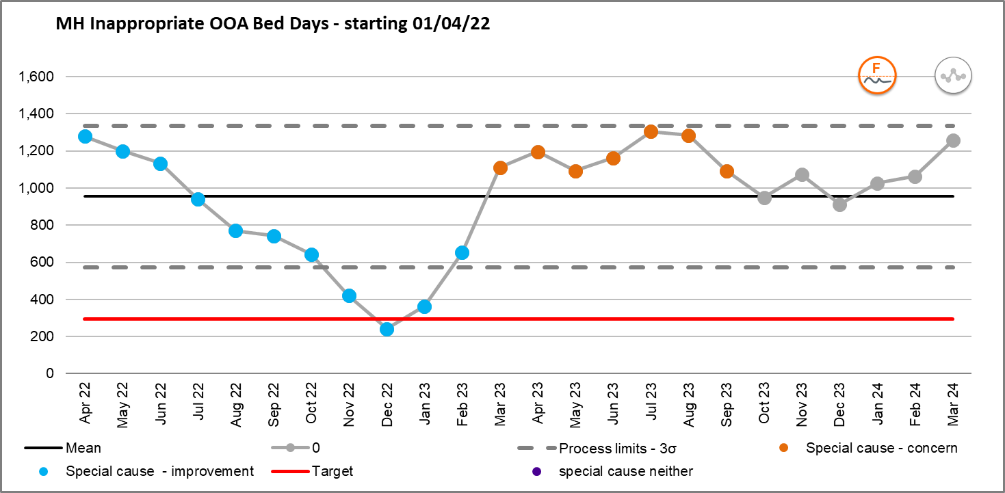
Key indicator: Inappropriate OOA placements
Out of Area (OOA) escalation points
Performance in March was 1,257 bed days against a plan of 295. Currently there is no significant change in the data and the target of 295 is unachievable.
There is some variation in performance with Place E showing a statistical improvement and the lowest number of bed days (10). Place A is also showing improvement however the volume of bed days is much higher at 252. The worsening position at Place B is being investigated urgently.
Key actions
The Inpatient Quality Transformation draft plan has been submitted to NHS England and has received extremely positive initial feedback. OOA placements is a key workstream within this plan. An ICB workshop for inpatients quality transformation took place in mid-March, with regional and national colleagues attending, as well as people with lived experience of inpatient services. The final plan will be submitted at the end of June 2024.
The OOA programme sits as a key element of the overall Mental Health, Learning Disability and Autism (MHLDA) Inpatient Quality and Safety Transformation Programme.
In 2024/25 we will focus on:
market development with the independent sector – to maximise provision within the area, negotiate fair and consistent pricing and enable greater oversight of patients
a full review for each major bed type with the relevant stakeholders, including service users and clinical leaders to develop the vision and implementation plans to conduct real change, starting with rehabilitation
review of housing options to support plans – it is clear that development and diversity of community provision will be a key enabler to delivering support closer to home for our populations
How indicator links to long term priorities:
Reducing inappropriate out of area placements directly supports the ICB’s long term ambition of transforming people’s health and care experiences and outcomes.
Transporting often vulnerable patients long distances out of area can be a poor experience for them and demonstrates a lack of local capacity and available services. It has also been identified as one of the ten key priorities due to financial impact of having to fund inpatient stays over and above existing contracted provision.
Notes:
Table subject to change depending on what detail is needed.
Consider keeping the original table for this slide and change the table header to the dark blue for consistency.

Slide 10
Inequality overview
NHS England’s statement sets out the information on health inequalities that, in NHS England’s view, relevant NHS bodies should collect, analyse and publish as part of addressing health inequalities. ICB boards should publish a range of health inequality indicators (Core20PLUS5) including measures broken down by deprivation and ethnicity (where available). As examples, the charts above show the number of 52+ week waiters and age standardised rates for emergency admissions broken down by deprivation level and ethnicity.

Slide 11
Metric glossary and definitions
Metric | Improvement Direction | Definition | Methodology / Exclusions | Data Source
UEC ED 4hr performance | Up
UEC ambulance CAT2 mean | Down
RTT 18 wk waiting list | Down
RTT 18 wk 65+wk waits | Down
Diagnostics Waiting List | Down
Diagnostics within 6 wks | Up
Cancer 28 Day FDS | Down
Cancer 62 Day Waits | Down
GP Appointments | Up
GP Booked & Seen in 14 days | Up
Community Waiting List | Down
Community 2hr UCR | Up
PHI Hypertension Performance | Up
PHI CVD Performance | Up
LD&A Health Checks in Month | Up
LD&A Adult IP Per Million | Down
MH Dementia Diagnosis Rate | Up
MH Inappropriate OOA | Down
Workforce Sickness Rate | Down
Workforce Turnover Rate | Down
For local agreement and completion

