Slide 1
IFRS 17 Insurance contracts
Application Guide
Published 13/01/2025

Slide 2
Matters covered in this application guide
1 | Background to IFRS 17 | Slide 3
2 | How to identify an insurance contract under IFRS 17 | Slide 6
3 | Scoping and contractual considerations for IFRS 17 | Slide 14
4 | Accounting for elements of Insurance Contracts | Slide 23
5 | Budgeting under IFRS 17 | Slide 38
6 | HMT Interpretations and adaptations for IFRS 17 | Slide 43
7 | Steps to implementation and implementation aides | Slide 47

Slide 3
Background to IFRS 17

Slide 4
Why IFRS 17 is replacing IFRS 4
IFRS 4 defined insurance contracts and this content is carried forward in IFRS 17.
However, IFRS 4 allowed entities to use a wide variety of approaches in accounting for insurance contracts. In contrast IFRS 17 provides comprehensive accounting requirements for insurance contracts.
Government entities may issue contracts that have the legal form of insurance but may not be insurance; some contracts that don’t have the legal form of insurance may be insurance.
IFRS 17 requires these contracts to be consistently recognised, measured and presented in financial statements in accordance with its principles to allow users to more fully assess how public money is being allocated to cover insurance risks by government entities implicitly or explicitly issuing insurance contracts.

Slide 5
Key principles of IFRS 17
Identify insurance contracts separately from other non-insurance components grouping similar contracts.
Recognise insurance obligations when they first arise including when they become onerous.
Recognise losses immediately but recognise gains over the period of insurance coverage.
Use DCF to measure claims and fulfilment obligations reflecting risk and time value of money through appropriate discount rates.
Present operating revenue and expenses separately from financing income and expenses.
Disclose information that allows the impact on the entity’s financial performance, position and cash flows to be assessed.

Slide 6
How to identify an insurance contract under IFRS 17

Slide 7
The elements of insurance contracts
Definition of an insurance contract:
“An insurance contract is a contract under which one party (the issuer) accepts significant insurance risk from another party (the policyholder) by agreeing to compensate the policyholder if a specified uncertain future event (the insured event) adversely affects the policyholder.”
Elements of an insurance contract under IFRS 17
Contractual agreement between two parties exists and the enforceable rights and obligations are accepted by the parties
The contract transfers significant pre-existing insurance risks from the policyholder to the issuer
Specified uncertain future event exists
Specified uncertain future event adversely affects the 3rd party

Slide 8
What is a legally enforceable contract?
A contract is described in IFRS 17 as an agreement between two or more parties that creates enforceable rights and obligations. Enforceability of the rights and obligations is a matter of law. Contracts can be written, oral or implied by an entity’s customary business practices.
Unlike other contract standards such as IFRS 15 and IFRS 16, IFRS 17 does not cover intra government arrangements that are not legally enforceable.
Legislation and regulations are not insurance contracts. Legislation is not a contract between the Government and individuals or entities, so responsibilities conferred by legislation on the NHS to provide healthcare services is not an insurance contract between the NHS and individuals.
Contracts that are subject to similar risks and are managed together form a portfolio of insurance contracts. IFRS 17 includes guidance on how to aggregate insurance contracts which is not adapted or interpreted by the FReM.

Slide 9
The definition of insurance risk
Insurance risk is any risk that is not a financial risk.
IFRS 17 defines a financial risk as;
“The risk of a possible future change in one or more of a specified interest rate, financial instrument price, commodity price, currency exchange rate, index of prices or rates, credit rating or credit index…
…or other variable, provided in the case of a non-financial variable that the variable is not specific to a party to the contract.”

Slide 10
Financial risk compared to insurance risk
FINANCIAL RISK | INSURANCE RISK
The risk of a possible future change in a specified rates such as financial instrument price, commodity price, currency exchange rate, index, credit rating or; | Any risk that is not a financial risk.
Non-financial variable not specific to the insured e.g. an index of earthquake losses or weather derivative. | Risk specific to the insured such as cover for risk of premises being damaged from flooding or fire.
Assumptions about inflation based on an index of prices or rates or on assets with inflation linked returns relates to financial risk. | Payments can be linked to a price index and still be insurance if payments on insured event is significant - annuity until death has a non-financial variable “mortality risk” specific to the insured.
Transfer of risk not covered by IFRS 17. | Transfer covered by IFRS 17 if significant in the contract.

Slide 11
Contract transfers significant insurance risks
Insurance risk is significant if, and only if, an insurance event could cause the issuer to pay additional amounts that are significant in any single scenario, excluding scenarios which have no commercial substance.
Scenarios with no commercial substance are those that have no discernible effect on the economics of the transaction.
If significant additional amounts are payable in a scenario, the contract is considered to transfer significant insurance risk even if the insured event is extremely unlikely, or if the expected present value of contingent cash flows is a small proportion of the expected present value of all the remaining contractual cash flows.
Additional amounts are those exceeding those payable if no insured event had occurred.
An entity should assess the significance of insurance risk contract by contract. Insurance risk can be significant even if there is low probability of significant losses for a portfolio or group of contracts – focus is the existence of a scenario in which the issuer has a possibility of a loss on a present value basis arising in a contract.

Slide 12
Pre-existing insurance risks
To be considered an insurance risk under IFRS 17 the risk must be pre-existing. This means the entity must accept from the policyholder a risk to which the policyholder was already exposed. New risks created by the contract for the entity or policyholder are not insurance risk.
Consider a scenario in which a person/ entity is buying or leasing a car and taking out insurance cover for it. There is a pre-existing risk of incurring a liability (an adverse effect) if a specified uncertain future event occurs(an accident occurs while driving the car) when cover is agreed with the policyholder. So, a pre-existing risk need not be overly historical.
An example of a more historically formed pre-existing risk may occur where flood risk is covered by an insurance policy due to a history of floods and related damage to property in a certain area.
The tool kit at the back of this pack gives some further insights into pre-existing risks in different types of contracts and questions that may help determine the nature of the risk.

Slide 13
Uncertain future event exists that adversely affects the policyholder
One of the following uncertain at the inception of an insurance contract:
the probability of an insured event occurring;
when the insured event will occur; or
how much the entity will need to pay if the insured event occurs.
The insured event can relate to losses discovered during the term of the contract even if the losses arose from an event that occurred before the inception of the contract.
Insurance contracts can cover insured events that occur during the term of the contracts even if the event is discovered after the end of the contact term and events that have already occurred but the financial effect of which is still uncertain, e.g., the discovery of the ultimate cost of claims for events that have already occurred.

Slide 14
Scoping and contractual considerations for IFRS 17

Slide 15
Contracts that are exempt from the scope of IFRS 17
Warranties (IFRS 15, IAS 37),
Employers’ assets (IFRS 2 Share based payments)
Contractual rights and obligations contingent on the future use of, or right to use, a non-financial item (IFRS 15, IAS 38, IFRS 16, etc.),
Contingent consideration payable in a business combination (IFRS 3)
Financial guarantee (IFRS 9),
Residual value guarantee except those that are not embedded in the lease contract,
Insurance contracts that limit compensation to the amount required to settle the policyholder’s obligation created by the contract (IFRS 9).

Slide 16
Self-insurance contracts between central government bodies
Central government entities generally self-insure against risks as this represents value for money as referenced in Managing Public Money. Such self-insurance is not within the scope of IFRS 17.
Where a department provides an insurance service via contract to its ALBs by agreeing to cover claims to damage incurred, at the group level the transactions between the two entities associated eliminate on consolidation. At the entity level there may be an insurance contract if it is determined there is a contract in place between the department and its ALBs, with the department taking on significant insurance risk.
If an entity chooses to bear the risk of an uncertain future event adversely affecting them, this arrangement would be outside the scope of IFRS 17, as there is no agreement with another party.

Slide 17
Reinsurance contracts between government bodies
Reinsurance under IFRS 17 is an insurance contract issued by one entity (the reinsurer) to compensate another entity for claims arising from one or more insurance contracts issued by that other entity (underlying contracts).
An entity will have a reinsurance contract if it agrees to provide cover to another entity that has issued an insurance contract to a third party. A department may reinsure for one of its arm’s length bodies (ALB) for example.
An entity which purchased reinsurance would recognise both the insurance contract and the reinsurance contract separately in its financial statements. If the insurance contract was a liability for the ALB and the department had agreed to cover the whole cost of the risk crystallising, then the reinsurance contract would be a corresponding asset and the net impact would be zero, assuming there are no timing differences in recognition of the insurance contract and reinsurance contract.

Slide 18
Fixed fee service contracts
IFRS 17 provides a scope exception so that fixed fee contracts may be accounted for under either IFRS 15 or IFRS 17. An entity may fix the fee agreed with a contractor for the provision of services under a maintenance contract, which could meet the definition of an insurance contract.
The accounting policy choice allowed under IFRS 17 to account for these contracts under IFRS 15 and IFRS 17 has been withdrawn by the FReM, instead mandating that these contracts should be accounted for under IFRS 15 if:
the entity does not reflect an assessment of the risk associated with an individual customer in setting the price of the contract with that customer,
the contract compensates the customer by providing services, rather than by making cash payments to the customer, and
the insurance risk transferred by the contract arises primarily from the customer’s use of services rather than from uncertainty over the cost of those services.

Slide 19
Financial guarantee contracts
Financial guarantee contracts require the issuer to reimburse the holder for a loss it incurs due to a specified debtor failing to make the payments due in accordance with the terms of a debt instrument.
IFRS 17 explicitly excludes from its scope financial guarantee contracts unless the issuer has previously asserted explicitly that it regards such contracts as insurance contracts and has used accounting applicable to insurance contracts.
The accounting policy choice in IFRS 17 paragraph 7(e) is withdrawn per the FReM. All entities shall account for financial guarantee contracts using IAS 32, IFRS 7 and IFRS 9.

Slide 20
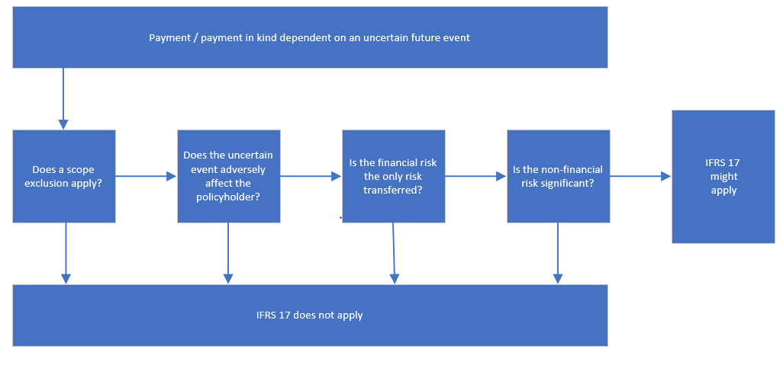
Decision tree considering whether IFRS 17 applies

Slide 21
Modification
Derecognition of the original contract and recognition of the modified contract as a new contract, applying IFRS 17 or other applicable Standards should occur if, and only if, any of the conditions in (a)–(c) of paragraph 72 are satisfied. This includes:
the existing contract would have been excluded from IFRS 17 if the modified terms had been included at the inception of the contract,
the modification would entail separating different components from the host (as in paras 10-13) leaving a different insurance contract in place,
the modified contract would have had a substantially different contract boundary applying paragraph 34.
If a contract modification meets none of the above conditions in paragraph 72, the entity shall treat changes in cash flows caused by the modification as changes in estimates of fulfilment cash flows.
The exercise of a right included in the terms of a contract is not a modification.

Slide 22
Derecognition
An entity shall derecognise an insurance contract when, and only when it is:
extinguished, i.e., when the obligation specified in the insurance contract expires or is discharged or cancelled, or
modified and replaced with a new insurance contract,
transferred to a third party.
When an insurance contract is extinguished, the entity is no longer at risk and is therefore no longer required to transfer any economic resources to satisfy the insurance contract.
When an entity buys reinsurance, it shall derecognise the underlying insurance contract(s) when, and only when, the underlying insurance contract(s) is or are extinguished.

Slide 23
Accounting for elements of Insurance Contracts

Slide 24
Accounting for insurance liabilities on the SoFP
The value of the IFRS 17 insurance contract liability on the SoFP is made up of several separate moving parts.
Each element contributes to creating a full, updated picture of the insurance provider’s commitments.

Slide 25
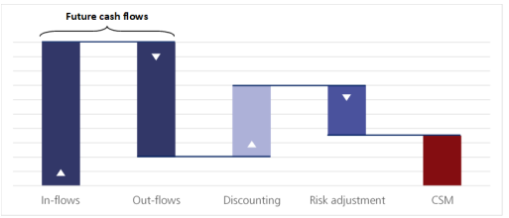
The moving parts of the contract liability
Both the liability for incurred claims and the liability for the remaining coverage are measured at current value at every SoFP date. In both cases this is achieved by calculating the present value of future cash flows and then making a risk adjustment. This is graphically represented below:
Cash flows are within the contract boundary if they arise from substantive rights and obligations imposed by the contract that exist during the reporting period and directly related to the fulfilment of the contract.
Both insurance and reinsurance contracts are measured using a probability-weighted average estimate of all future cash flows within the contract boundary with a risk adjustment to reflect the uncertainty in the timing and amount of cash flows that arises from non-financial risk. Determining which cash flows should be included is an area of judgement.

Slide 26
Discount rates to use
Under IFRS 17 the discount rates used to measure the present value of future cash flows need to reflect not just the time value of money but also liquidity characteristics of the insurance contracts themselves.
HM Treasury currently provide central discount rates to be used in the accounting for financial instruments, leases, provisions, and pensions.
HM Treasury therefore adapts IFRS 17 in respect of discount rates to have a rebuttable presumption that the financial instrument discount rate stated in the PES paper is used to discount IFRS 17 liabilities, except for regulated insurers and entities whose principal business is insurance or reinsurance activities.
Where entities use the PES discount rate reporting entities do not need to disclose the yield curve required by paragraph 120 as a further adaptation in this area.

Slide 27
Risk adjustment for non-financial risk
The risk adjustment is the compensation an entity requires for bearing the uncertainty about the amount and timing of the cash flows that arises from non-financial risk as the entity fulfils insurance contracts. It is calculated from the perspective of the issuer.
Whilst IFRS 17 doesn’t specify estimation techniques to employ it does provide a list of characteristics the adjustment should have in paragraph B91 including that where risks with low frequency and high severity will have higher adjustments than high frequency and low severity risks and when looking at similar risks a contract with a longer duration will have a higher risk adjustment than those with contracts of a shorter duration.
There are several disclosure requirements associated with the risk adjustment, one of which is paragraph 119 of IFRS 17, requiring entities to disclose the confidence level used. However, this requirement has been withdrawn as a HMT adaptation.

Slide 28
Contractual service margin
The contractual service margin (CSM);
represents the unearned profit on an insurance contract or group of insurance contracts,
relates to future service to be provided under the insurance contracts issued by the entity,
represents the margin the entity has charged for the insurance services it is providing in addition to bearing risk.
This unearned profit is recognised over the coverage period of that contract (or group of contracts) as and when insurance services are provided by the insurer to the policyholder.
If the expected present value of cash inflows related to a group of insurance contracts are greater than the expected present value of cash outflows that difference is the profit for that group of contracts. The unearned element, updated at each SoFP date, is the contractual service margin, forming part of the insurance contract liability.
The CSM is the balancing figure included on the SoFP to avoid profit being recognised on day 1.

Slide 30
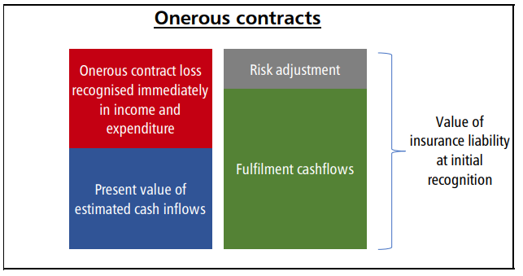
Onerous contracts
When an insurance contract is issued and the expected cash outflows are expected to exceed inflows, the insurance contract is onerous.
The CSM cannot depict unearned losses.
If a contract or group of contracts is onerous from inception or becomes onerous so that no profit is ever anticipated, then there is no contractual service margin. In the case of onerous contracts, the loss on the contracts is recognised through income and expenditure immediately as insurance service expenditure.

Slide 31
In each period the entity recognises the revenue for the coverage provided in that period, as well as any expenses incurred in that period. As time passes some of the uncertainty associated with the original insurance contract(s) is reduced, and the risk adjustment is accordingly released. IFRS 17 paragraphs 41 and 42 set out the amounts recognised as income and expense. To ensure consistency of accounting all entities shall recognise insurance finance income and expense for the period in the SoCNE.
Statement of consolidated net expenditure (SOCNE)

Slide 32
Models for accounting for insurance contracts
There are three models for accounting for insurance contracts in IFRS 17:
• The General Measurement Model (GMM) – described in the previous slides and expected to apply for entities in the health sector applying IFRS 17.
• The Premium Allocation Approach (PAA) – is a simplified model that can be employed to a group of insurance contracts if;
The entity expects simplification would produce a measurement for remaining coverage that wouldn’t materially differ from the one produced applying GMM, or
The coverage period of each contract in the group is one year or less.
The extent to which this may be employed in the health sector is expected to be limited.
• The Variable Fee Approach (VFA) - used for groups of investment contracts with discretionary participation features. Such contracts are unlikely to be common in the health sector.

Slide 33
Transition
The date of initial application across the public sector is 1 April 2025.
On transition entities shall apply IFRS 17 on a fully retrospective basis.
The transition date is the beginning of the annual reporting period immediately preceding the date of initial application, so 1 April 2024.
Per paragraph C3(a) an entity is not required to present quantitative information required under IAS 8 28(f) so no requirement to present the amount of adjustment to financial statement line items.
There are several considerations to evaluate as part of the transition to IFRS 17 including;
Inform, train and support stakeholders about the requirements and applications of the Standard,
Identifying and grouping contracts,
Assessing materiality for disclosure.

Slide 34
Alternative approach to transition: Fair value approach
If full retrospective restatement is impracticable, entities shall apply the fair value approach per IFRS 17 paragraphs C20-C24.
As noted in IAS 8 entities must make every reasonable effort to apply a new standard retrospectively before concluding impracticability.
The insurance liability at transition using the fair value approach is measured at the higher of the fulfilment cashflows and fair value amount (these are graphically illustrated in the slides below):
The fair value approach calculates CSM prospectively on the transition date (1 April 2024).
If the fair value amount is higher than the fulfilment cashflows at transition, then the insurance liability is measured at the fair value amount. There is a CSM in this scenario, being the difference between the fair value and the fulfilment cashflows at transition.
If the fair value is less than the fulfilment cashflows then the insurance liability at transition is measured at the fulfilment cashflows amount. There is a loss component in this scenario, being the difference between the fair value amount and the fulfilment cashflows at transition.

Slide 35
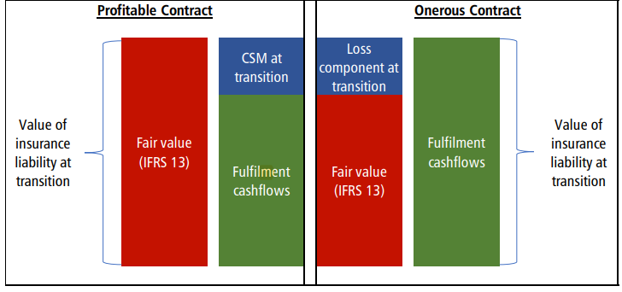
The insurance liability at transition: fulfilment cash flows vs fair value

Slide 36
FReM adaptation regarding fulfilment cashflows
For insurance contracts where a nil premium is charged and the fair value approach is being used to transition to IFRS 17 for those contracts, entities must measure the transition value of those contracts at fulfilment cashflows.
This is to avoid situations where the transition value of insurance contracts with a nil premium charged results in a significant CSM being recognised on transition for central government contracts.
The IFRS 17 measurement basis allows the recognition and measurement of insurance liabilities on a more realistic and consistent basis reflecting the entity’s risk profile and cash flow characteristics more closely than market participant’s assumptions about identical exit values under IFRS 13.

Slide 37
Disclosure
Except where excluded by the HMT’s adaptations an entity shall disclose qualitative and quantitative information about:
the amounts recognised in its financial statements for contracts within the scope of IFRS 17, covering only the key elements (see paragraphs 97–116),
the significant judgements, and changes in those judgements, made when applying IFRS 17 (see paragraphs 117–118), and
the nature and extent of the risks from contracts within the scope of IFRS 17 (see paragraphs 121–132).
Note that on transition the impact on each financial statement line item is not required to be disclosed.
The HMT’s adaptations remove the following disclosure requirements:
the requirement in paragraph 119 to disclose the confidence level used to determine the risk adjustment for non-financial risk.
the requirement in paragraph 120 to disclose the yield curve where entities use financial instrument discount rate stated in PES papers.
The transition relief noted in IFRS 17 paragraph C28 is mandated in which an entity need not disclose previously unpublished information about claims development occurring five years before 31 March 2026.

Slide 38
Budgeting under IFRS 17

Slide 39
Budgeting approach to IFRS 17
Under IFRS 17, insurance liabilities will be accounted for in a more consistent way than under IFRS 4.
The budgeting treatment reflects both IFRS and national accounts impacts. There are similarities to provisions treatment, but insurance expenditure will score to CDEL
The budgeting treatment recognises the movements of the liability on the SoFP as well as the initial recognition and any movements that appear in the SoCNE. It does however score insurance expenditure to CDEL. Entities need to be aware that income and expenditure movements relating to insurance contracts will score to different budgeting currencies.
Scoring the separate elements to the transaction in this way ensures that the information required for the national accounts is available and allows HM Treasury to control spending in support of the fiscal framework.
The HMT guidance gives worked examples two of which are reproduced in the following slides after providing a quick refresher on budgeting for provisions.

Slide 40
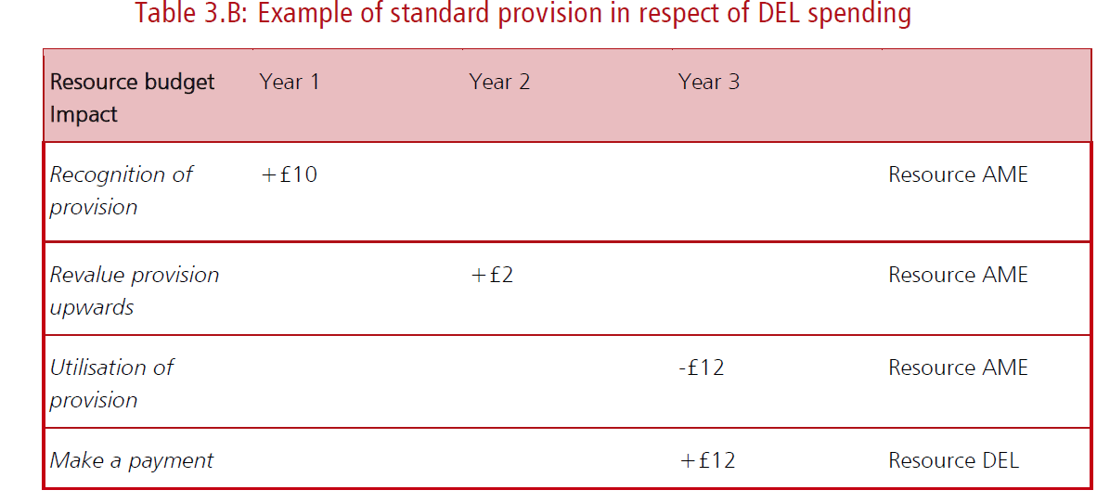
Budgeting for provisions

Slide 41
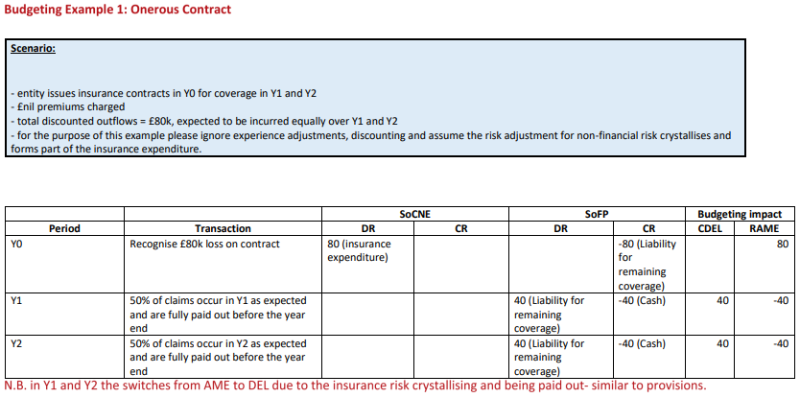
Budgeting for onerous IFRS 17 contract

Slide 42
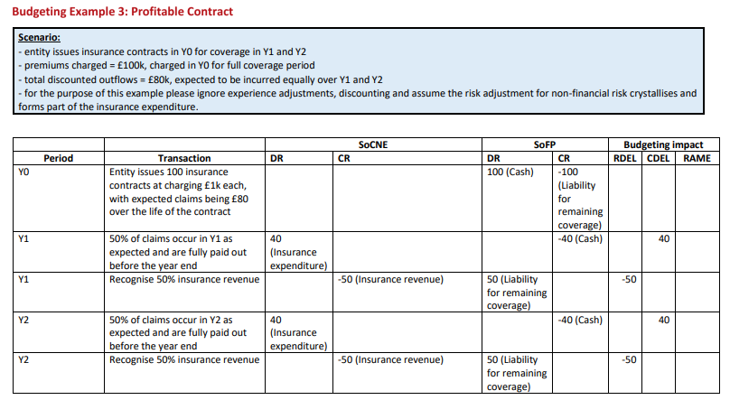
Budgeting for profitable IFRS 17 contract

Slide 43
HMT interpretations and adaptations for IFRS 17

Slide 44
HMT interpretations in the IFRS 17 Application Guidance
• For the purpose of applying IFRS 17 in central government, legislation and regulations, in isolation, are not equivalent to insurance contracts. Legislation and regulations can include binding rights or obligations, can facilitate the creation of arrangements that fall within the definition of a contract and can form part of the implied terms of a contract, but in themselves are not agreements between parties.
• The accounting policy choice to account for contracts meeting the criteria set out in IFRS 17 paragraph 8 has been withdrawn. All entities applying the FReM shall account for contracts meeting the criteria in IFRS 17 paragraph 8 under IFRS 15.
• The accounting policy choice in IFRS 17 paragraph 7(e) is withdrawn. All entities shall account for financial guarantee contracts using IAS 32, IFRS 7 and IFRS 9.
• The accounting policy choice under IFRS 17 paragraphs 88 and 89 has been withdrawn. All entities shall follow IFRS 17 paragraphs 88(a) and 89(a) and recognise insurance finance income and expense for the period in the SoCNE.
• For insurance contracts that limit the compensation for insured events to the amount otherwise required to settle the policyholder’s obligation created by the contract (for example, loans with death wavers), entities shall account for these contracts under IFRS 9.

Slide 45
HMT Interpretations continued
• If an entity has reasonable and supportable information to conclude that a set of contracts will all be in the same group applying IFRS 17 paragraph 16, it shall measure the set of contracts to determine if the contracts are onerous and assess the set of contracts to determine if the contracts have no significant possibility of becoming onerous subsequently.
• In applying the premium allocation approach, an entity shall recognise any insurance acquisition cash flows as expenses when it incurs those costs, provided that the coverage period of each contract in the group at initial recognition is no more than one year.
• Entities shall include the entire change in the risk adjustment for nonfinancial risk as part of the insurance service result.
• An entity shall present the income or expenses from a group of reinsurance contracts held (see paragraphs 60–70A), other than insurance finance income or expenses, as a single amount.
• Entities shall include insurance finance income or expenses for the period in the SoCNE.
• On transition entities shall restate retrospectively following the requirements of IFRS 17 paragraphs C3-C4. If full retrospective restatement is impracticable, entities shall apply the fair value approach per IFRS 17 paragraphs C20-C24.

Slide 46
HMT adaptations
• There is a rebuttable assumption that the financial instrument discount rate provided in PES papers will be used to discount IFRS 17 insurance liabilities, except for insurers regulated by the Prudential Regulation Authority (PRA) and entities whose principal business activity is insurance or reinsurance.
• Where entities use the financial instrument discount rate stated in PES papers, reporting entities do not need to disclose the yield curve used to discount cash flows as required by IFRS 17 paragraph 120.
• The requirement of IFRS 17 paragraph 119 to disclose the confidence level used to determine the risk adjustment for non-financial risk has been withdrawn.
• For insurance contracts where a £nil premium is charged and the fair value approach is being used to transition to IFRS 17 for those contracts, entities must measure the transition value of those contracts at fulfilment cashflows.

Slide 47
Steps to implementation and implementation aides

Slide 48
Work to discover potential insurance contracts
Review underlying contracts for possible insurance risks
Review judgements between financial and insurance risk arising
Consider the possibility and criteria for reclassification between other standards and IFRS 17 – for instance contingent liabilities may be an area in which transfer of significant non-financial risk occurs
IFRS 17 imposes no limitations on when contracts can be assessed for significant insurance risk.
This slide pack gets you started but isn’t a substitute for HMT’s guidance or IFRS 17 which must be read to get the full technical understanding.
Additional training materials can be found on the GFF One Finance page at the below link
Technical Accounting Training (TAcT)

Slide 49
Insurance Contract Toolkit
The toolkit gives specific examples to help with identifying insurance risk within contracts
and as such supplements Appendix 1 in HMT’s Application Guidance which helps with identifying insurance contracts. The toolkit is in two parts:
The first part of the toolkit provides some basic questions and scenarios to aide identification of insurance contracts. The distinction between insurance risk financial risk is included as a differentiator to delineate insurance risk.
The second part of the toolkit develops a ‘starter for 10 questionnaire’ for entities to consider when developing considerations around the implementation and impact of IFRS 17.

Slide 50
Scenario | A contract protects the policyholder against the risk of adverse movements in exchange rates | A contract provides for payment up to £10m in the event that flooding causes damage to the entity’s property rendering the property unsafe for use.
What is the pre-existing risk? | Exchange rates can move adversely against balances and transactions. | Floods can happen in the area – there is a c30% risk of this happening and the entity would be adversely affected by the occurrence.
Who is exposed to the risk? | Entities exposed to changes in the exchange rate including the policyholder | The policyholder
The non-financial variable is | n/a | Specific
What is the nature of the risk? | Financial | Non-financial
What is the type of risk? | Financial risk | Insurance risk
Is the insurance risk transferred by the contract significant? | n/a | Yes. In at least one scenario that has commercial substance the insurer compensates the policyholder for the loss suffered from the specified future event. The additional amount represents a present value loss to the insured because it exceeds the amount that would have been paid had the insured event not occurred.
Implications of the contract being modified | New terms need to be assessed for whether they create a transfer of significant non-financial risk, though considered unlikely | Modifying the contract can result in the initial contract being derecognised and replaced with a new contract, or there being changes in the estimates of fulfilment cashflows.

Slide 51
Is there an agreement that creates enforceable rights and obligations between the issuer entity and another entity acting as the policyholder?
Is the contract in scope of the application IFRS 17 (see slide 15 and 44 to 46 for HMT adaptations and interpretations)?
Is payment / payment in kind required to the policyholder when a future event adversely affects the policyholder?
Is there a transfer of insurance risk (non-financial risk) and / or financial risk (non-financial not specific to the policy holder or risk of future changes in rate or index)?
Is the transfer of insurance risk significant (additional amounts payable in any scenario with commercial substance creating the possibility of a loss on a present value basis)?
Have you identified risks that did not exist before the insurance contract was created?
Have you reviewed all contracts to identify latent transfer of significant insurance risks such as those which may arise from contingent liabilities?
Have you entered into a reinsurance arrangement in relation to the insurance contract/s identified?
Have you grouped similar insurance contracts?
Where you have a group of insurance have you decided whether to apply the premium allocation approach for accounting for the group of insurance contracts?

Slide 52
Have you assessed the materiality of the impact of IFRS 17 for your organisation?
Have you assessed the expected impact of applying IFRS 17 in the year of implementation and in future periods for accounting and budgeting purposes?
Is the accounting system set up so that you can monitor, account, budget and disclose relevant information regarding insurance contracts?
Has the transition approach been determined either using the full retrospective approach from the transition date or employing the fair value approach where full retrospective approach is impracticable?
Have you determined whether the HMT promulgated rate is the correct rate to use for discounting cashflows?
Has an appropriate calculation/s been created to derive an appropriate risk adjustment for your insurance contract/s?
Have all onerous insurance contract losses been immediately recognised?
Have you determined the entity’s approach to disclosure of insurance contracts?
Have you reviewed all recently modified contracts to identify the implications for insurance contracts?
Have obligations expired, been discharged, modified, cancelled or transferred to warrant derecognition of the contract?

