Slide 1
Process Mapping
Resource for ‘How to improve care navigation in general practice’ guidance
May 2025

Slide 2
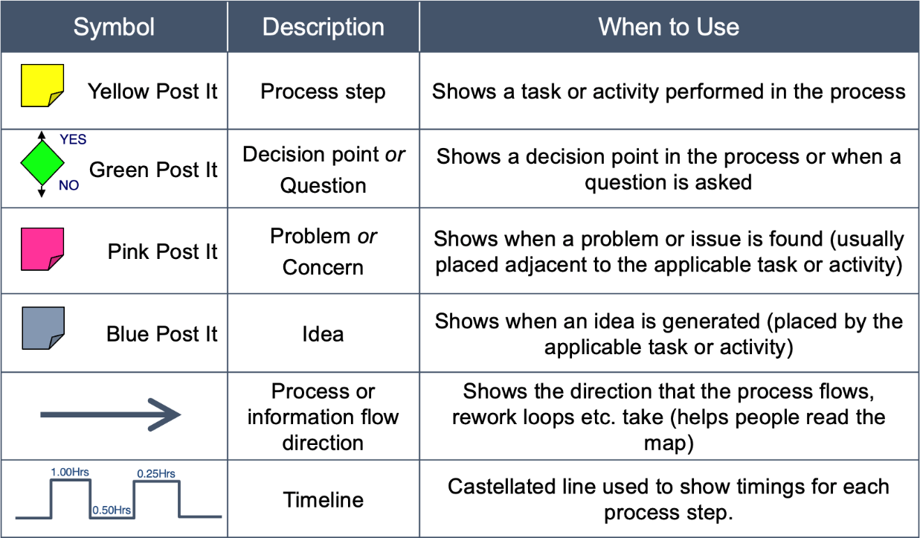
Process mapping key

Slide 3
Editable process map
Advise patient to dial 999
This is an editable process map that you can amend if you wish.
It does not show a complete process.
It is not suggesting that this is a good process.
emergency
Telephone call from patient
Reception answers call & identifies patient
Reception asks what help patient needs
Clinical need identified
Reception decides appropriate service to help patient
Patient offered advice / appointment with appropriate service
Patient accepts advice / appointment
Clinical or admin problem?
clinical
How urgent is the need?
Non- emergency
Patient not willing to disclose need
admin
Patient navigated incorrectly
Patient not willing to be navigated elsewhere
Patient doesn’t accept advice / appointment
Admin need identified
Request passed to appropriate admin team member
Patient perception of level of urgency
New telephone system to include patient options
Service patient requests is not available
Use agreed protocol
Educate patients on available services
Staff reluctant to ask questions
Use template to capture information

