Slide 1

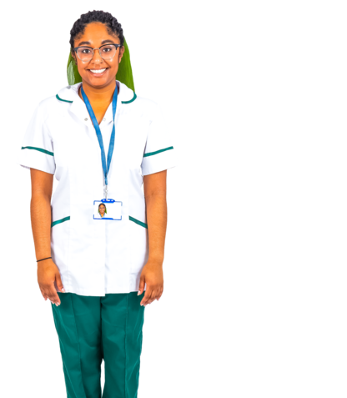




Allied Health Professionals –
14 jobs they do
Allied health professionals (sometimes called AHPs) focus on stopping people from getting ill and improving people’s health and wellbeing.
They do this by-
looking at your health
diagnosing health problems
giving you treatment.
14
There are 14 different jobs that an Allied Health Professional can do.
1

Slide 2



1) Art therapists use art as a way to help you express your problems.
2) Drama therapists use role play, movement and storytelling to help you explore and understand your problems.
3) Music therapists use the power of music to help you deal with feelings.
2

Slide 3
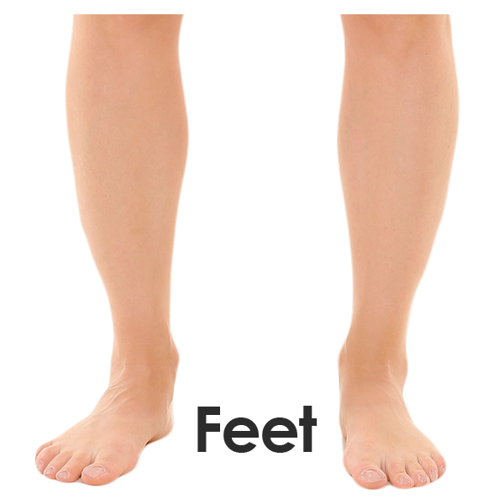

4) Chiropodists and podiatrists are trained to spot and treat conditions to do with your feet. They give advice about how to look after your feet and what type of shoes to wear.
5) Dietitians give you advice about the kinds of food you should eat. They help to change your diet based on what you need.
3

Slide 4

6) Occupational therapists look at life skills you find difficult (like getting washed and dressed) and see if there’s another way you can do it.
They help you to be more independent in activities that matter to you.
4

Slide 5

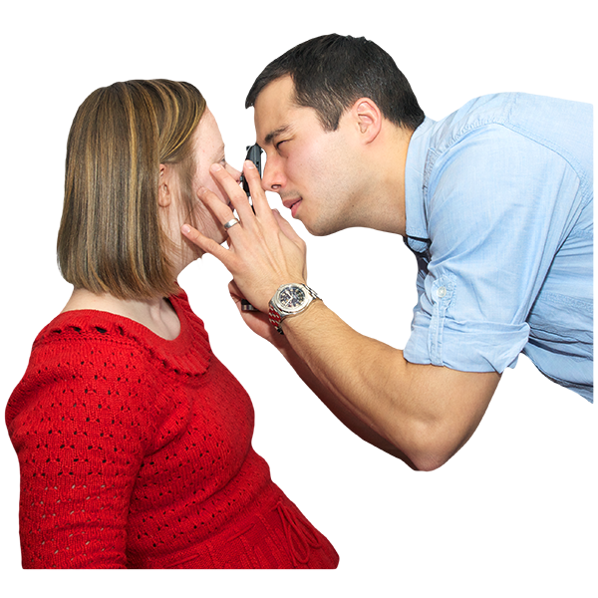
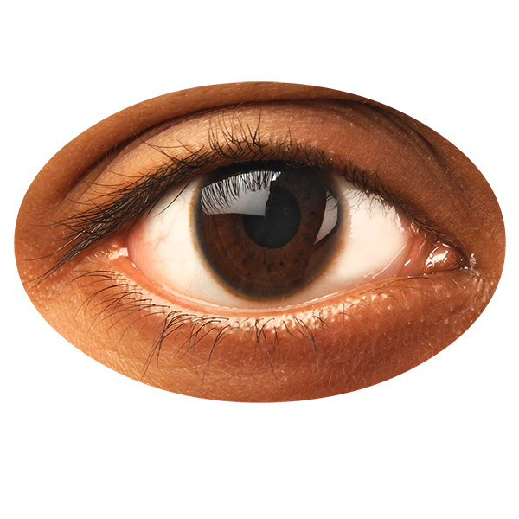
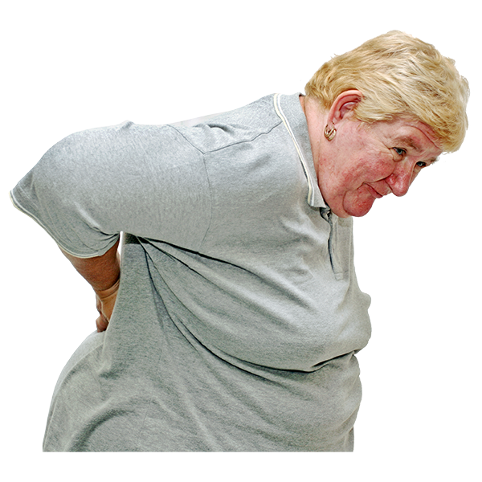
7) Operating department practitioners care for you before, during and after an operation. They help the doctors during operations with things like preparing tools.
8) Orthoptists spot and treat eye problems. They look at the way your eyes move.
9) Osteopaths treat and prevent health problems by moving, stretching and massaging your muscles and joints.
5

Slide 6

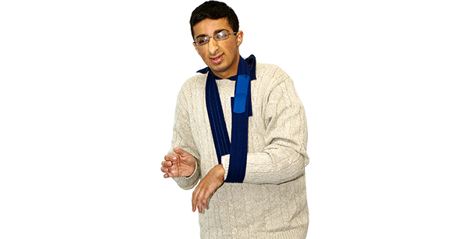
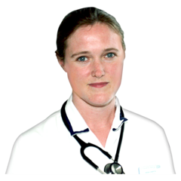
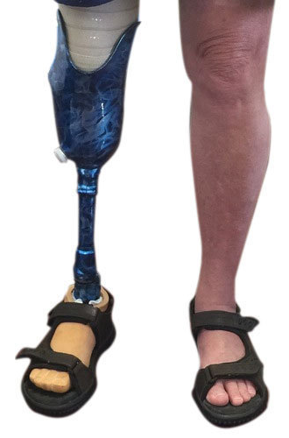
10) Paramedics deal with emergencies. They give you care when you are seriously ill. They try to help you before you are taken to hospital.
11) Physiotherapists help to improve your movement if you’ve had an injury or illness or you are disabled.
12) Prosthetists provide artificial limbs to people who don’t have all or part of a body part.
An artificial limb is a manmade limb – for example a new leg.
6

Slide 7
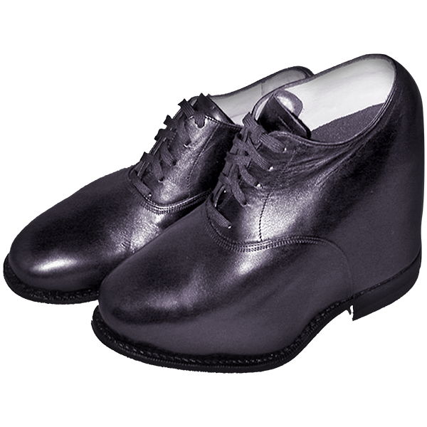
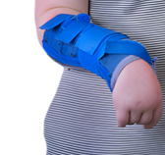
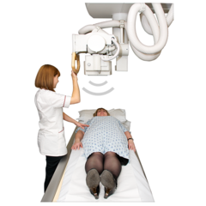
13) Orthotists give you splints, braces and special footwear to make you more comfortable.
Splints and braces are something you wear to support an injured joint.
13) Radiographers.
There are two kinds of radiographers:
Diagnostic Radiographers use technology (such as x-ray) to look inside the body. They use this to work out what is causing your illness.
7

Slide 8
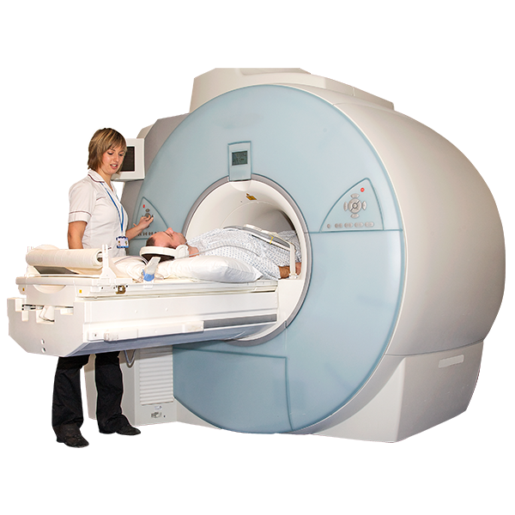
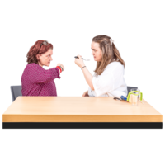

Therapeutic Radiographers use x-rays and other kinds of radiation to treat medical conditions such as cancer.
14) Speech and Language Therapists support and care for you if you have difficulties with communication, eating, drinking and swallowing.
8

